Slide 1
Exploring Expressions and Sums
Materials Needed: 2 dot cubes per group

Slide 2
Let’s Explore Expressions & Sums

Slide 3
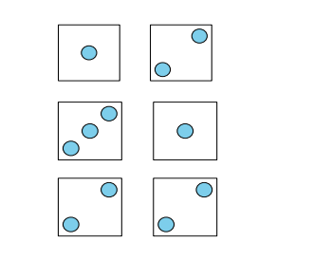
Warm Up: How many do you see?
How many do you see?
How do you see them?

Slide 4




Warm Up: Synthesis

Slide 5
Activity 1: Matching Dot Cards & Expressions
During the warm-up today we wrote some expressions to match dot images. In this activity, match each dot image to its matching expression and draw a line. Then find the sum of the expression. On the second page, complete the missing parts of the table.

Slide 6

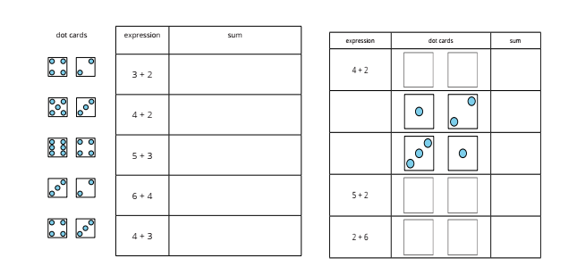
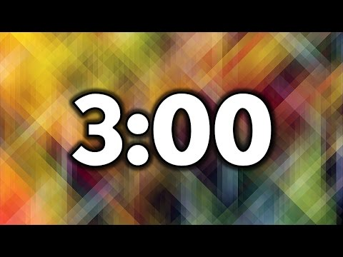
Activity 1: Matching Dot Cards & Expressions

Slide 7
Activity Synthesis
How did you know which expression matched each image?

Slide 8
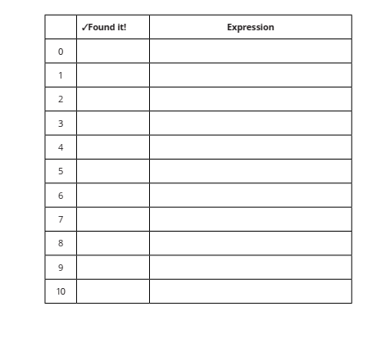
Activity 2: Make the number: Add to 10
We are going to play a game called Make the Number. Let’s play a round together.
I’m going to roll two dot cubes. What is the sum? How do you know?

