Slide 1
Sum it Up!
Materials needed:

Slide 2
Let’s explore what we know about math.

Slide 3

Warm Up: What do you know about Math?

Slide 4
Warm Up: Synthesis
Today, you will get to do math in different ways.

Slide 5
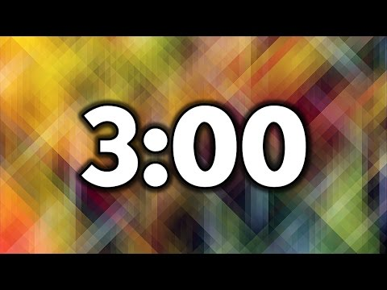
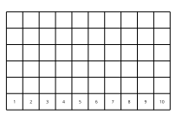
Activity 1 Number Race: Add to 10
Today we will play a game called Number Race: Add to 10.
Let’s play a round together.
I am going to roll both dot cubes and find the sum.
What is my sum? How do you know?

Slide 6

Activity 1 Continued: Partner Work Time
How many dots are on this dot cube?
How did you find the total number of dots?
Look at your game board. Talk to your partner about what you notice.
Partner discussion

Slide 7
Activity 1 Synthesis
What did you notice about your completed game board?
Are there any rolls that you couldn’t write down on your game board?
Which ones? Why couldn’t you write them down?

Slide 8
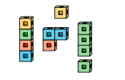
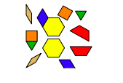
Activity 2 Centers: Exploring Math Tools
What do you notice about these math tools?
How have you used them in the past?”

Slide 9
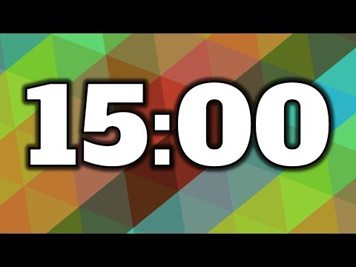
Activity 2 Continued: Exploring Math Tools
You are going to choose a center activity.
You can choose to work with connecting cubes or pattern blocks.
Think about how you can use your tools to do math.
Tell me about your creation.
How many cubes/pattern blocks do you have?
Who has more/fewer?
What are the names of the shapes you used?

Slide 10
Activity 2 Synthesis
How did you use your tools to do math?
Who has more/fewer?
What are the names of the shapes you used?

Slide 11
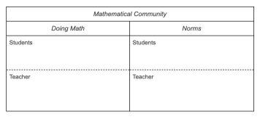
Lesson Synthesis
Today, you played a math game and explored our math tools. We are going to make a chart of what you do and what I do in our mathematical community.
What does it look and sound like to do math together as a mathematical community?

