Slide 1
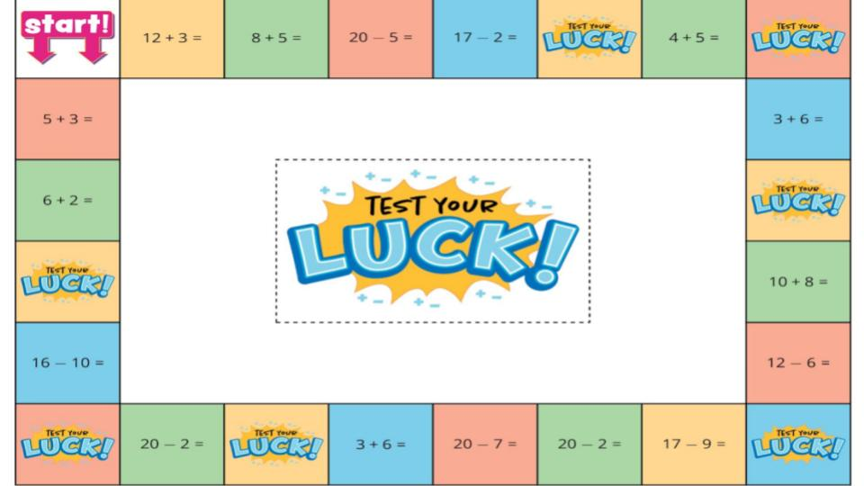

Game Pieces:
Click the dice to be able to roll.
Notes:
Game Pieces are on the side of the board.

Slide 2
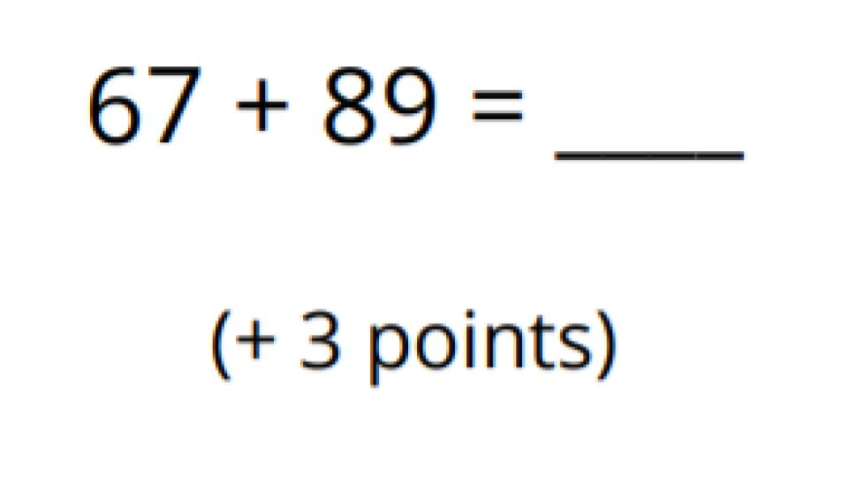
Back to Board

Slide 3
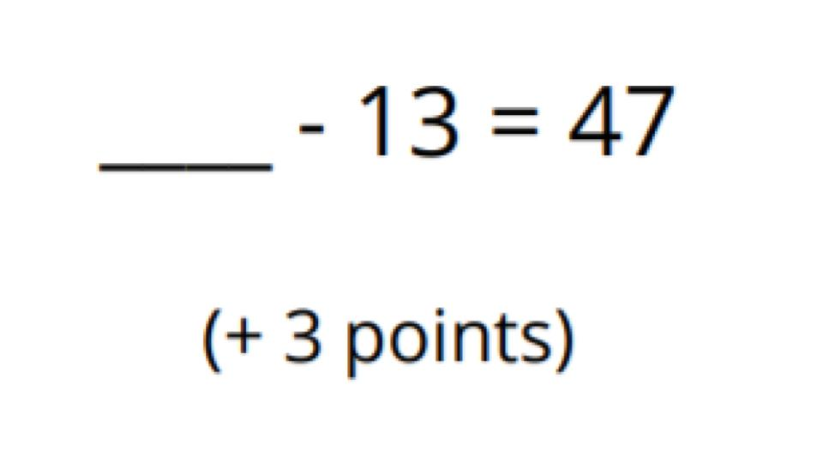
Back to Board

Slide 4
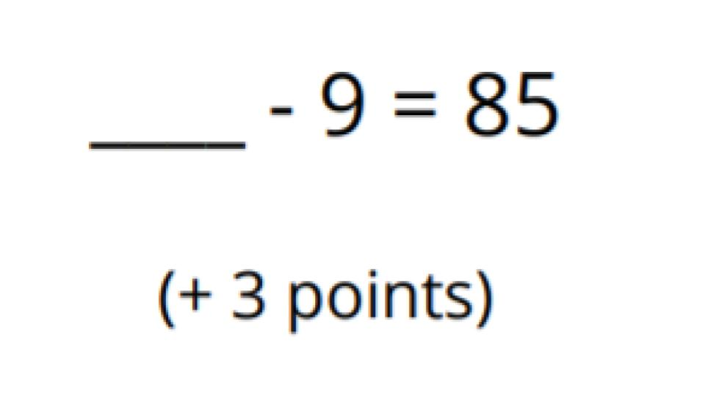
Back to Board

Slide 5
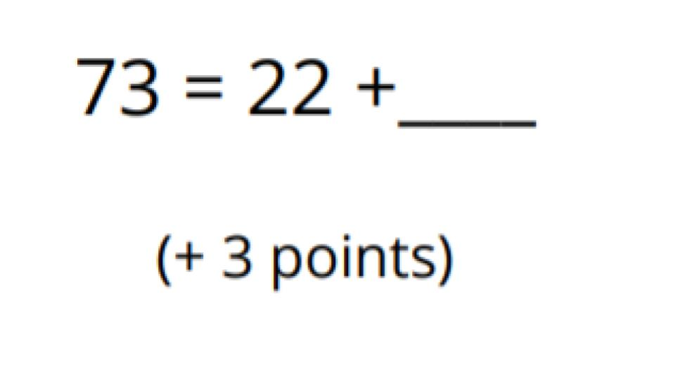
Back to Board

Slide 6
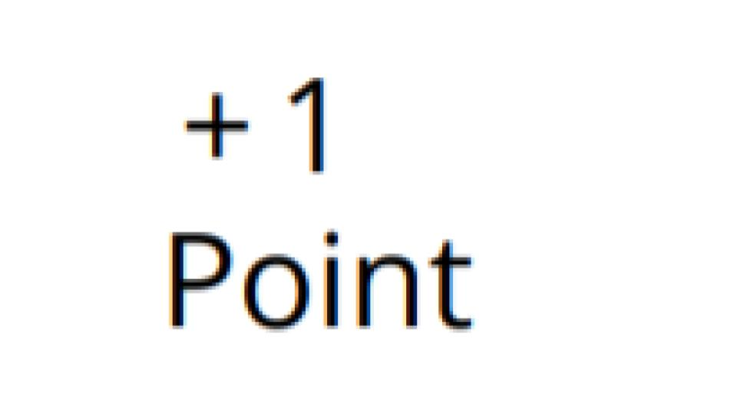
Back to Board

Slide 7

Back to Board

Slide 8
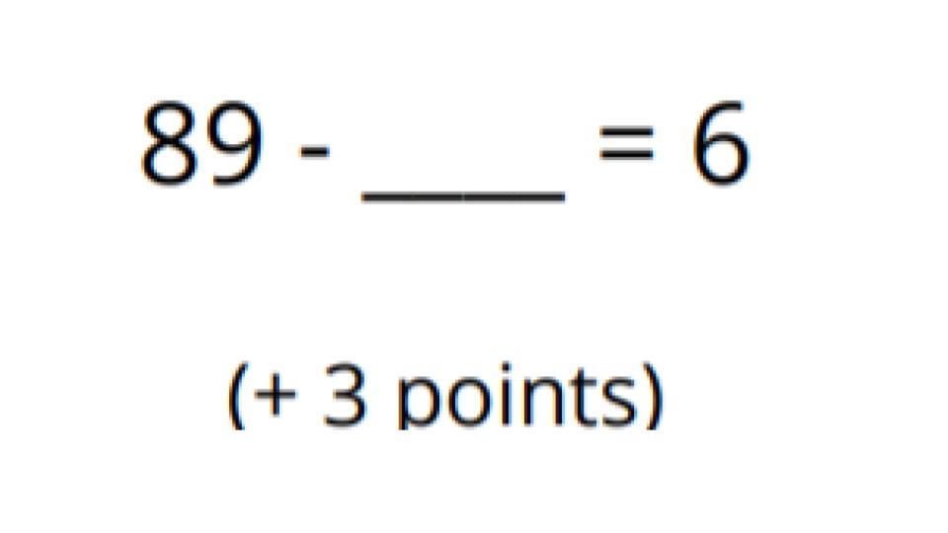
Back to Board

Slide 9
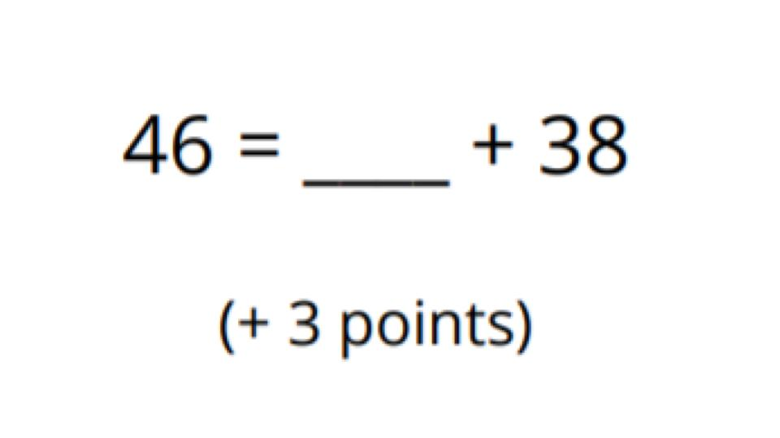
Back to Board

