Slide 1
Cubic Units of Measure
Materials needed: pencil, book

Slide 2
Let’s use different size cubic units to measure volume.

Slide 3
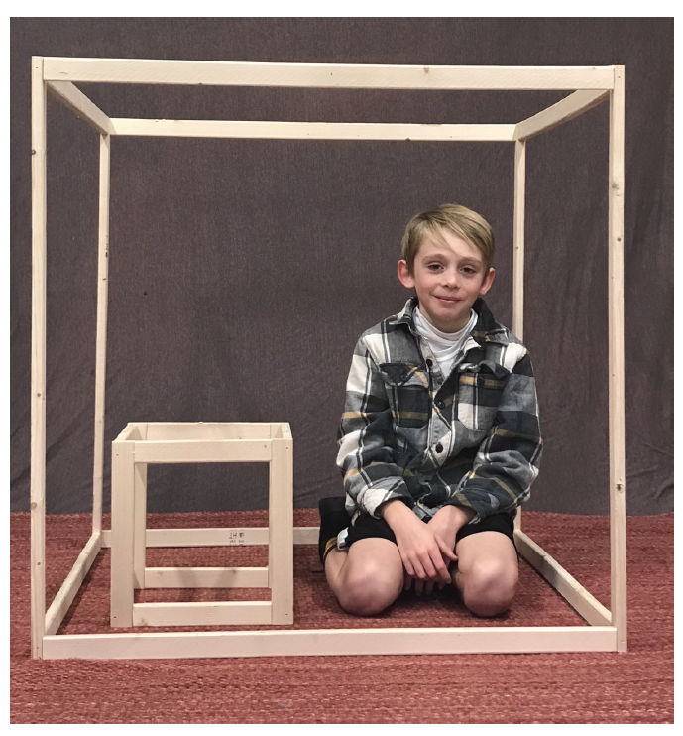

Warm-Up Notice and Wonder: Two Prisms
What do you notice? What do you wonder?
Notes:
Restart the timer for partner talk.

Slide 4
Warm-Up Synthesis
The little cube represents a cubic foot.
The big cube represents a cubic yard.
About how many of the big cubes could we fit in our classroom?
We have been using cubic units to measure
volume, but haven't defined the size of the
unit. The choice of the unit depends on the
size of the object.

Slide 5
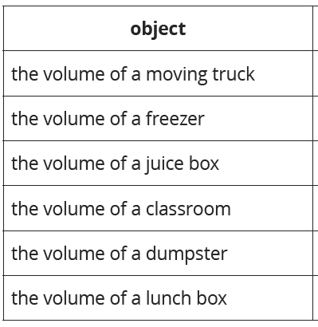
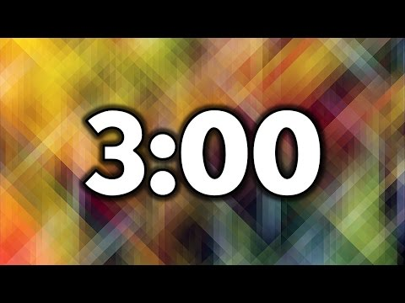
Activity 1 What are the Units?
Take a minute to read this list.
Discuss with a partner the objects you know or have questions about.

Slide 6

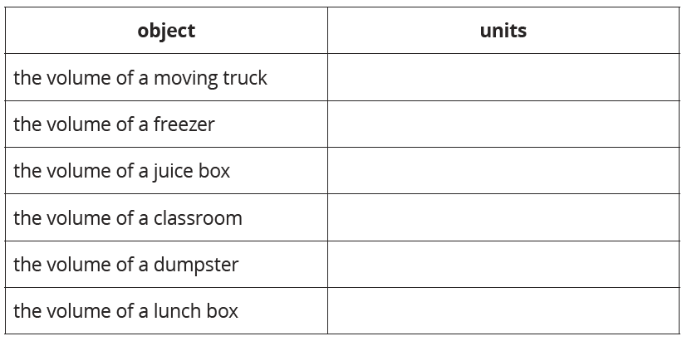

Activity 1 What are the Units?
In this activity we are going to consider using different cubic units of measure to find the volume of different sized objects. There is no right or wrong answer in these questions, but be prepared to explain your choice
Discuss with a partner the units you thought to use the find the volume of each object.

Slide 7
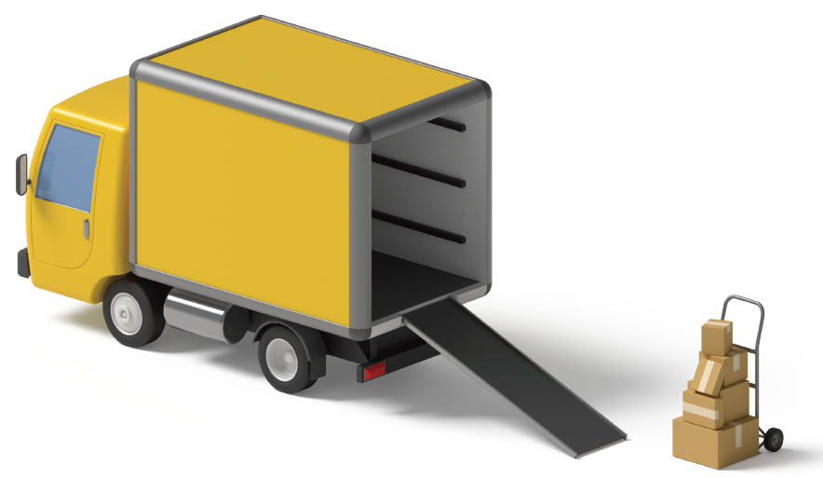
Activity 1 Synthesis
How did you decide which units made sense?
What if I only wrote 24 as the volume for the
freezer? What questions would you have?

Slide 8
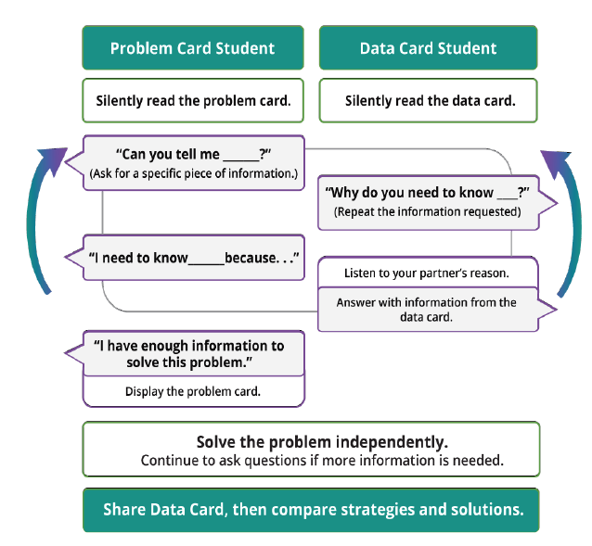
Info Gap
One partner has a Problem Card.
One partner has a Data Card.
You cannot see your partner’s card.

Slide 9
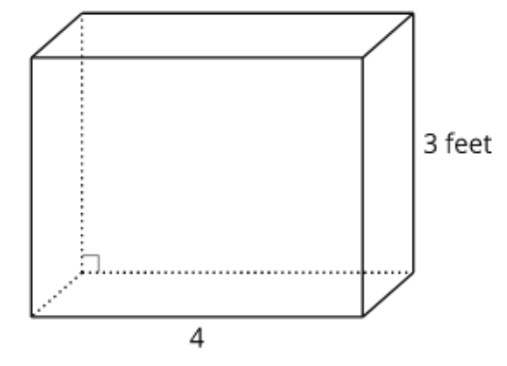
Info Gap
Problem Card
This is a diagram of a freezer.
What is the volume of the freezer?
Some of the information you need to solve this problem is missing, and I have it here.
With your partner, decide what information you need to solve the problem, and create a list of questions you can ask to find out.
Notes:
Data Card:
The width of the freezer is 2 feet.
The length of the freezer is 4 feet. (Units are not on the diagram.)

Slide 10
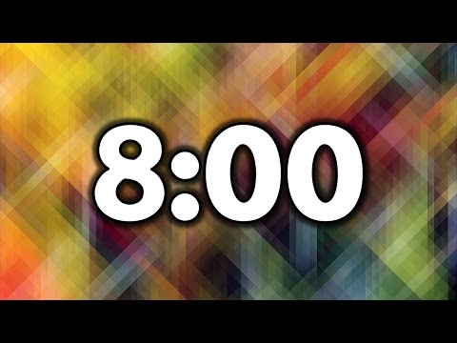
Info Gap
One partner has a Problem Card.
One partner has a Data Card.
You cannot see your partner’s card.
Notes:
Switch partner cards and restart timer for second set of cards.

Slide 11
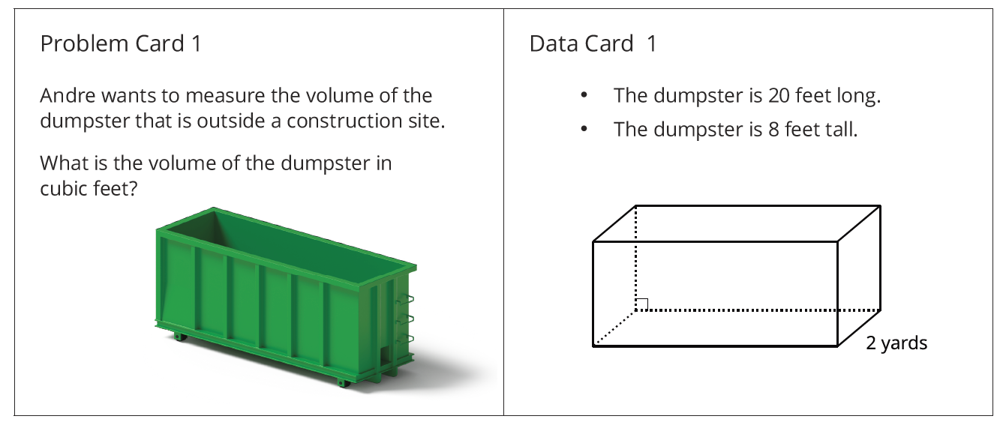
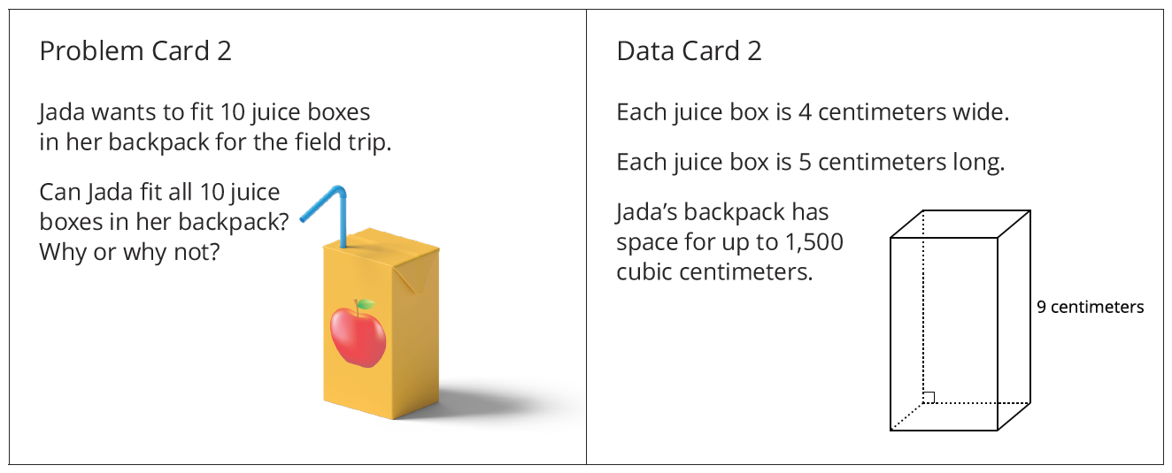
Activity 2 Synthesis
What questions did you ask to help you find the volume?
What units were used for each problem?
Did those units make sense?

Slide 12

Lesson Synthesis
Today we worked with these different sized cubic units. Turn and talk with your partner and try to think of an object for which you would use each unit of measure to find the volume.
Now, pick one of the things you discussed and explain to your partner how you would find the volume of that object.
Notes:
Restart timer

Slide 13
Let’s use different size cubic units to measure volume.

Slide 14
Cool-Down
Find the Volume
Complete the cool-down by yourself.

