Slide 1
Volume as Expressions
Materials needed: pencil, book

Slide 2
Let’s write expressions for the volume of rectangular prisms.

Slide 3



Warm-Up True or False: Parentheses or No Parentheses
Determine if the following equations are true or false. Give me a signal when you know whether the equation is true and can explain how you know.
(4 x 2) x 5 = 4 x (2 x 5)
(2 x 5) x 4 = 2 x 20
TRUE.
5 x 4 x 2 = 10 x 40
FALSE.

Slide 4
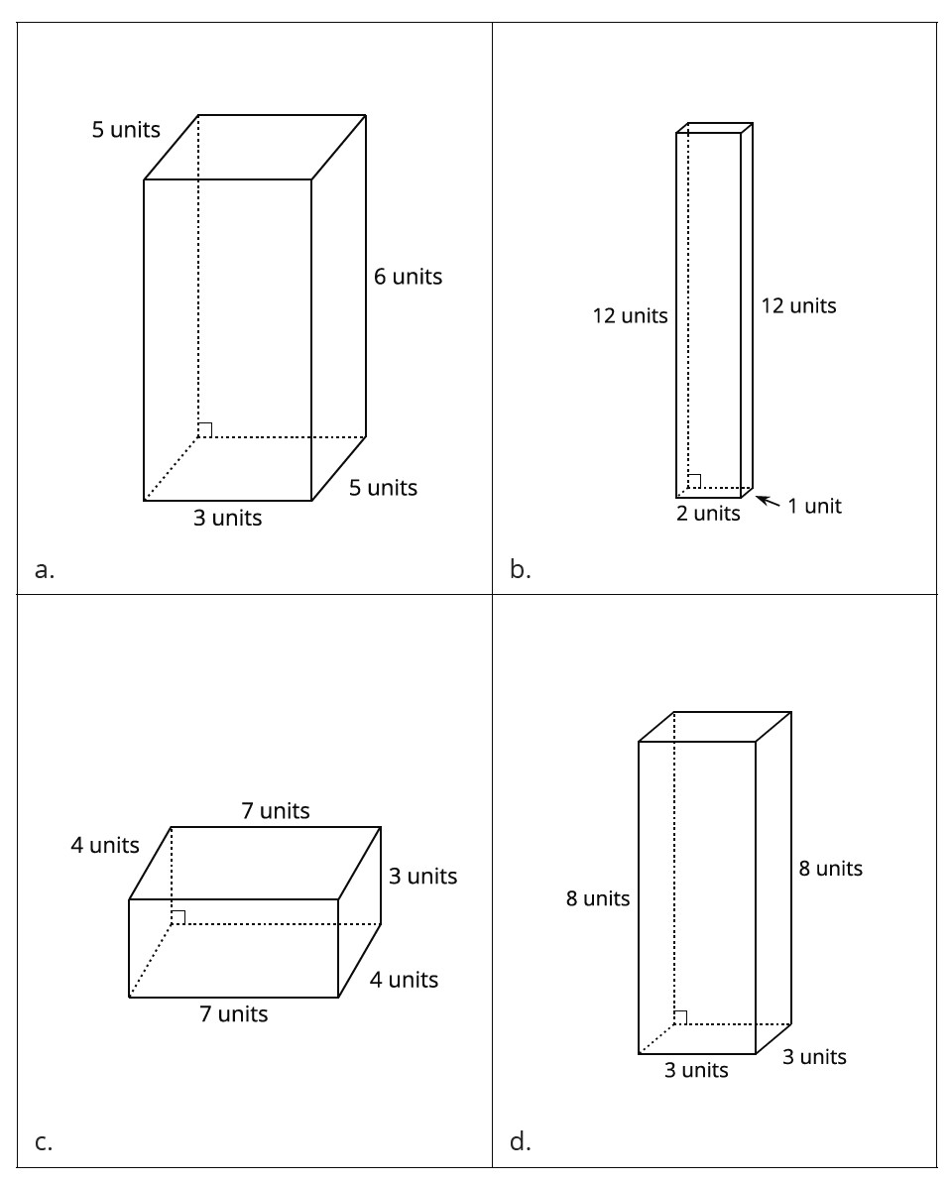
Activity 1 Card Sort: Match the Equation
What do you notice about the prisms on these cards?
When the measurements are in units, the cubes we use to fill the prism are called cubic units.

Slide 5
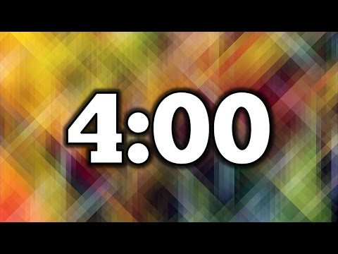
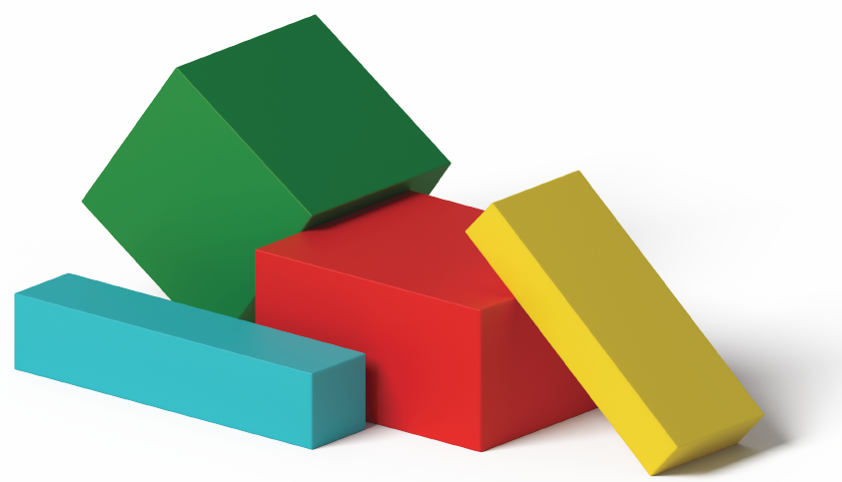
Activity 1 Card Sort: Match the Equation
In this activity, you will sort some cards into categories of your choosing. When you sort the cards, you should work with your partner to come up with categories.
Now work with your partner to match each prism with the expressions that represent the volume.
Notes:
Restart the timer for expression work.

Slide 6
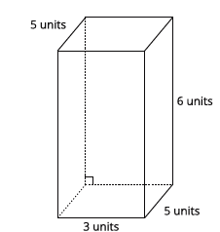
Activity 1 Synthesis
How do these expressions represent the volume?
6 x (5 x 3)
(6 x 5) x 3
15 x 6
(5 x 3) x 6 = 16 x 5 Where do we see this equation in the diagram?

Slide 7

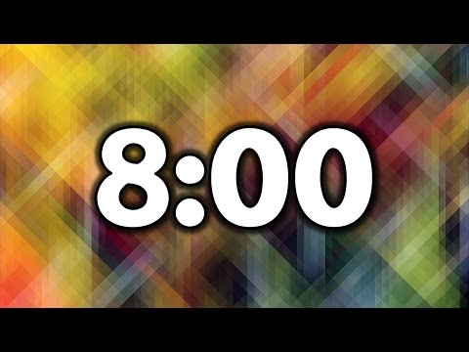
Activity 2 A Tale of 2 Tables
Partner A complete Table 1. Partner B complete Table 2.
Compare your tables and discuss:
a. What do the tables have in common?
b. What is different about the tables?

Slide 8
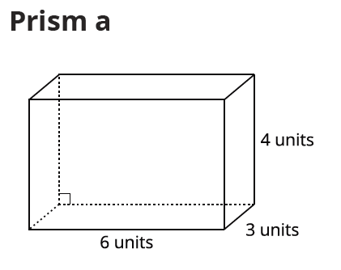
Activity 2 Synthesis
6 x 3 x 4 Why does this expression represent the volume of prism a?
(6 x 3) x 4 How does this expression show the volume of prism a?
Which expression could you use to find the volume using the 3 unit by 4 unit base?
(6 x 3) x 4 = (3 x 4) x 6 How do you know the equation is true?

Slide 9

Activity 3 Two Truths and a Lie
You and your partner are going to play 2 truths and a lie with rectangular prisms.
You will each write expressions, some true and one false, to represent the volume of two prisms and then trade to answer some questions.
One partner use Prisms A and C and the other partner uses Prisms B and D.

Slide 10
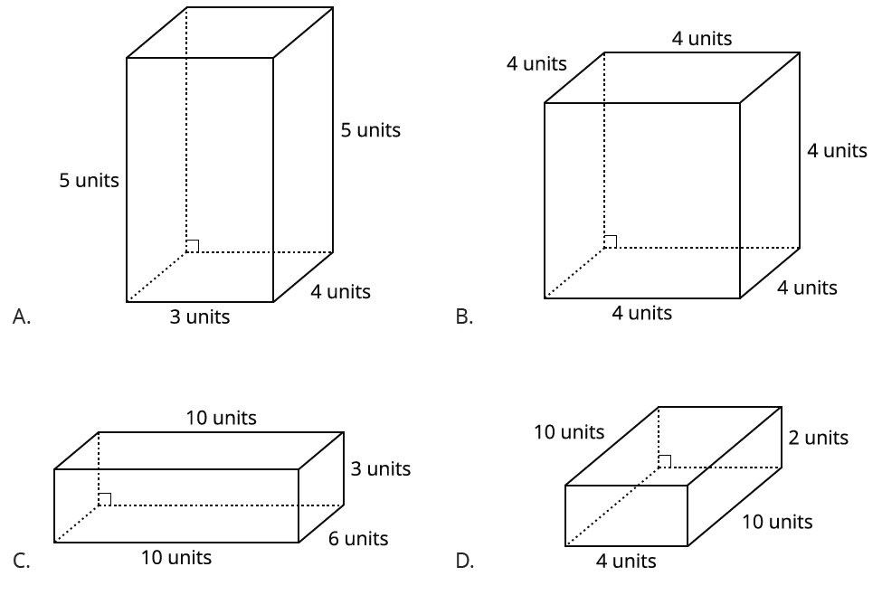
Activity 3 Synthesis
Which expression represented the volume of the prism in cubic units? Which did not?
How did you decide the expressions that did not represent the volume of a rectangular prism?

Slide 11
Lesson Synthesis
Which expressions could we write to represent the volume of this prism in cubic units?
For each expression, explain where they see the expression in the prism.

Slide 12
Let’s write expressions for the volume of rectangular prisms.

Slide 13
Cool-Down
Choose the Expression
Complete the cool-down by yourself.

