Slide 1
All About
That Base
Materials needed; pencil, book, snap cubes

Slide 2
Let’s describe the dimensions of a prism and find the volume.

Slide 3
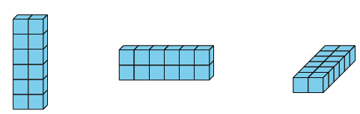
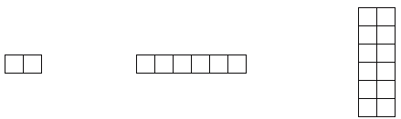

Warm-Up Notice and Wonder: Prism Print
What do you notice? What do you wonder?
Be prepared to discuss with your partner.

Slide 4
Warm-Up Synthesis
These rectangles show different faces of the prism.
Any face of a prism can be a base.
Where do we see each base in the prism?

Slide 5
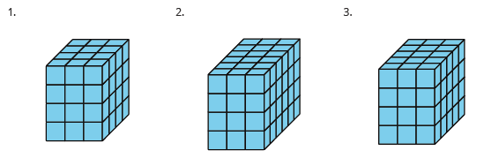
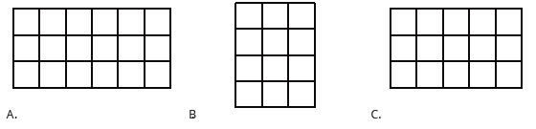
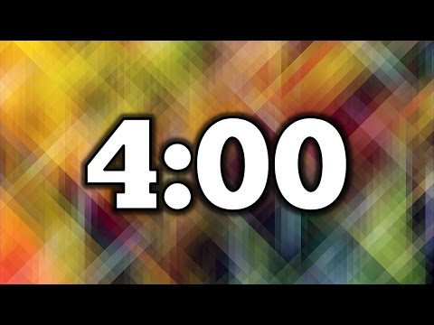
Activity 1 Match the Base
Complete activity 1 in your book.
Be prepared to explain your reasoning to a partner.
Notes:
Restart timer for partner work.

Slide 6
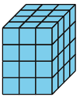
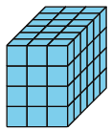

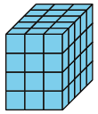
Activity Synthesis Let’s Share!
Where do we see this rectangle as a base in each prism?
If prism 2 was resting on the 4 by 3 base, how many layers tall would the prism be?
We can use the word height to describe how tall a prism is.
If prism 3 was resting on the 4 by 3 base, what would the height of the prism be?

Slide 7



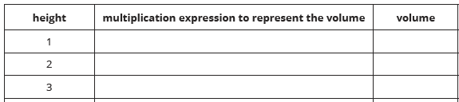
Activity 2 Growing Prism
Complete activity 2 in your book.
You have a few minutes of independent think time before working with a partner.
Here is a base of a rectangular prism. Complete the table for the volumes of rectangular prisms with this base and different heights.

Slide 8
Activity 2 Synthesis Let’s Share!
How is the prism changing as you go down the table? How is it staying the same?
40 x 3 Where do we see the 40 in the prism?
Where do we see the 3 in the prism?
Where do we see the expression 3 x 4 x 5 in the prism that is being described in question 2?

Slide 9
Lesson Synthesis
What information do you need to measure the volume of any rectangular prism?
What language can we add to our poster to explain how to find the volume of a prism when we can’t see the cubes?
What is the connection between the number of layers and the height of the prism?

Slide 10
Let’s describe the dimensions of a prism and find the volume.

Slide 11

Cool-Down
Determine the Volume
Complete the cool-down by yourself.

