Slide 1
Use Layers to Determine Volume
Materials needed: book, pencil

Slide 2
Let’s find the volume when we can’t see all of the cubes.

Slide 3
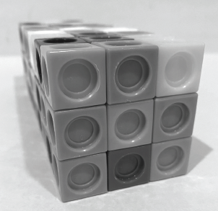

Warm-Up Estimation Exploration
Let’s think about how many cubes were used to build the prism.
What is an estimate that’s too high?
What is an estimate that’s too low?
What is an estimate that is about right?
Notes:
Restart timer for partner talk.

Slide 4
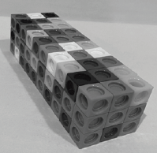
Activity Synthesis
Why are multiples of 9 good estimates?
What other information would help you find the exact number of cubes in the prismt?
Based on this discussion does anyone want to revise their estimate?

Slide 5
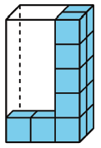
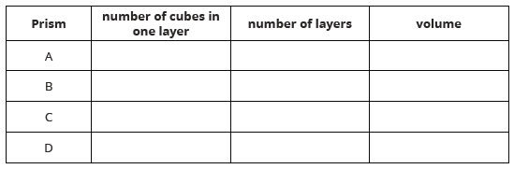

Activity 1 Layers in Rectangular Prisms
Complete activity 1 (questions 1, 2 and 3) in your book.
Be prepared to explain your reasoning to a partner.
Notes:
Explain to students that Prisms C and D are completely full of cubes, but only a few are shown.
Restart the timer for partner time.

Slide 6
Activity Synthesis

Slide 7
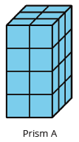
Activity Synthesis
2 x 12 3 x 8
Where do we see these expressions in Prisms A?
How does thinking about layers help us find the volume of prisms that are not completely filled?

Slide 8
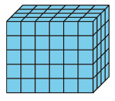
Activity 2 Finding Volume in Different Ways
You are going to analyze different ways to find the volume of a rectangular prism.
Complete activity 2 in your book.
Be prepared to explain your reasoning to a partner.

Slide 9
Activity Synthesis
How did you interpret the 5 in Han’s calculation?
Where do you see the 24 from Han’s calculation?
5 x (4 x 6) How does this expression show Han’s calculations?
How did you interpret Elena’s expression 6 x 20?
6 x (4 x 5) How does this expression show Elena’s calculations?

Slide 10
Lesson Synthesis
We call the amount of space an object takes up volume.
This prism has a volume of 120 cubes.
To find the volume of any prism, we can find the number of cubes in one layer and multiply that number by the number of layers. We can describe this prism as having 6 layers of 20 cubes, 4 layers of 30 cubes, or 5 layers of 24 cubes. We can use all of these expressions to represent the volume of the prism:
5 x 24, 5 x (6 x 4) 6 x 20, 6 x (5 x 4) 4 x 30, 4 x (5 x 6)

Slide 11
Let’s find the volume when we can’t see all of the cubes.

Slide 12
Cool-Down
Use Expressions
Complete the cool-down by yourself.

