Slide 1
Layers, Layers, and More Layers
Materials needed: pencil and number cubes
Notes:
Lesson Purpose
Find the volume of a rectangular prism using its layered structure.
In previous lessons, students built objects, including rectangular prisms, with unit cubes and counted the number of cubes. In this lesson, students continue to count the amount of unit cubes needed to build a rectangular prism, but now they are presented with images of prisms instead of the objects themselves. To encourage students to develop a systematic way to count the cubes, they are given situations in which the number of cubes is too large to effectively count by building. As students use horizontal or vertical layers to measure the volume, they make use of the layered structure of prisms

Slide 2

Let’s find value of each expression mentally

Slide 3
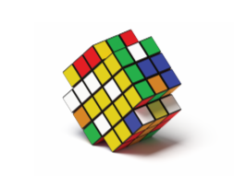





Warm-Up Number Talk: Multiplication
Notes:
Launch:
Display one problem.
“Give me a signal when you have an answer and can explain how you got it.”
1 minute: individual think time
Activity:
Share and record answers and strategies. Keep problems and work displayed. Repeat with each problem

Slide 4
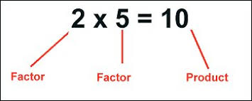
Activity Synthesis
How did changing one of the factors impact the product?
How are problems 2–4 like the work we did with prisms yesterday?
Notes:
More possible questions to ask:
“Who can restate _______’s reasoning in a different way?”
“Did anyone have the same strategy but would explain it differently?”

Slide 5

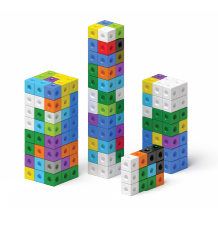
Activity 1 Build Rectangular Prisms
The prisms on the cards are completely packed with unit cubes.
1. Pick a card.
2. Build the rectangular prism.
3. Find the volume. Explain how you found the volume to your partner.
4. Repeat.
Notes:
Launch
Groups of 2 “You are going to build rectangular prisms shown on cards.
Before we look at the cards, what information in the image will help you build the prism?” (The number of cubes in each layer and the number layers.) Share responses. “Now, you will each pick a card, build the prism, and find its volume. Explain how you found the volume to your partner and then pick another card.”
Activity
Monitor for students who discuss: how many cubes are in each layer how the cubes are arranged in each layer how many layers are in the prism
Mathematical Community: As students work, monitor for examples of the “Doing Math” actions.

Slide 6
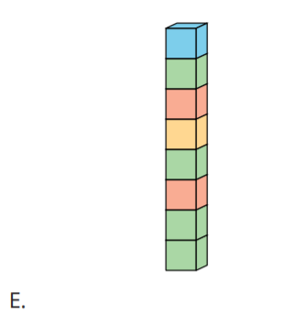
Activity Synthesis
How did you build this rectangular prism?
What is the volume of this rectangular prism? How do you know?

Slide 7
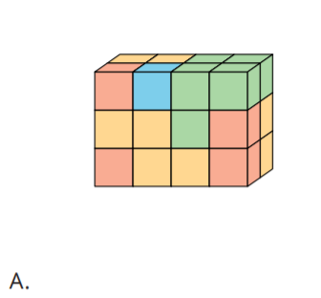
Activity Synthesis
How did you build this rectangular prism?
What is the volume of this rectangular prism? How do you know?
Notes:
Advancing Student Thinking
Some students may still count each individual cube to determine the volume of the prism. Ask, “How many cubes are in each layer? How many layers are there?”

Slide 8
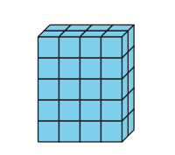
Activity 2 Practice Finding Volume
How would you describe this prism?
What is the volume of this prism?
How do you know?
Notes:
Launch
Groups of 2 Display the first prism. “How would you describe this prism?” (There are 5 layers and each layer has 8 cubes or there are 2 layers and each layer has 20 cubes in it.)

Slide 9
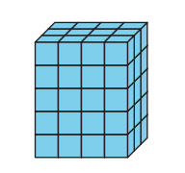
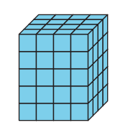
Activity 2 Practice Finding Volume
Determine the volume of each prism.
Show or explain your reasoning.
Notes:
10 minutes: independent work time
2 minutes: partner discussion
Monitor for students who use the layered structure to determine the volume.

Slide 10
Activity Synthesis
How did you find the volume of the prisms?
Where do you see 5 groups of 8 cubes in this prism?

Slide 11
Activity Synthesis
What do these rectangular prisms have in common?
Notes:
They are all 5 cubes high. They can all be broken into 5 equal layers or groups. They also all have a side that is 4 cubes long. They can all be broken into layers with 20 cubes.)
If time permits, ask “Who saw the layers differently?” (I used the side layer of 10 cubes. I multiplied 10 by 4 layers to get 40.)
Advancing Student Thinking
If students cannot keep track of the cubes they cannot see, prompt them to build the prism with unit cubes.

Slide 12
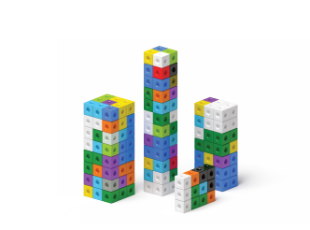
Lesson Synthesis
What do you know about finding the volume of a prism made of cubes after today’s activities?
Is there anything you have questions about?

Slide 13

Cool-Down
Jada’s Prism
Complete the cool-down by yourself.

