Slide 1
Measure Volume
Materials needed: pencil, book, snap cubes

Slide 2
Let’s count cubes.

Slide 3


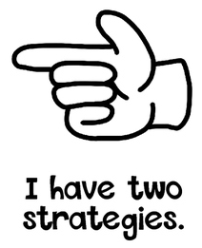

Hand Signals
These are our thinking signals. We will allow everyone the opportunity to think. We will not blurt out answers. Hold your hand to your chest using the “I am ready and thinking symbol.”

Slide 4
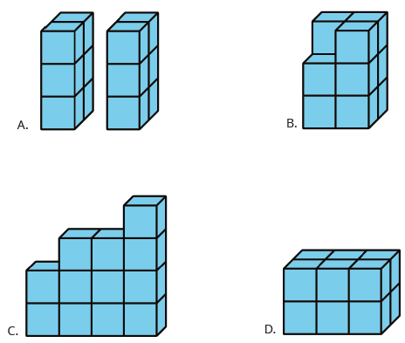

Warm-up: Which One Doesn’t Belong
Pick one that doesn’t belong. Be prepared to share why it doesn’t belong.
Be sure to use your hand signals.

Slide 5
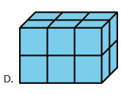
Warm-up Synthesis
We can count the number of unit cubes in an object to measure its volume.
How many unit cubes are in Figure D?
For which other object would you use a similar strategy to count the cubes? Why?

Slide 6

Activity 1: Find Volume
In this activity, you will use unit cubes to build objects and describe how you would measure the volume.
Partner A will build an object using 8-12 cubes and give to Partner B.
Partner B will explain how they would count the number of cubes in the object.
Partner A will then explain if they would count the same way or different.
Switch roles so that Partner B builds an object and repeat.
Make sure you record your thoughts.

Slide 7

Activity 1 Synthesis
Which objects were easiest to count? Why?
Which objects were most challenging to count?
How did you count the cubes?
Objects that have the same number of cubes in each layer are called rectangular prisms.
What were some ways you used to count the cubes in a rectangular prism?

Slide 8
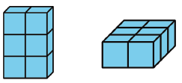
Activity 2: Guess My Prism
What is the same? What is different?
Can you build my prism?
I used 16 cubes.
My prism is 4 cubes wide.
My prism is 2 cubes long.
My prism is 2 cubes tall.

Slide 9
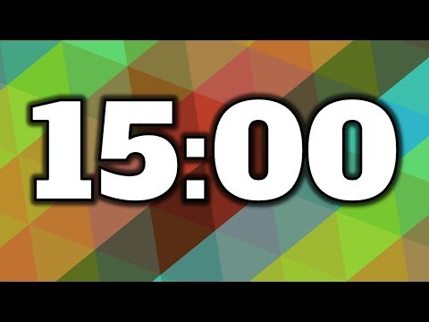
Activity 2: Guess My Prism
1.The object of the game is to get your partner to build the same prism.
a. Partner A: Use 16-24 cubes to build a prism. Describe it to your partner.
B. Partner B: Build the prism your partner describes to you.
2. Place the two prisms next to each other. What is the same? What is different?
3. Switch roles and repeat.

Slide 10
Activity 2 Synthesis
What language did your partner use that was most helpful for you to understand the prism they wanted you to build?
How did you describe your object to your partner?
How can we describe this prism using language we all understand?

Slide 11
Lesson Synthesis
Today we described rectangular prisms and measured their volumes.
How can we find the volume of this rectangular prism?
How can we describe this object so that our partner can build the same shape?

Slide 12
Let’s count cubes.

Slide 13

Cool-Down
What is the Volume?
Complete the cool-own by yourself.

