Slide 1
Find Factors and Multiples
Materials needed: pencil, book, counters

Slide 2
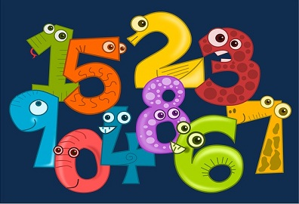
Let’s find factors and multiples of whole numbers from 1-100.

Slide 3




Warm-Up Number Talk: Division
Give me a signal when you have an answer and can explain how you got it.
12 ÷ 3
30 ÷ 3
60 ÷ 3
72 ÷ 3

Slide 4
Warm-Up Synthesis
How does knowing the first and third quotients help you find the last quotient?
12 ÷ 3
Did anyone have the same strategy but would explain it differently?
30 ÷ 3
60 ÷ 3
Did anyone approach the problem in a different way?
72 ÷ 3

Slide 5
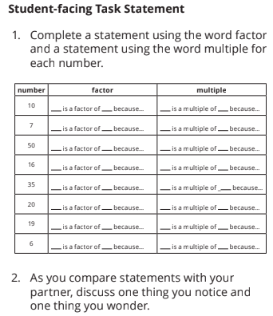

Activity 1 Factor and Multiple Statements
We are going to practice using the words factor and multiple in preparation for a game we are going to play. Take some time to complete the statements on your own.
Now share your statements with your partner. Be sure to ask any questions you have as you justify each of your statements together.

Slide 6
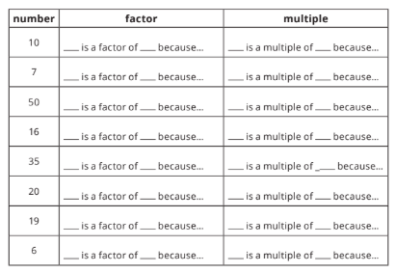
Activity 1 Synthesis
What was your favorite statement you came up with? Why was it your favorite?
What did you and your partner notice and wonder about in this activity?

Slide 7
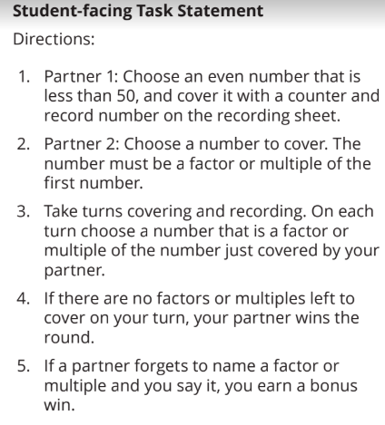


Activity 2 Factor and Multiple Game
Now you’re going to use your knowledge of factors and multiples to play a game against your partner.

Slide 8
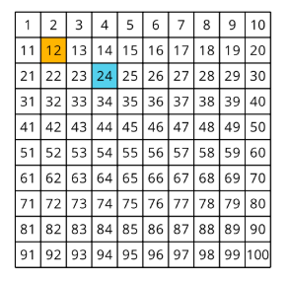
Activity 2 Synthesis
What was your strategy for choosing numbers as you played the game?

Slide 9
Lesson Synthesis
In today’s lesson we used the terms factors and multiples to describe numbers within 100.
We learned that:
1 is a factor of every number and every number is a multiple of 1.
2 is a factor of each even number.
Each even number is a multiple of 2.
A number is a multiple of 5 when the last digit of the number is 5 or 0.
10 is a factor of a number and a number is a multiple of 10 when the last digit of a number is 0.
Notes:
Restart timer

Slide 10
Lesson Synthesis
Take turns using each number to complete each statement with a partner: 1, 2, 5, 10.
For example:
How do you know if 2 is a factor of a number?
How do you know if a number is a multiple of 2?
How do you know if is a factor of a number?
How do you know if a number is a multiple of ?
Notes:
Restart timer

Slide 11
Let’s find factors and multiples of whole numbers from 1-100.

Slide 12
Cool-Down
Complete the Statements
Complete the cool-down by yourself.

