Slide 1
The Locker Problem
Materials needed: pencil, book

Slide 2
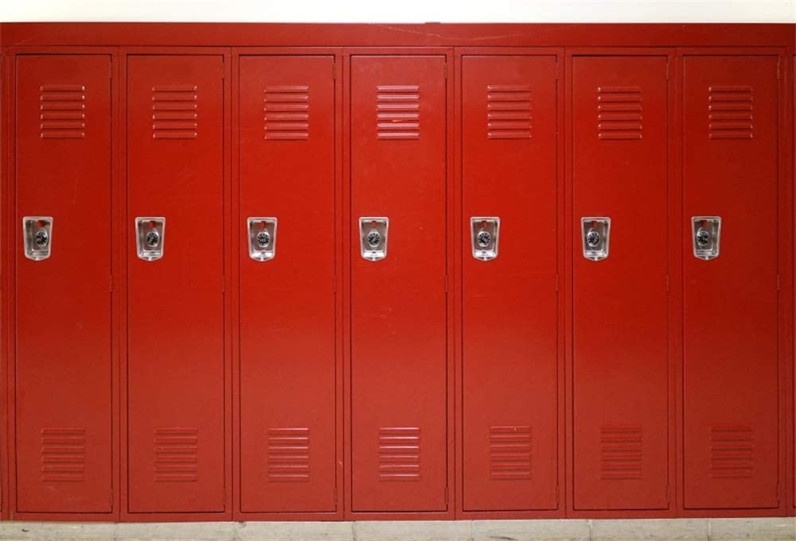
Let’s figure out which lockers are open and why.

Slide 3





Warm-Up Choral Count: Twos and Fours
Count by 2, starting at 0. I will record your counting on chart paper.
Now, count by 4, starting at 0.
What patterns do you see in the individual counts? Use your hand signals.
What patterns do you see between the two counts? Use your hand signals.

Slide 4
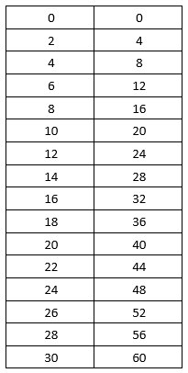
Warm-Up Synthesis
How can I get the number in the second list from the corresponding number in the first list?
How can I get the number in the first list from the corresponding number in the second list?

Slide 5
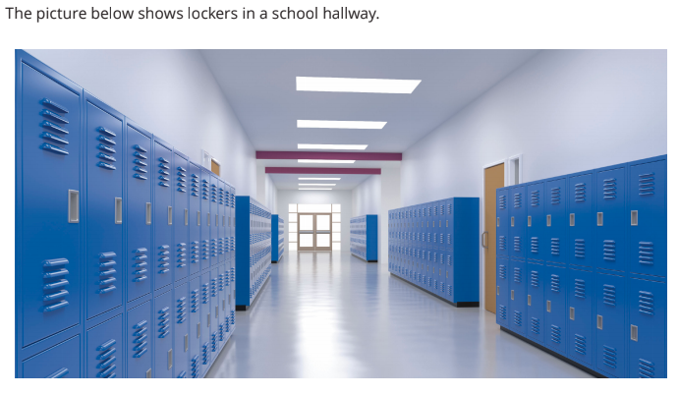
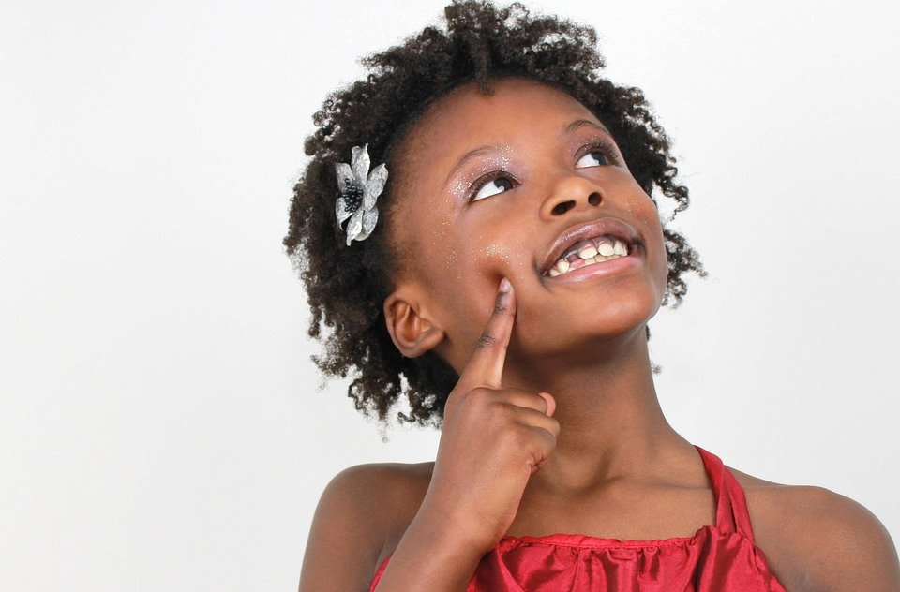

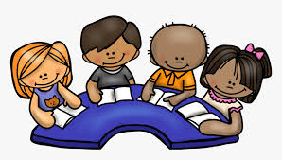
Activity 1 Questionable Lockers
In your small group, discuss what you know or have questions about related to the picture.
Notes:
Restart the timer for expression work.

Slide 6
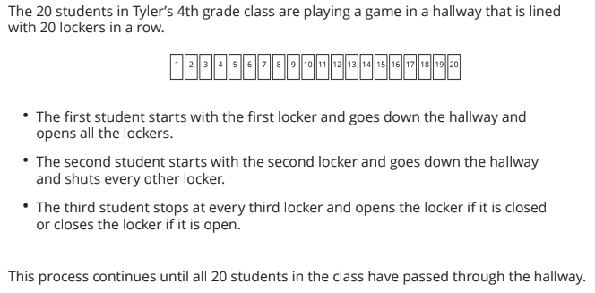

Activity 1 Questionable Lockers
Read about the game Tyler’s class played.
Notes:
Restart the timer for expression work.

Slide 7

Activity 1 Questionable Lockers
Based on what you know, create a representation to show what you understand about this problem.
When you have completed your representation, answer the 3 questions about your representation.
Notes:
Restart the timer for expression work.

Slide 8
Activity 1 Synthesis
Let’s look at several different representations I noticed while you were working.
For each representation, we will answer the following questions.
Where are the lockers?
How can we tell if a locker is open or closed?
How does this representation show which student is touching the locker?
In the next activity, you will work with your group to answer questions about the game. You may choose to use the representation you created or one shared by a classmate to help answer questions in the next activity.

Slide 9

Activity 2 An Open and Shut Case
Silently read and think about each question in Activity 2 in your book.
Work in your groups to answer each of the questions.

Slide 10
Activity 2 Synthesis
Explain why the first locker is open.
What do the locker numbers that are only touched by two people have in common?
These numbers are prime numbers.
Explain why the second locker is closed.
Which students touch locker 12? How do you know?
These numbers are factors of 12.
12 is also a multiple of 12.

Slide 11
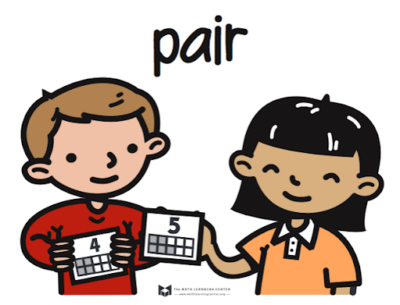
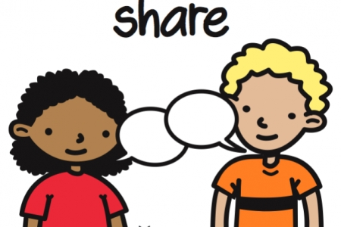
Lesson Synthesis
Which students will touch locker 7? How do you know?
Which students will touch locker 13? How do you know?
Which lockers get touched exactly 2 times?

Slide 12
Let’s figure out which lockers are open and why.

Slide 13
Cool-Down
Locker 18
Complete the cool-down by yourself.

