Slide 1
More Multiples
Materials needed; pencil, book

Slide 2
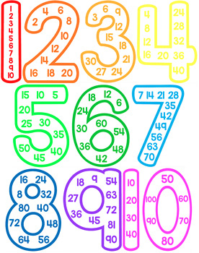
Let’s explore more contexts that involve multiples.

Slide 3
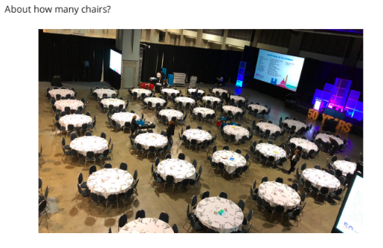
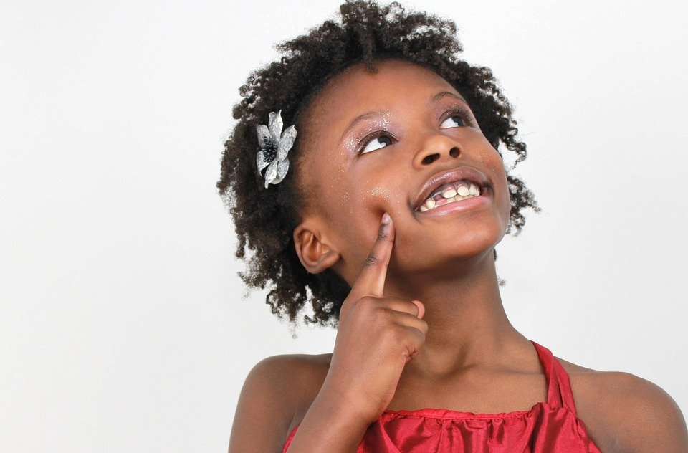

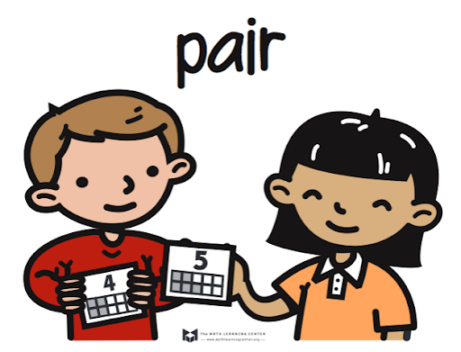
Warm-Up: Estimation Exploration: Banquet Seating
What is an estimate that’s too high?
What is an estimate that’s too low?
What is an estimate that’s about right?

Slide 4
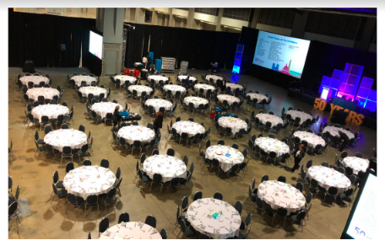
Warm-Up Synthesis
Which estimates would have been unreasonable?
Explain your reasoning.

Slide 5
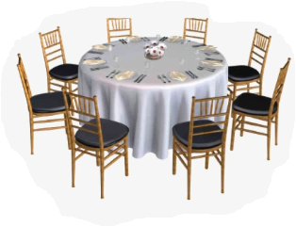
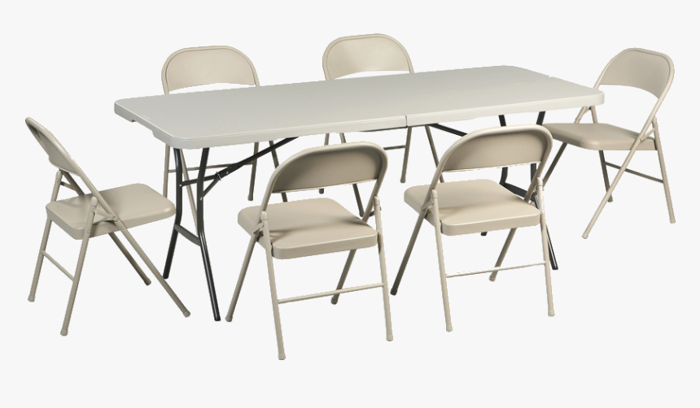

Activity 1 Choosing the Right Seat
Complete activity 1 in your book. Work with your partner to choose a type of table to seat different groups of students.
Notes:
Restart timer for partner work.

Slide 6
Activity Synthesis Let’s Share!
Can Noah’s class fit exactly in tables for 6? How do you know?
Can Noah’s class fit exactly in tables for 8? How do you know?
How does thinking about multiplication facts for 8 help to think about this problem?
For the problem with both classes and the teachers, could they all fit at tables of 6? Why?
Could they all fit at tables of 8? Why?

Slide 7

Activity 2 Hot Dogs and Buns
What questions do you have about the situation? What questions could you ask about the situation? What questions could you answer about the situation?
You are going to solve problems about hot dogs and hot dog buns. Hot dogs come in packages of 10 while hot dog buns come in packages of 8. You will look for the best number of hot dogs and buns to use in different situations.
Take a minute to read these problems and think about how you would solve them.

Slide 8
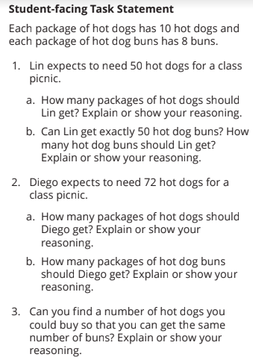
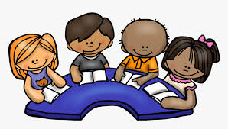

Activity 2 Hot Dogs and Buns
Now solve these problems with your partner.
Now get together with another group and share your ideas.

Slide 9


Activity 2 Synthesis Let’s Share!
Let’s share our answers for problem 2 with Diego.
Why are there different answers to this question?
For problem 3, are there numbers of hot dogs you can buy so you can also get that same number of buns?
Why can we find a number that represents both hot dogs and buns even when the packaging is different?

Slide 10
Lesson Synthesis
Today we looked at multiples of different numbers.

Slide 11
Lesson Synthesis
For the seats at tables, we looked at the multiples of 6 and 8. What are some multiples of 6?
To seat 18 students, how many tables of 6 would you need? Why?
To seat 18 students, how many tables of 8 would you need? Why?
Can you find a number of students who could fit exactly at tables of 6 or at tables of 8?

Slide 12
Let’s explore more contexts that involve multiples.

Slide 13

Cool-Down
Grade 4 Party
Complete the cool-down by yourself.

