Slide 1
Multiplication Center Day
Materials needed: book, pencil, counters

Slide 2

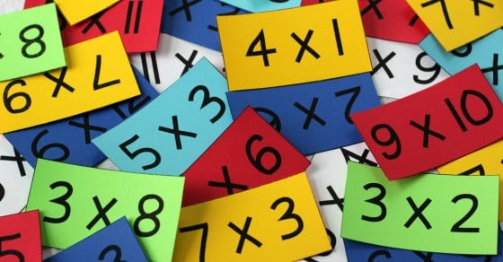
Let’s learn how centers work and practice multiplication.

Slide 3


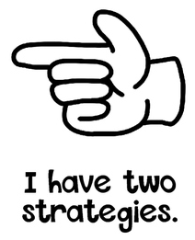

Warm-Up Number Talk: Multiplication Over Ten
Give me a signal when you have an answer and can explain how you got it.
10 x 6
3 x 6
13 x 6
12 x 4

Slide 4
Warm-Up Synthesis
How can knowing the first two problems help you solve the third problem?
10 x 6
3 x 6
Did anyone have the same strategy but would explain it differently?
13 x 6
Did anyone approach the problem in a different way?
12 x 4

Slide 5
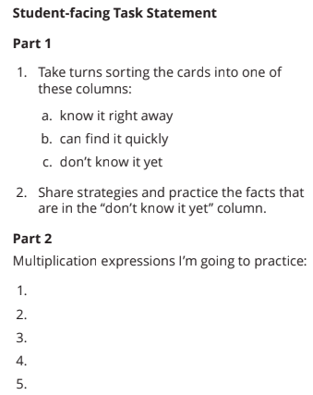
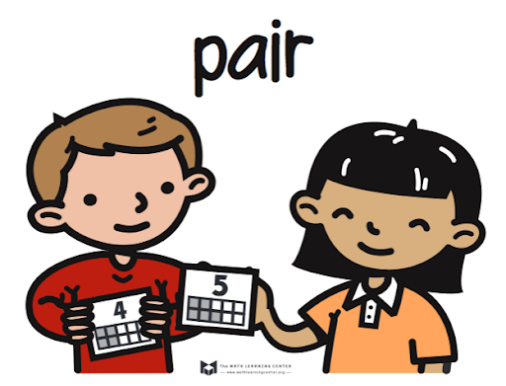




Activity 1 Multiplication Fluency Sort
Take some time to sort the cards into one of the three columns.
Choose 5 multiplication facts that you don’t know and record the expressions in part 2.
Now, share the multiplication expressions you want to practice with your partner and have them help you think of some strategies you could use to find the products quickly.
Notes:
Explain to students that Prisms C and D are completely full of cubes, but only a few are shown.
Restart the timer for partner time.

Slide 6
Activity Synthesis
What were some useful strategies for finding products you didn’t know yet?

Slide 7
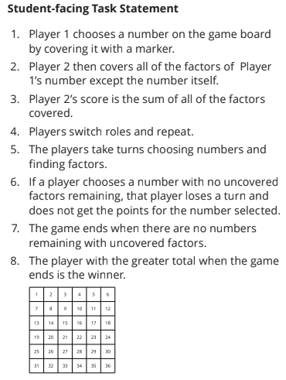

Activity 2 Finding Factors
If I selected the number 9, which factors could you cover?
What would your score be?
Play Finding Factors with your partner.

Slide 8
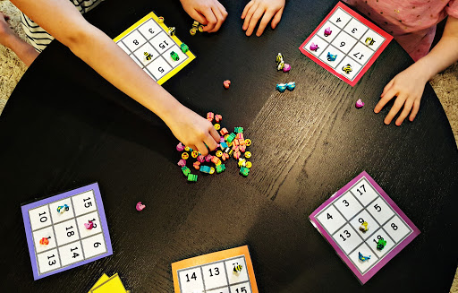
Activity Synthesis
What strategies were helpful as you played Finding Factors?

Slide 9
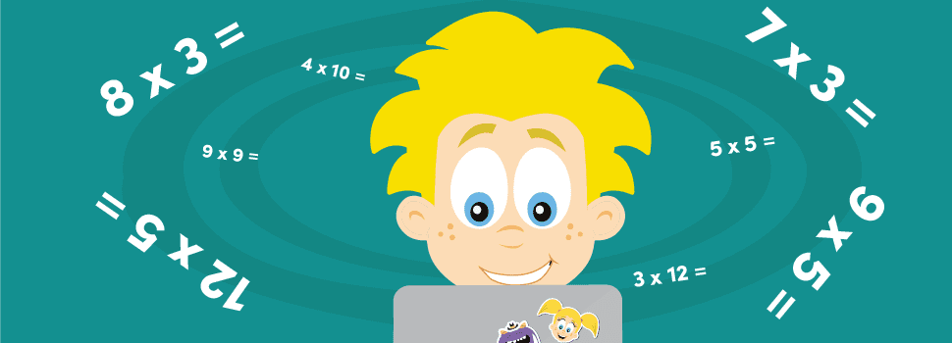

Lesson Synthesis
Today we practiced multiplication. What is a strategy you remember from 3rd grade, or a new strategy you learned today?

Slide 10
Let’s learn how centers work and practice multiplication.

Slide 11
Cool-Down
Reflect on Strategies
Complete the cool-down by yourself.

