Slide 1
Build Many Rectangles
Materials needed: pencil, book, tiles, grid paper

Slide 2

Let’s identify prime and composite numbers.

Slide 3




Warm-Up Number Talk: Multiplication
Count by 2, starting at 0. I will record your counting on chart paper.
Now, count by 5, starting at 0.
What patterns do you see in the individual counts? Use your hand signals.
What patterns do you see between the two counts? Use your hand signals.

Slide 4
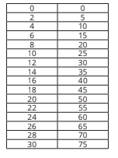
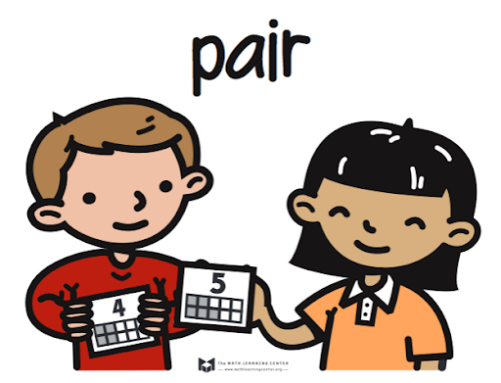


Warm-Up Synthesis
How many twos did it take to get to 10?
How many fives did it take to get to 10?
Ten is a multiple of 2 and 5. Do you notice any other common multiples?
If the counts continue, what other common multiples would you expect to see?

Slide 5
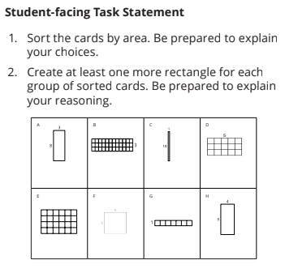


Activity 1: AREA SORT
Take a look at these cards and sort them in a way that makes sense to you.
Some of you sorted by size and others by orientation.
If you did not already, sort the rectangles into piles that have the same area.
Notes:
Restart the timer after the first seven minutes for them to start the process again.

Slide 6
Activity 1: AREA SORT
For areas of 24 and 36, how did you determine the areas were the same?
Now create at least one rectangle to add to each category in your card sort.
Notes:
Restart the timer after the first seven minutes for them to start the process again.

Slide 7



Activity 1 Synthesis
Why were you able to create more rectangles for some areas and not others?
Only one rectangle can be made for the area of 7. Numbers like this are called prime numbers. Prime numbers have only one factor pair: 1 and itself.
Which other numbers from your work are prime numbers? How do you know?

Slide 8
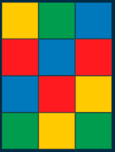
Activity 1 Synthesis
Numbers like 15 that have more than 1 factor pair are called composite numbers.
What other composite numbers did you work with? How do you know they are composite?

Slide 9
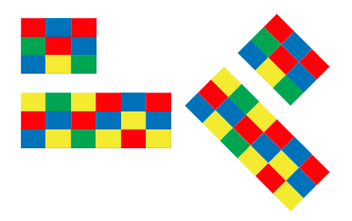
Activity 2: PRIME OR COMPOSITE
If you were given a number that is the area of a rectangle, how could you determine the number of possible rectangles for that area?
Notes:
Restart the timer after the first seven minutes for them to start the process again.

Slide 10
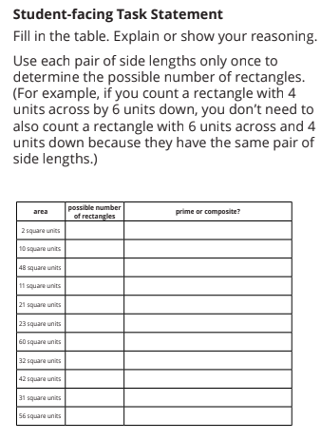

Activity 2: PRIME OR COMPOSITE
Work with your partner to complete this table. Inch tiles and grid paper are available if you’d like them.
Notes:
Restart the timer after the first seven minutes for them to start the process again.

Slide 11
Activity 2 Synthesis
Share your strategies for finding the number of rectangles for a given area.
How does the number of possible rectangles relate to the factor pairs of the number for the area?

Slide 12
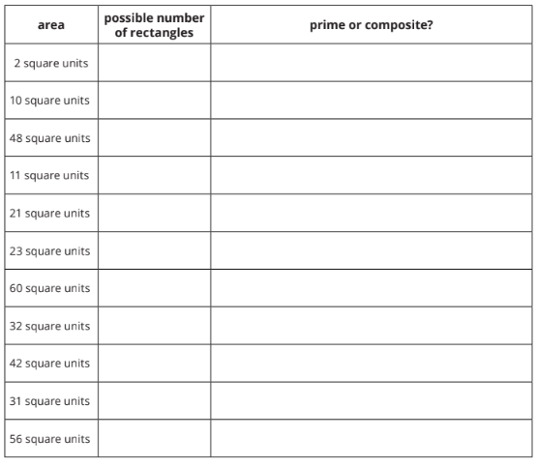

Activity 2 Synthesis
What are all of the prime numbers in our list?
What do you notice about these numbers?
What are the side lengths of a rectangle with an area of 1 square unit?
Since 1 only has 1 factor, it doesn’t have any factor pairs, so it is neither prime nor composite.

Slide 13
Activity 2 Synthesis
What are all of the composite numbers in our set?
How do we know they are not prime?

Slide 14
Lesson Synthesis
Today we learned about prime and composite numbers.

Slide 15
Lesson Synthesis
How does finding all the possible rectangles with a certain area help you determine if the value of the area is prime or composite?
What questions do you still have about these types of numbers?

Slide 16
Let’s identify prime and composite numbers.

Slide 17
Cool-Down
Prime or Composite?
Complete the cool-down by yourself.

