Slide 1
Factor Pairs
Materials needed: pencil, book, tiles, grid paper, poster paper, scissors, glue

Slide 2
Let’s Learn about factor pairs.

Slide 3


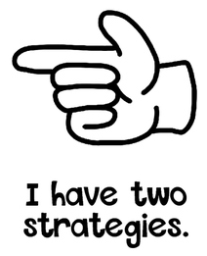

Hand Signals
These are our thinking signals. We will allow everyone the opportunity to think. We will not blurt out answers. Hold your hand to your chest using the “I am ready and thinking symbol.”

Slide 4
Lesson 1 Warm up:
Number Talk: Multiplication
2x7
4x7
3x7
7x7

Slide 5

Warm-Up Synthesis
HOw did the first 3 problems help you find 7x7?
Does anyone want to add on to --’s strategy?

Slide 6

Activity 1: how many rectangles?
Group A: 11, 27
Group B: 25, 5
Group C: 16, 8
Quiet work time.
Discuss with your partner.
Notes:
Restart timer for partner work.

Slide 7
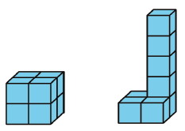

Activity 1 Synthesis
How would you describe the amount of space each object takes up?
Which shape has a greater volume?
We call the amount of space an object takes up as the object’s volume.
What is different about the two shapes?

Slide 8
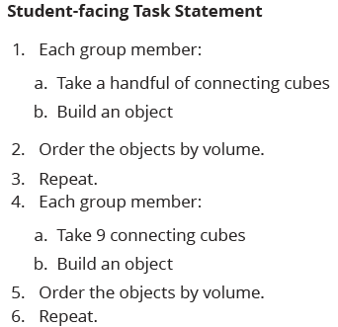
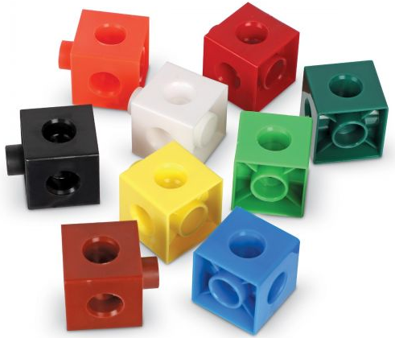

Activity 2: Build and Order
With your group, work on the Student-facing Task.
You will have 10 minutes of group work time.

Slide 9
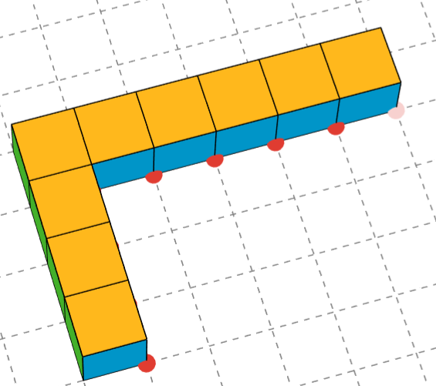
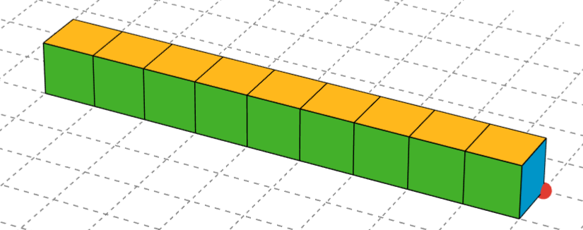
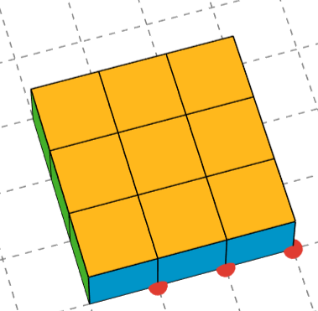
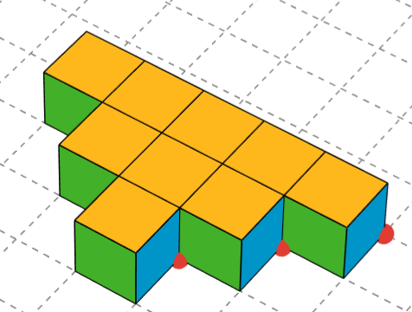
Activity 2 Synthesis
What is the same?
What is different?
How do the volumes of these shapes compare?
How do you know?
How much space does each shape take up?

Slide 10
Lesson Synthesis
Today, we built objects out of cubes and compared them by the amount of space they take up. We call this an object’s volume.

Slide 11
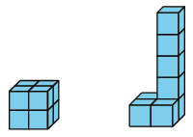
Lesson Synthesis
How are the two shapes the same?
How are the two shapes different?
These two objects have different shapes, but take up the same about of space, that is they have the same volume.

Slide 12
Let’s build and compare objects made of cubes.

Slide 13
Cool-Down
Which has more volume?
Complete the cool-down by yourself.

