Slide 1
Build rectangles
Materials needed: pencil, book, tiles, grid paper

Slide 2
Let’s build some rectangles.

Slide 3


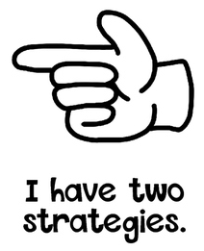

Hand Signals
These are our thinking signals. We will allow everyone the opportunity to think. We will not blurt out answers. Hold your hand to your chest using the “I am ready and thinking symbol.”

Slide 4
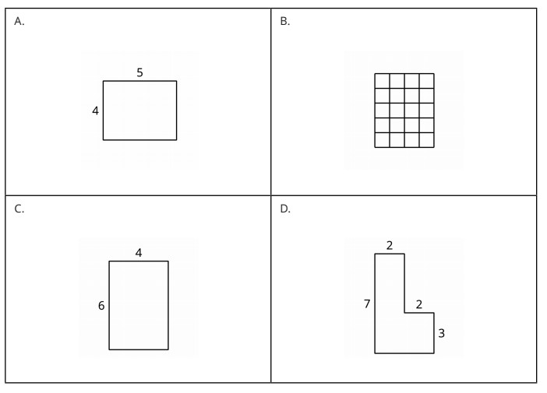

Lesson 1: Build Rectangles Warm-Up
Pick one that doesn’t belong and be ready to share why it doesn’t belong.
Be sure to use your hand signals.

Slide 5
Warm-Up Synthesis
Let’s find at least one reason why each doesn’t belong.
How might we determine the area of each figure?

Slide 6
Mathematical Community
Doing Math
Students
Teacher
Norms
Students
Teacher

Slide 7
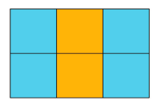
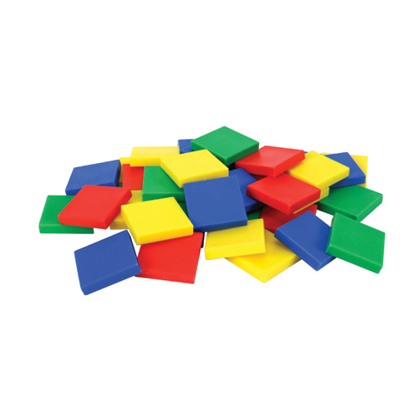

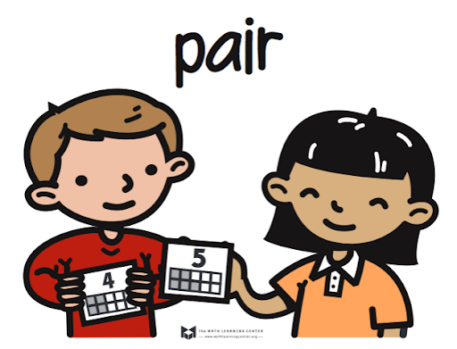
Activity 1: Build and find area
Look at the rectangle and describe it to a partner.
Build all the rectangles you can using all 10 tiles.
Notes:
Restart timer for partner work.

Slide 8



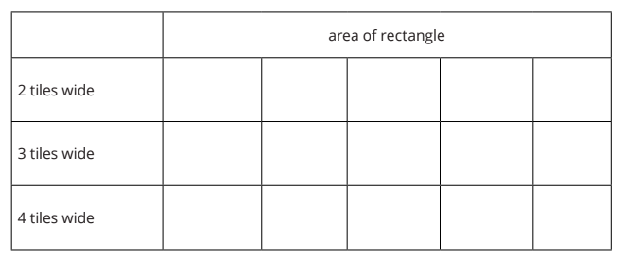
Activity 1: Build and find area
Take a minute to think about how you would build rectangles with these areas.
Talk with your partner about your strategies.
Notes:
Restart timer for partner work.

Slide 9
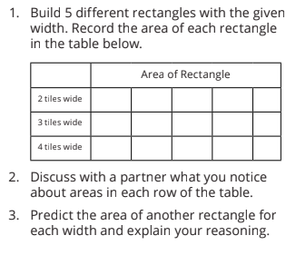



Activity 1: Build and find area
Notes:
Restart timer for partner work.

Slide 10
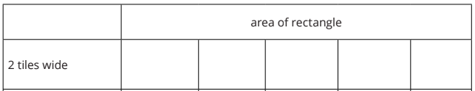


Activity 1 Synthesis
Share your predictions for areas of rectangles with a width of 2.
Is this also true for a width of 3? Are all the predictions numbers we say when multiplying by 3 or counting by 3?
How might we know each prediction was a possible rectangle without building?
What about a width of 4?

Slide 11

Activity 2: what areas can you build?
I am thinking of a rectangle that is 2 tiles wide. What is the area of my rectangle?
Share with class
How do we know all of these are possible areas?

Slide 12
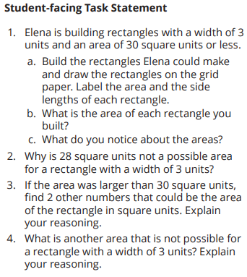
Activity 2: what areas can you build?
In this activity we are going to think about areas we could build if we only knew 1 side length of a rectangle.
With your partner, work on the Student-facing Task.
You will have 7 minutes of group work time.

Slide 13
Activity 2 Synthesis
What did you notice about the areas you built in question 1?
Share your responses to question 2.
What other numbers did you find for questions 3 and 4? How did you know they could or could not be an area for this rectangle with width 3 units?

Slide 14
Activity 2 Synthesis
Look back at your work. Which numbers are multiples of 3? Which numbers are not multiples of 3?
We can have an area of 12 square units when the width of our rectangle is 3 units. That is because 12 is a multiple of 3. A multiple is the result of multiplying a number by a whole number.

Slide 15
Lesson Synthesis
Today we built rectangles and learned about multiples.

Slide 16
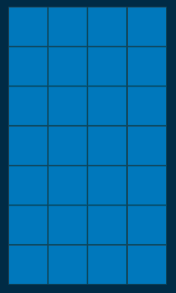
Lesson Synthesis
How can we decide if a number is a multiple of another number?
How would you decide whether 28 is a multiple of 4 ?
What is a number that would not be a multiple of 4?
How do you know?

Slide 17
Let’s build some rectangles.

Slide 18

Cool-Down
If a rectangle is 6 tiles wide, what are 3 possible areas of that rectangle?
Explain or show your reasoning.
Complete the cool-down by yourself.

