Slide 1

High School Claim 4
Smarter Balanced Sample Items
Modeling and Data Analysis
Questions courtesy of the Smarter Balanced Assessment Consortium Item Specifications – Version 3.0
Slideshow organized by SMc Curriculum – www.ccssmathactivities.com

Slide 2

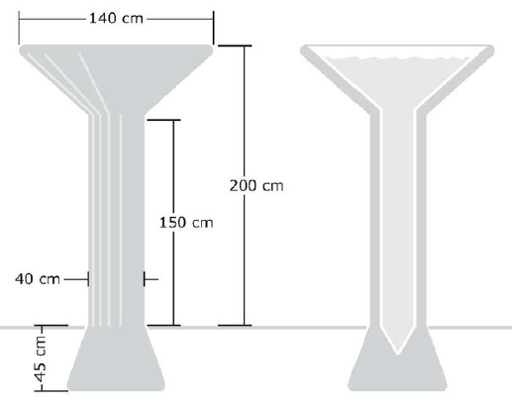
#1
A rainwater cistern is shown in the figure.
Estimate that number of liters
(l) of water the cistern can hold
when full.
Enter your estimate in the
response box.

Slide 3
#1 Answer
Rubric:
(1 point) The student enters a reasonable estimate for the amount of water in the cistern.
Answer: between 340 and 700

Slide 4
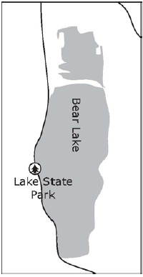
#2
Bear Lake straddles the border between Idaho and
Utah. It is about 30 kilometers (km) long and about
11 km wide at the widest spot, as shown in the figure.
The water is about 60 meters (m) deep at the deepest
Spot with an average depth of about 30 m. Use this
Information to estimate the number of liters (l) of
Water in Bear Lake.
Part A: Enter your estimate in the response box
using scientific notation.
Part B: The surface area of Bear Lake is approximately 280 km2. Use this information to improve your estimate of the number of liters contained in the lake if you can.
Enter your revised estimate in the response box using scientific notation.

Slide 5
#2 Answer
Rubric:
(2 points) The student enters a reasonable estimate in Part A for the number of liters in the lake in the first response box and enters a more precise estimate for Part B that is closer to 8.4 x 10¹².
(1 point) The student enters a reasonable estimate for Part A but does not enter an improved estimate in the second box or the student enters an unreasonable estimate in the first response box and 8.4 x 10¹² in the second response box.
Answer: first response box: any number between 4.95 x 10¹² and 9.9 x 10¹²

Slide 6
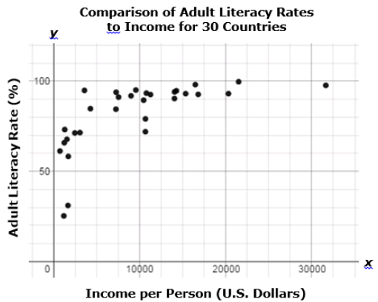
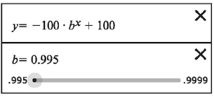
#3
This scatterplot shows the income per person (in U.S. dollars) versus the adult literacy rates for 30 countries throughout the world. The adult literacy rate is the percentage of people ages 15 and above who can, with understanding, read and write a short, simple statement about their everyday life.
Part A: Use the slider to adjust the value
for the base for the given exponential
model so that it fits the data in the
scatterplot.
Part B: Your model predicts the literacy
rates in some countries better than
others. Which country’s literacy rate is
least well predicted by your model?
Click on the point in the scatterplot to indicate your choice.

Slide 7
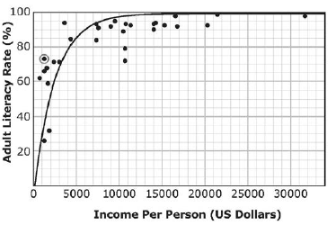
#3 Answer
Rubric:
(1 point) The student adjusts the graph so it fits the scatterplot reasonably well (see exemplar below). At a minimum, at least five of the data points must be above the graph and at least five must be below the graph. The student then clicks on the point that has the greatest vertical distance from their graph.
Answer:

Slide 8
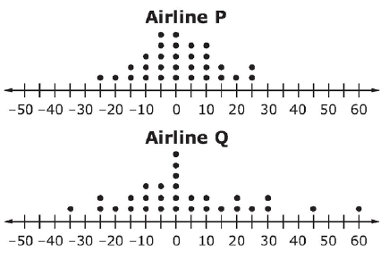
#4
Two airlines each made 30 flights. The dot plots shown compare how many minutes the actual arrival times were before or after the
scheduled arrival times of these flights.
Negative numbers represent the minutes
the flight arrived before its scheduled time.
Positive numbers represent the minutes the
flight arrived after its scheduled time.
Zero indicates the flight arrived
at its scheduled time.
Assuming you want to arrive as close to the scheduled time as possible, from which airline should you buy your ticket? Use all three drop-down menus to respond to this question.
I should choose (Airline P/Airline Q) because the distribution of flights for Airline P has a center that is (greater than/about the same as/less than) the center of the distribution of flights for Airline P has a spread that is (greater than/about the same as/less than) the spread of the distribution for Airline Q.

Slide 9
#4 Answer
Rubric:
(2 points) The student choose Airline P, about the same as, less than.
(1 point) The student chooses Airline P and one of the correct choices for the other two menus.

Slide 10
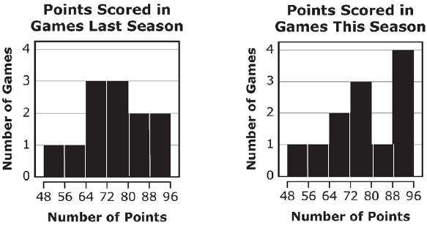
#5
Dirk wants to compare the performance of the school basketball team las year with its performance this year. Decide whether he will use the mean or the median number of points earned in a basketball game to make the comparison. Either measure is acceptable, but you must choose one.
Dirk will use the (mean, median) number of points scored in a game.
Based on the measure of center Dirk will use, which of the following is the best comparison between the performance of the school basketball team last season and this season? You can choose to view the data sets on which the histograms are based if you think it will help you choose. The basketball team performed (better, about the same, worse) this year than last year based on the fact that the (mean, median) is
(higher, about the same, lower) this year.

Slide 11
#5 Answer
Rubric:
(1 point) The student selects mean or median, and then selects the answer choice that is best given their selection.
Answer: If mean is selected: better; higher
If median is selected: about the same; about the same

Slide 12
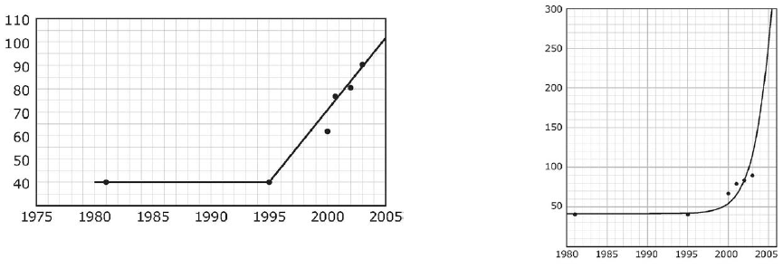
#6
Between 1980 and 1995, there was a single surviving group of Florida panthers that ranged from 30 to 50 individuals in number. In 1995, two females from a closely related species were introduced into this population, and the number of Florida panthers increased to 87 by 2003.
Part A: Would you model this data with a piece-wise linear function or an exponential function? Select one of these models. Either model is acceptable, but you must choose one.
Part B: You chose to model this data with a (piece-wise linear; exponential). This graph shows such a model.
What would the approximate population of Florida panthers have been in 2005 according to the model you chose? Enter your answer in the response box.

Slide 13
#6 Answer
Rubric:
(1 point) The student selects a piece-wise linear or exponential, and then enters the appropriate estimate.
Answer: If piece-wise linear is selected: between 98 and 100
If exponential is selected: between 240 and 260

Slide 14
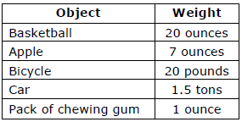
#7
Eric is using a shovel to clear the snow from his driveway. He moves 8 shovelfuls of snow each minute. After 60 minutes of hard work, Eric states, “I think I have shoveled more than a ton of snow.”
Part A: Estimate the weight of snow that Eric can move with each shovelful. If you want to, you can use the table of weights of everyday objects below. A ton is 2000 pounds, and a pound is 16 ounces.
Eric can move (1 ounce/1 pound/10 pounds/0.25 tons) of snow with each shovelful.
Part B: Use your estimate to decide if Eric’s claim is correct or not.

Slide 15
#7 Answer
Rubric:
(1 point) The student selects 1 or 10 pounds and then the corresponding answer to part B.
Answer: If 1 pound is selected: Eric is not correct.
If 10 pounds is selected: Eric is correct.

Slide 16
#8
There is a traffic jam on a highway. A reporter is trying to estimate the number of vehicles involved in the traffic jam. Select all of the information that will help the reporter make a reasonable estimate of the number of vehicles in the traffic jam.
A. The cause of the traffic jam
B. The average length of a vehicle
C. The number of lanes on the highway
D. The average distance between vehicles
E. The average number of people in each vehicle
F. The distance from the beginning to the end of the traffic jam

Slide 17
#8 Answer
Rubric:
(1 point) Student selects the correct option(s).
Answer: B, C, D, F

Slide 18
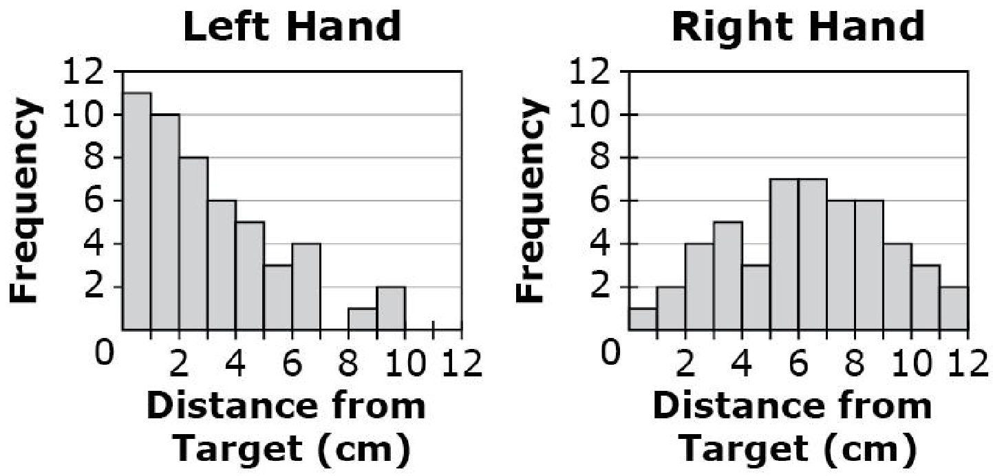
#9
Lisa was throwing a dart at a target. She threw 50 times with her left hand and 50 times with her right hand. The histograms show the distance Lisa missed the target by each time.
Which statement is an appropriate inference based on the median of each data set?
A. Lisa has better aim with her left hand because the median for her left hand is greater than the median for her right hand.
B. Lisa has better aim with her right hand because the median for her left hand is less than the median for her right hand.
C. Lisa has better aim with her left hand because the median for her left hand is less than the median for her right hand.
D. Lisa has better aim with her right hand because the median for her left hand is greater than the median for her right hand.

Slide 19
#9 Answer
Rubric:
(1 point) The student selects the correct option.
Answer: C

Slide 20
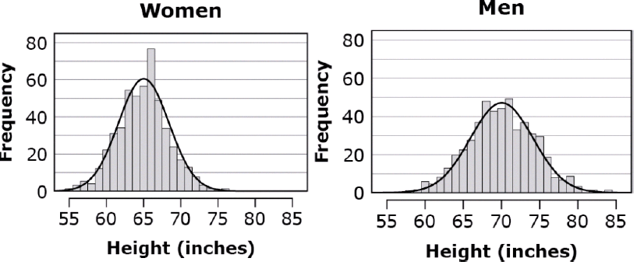
#10
The distributions of heights of 1000 men and 1000 women selected at random from the population of a large metropolitan area are shown.
Which statement gives an accurate comparison of the heights of men and women shown?
The mean height for women is greater than for men and women’s heights vary more than men’s heights.
The mean height for women is greater than for men and women’s heights vary less than men’s heights.
The mean height for women is less than for men and women’s heights vary more than men’s heights.
The mean height for women is less than for men and women’s heights vary less than men’s heights.

Slide 21
#10 Answer
Rubric:
(1 point) Student selects the correct comparison statement.
Answer: D

Slide 22
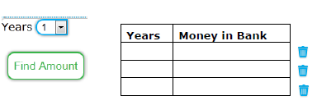
#11
Maia deposited $5500 in a bank account. The money earns interest annually, and the interest is deposited back into her account.
Maia uses an online calculator to determine the amount of money she will have in the account at the end of each year. Follow these steps to use the calculator for each row in the table.
Select number of years.
Select “Find Amount.”
The amount of money that Maia will have in her account at
the end of the selected year, up to 12 years, will appear in
the table.
You may use the calculator as many times as you need to help solve the problem.
Enter an equation that models the amount of money, y, Maia will have in the account at the end of t years.
NOTE: Need interactive aspect to solve problem!

Slide 23
#11 Answer
Rubric:
(1 point) The student is able to determine an equation to fit the situation.
Answer: y = 5500(1.03)^{t}

Slide 24
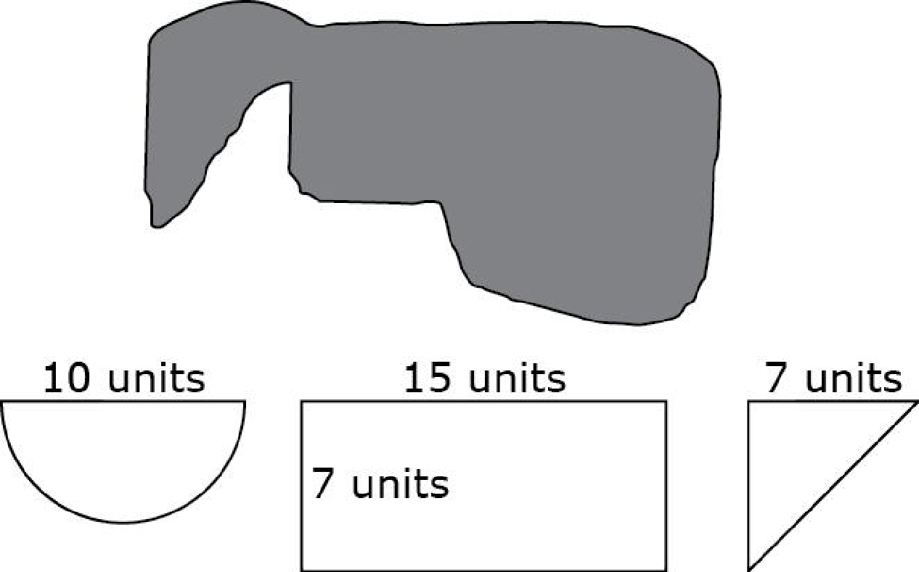
#12
A researcher models the area of the surface of a pond using a rectangle, a semi-circle, and an isosceles triangle. Drag each shape onto the scale diagram of the pond to show how the model fits.
Explain whether the researcher’s
model will estimate an area greater
than, equal to, or less than the
actual area of the pond’s surface. Use specific examples and mathematics to support your answer.

Slide 25
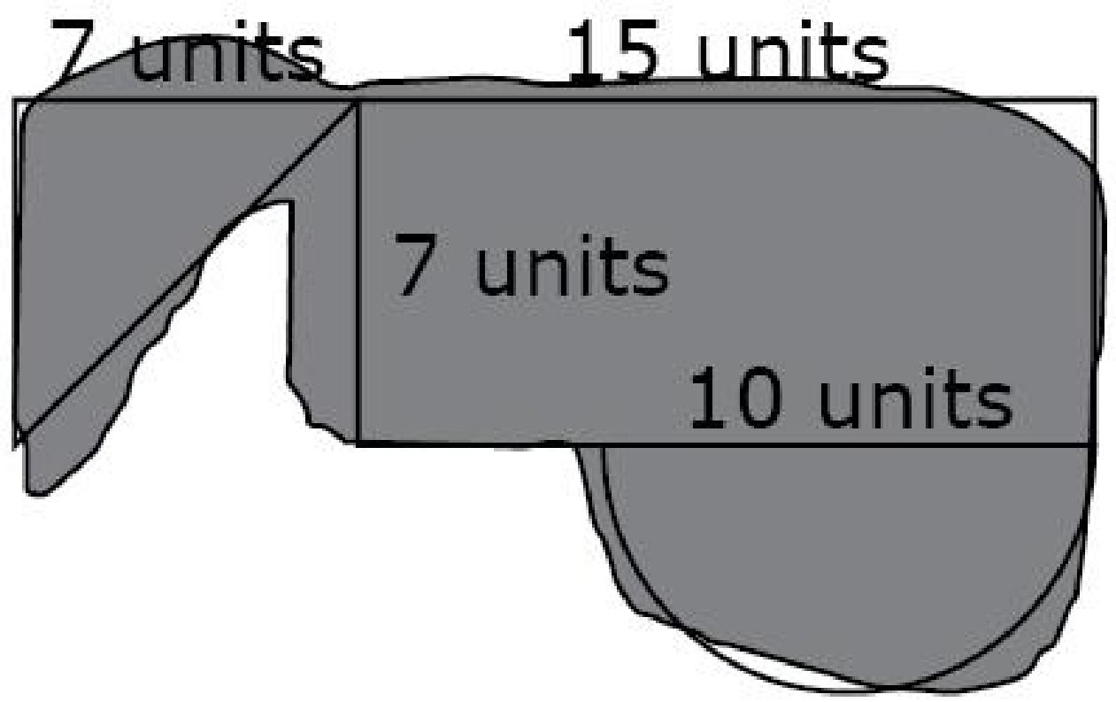
#12 Answer
Rubric:
(2 points) The student is able to drag the shapes onto the pond in a way to model the best possible fit and make the determination that the pond is slightly larger than the combined areas of the three shapes. The student must supply an explanation that adjusts for the difference in size by either determining the areas of the shapes with specific values or stating how the pond is larger than the combined shapes by a certain portion of one of the shapes (e.g., the triangle needed to be about 2 units longer).
(1 point) The student is able to place the shapes onto the pond in a way to model the best possible fit, but is not able to draw a correct conclusion or support the conclusion.
Answer:
The area of the pond is slightly greater than the combined
area of the three shapes. The semi-circle is the best fit, with
a only small amount of the pond extending out the right side,
but that is accounted for because of the gap between the
pond and the semi-circle at the bottom left side. The rectangle is a good match to the main portion of the pond. However, the triangle is smaller than the remaining portion of the pond. Given the combined area of the three shapes is about 39.3 + 105 +24.5 or 168.8 sq units, I would estimate the pond to be about 175 sq units.

Slide 26
#13
Lana wrote an article for the school newspaper about the seniors at her school. There are over 1000 students in the senior class and over 4000 students at her school. Lana asked all 40 of the seniors on the swim team whether they intend to go to college, and 22 said yes. She reported in her article that 55% of this year’s senior class intends to go to college.
How could Lana improve the accuracy of the information she reported in her article about the seniors at her school? Select all that apply.
She could report that this only applies to seniors who are swimmers.
She could check her arithmetic because she made a mistake computing the percentage.
She could ask the guidance counselors what percentage of the senior class went to college last year.
There is no need to improve the accuracy of the information she reported because she did everything correctly.
She could randomly select 40 students at the all-senior assembly and ask them whether they intend to go to college.

Slide 27
#13 Answer
Rubric:
(1 point) The student selects all correct answer choices.
Answer: A and E

Slide 28


#14
The relationship between Jack’s distance from home and the time since he left home is linear, as show in the table.
Based on the values in the table, determine whether each statement is true. Select True or False for each statement.

Slide 29
#14 Answer
Rubric:
(1 point) The student determines each statement as being either true or false.
Answer: T, T, F

Slide 30
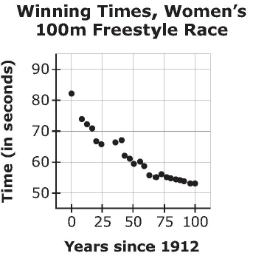
#15
The scatterplot shown represents the winning times for the women’s 100 meter freestyle race for the Olympic Games between 1912 and 2012.
Part A: Let x be the year since 1912 and f(x) be the winning time in seconds. Enter either a linear or an exponential function that models the data in the response box.
Part B: Greta Andersen from Denmark won the race in 1948 with a time of 66.3 seconds. What is the difference between your model’s prediction and Greta’s actual winning time? Enter your answer in the response box.
Part C: What does your model predict the winning time will be in the 2016 Olympics? Enter your answer in the response box.

Slide 31
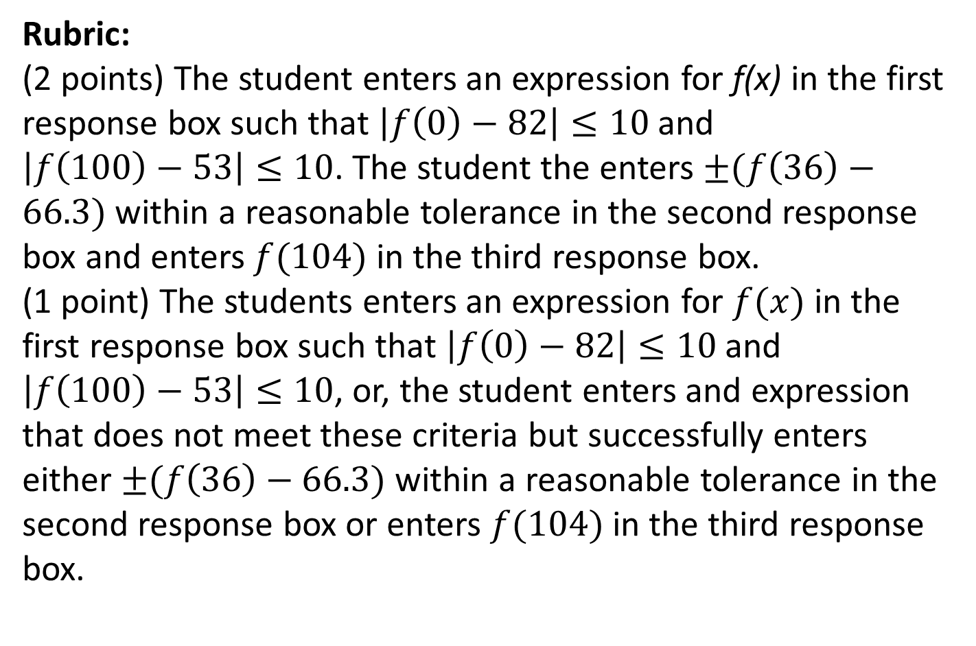
#15 Answer

