Slide 1

High School Claim 3
Smarter Balanced Sample Items
Communicating Reasoning
Questions courtesy of the Smarter Balanced Assessment Consortium Item Specifications – Version 3.0
Slideshow organized by SMc Curriculum – www.ccssmathactivities.com

Slide 2
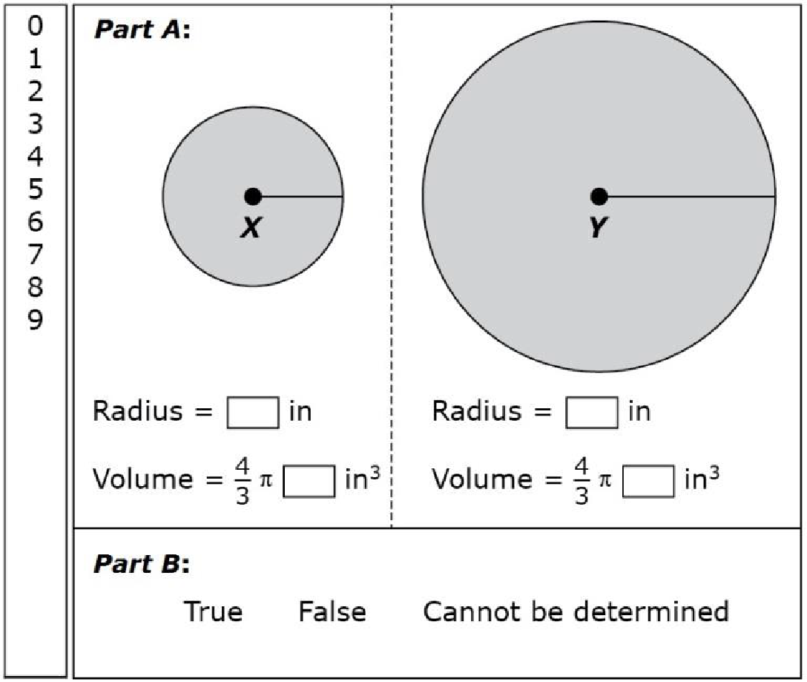
#1
The radius of sphere Y is twice the radius of sphere X. A student claims that the volume of sphere Y must be exactly twice the volume of sphere X.
Part A: Drag numbers into the
boxes to create one example
to evaluate the student’s claim.
Part B: Decide whether the
student’s claim is True, False,
or whether it Cannot be
determined. Select the
correct option.

Slide 3
#1 Answer
Rubric:
(1 point) The student supplies an example of two radii and missing numbers for the volumes that makes the conjecture false.
Answers:
Part A: radii are 1 and 2, missing numbers are 1 and 8; radii are 2 and 4, missing numbers are 8 and 64; radii are 1 and 3, missing numbers are 1 and 27; etc.) Part B: False

Slide 4
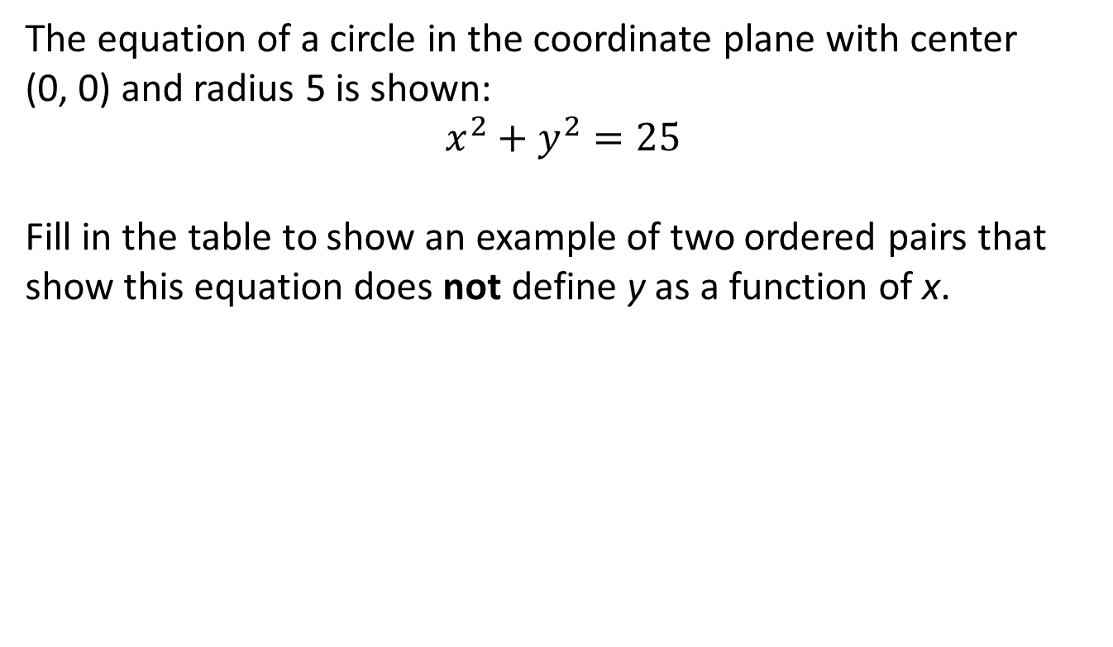
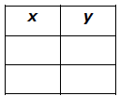
#2

Slide 5
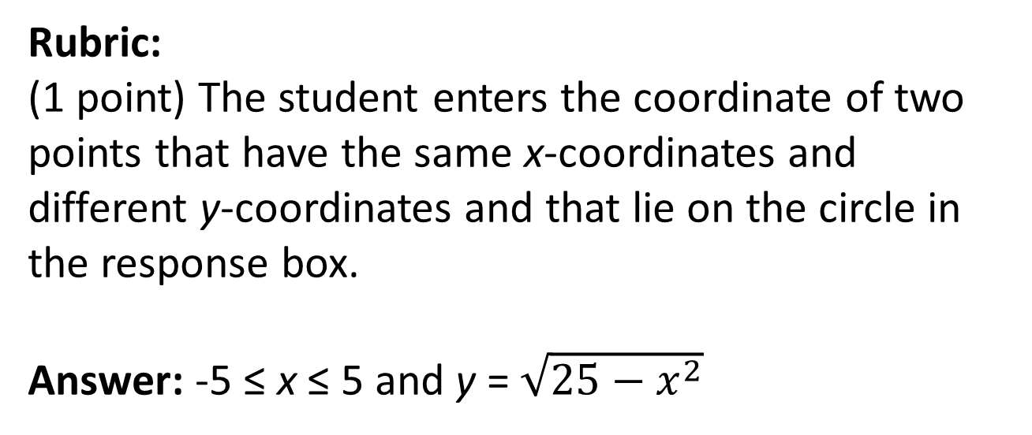
#2 Answer

Slide 6
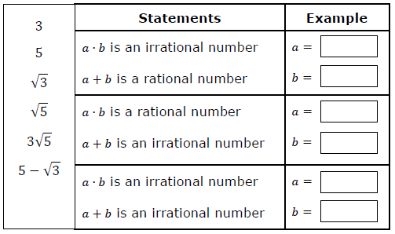
#3
Consider the two numbers a and b as well as their sum and product. Drag values for a and b into the boxes to make the paired statements true for both a ∙ b and a + b. If none of the values make both statements true, leave the boxes empty for that pair of statements.

Slide 7
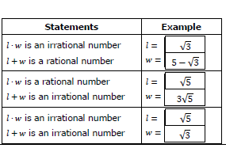
#3 Answer
Rubric:
(1 point) The student drags correct combinations of values that result in the indicated rational and irrational perimeters and areas of the rectangle.
Answer: Other correct responses are possible.

Slide 8

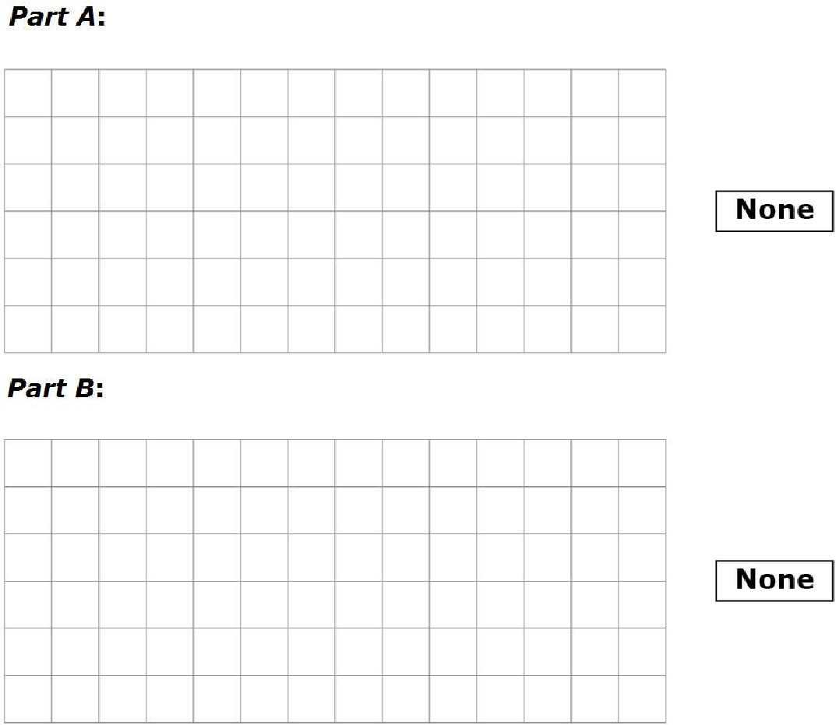
#4
A geometry student made this claim: If
two lines are cut by a transversal, then alternate interior angles are always congruent.
Part A:
Draw a diagram that shows two lines cut by a transversal with alternate interior angles that are congruent or select None
if there is not a situation to support the student’s claim.
Part B:
Draw a diagram that shows two lines cut by a transversal with alternate interior angles that are not congruent or select None if there is not a situation to support the student’s claim.

Slide 9
#4 Answer
Rubric:
(1 point) The student draws a transversal through two parallel lines to create congruent alternate interior angles in Part A and through two non-parallel lines for Part B.

Slide 10
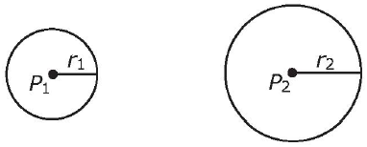
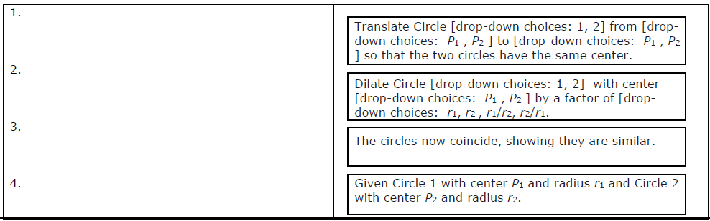
#5
Proposition. All circles are similar.
The four statements can be
completed and ordered to outline
an argument that proves this proposition.

Slide 11
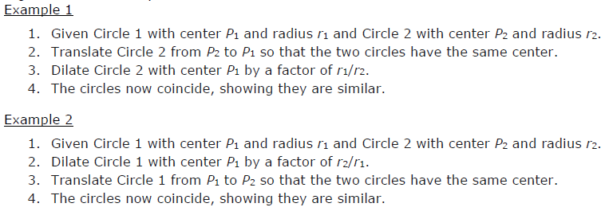
#5 Answer
Rubric:
(2 points) The student completes and orders the four statements that support the claim in a logical order.
(1 point) The student completes and orders the four statements that support the claim in a logical order but either chooses some of the options from the drop-down menus incorrectly or chooses them in a sensible way if the order were correct, but the order is not correct.
Answer: Examples. Note that the order of 2 and 3 can be reversed, but 1 must be first and 4 must be last. Also note that the ordering of 2 and 3 changes the correct center of dilation.

Slide 12
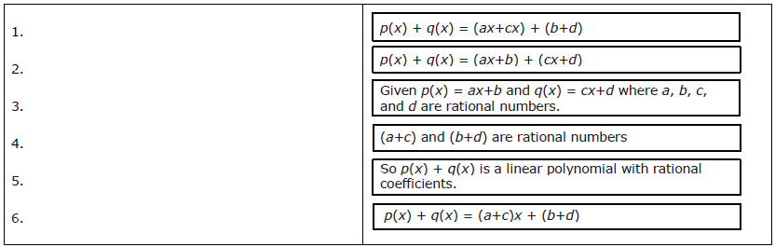
#6
Kiera claimed that the sum of two linear polynomials with rational coefficients is always a linear polynomial with rational coefficients. Drag the six statements into a logical sequence to outline an argument that proves this claim.

Slide 13
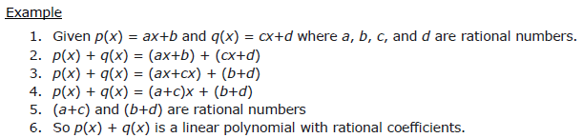
#6 Answer
Rubric:
(1 point) The student completes and orders the six statements that support the claim in a logical order.
Answer: Note that 1 must come first, 6 must come last, the order of 2, 3, 4 must be preserved but 5 can go anywhere in between 1 and 6.

Slide 14
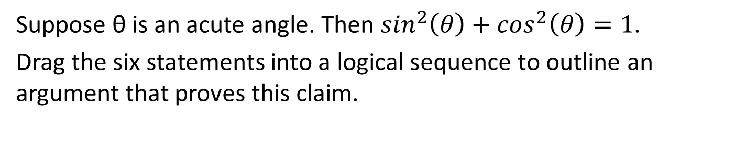
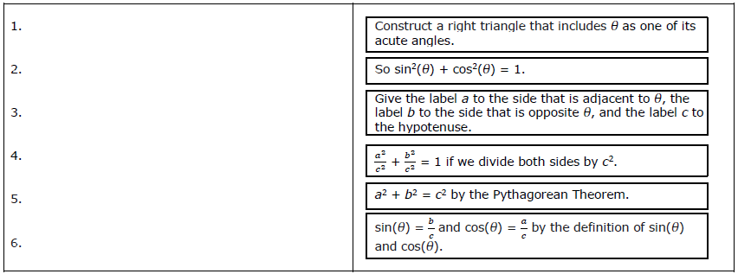
#7

Slide 15
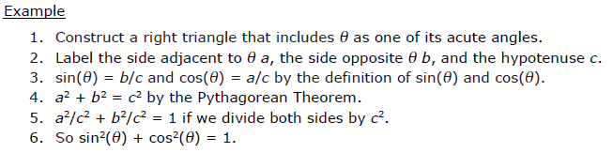
#7 Answer
Rubric:
(1 point) The student completes and orders the six statements that support the claim in a logical order.
Answer: Note that 1 and 2 must come first, 5 and 6 must come last, but the order of 3 and 4 can be switched.

Slide 16
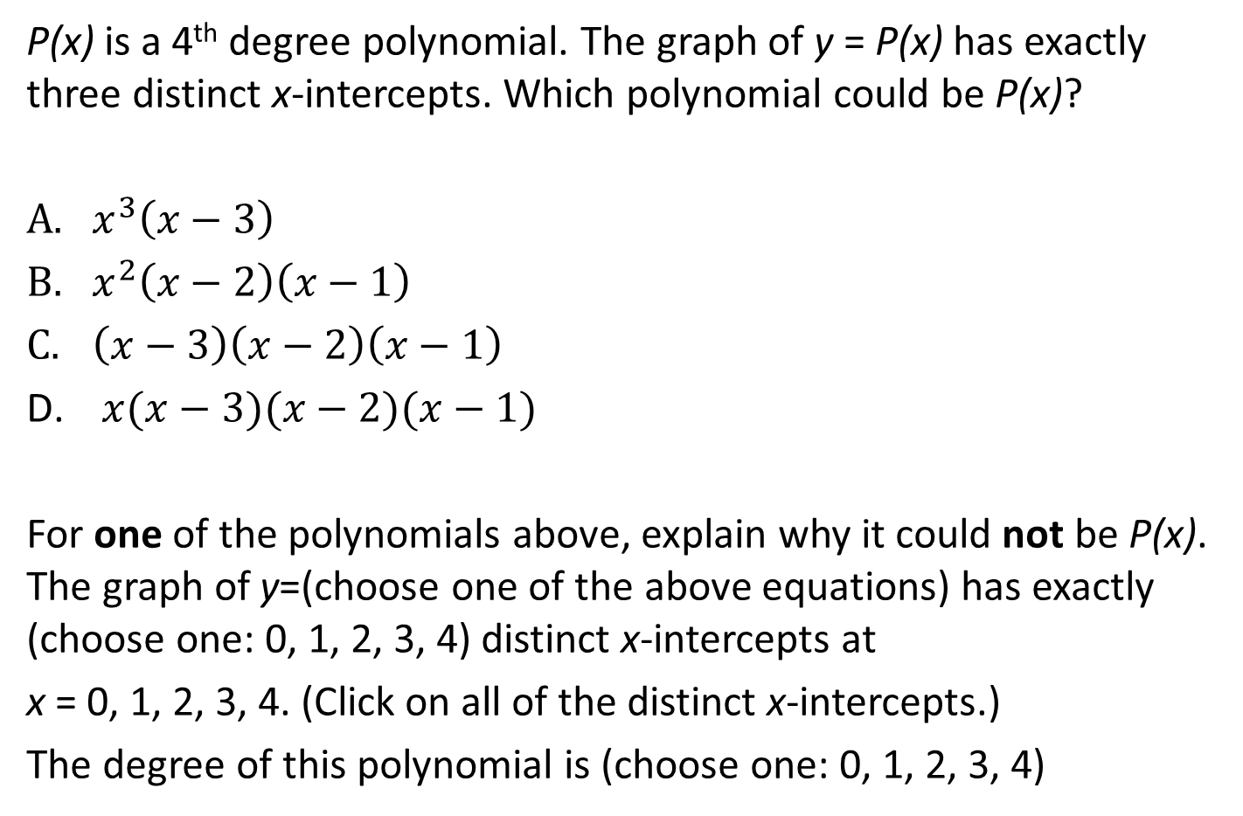
#8

Slide 17
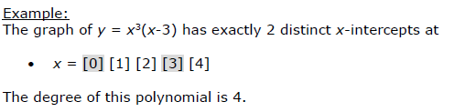
#8 Answer
Rubric:
(2 points) The student clicks on the correct polynomial and selects one of the polynomials, identifies the correct number of distinct x-intercepts, correctly identifies the x-intercepts, and correctly identifies the degree of the polynomial.
(1 point) The student clicks on the polynomials that could be P(x) or fills out the information about one of the polynomials correctly.
Answer: B

Slide 18
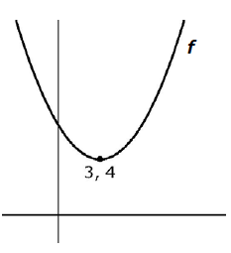
#9
The graph of a quadratic function f is shown and the vertex is labeled with its coordinates. If g(x) = f(x – 1) + 2, what is the minimum value of g?
The minimum value of g is (choose one: 1, 2, 3, 4, 5, 6) because the minimum value for f is (choose one: 1, 2, 3, 4, 5, 6) and the graph of g is shifted (choose one: up, down, left, right) from the graph of f by (choose one: 1, 2, 3, 4, 5, 6) units in addition to the other shift.

Slide 19
#9 Answer
Rubric:
(1 point) The student selects the correct choices from the drop-down menus.
Answer: 6; 4; up; 2 or 6; right; 1

Slide 20
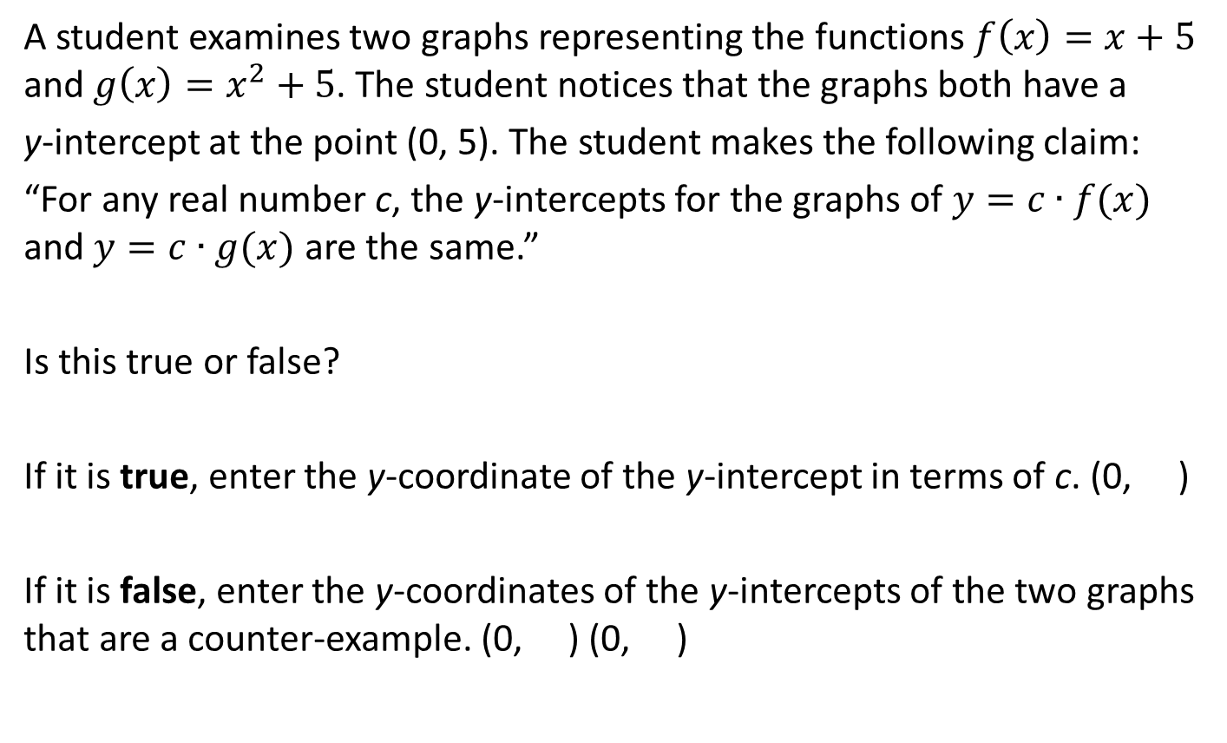
#10

Slide 21
#10 Answer
Rubric:
(1 point) The student is able to identify the correct y-coordinate of the y-intercept and enter it into the first response box.
Answer: 5c

Slide 22
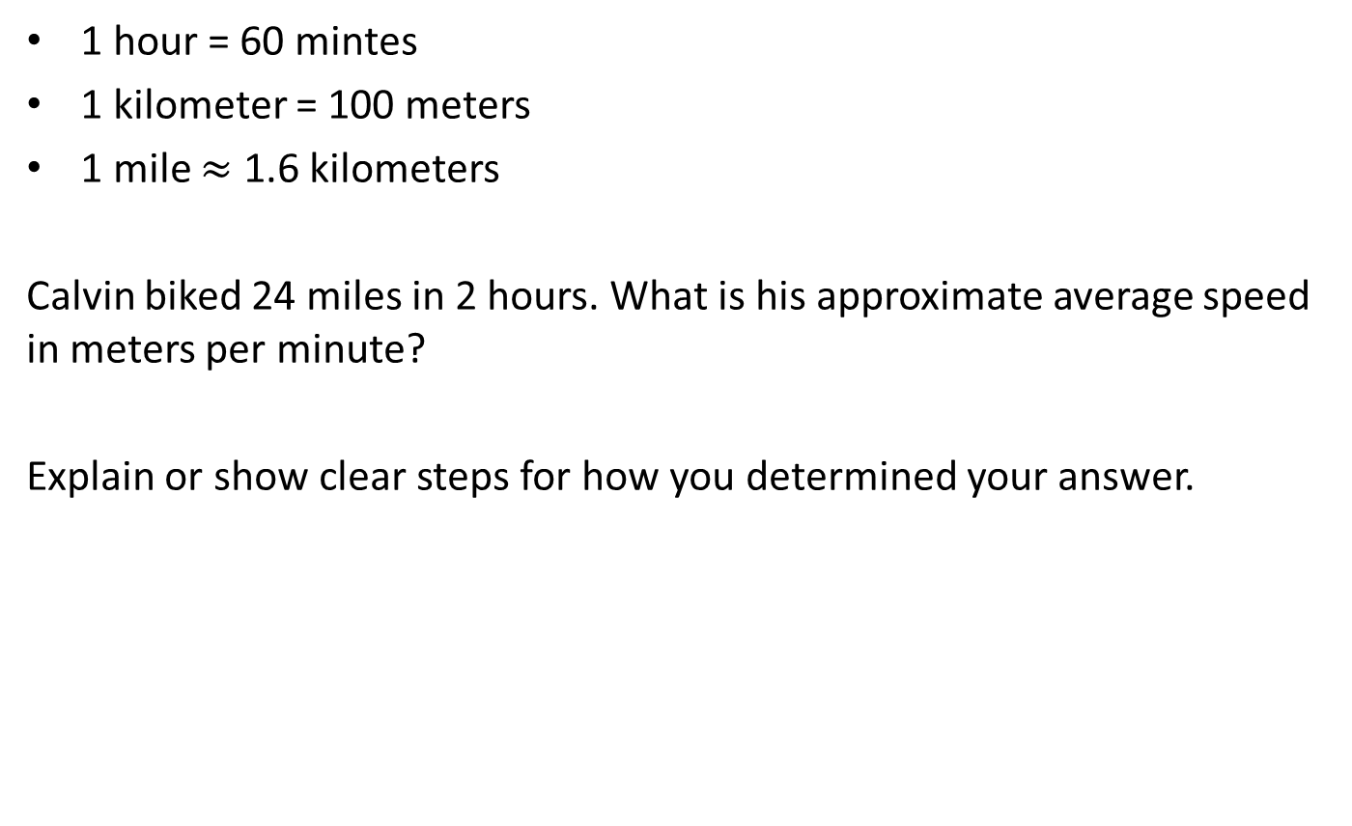
#11

Slide 23
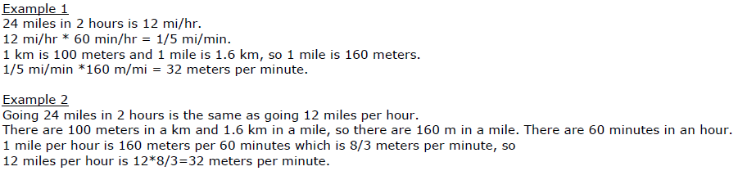
#11 Answer
Rubric:
(2 points) The student enters the correct numeric value in the response and enters a coherent, complete explanation or sequence of computations that shows where this comes from.
(1 point) The student enters the correct numeric value in the response but does not provide a coherent explanation OR the student enters a different number in the response but includes an explanation that shows an understanding of how the answer could be found, but with some computational errors or a small misstep in reasoning.
Answer: 32

Slide 24
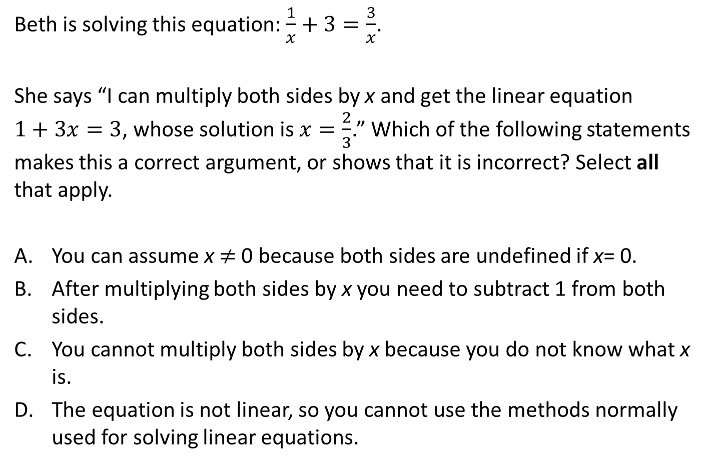
#12

Slide 25
#12 Answer
Rubric:
(1 point) The student selects the correct option.
Answer: A, or A and B

Slide 26

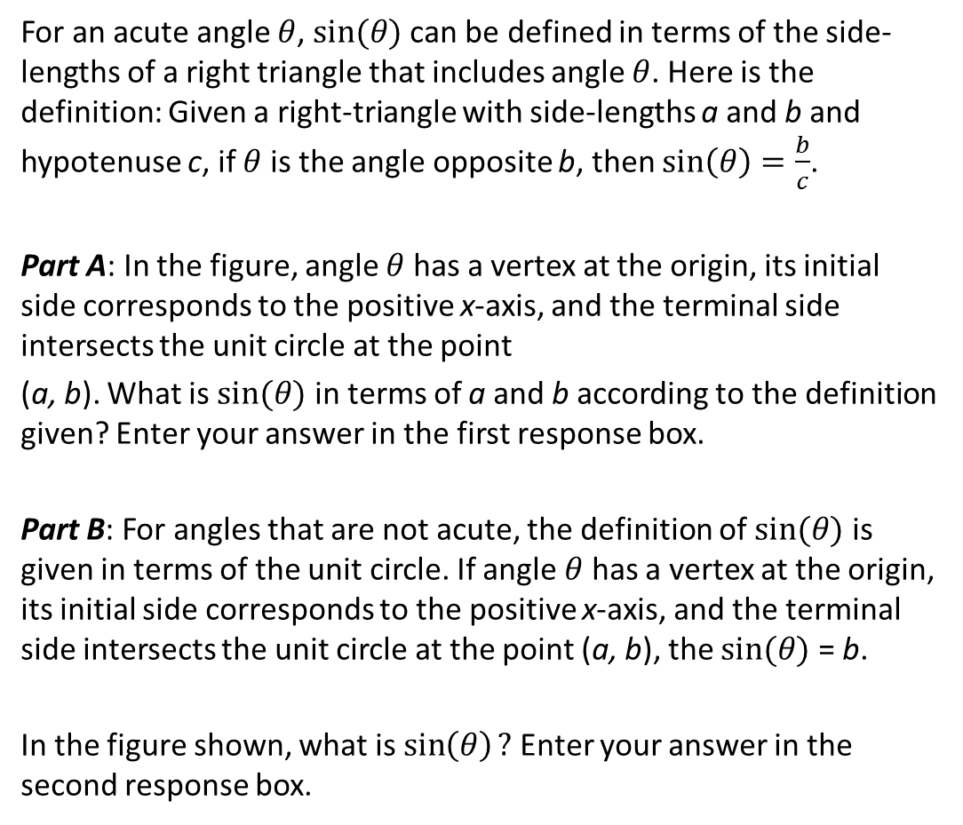
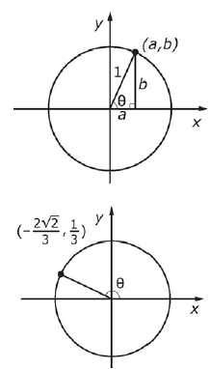
#13

Slide 27
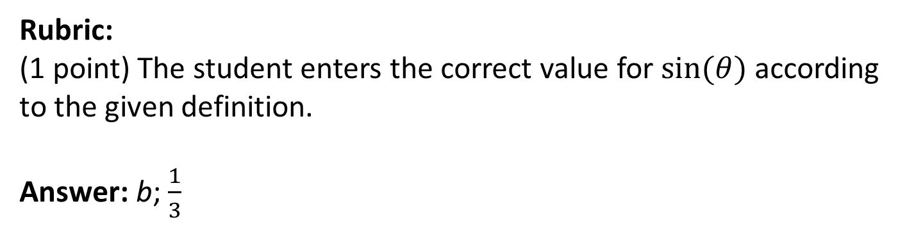
#13 Answer

Slide 28
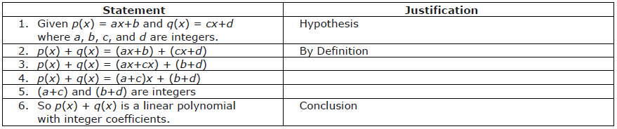
#14
Proposition 1 The sum of two linear polynomials with integer coefficients is always a linear polynomial with integer coefficients.
The Closure of the Integers Under Addition The sum of two integers is always an integer
The Commutative Property If A and B are real numbers, then A + B = B + A
The Associative Property If A, B, and C are real numbers, then (A + B) + C = A + (B + C)
The Distributive Property If A, B and C are real numbers, then A(B + C) = AB + AC
The Any-Order Property of Addition The sum of two or more real numbers can be performed in any order or any grouping.
The outline of a proof of Proposition 1 is shown. Add one or more justifications for steps 3, 4, and 5 of the proof.

Slide 29
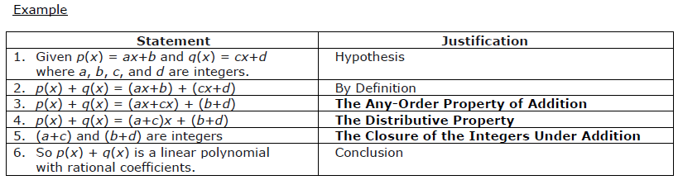
#14 Answer
Rubric:
(1 point) The student provides a correct justification for each step of the proof.
Answer: Note that for step (3), students can either cite the any-order property of addition or cite the commutative and associative properties together.

Slide 30
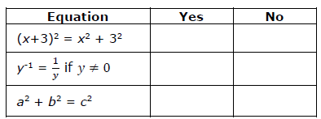
#15
An algebraic identity is an equation that is always true for any value of the variables. For example, 2(x + y) = 2x + 2y is an identity because of the distributive property. For each equation, select “Yes” if the equation in an algebraic identity. Select “No” if it is not an algebraic identity.

Slide 31
#15 Answer
Rubric:
(1 point) The student correctly indicates which equation is an identity and which is not.
Answer: N, Y, N

Slide 32
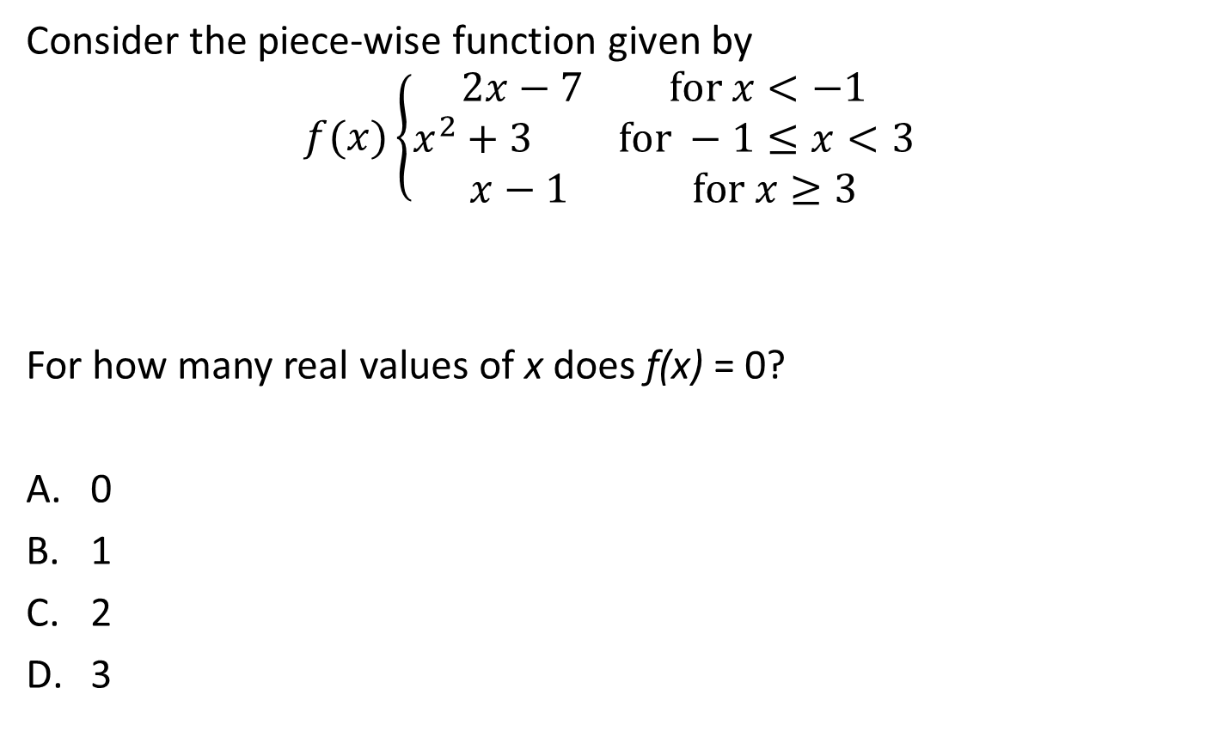
#16

Slide 33
#16 Answer
Rubric:
(1 point) The student selects the correct number of zeros for the function.
Answer: A

Slide 34
#17
An arithmetic sequence is a sequence in which the difference between any two consecutive terms is the same. For example, the sequence 2, 9, 16, 23, 30, 37 is an arithmetic sequence because the difference between any two consecutive numbers is 7.
Suppose that an arithmetic sequence of integers starts with a 5 and also later includes an 11.
5, …?..., 11, _____
Which number could not be the term that immediately follows 11 in the sequence?
12
13
14
15
17

Slide 35
#17 Answer
Rubric:
(1 point) The student selects the number that could not be the next term in an arithmetic sequence.
Answer: D

Slide 36
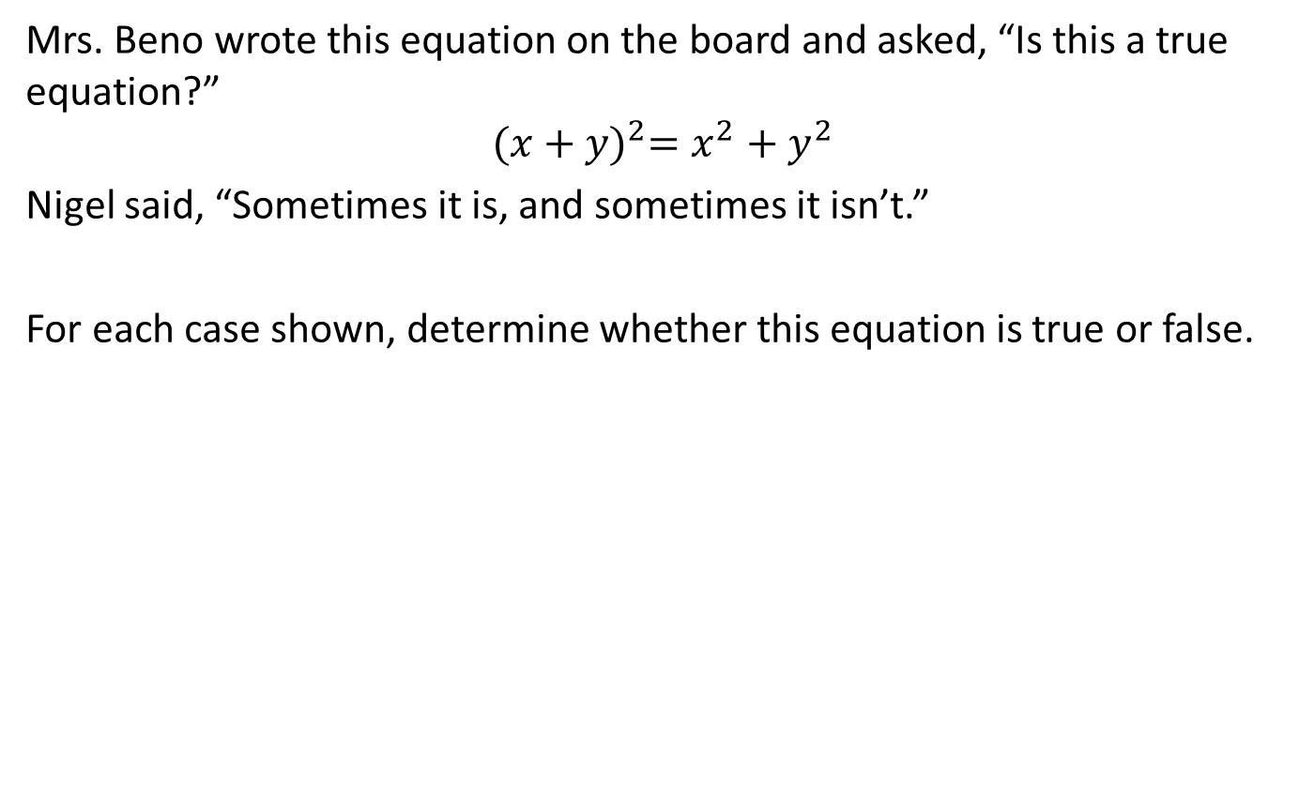
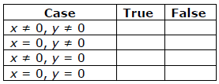
#18

Slide 37
#18 Answer
Rubric:
(1 point) The student correctly indicates which conditions make the equation true and which makes it false.
Answer: F, T, T, T

Slide 38
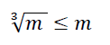
#19
Consider this inequality:
Part A: Determine the positive values of m for which the inequality is true. Enter your response as an inequality in the first response box.
Part B: Determine the positive values of m for which the inequality is false. Enter your response as an inequality in the second response box.

Slide 39
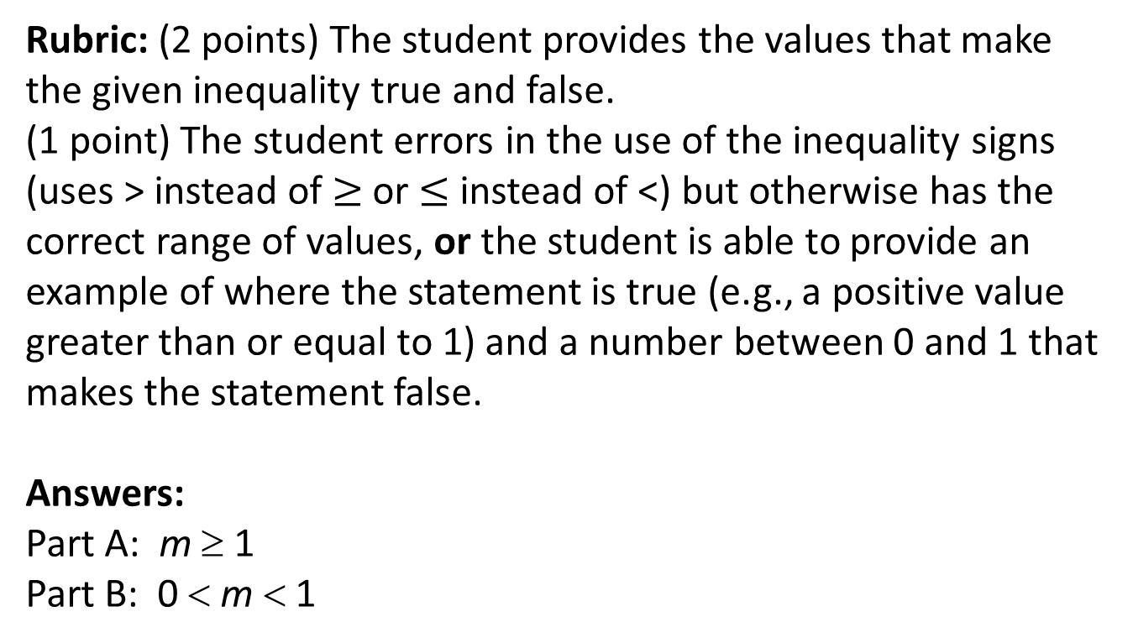
#19 Answer

Slide 40
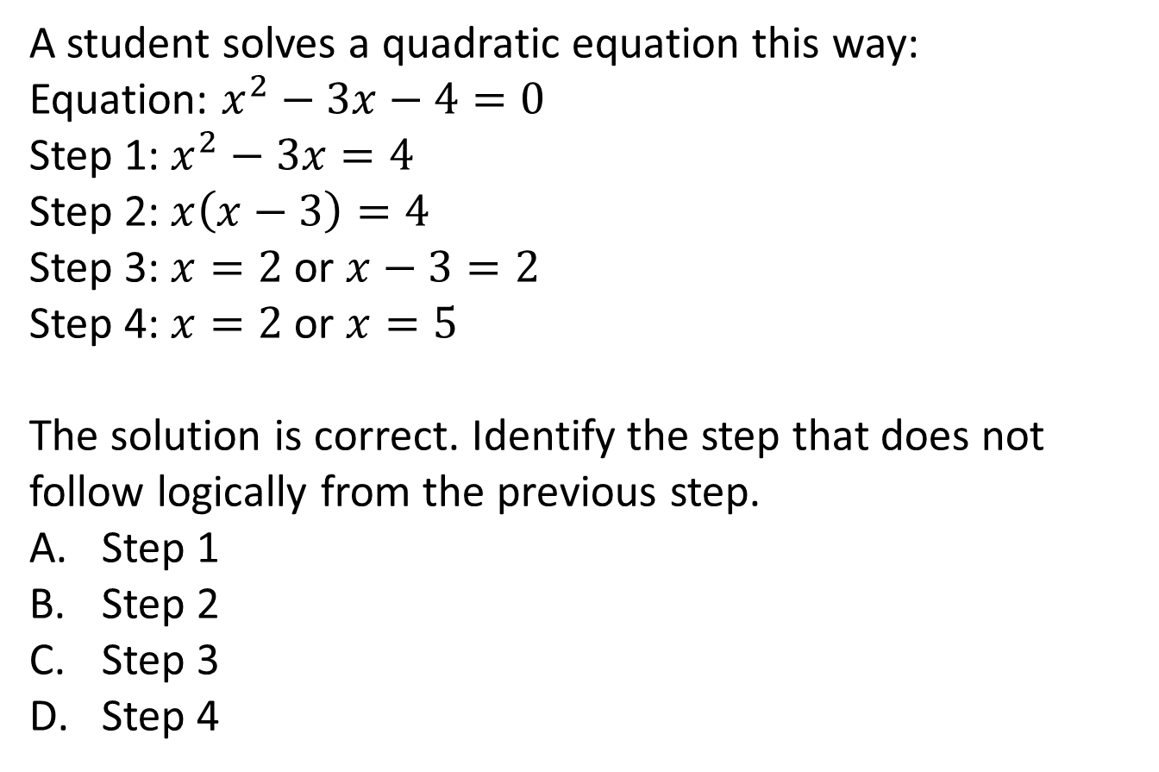
#20

Slide 41
#20 Answer
Rubric:
(1 point) Student selects the incorrect step
Answer: C

Slide 42
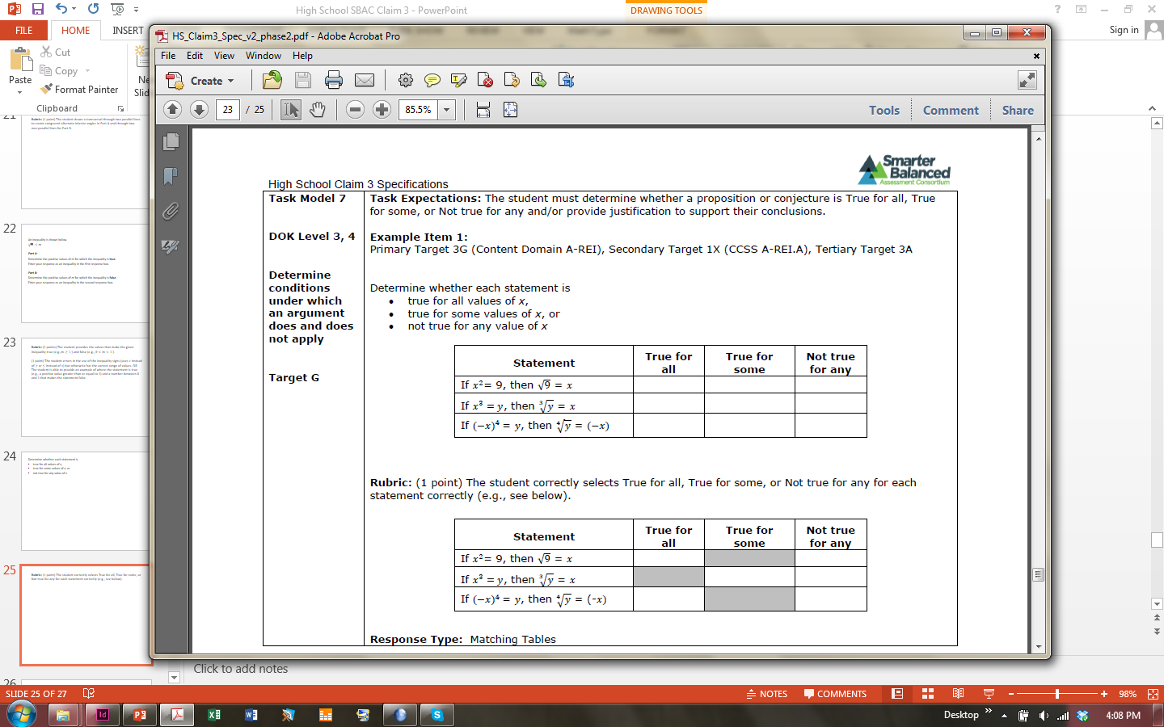
#21
Determine whether each statement is
true for all values of x,
true for some values of x, or
not true for any value of x.

Slide 43
#21 Answer
Rubric:
(1 point) The student correctly selects True for all, True for some, or Not true for any for each statement correctly.
Answer:

Slide 44
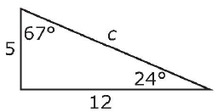
#22
Brandon uses the following reasoning to find the length c of the third side in the triangle shown.
“The two legs of the triangle are 5 and 12. I know by the Pythagorean Theorem that 5² + 12² = c². I calculate 5² + 12² = 25 + 144 = 169. My calculator says that the square root of 169 is 13, so c= 13.”
Which statement is true about this reasoning?
Brandon’s reasoning is correct.
The Pythagorean Theorem does not apply to this triangle.
The Pythagorean Theorem applies, but Brandon made a calculation error.
It is true that c = 13, but Brandon’s reasoning is incorrect because used a calculator.

Slide 45
#22 Answer
Rubric:
(1 point) The student selects the correct answer.
Answer: B

Slide 46
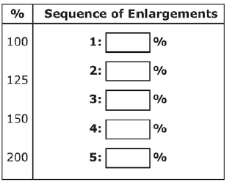
#23
Sherry wants to enlarge a photograph to 300% of its original size. The machine she is using can only make
enlargements for the following
percentages: 100%, 125%,
150%, and 200%. Sherry thinks
that she should enlarge the
photograph by 100% and then
by 200% to get a total enlargement
of 300%.
Decide if Sherry is correct. If Sherry is correct, drag the 100 and 200 from the palette into the first two answer spaces. If Sherry is incorrect, drag a sequence of enlargements she can use to get a total enlargement of 300%. Each enlargement percentage may be used more than once. If a sequence is not needed, leave the box blank.

Slide 47
#23 Answer
Rubric:
(1 point) The student drags the percentages into the appropriate boxes to show Sherry is incorrect.
Answer: 250, 150; other correct responses are possible.

Slide 48
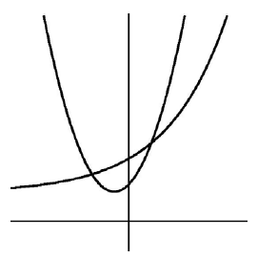
#24
The two graphs shown represent the equations y = P ∙ b^{x} and
y = a(x – h)² + k, where a, b > 0, and h, k and P are rational numbers.
Which statement best describes the number of solutions the equation P ∙ b^{x} = a(x – h)² + k has and why?
There is only one solution because b can’t be negative.
There are no solutions to this equation because you can’t solve it.
There are exactly two solutions because the graphs intersect twice.
There could be three solutions because the graphs might intersect at a third point.

Slide 49
#24 Answer
Rubric:
(1 point) The student selects the correct answer.
Answer: D

Slide 50
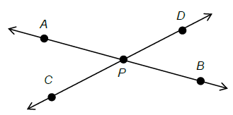
#25
The line through A and B intersects the line through C and D at point P, as shown in the figure. Prove that angle APC is congruent to angle BPD.

Slide 51
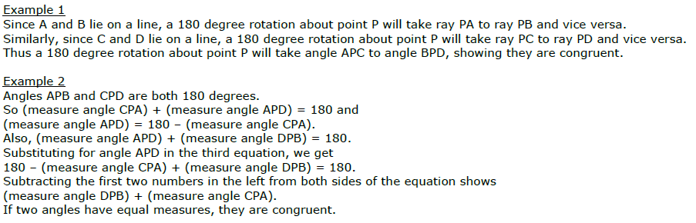
#25 Answer
Rubric:
(2 points) The student gives a correct argument for the angle congruence.
(1 point) The student gives a response that shows some understanding of a correct argument, but some details are missing or unclear.
Answer: Examples:

