Slide 1

Claim 1
Smarter Balanced Sample Items
High School - Target P
Summarize, represent, and interpret data on a single count or measurement variable.
Questions courtesy of the Smarter Balanced Assessment Consortium Item Specifications – Version 3.0
Slideshow organized by SMc Curriculum – www.ccssmathactivities.com
Notes:
‹#›

Slide 2

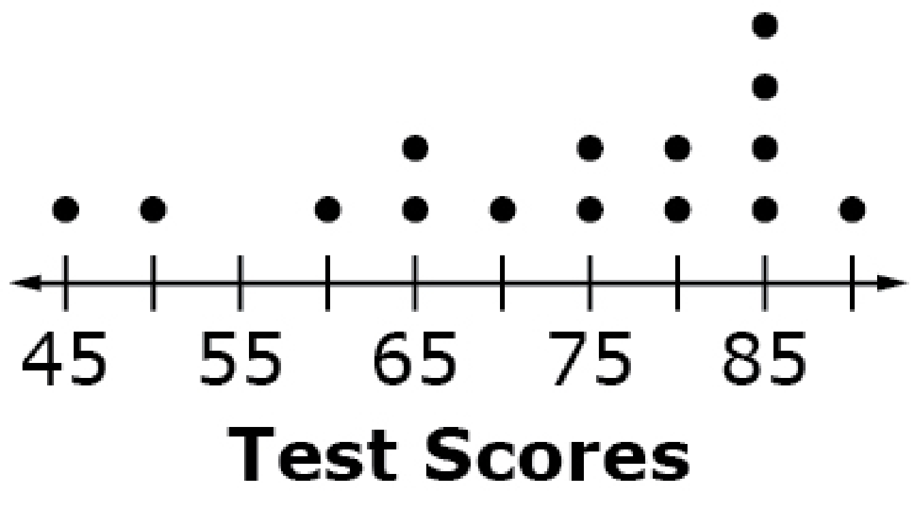
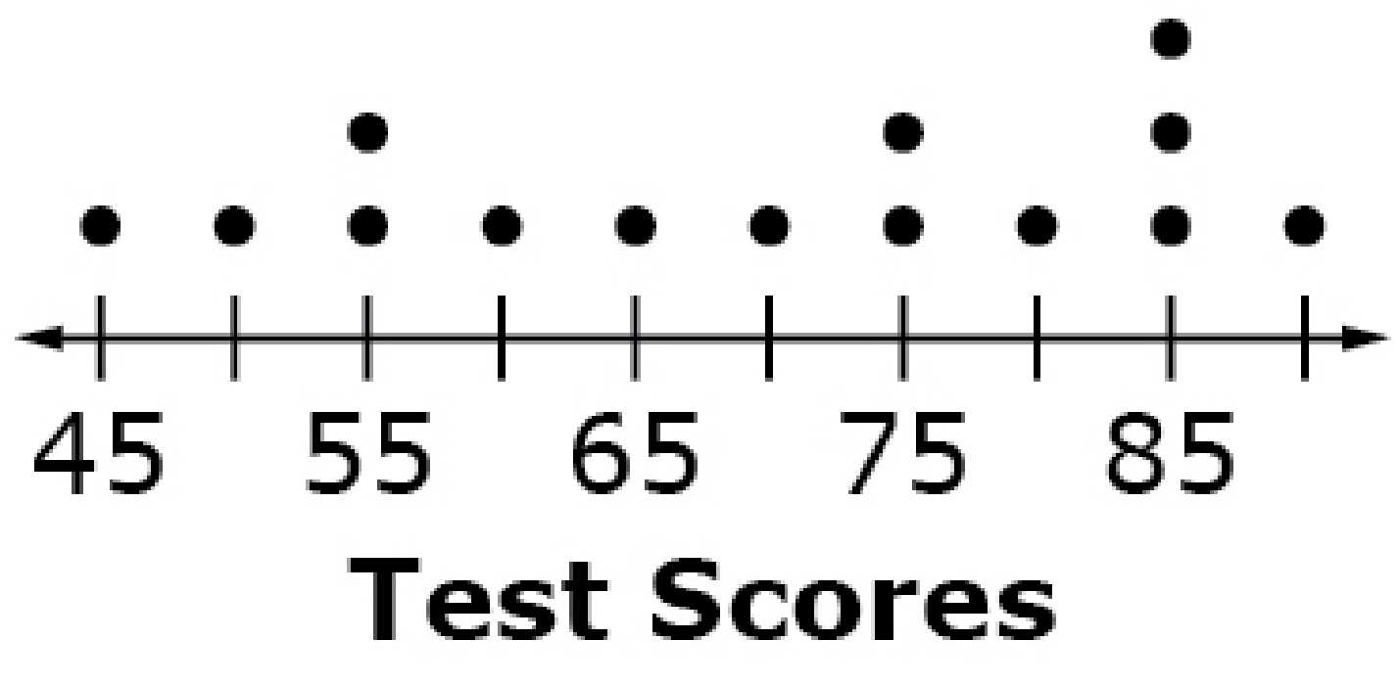
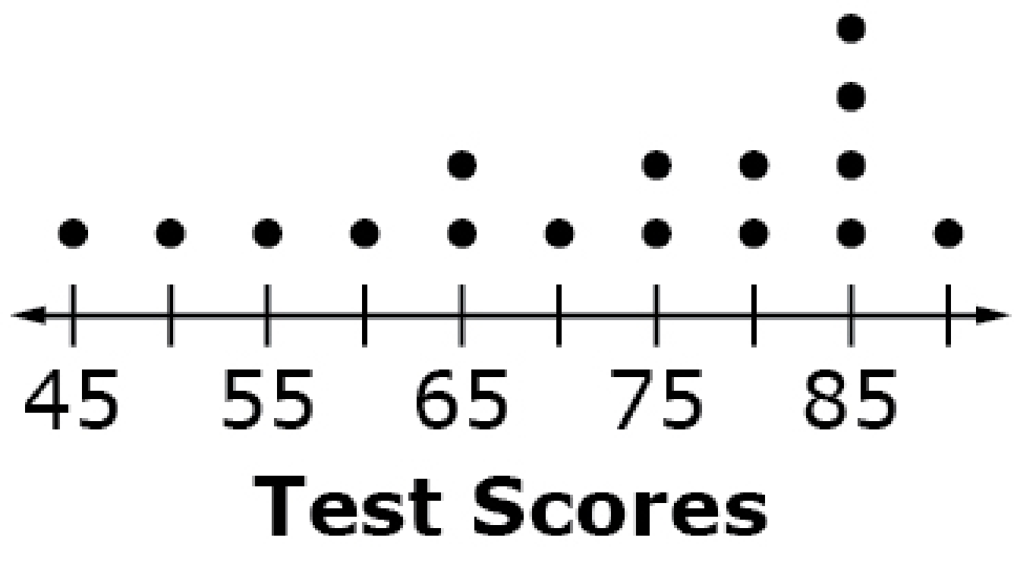
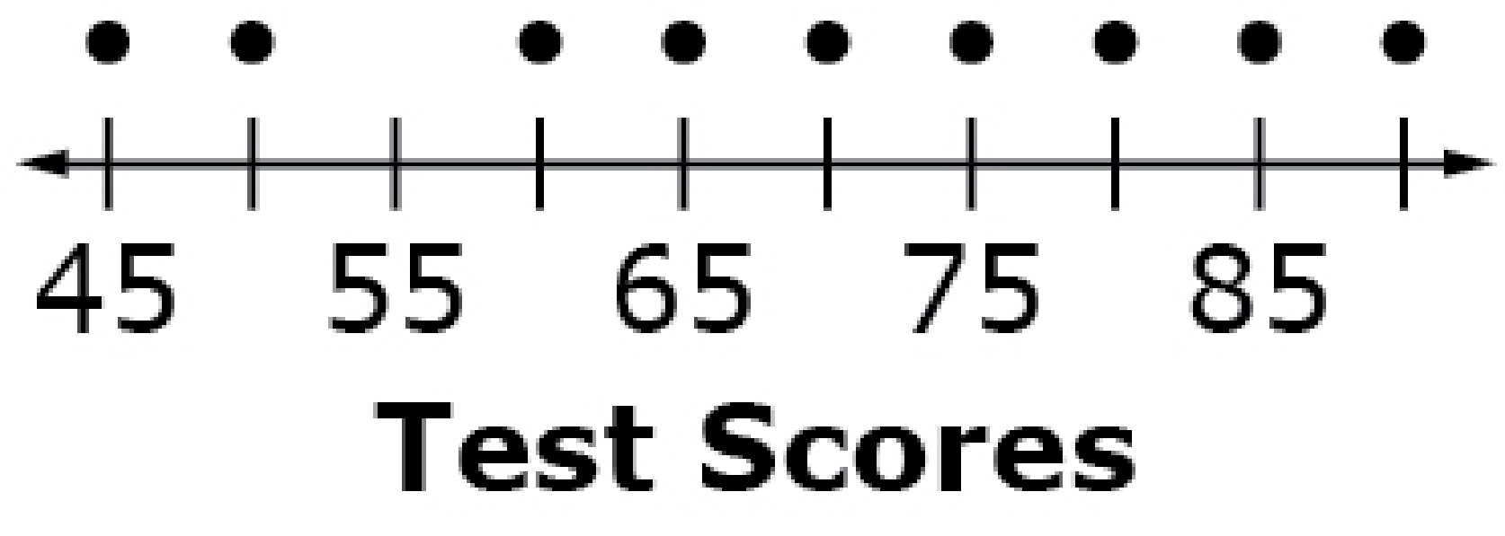
#1
Select the dot plot that represents the given test scores.
90, 45, 85, 70, 85, 50, 75, 85, 65, 75, 60, 85, 80, 65, 80
A. B.
C. D.
Notes:
‹#›

Slide 3

#1 Answer
Rubric:
(1 point) The student selects the correct option.
Answer: A
Notes:
‹#›

Slide 4
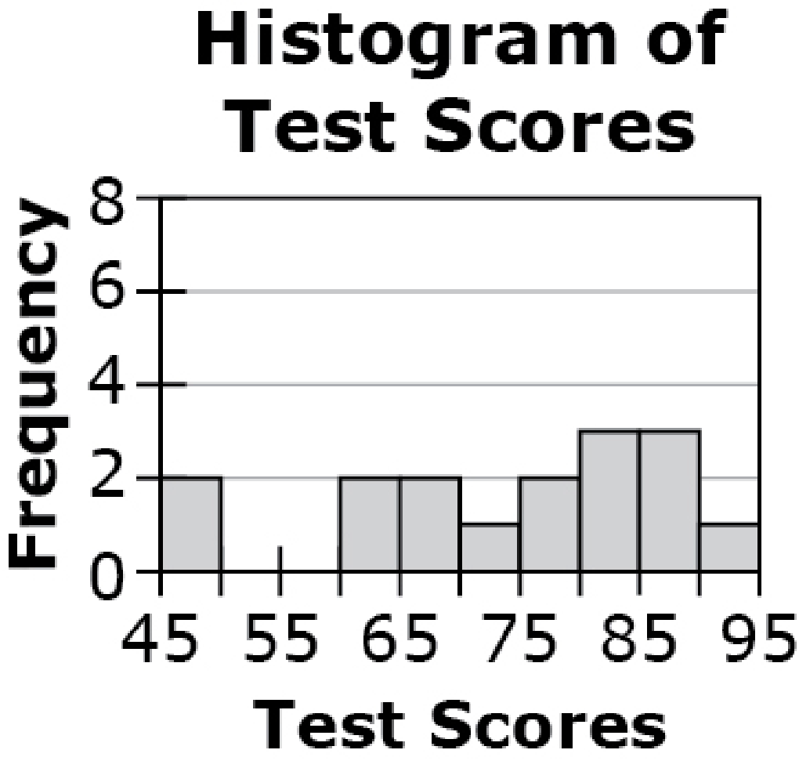
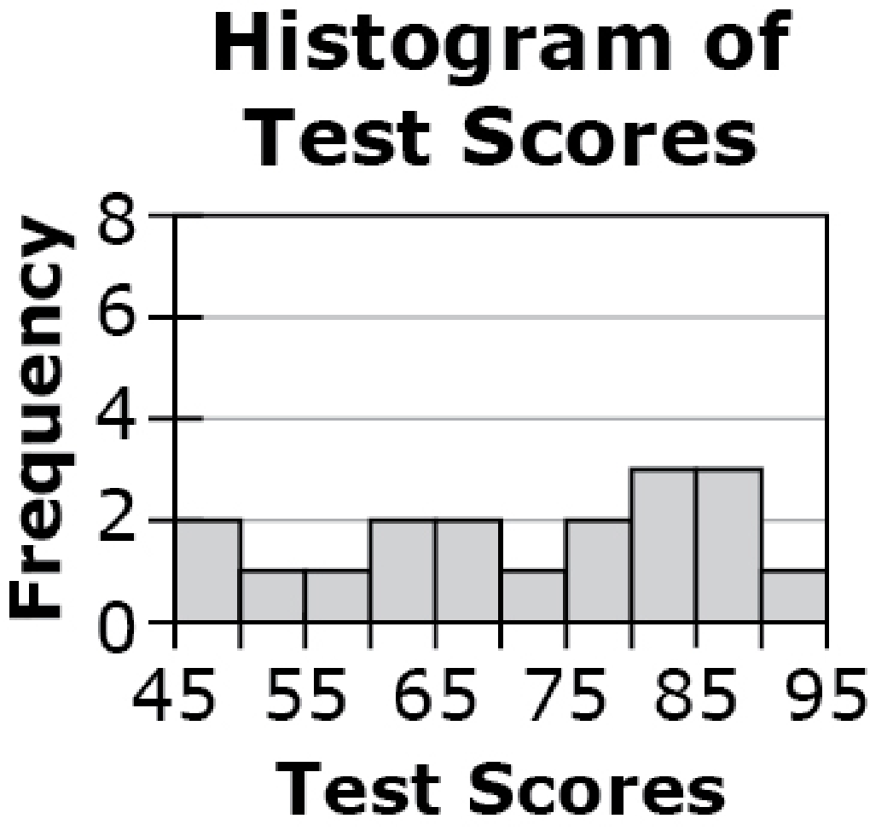
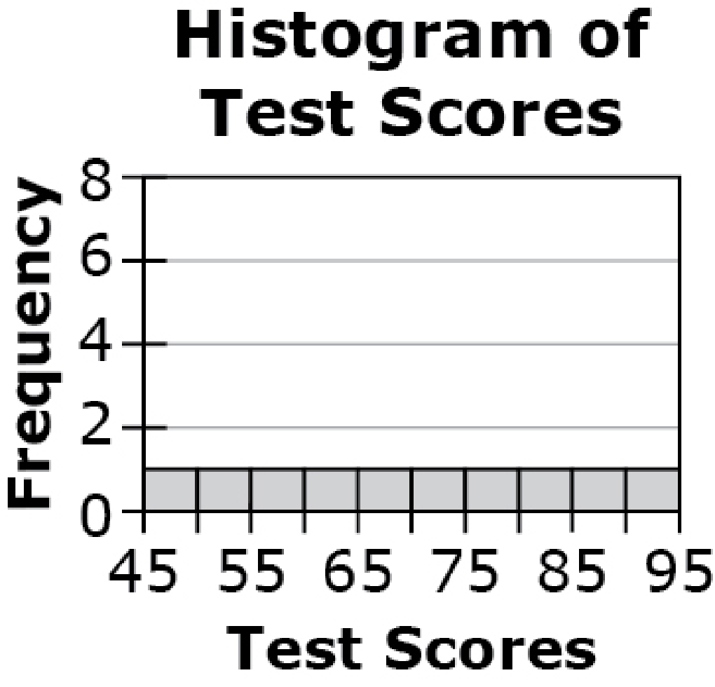
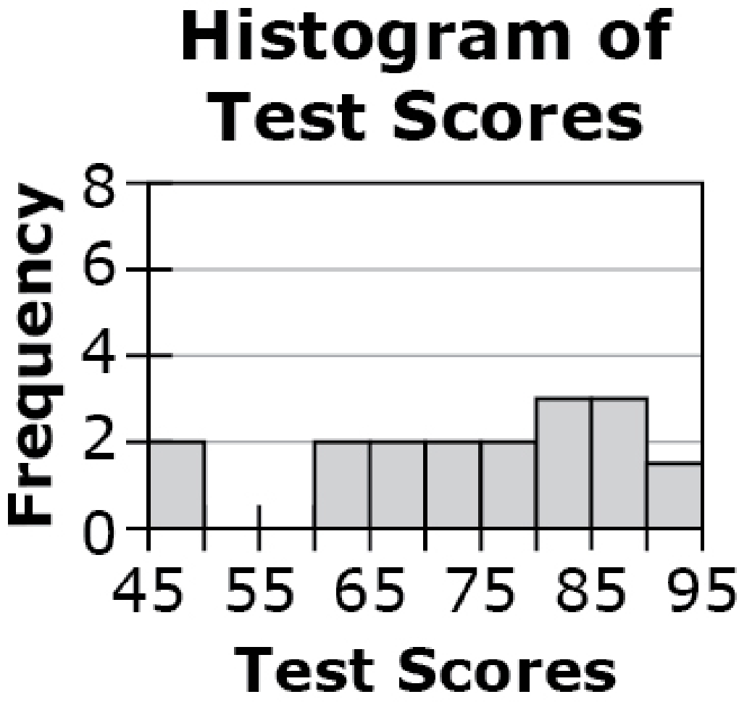
#2
Select the histogram that represents the given test scores.
91, 48, 86, 73, 86, 49, 77, 86, 64, 78, 64, 82, 68, 82, 68, 82
A. B.
C. D.
Notes:
‹#›

Slide 5
#2 Answer
Rubric:
(1 point) The student selects the correct option.
Answer: A
Notes:
‹#›

Slide 6
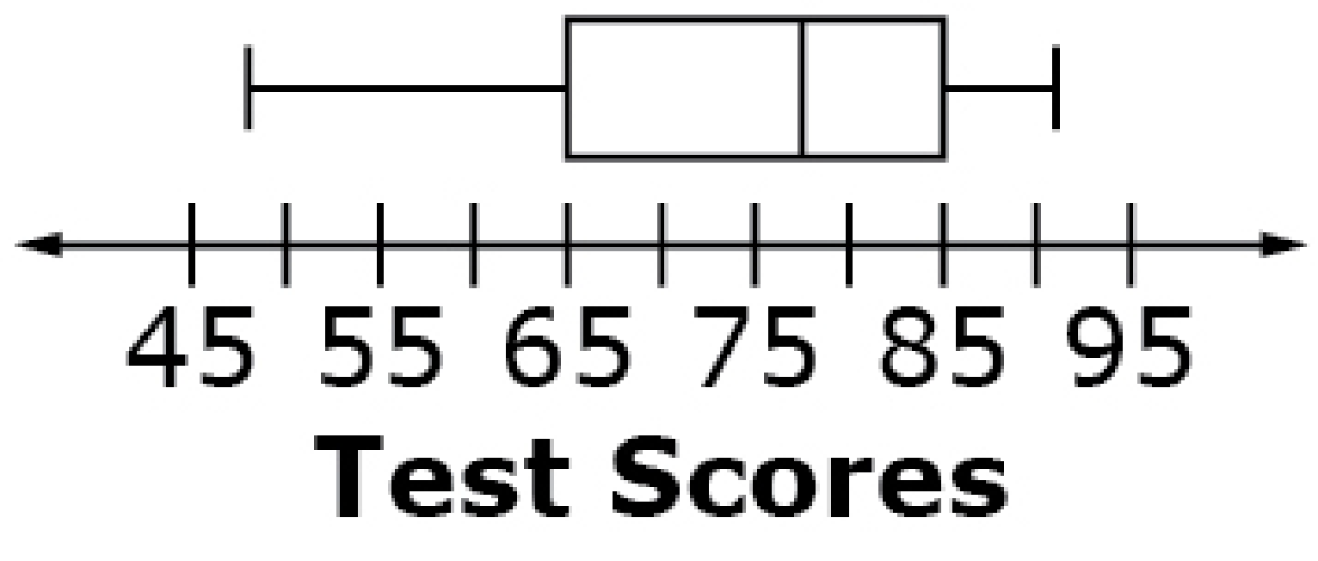
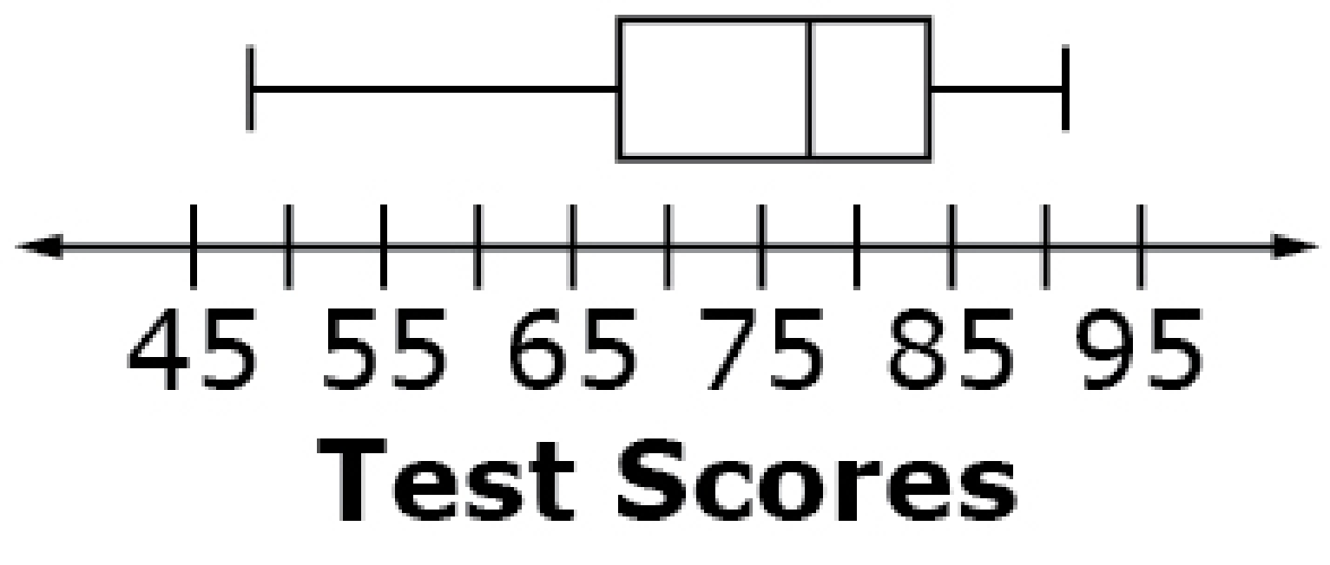
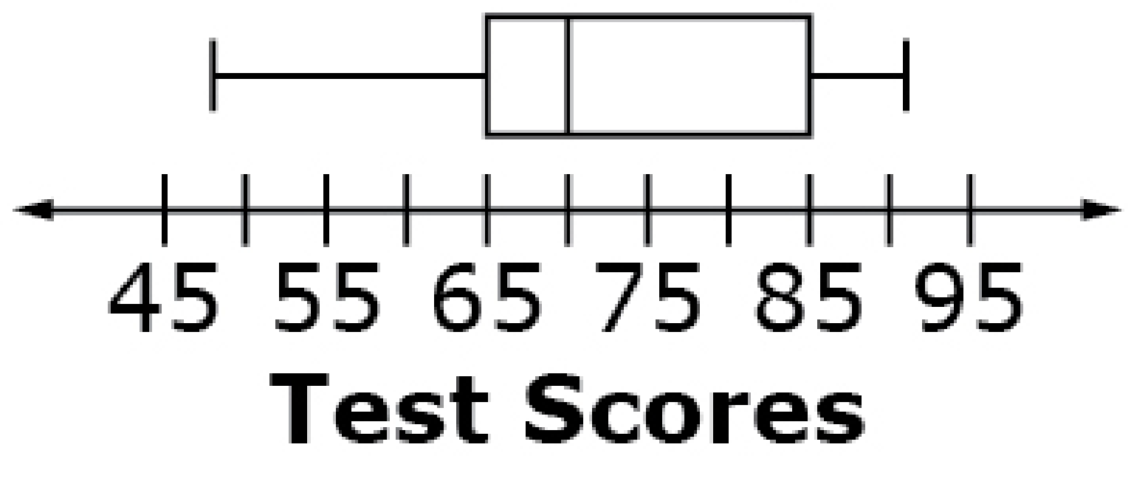

#3
Select the box plot that represents the given test scores.
48, 50, 64, 64, 68, 68, 73, 77, 78, 82, 82, 82, 86, 86, 86, 91
A. B.
C. D.
Notes:
‹#›

Slide 7
#3 Answer
Rubric:
(1 point) The student selects the correct option.
Answer: A
Notes:
‹#›

Slide 8
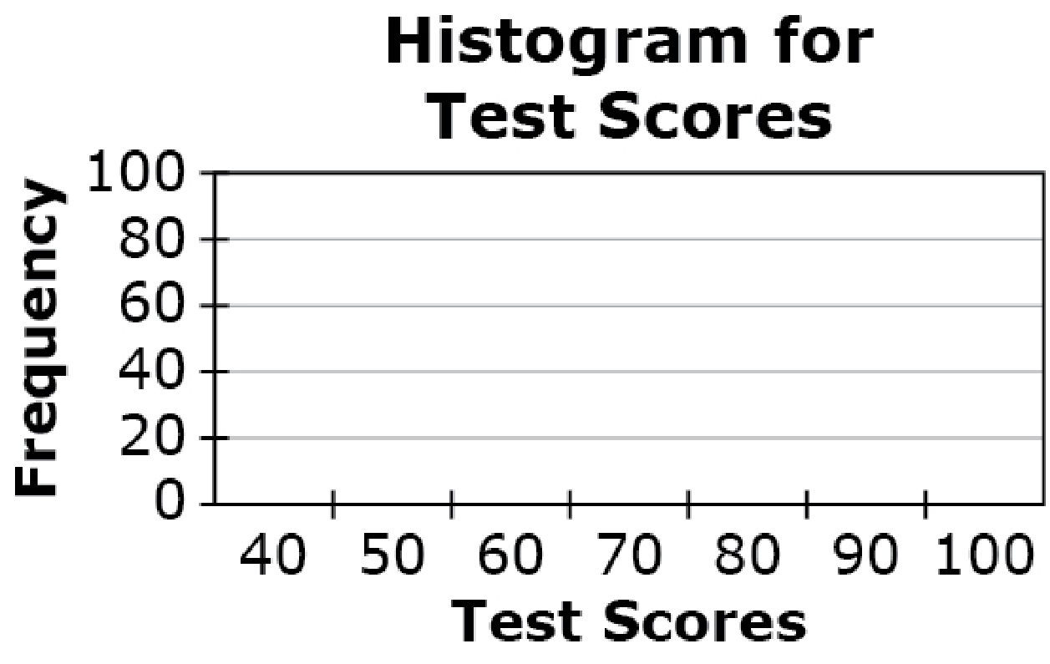
#4
Click above the numbers to create a histogram for the given test scores.
91, 48, 86, 73, 86, 50, 77, 86, 64, 78, 64, 82, 68, 82, 68, 82

Slide 9
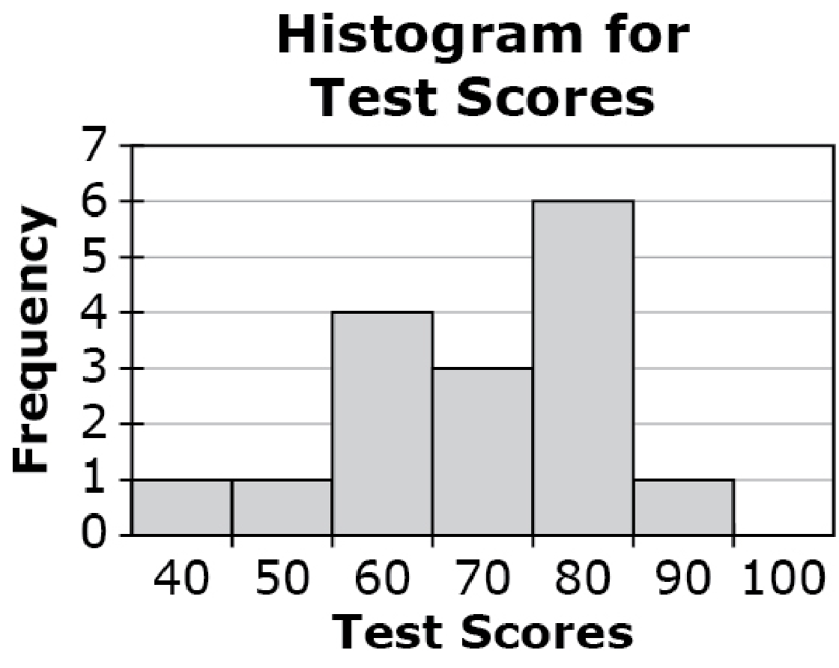
#4 Answer
Rubric:
(1 point) Student gets 100% correct.
Answer:

Slide 10

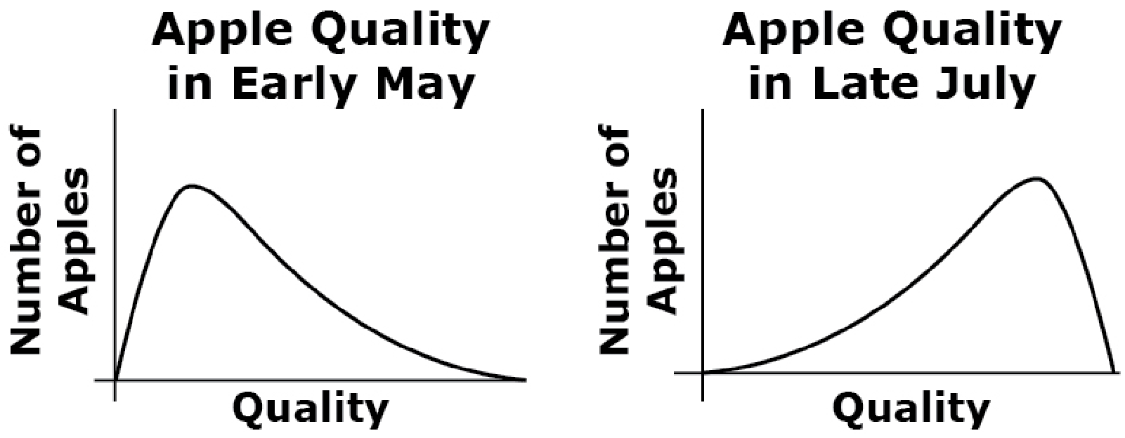
#5
Data distributions are shown for the taste quality of a farm’s red apples at different points in time during the harvest season.
Which summary statistics should be best to use to compare the two data sets and why?
The median and the interquartile range because the data sets are normally distributed.
The median and the interquartile range because both data sets are skewed.
The mean and standard deviation because the data sets are normally distributed.
The mean and standard deviation because both data sets are skewed
Notes:
‹#›

Slide 11
#5 Answer
Rubric:
(1 point) The student selects the correct option.
Answer: B
Notes:
‹#›

Slide 12
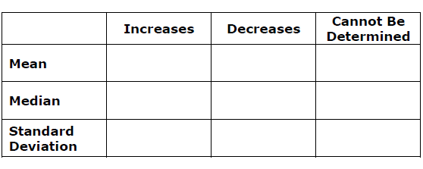
#6
A car dealership has 41 cars for sale. The least expensive car costs $11,999. The most expensive car costs $19,499. Another car, priced at $33,499, is added to the dealership’s inventory. Select whether the value of each statistic, for the prices of the cars, increases, decreases, or cannot be determined when the new car is added.

Slide 13
#6 Answer
Rubric:
(1 point) Student selects all of the correct options.
Answer: Increases, Cannot Be Determined, Increases.

