Slide 1

Claim 1
Smarter Balanced Sample Items
High School - Target O
Define trigonometric ratios and solve problems involving right triangles.
Questions courtesy of the Smarter Balanced Assessment Consortium Item Specifications – Version 3.0
Slideshow organized by SMc Curriculum – www.ccssmathactivities.com
Notes:
‹#›

Slide 2

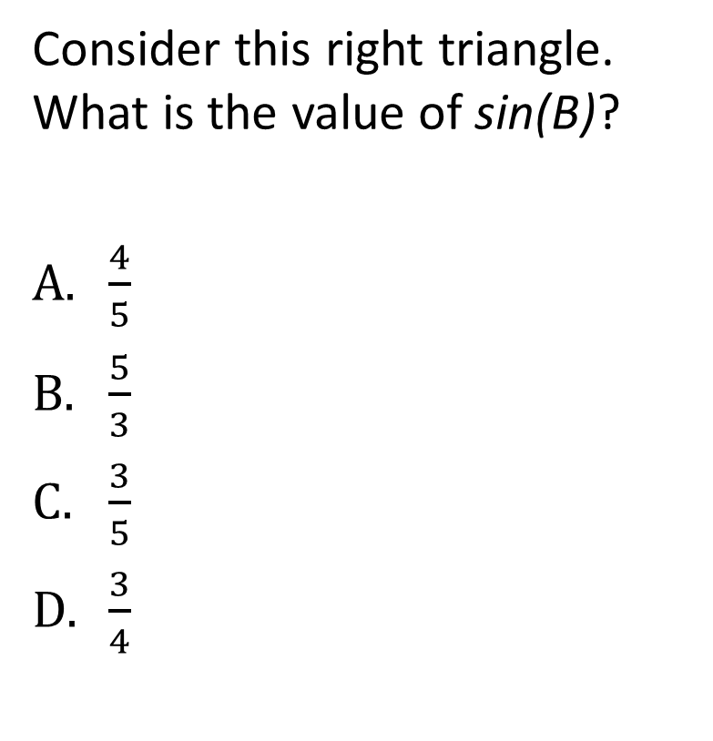
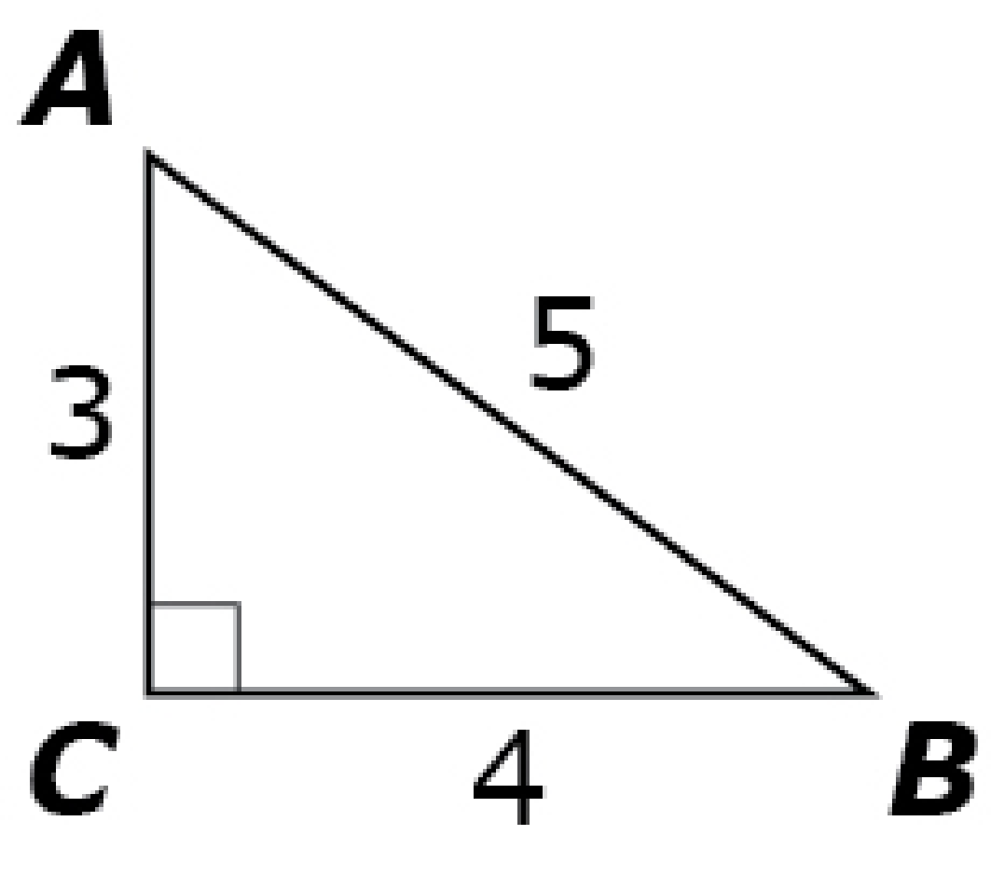
#1
Notes:
‹#›

Slide 3

#1 Answer
Rubric:
(1 Point) The student selects the correct number.
Answer: C
Notes:
‹#›

Slide 4
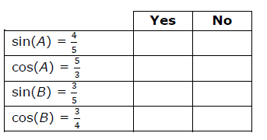
#2
Consider this right triangle.
Determine whether each equation
is correct. Select Yes or No for each
equation.
Notes:
‹#›

Slide 5
#2 Answer
Rubric:
(1 Point) The student chooses the correct option for each equation.
Answer: Y, N, Y, N

Slide 6
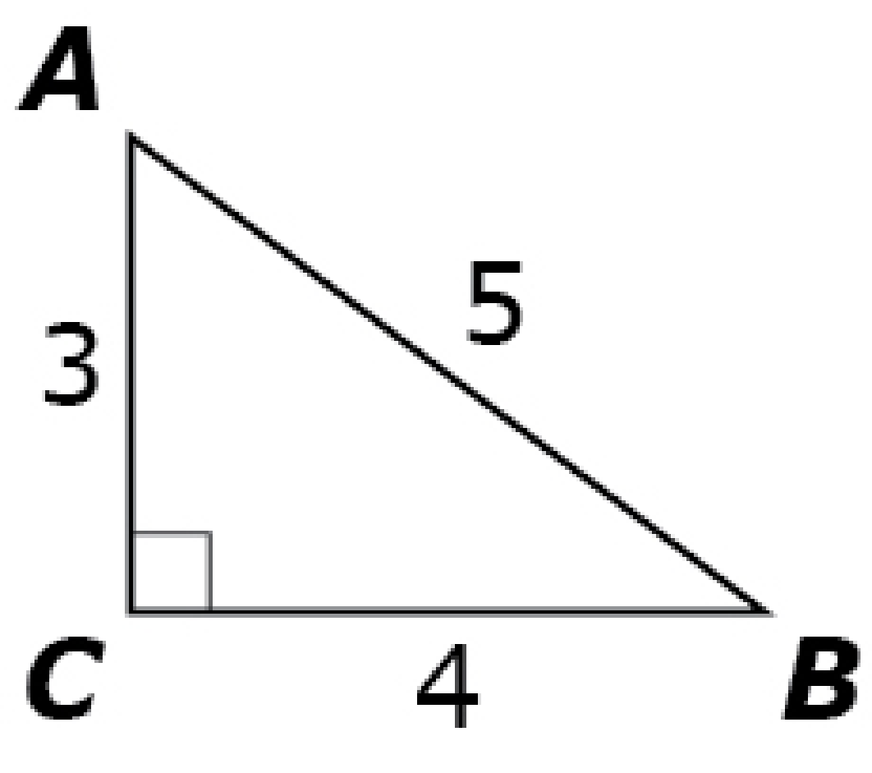
#3
Consider this right triangle. Enter the value of sin(B).

Slide 7

#3 Answer
Rubric:
(1 Point) The student enters the correct value.
Answer:
Notes:
‹#›

Slide 8

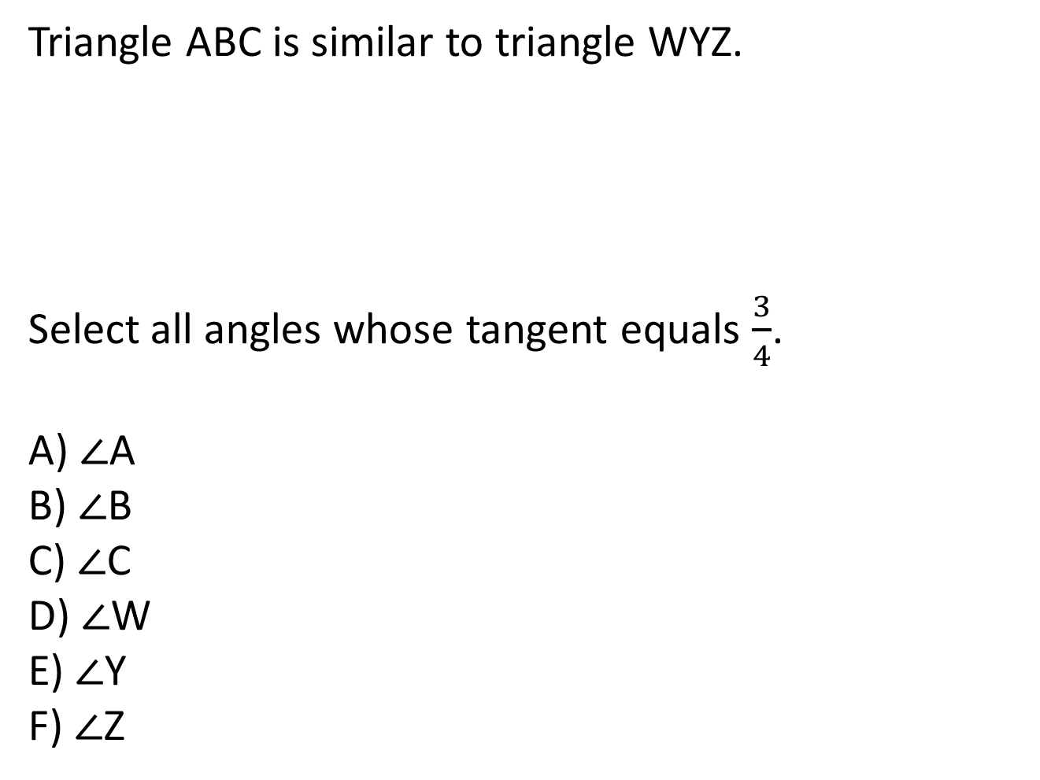
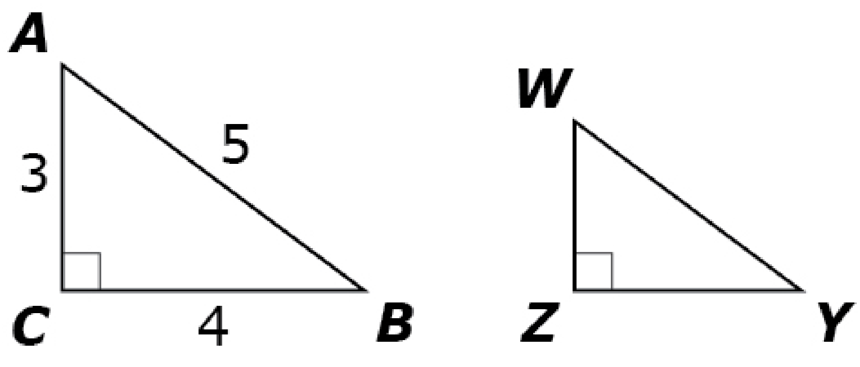
#4
Notes:
‹#›

Slide 9
#4 Answer
Rubric: (1 point) The student correctly identifies all angles.
Answer: B, E
Notes:
‹#›

Slide 10
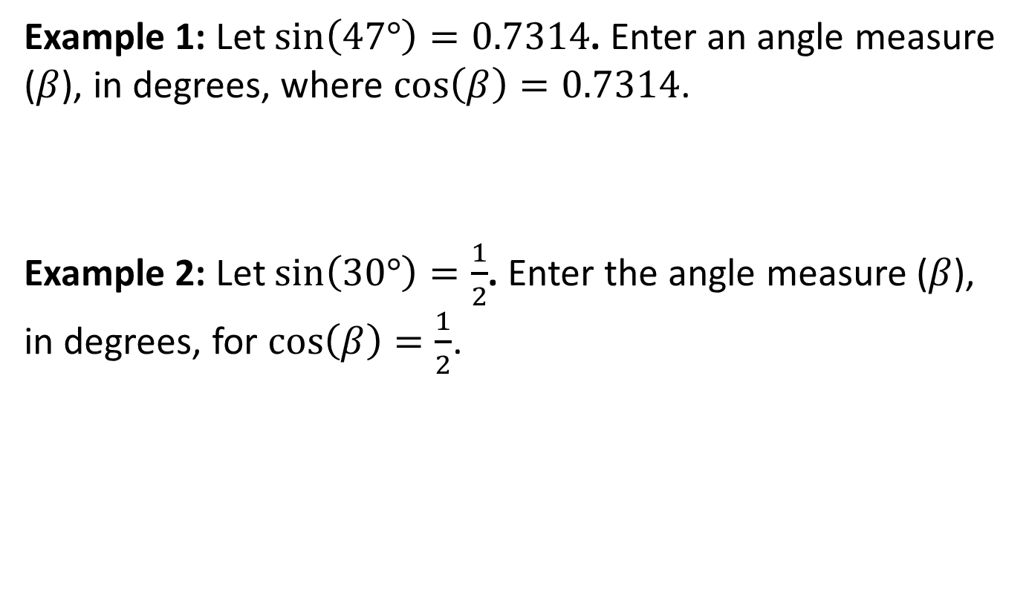
#5
Notes:
‹#›

Slide 11
#5 Answer
Rubric: (1 point) The student enters the correct angle that can be used to satisfy the equation.
Answers:
Example 1: any value so that 360n +/- 43 where n is an integer
Example 2: any value so that 60(6n +/- 1) where n is an integer
Notes:
‹#›

Slide 12
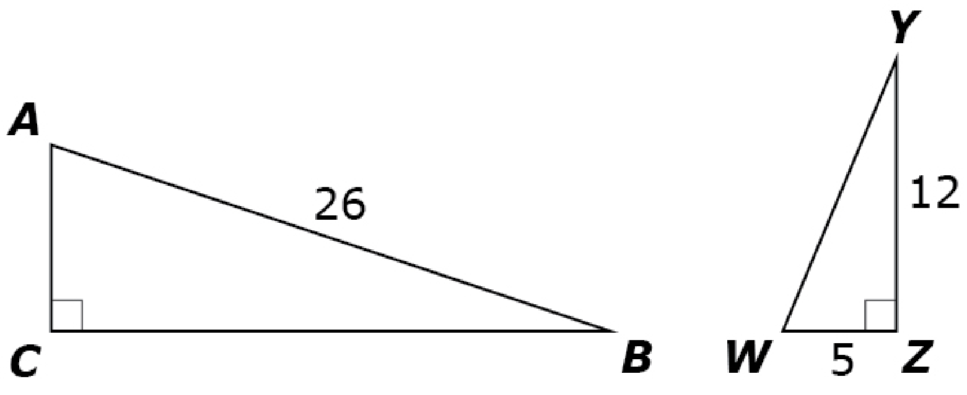
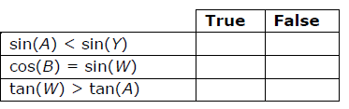
#6
Triangle ABC is similar to triangle WYZ.
Determine whether each statement is true. Select True or False for each statement.
Notes:
‹#›

Slide 13
#6 Answer
Rubric:
(1 point) The student evaluates each statement correctly.
Answer: F, T, F
Notes:
‹#›

Slide 14
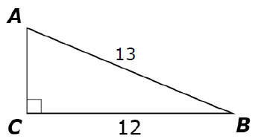
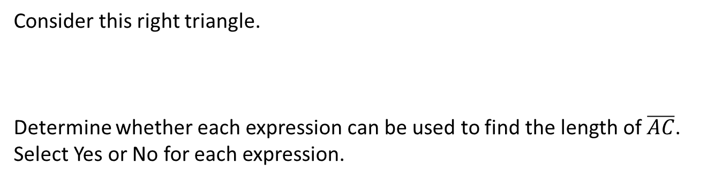
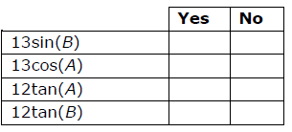
#7
Notes:
‹#›

Slide 15
#7 Answer
Rubric:
(1 point) The student selects the correct response for each expression.
Answer: Y, Y, N, Y
Notes:
‹#›

Slide 16
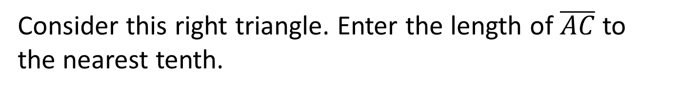
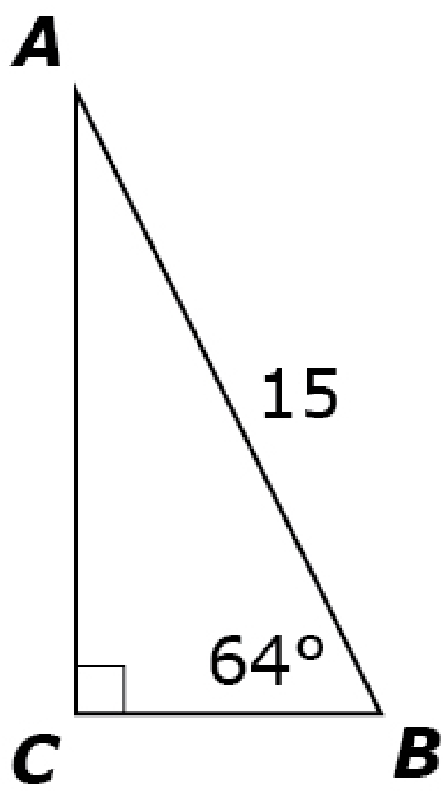
#8
Notes:
‹#›

Slide 17
#8 Answer
Rubric:
(1 point) The student enters the correct side length.
Answer: 13.5
Notes:
‹#›

Slide 18
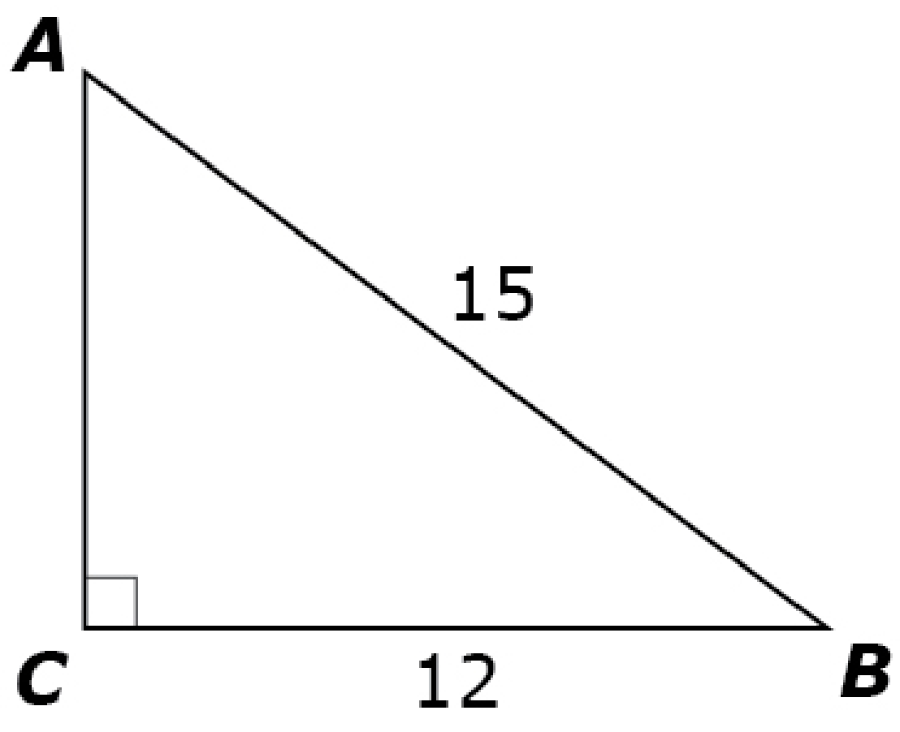
#9
Consider this right triangle. Enter the measure of ∠A, to the nearest degree.
Notes:
‹#›

Slide 19
#9 Answer
Rubric:
(1 point) The student enters the correct angle measure.
Answer: 53
Notes:
‹#›

Slide 20
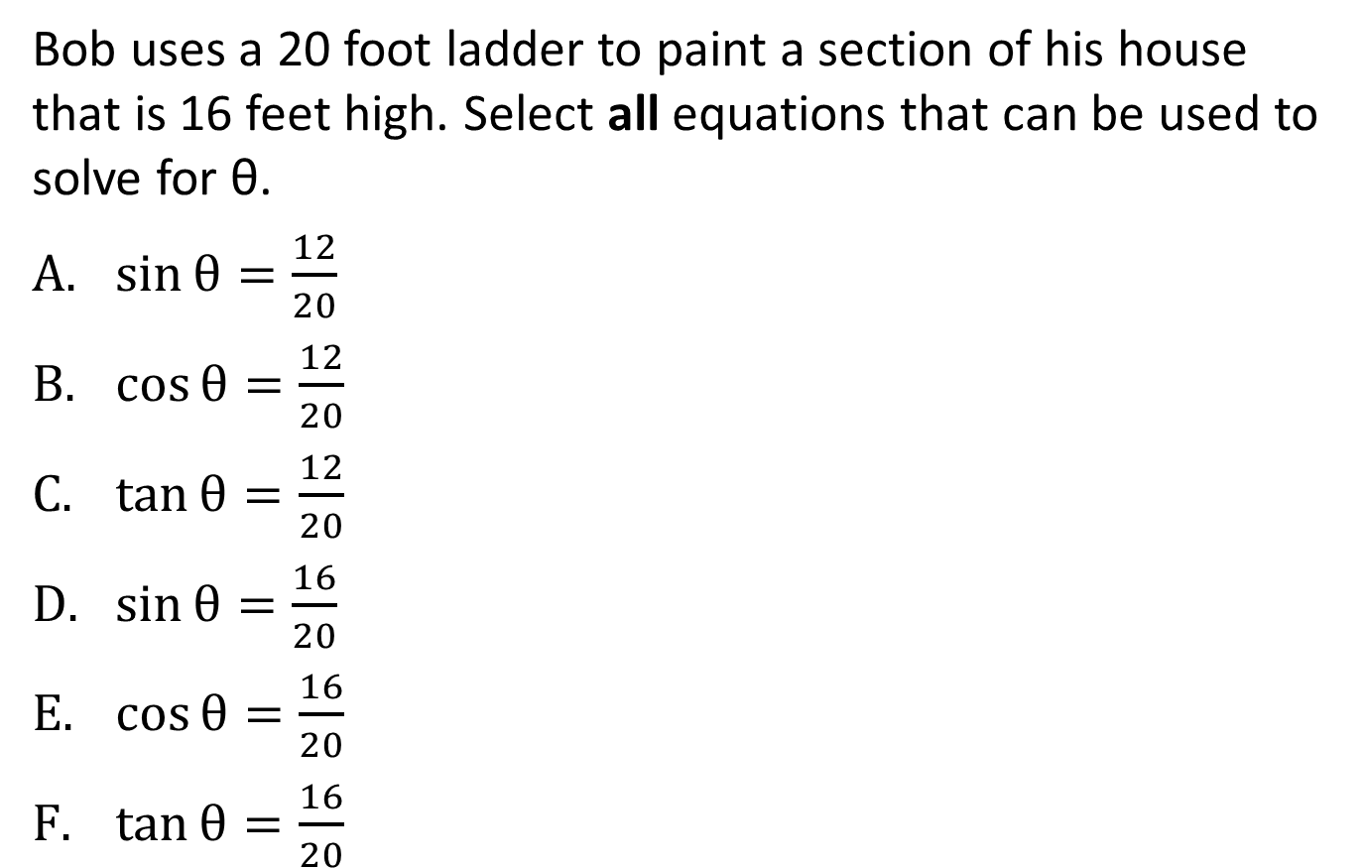
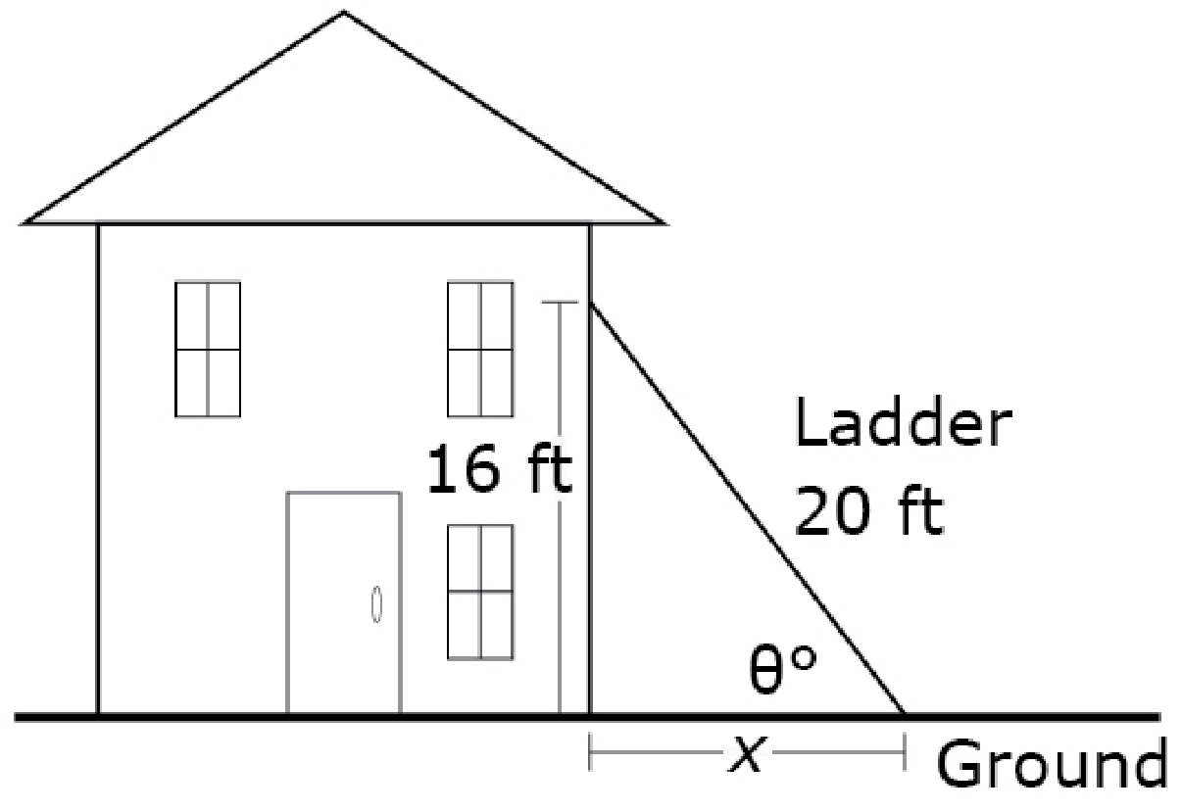
#10
Notes:
‹#›

Slide 21

#10 Answer
Rubric:
(1 point) The student is able to identify all correct equations.
Answer: B, D
Notes:
‹#›

Slide 22
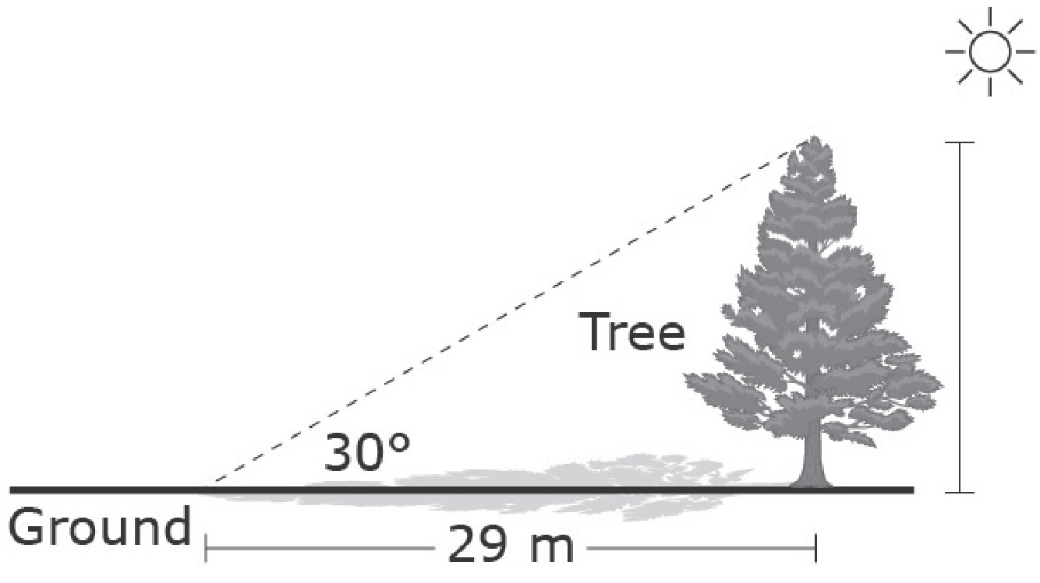
#11
Donna wants to calculate the height of a tree. She makes the following measurements.
The length of the tree’s shadow is 29 meters.
The angle of elevation from the ground to the top of the tree is 30°.
The tree stands perpendicular to the ground.
Enter the height of the tree, in meters. Round your answer to the nearest whole meter.
Notes:
‹#›

Slide 23
#11 Answer
Rubric:
(1 point) The student finds the missing side of the right triangle.
Answer: 17
Notes:
‹#›

