Slide 1

Claim 1
Smarter Balanced Sample Items
High School - Target N
Build a function that models a relationship between two quantities.
Questions courtesy of the Smarter Balanced Assessment Consortium Item Specifications – Version 3.0
Slideshow organized by SMc Curriculum – www.ccssmathactivities.com
Notes:
‹#›

Slide 2


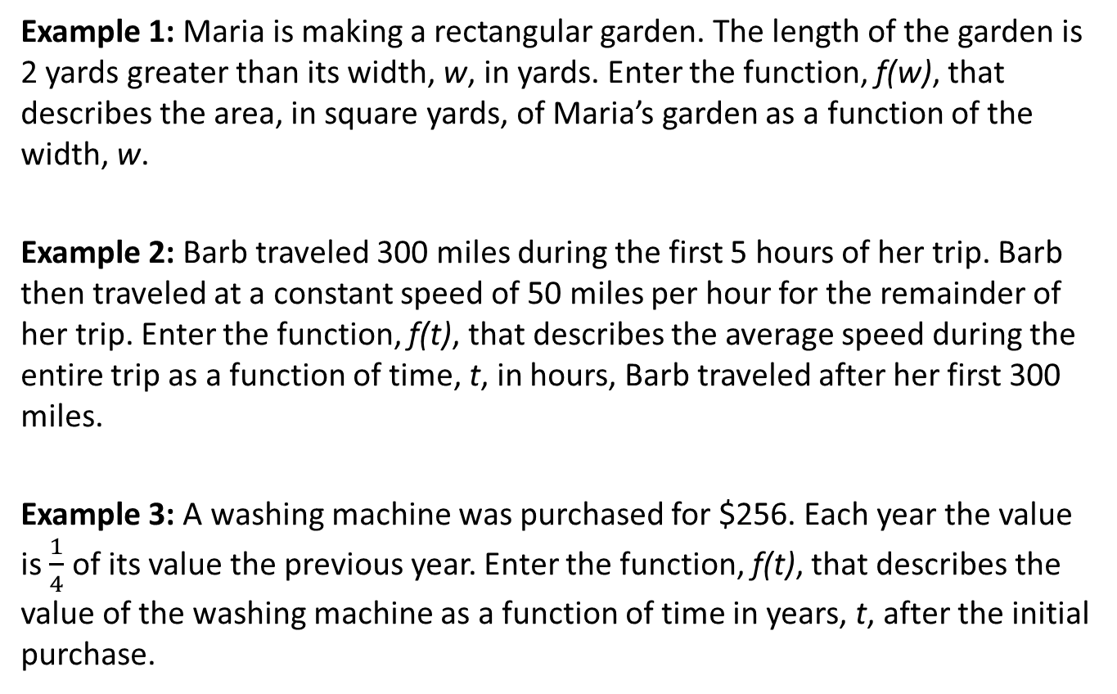
#1

Slide 3
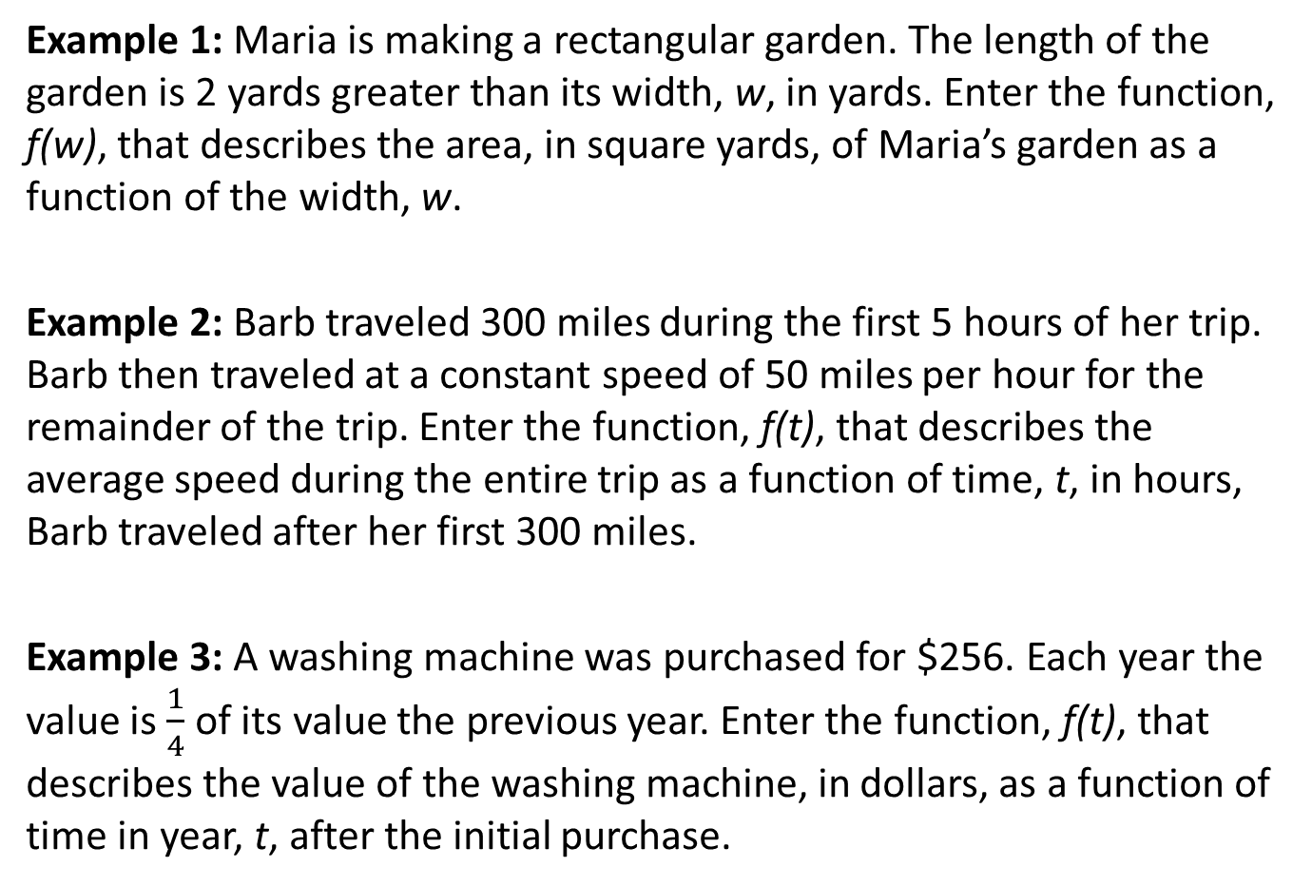
#1
Notes:
‹#›

Slide 4

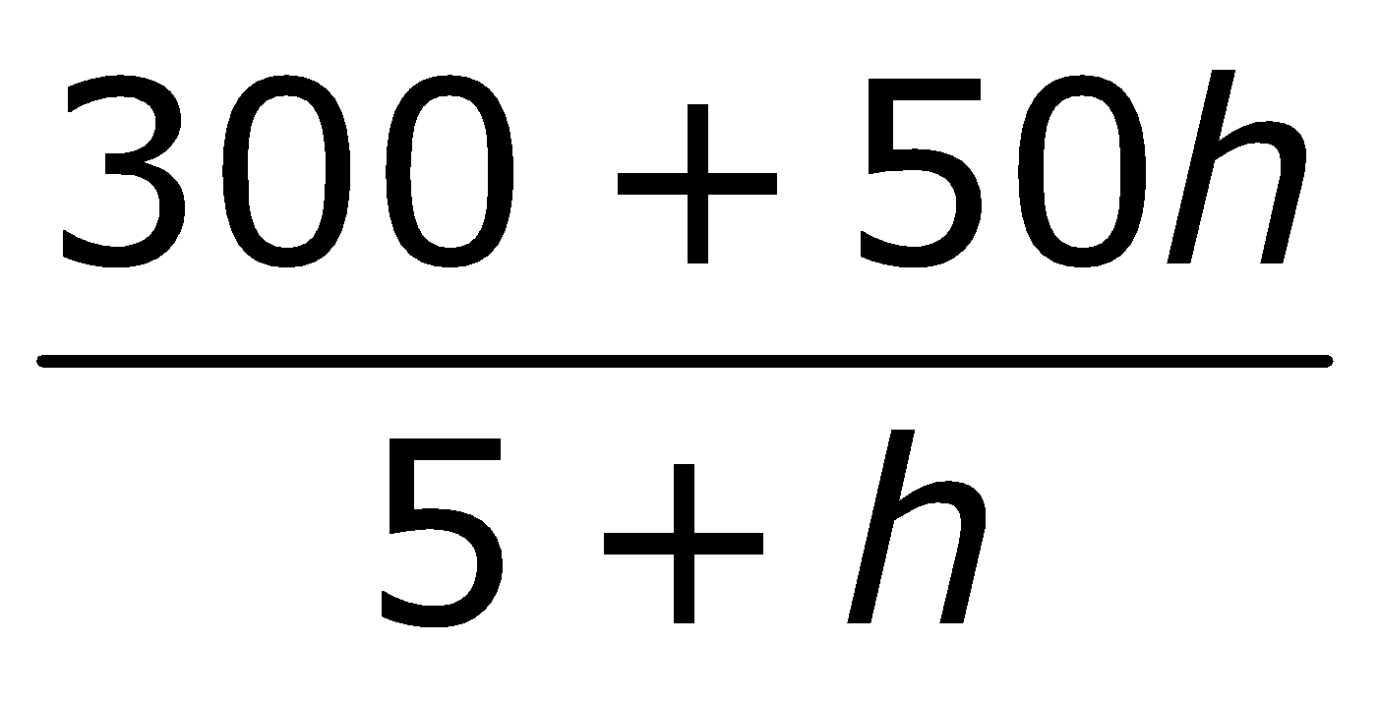
#1 Answer
Rubric:
(1 point each) The student correctly enters the function describing the relationship between two quantities in the given contextual situation.
Answers:
Example 1: f(w) = w(w + 2)
Example 2: f(h) =
Example 3: f(t) = $256(0.75)^{t}
Notes:
‹#›

Slide 5
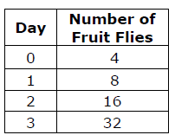
#2
A researcher studies the growth of a fruit fly population. The researcher counts the number of fruit flies at noon each day. The results are in the table.
𝑉(n) = Total number of fruit flies
after n days
𝑉(0) = 4
Enter the function for n ≥ 1, which describes the number of fruit flies, 𝑉(n), at noon on the n^{th} day in terms of the number of fruit flies at noon on the previous day, 𝑉(n − 1).

Slide 6
#2 Answer
Rubric:
(1 point) Student correctly enters the recursive function describing the relationship between two quantities in the given contextual situation.
Answer: V(n) = 2V(n – 1)
Notes:
‹#›

Slide 7
#3
The first row in a theater has 8 seats, the second row has 11 seats, the third row has 14 seats and the fourth row has 17 seats. The pattern of increasing each successive row by 3 seats continues throughout the theater.
f(r) = the number of seats in row r
f(1) = 8
Enter an equation, for 𝑟 ≥ 2, which describes the number of seats, 𝑓(𝑟), in the 𝑟^{th} row in terms of the number of seats in the (𝑟 − 1)^{th} row, 𝑓(𝑟 − 1).
Notes:
‹#›

Slide 8
#3 Answer
Rubric:
(1 point) Student correctly represents the sequence using the recursive process.
Answer: 𝑓(𝑟) = 𝑓(𝑟 − 1) + 3
Notes:
‹#›

Slide 9
#4
The 13th row in a theater has 41 seats, the 12th row has 38 seats, the 11th row has 35 seats and the 10th row has 32 seats. The pattern of decreasing each successive row by 3 seats continues from the 13th row to the 1st row.
f(r) = the number of seats in row r
f(1) = 5
Enter an equation, for 𝑟 ≥ 2, which describes the number of seats, 𝑓(𝑟), in the 𝑟^{th} row in terms of the number of seats in the (𝑟 − 1)^{th} row, 𝑓(𝑟 − 1). Assume that the pattern described applies to all rows.
Notes:
‹#›

Slide 10
#4 Answer
Rubric:
(1 point) Student correctly represents the sequence using the recursive process.
Answer: 𝑓(𝑟) = 𝑓(𝑟 − 1) + 3
Notes:
‹#›

Slide 11
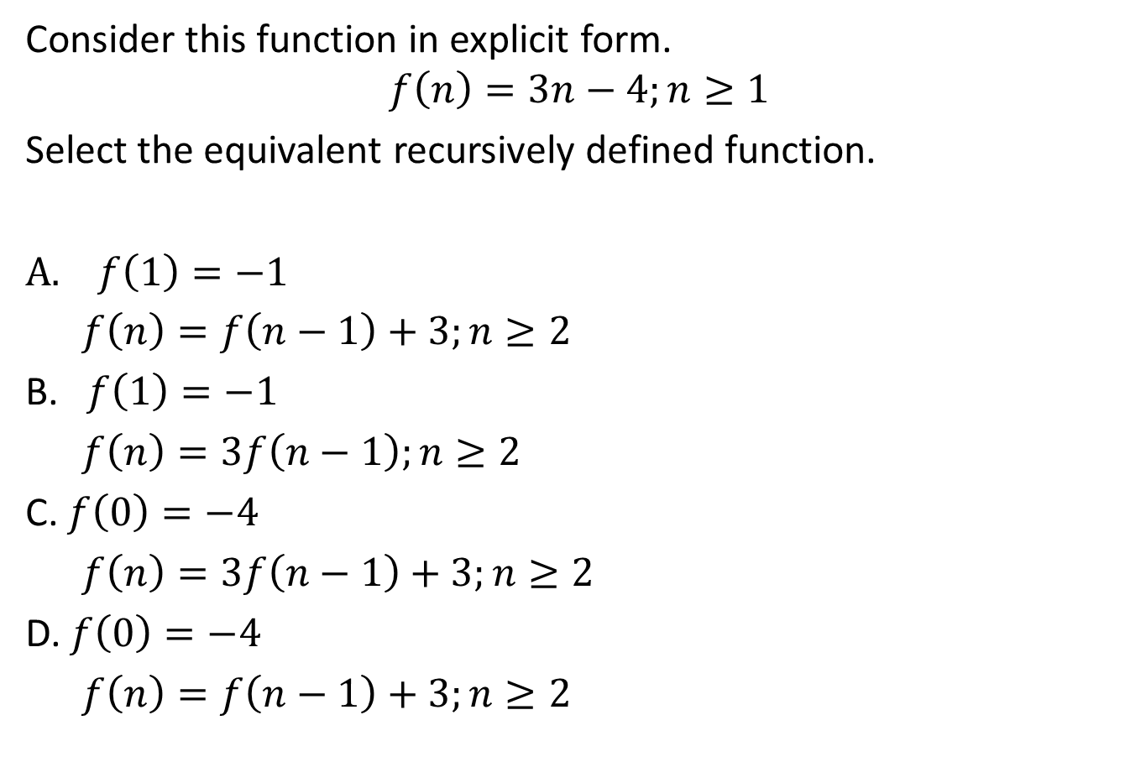
#5
Notes:
‹#›

Slide 12
#5 Answer
Rubric:
(1 Point) Student selects the correct choice.
Answer: A
Notes:
‹#›

Slide 13
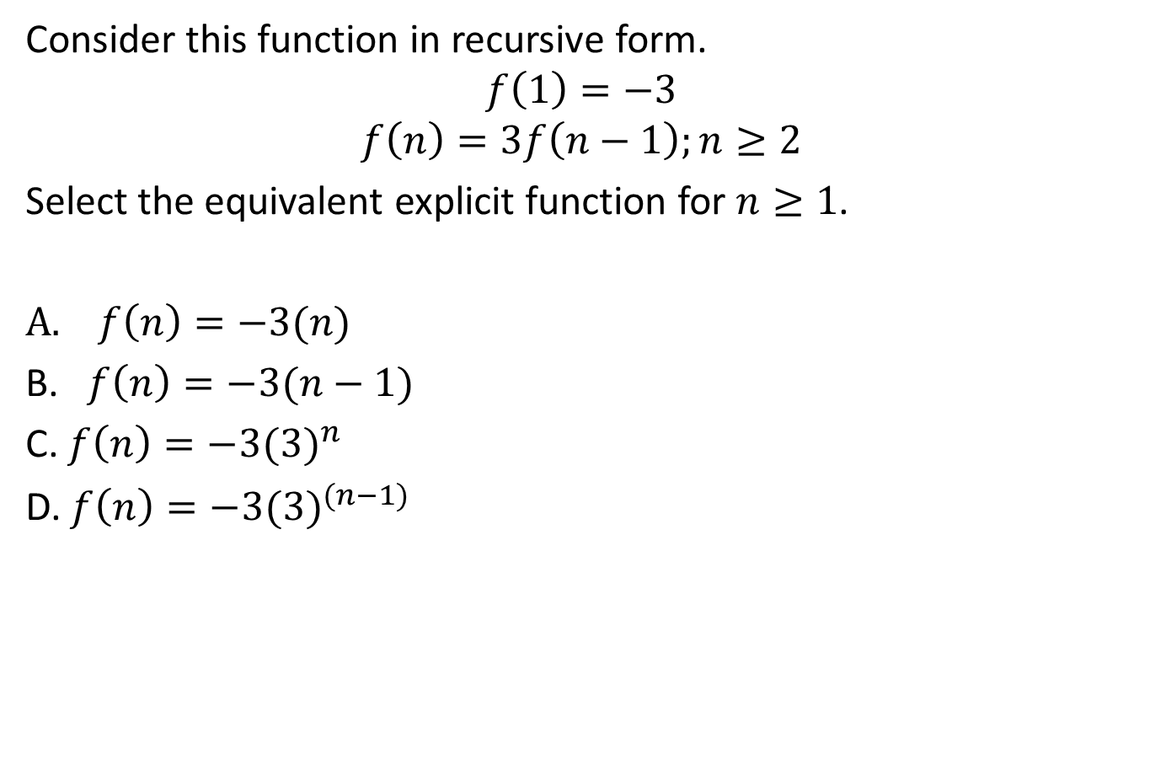
#6

Slide 14
#6 Answer
Rubric:
(1 Point) Student selects the correct choice.
Answer: D

Slide 15
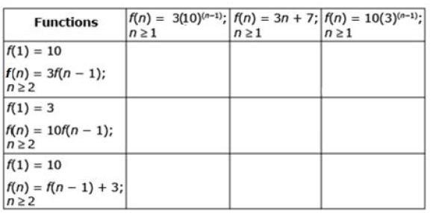
#7
The functions in the table are defined for integers n ≥ 1. Match each recursively defined function with the equivalent explicit form.
Click the appropriate box that matches the recursive function in the first column with its equivalent explicit function in the top row.
Notes:
‹#›

Slide 16
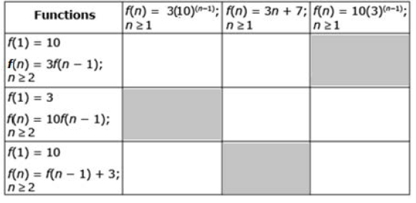
#7 Answer
Rubric:
(1 point) Student correctly matches all functions.
Answer:
Notes:
‹#›

Slide 17
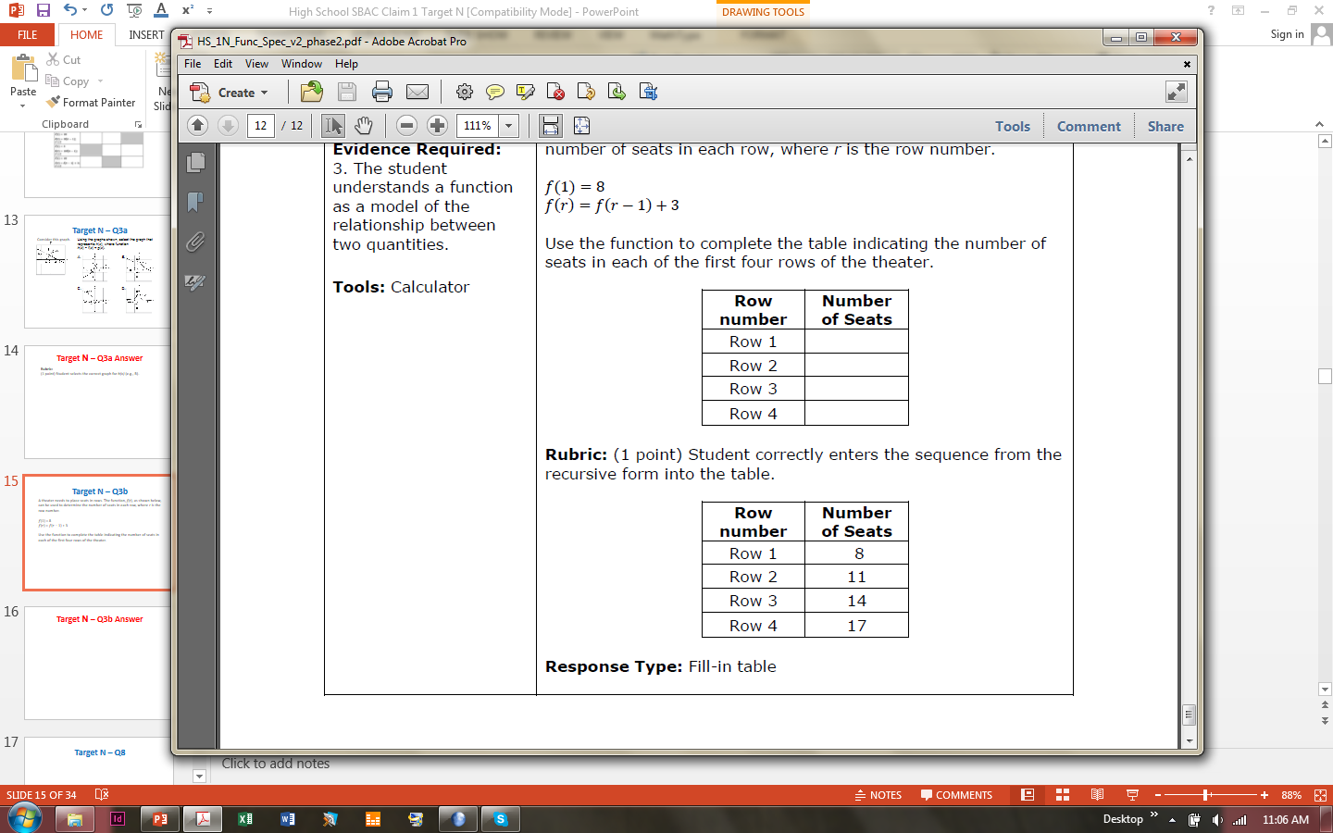
#8
A theater needs to place seats in rows. The function, f(r), as shown below, can be used to determine the number of seats in each row, where r is the row number.
𝑓(1) = 8
𝑓(𝑟) = 𝑓(𝑟 − 1) + 3
Use the function to complete the
table indicating the number of
seats in each of the first four
rows of the theater.

Slide 18
#8 Answer
Rubric:
(1 point) Student correctly enters the sequence from the recursive form into the table.
Answer:

