Slide 1

Claim 1
Smarter Balanced Sample Items
High School - Target M
Analyze functions using different representations.
Questions courtesy of the Smarter Balanced Assessment Consortium Item Specifications – Version 3.0
Slideshow organized by SMc Curriculum – www.ccssmathactivities.com
Notes:
‹#›

Slide 2

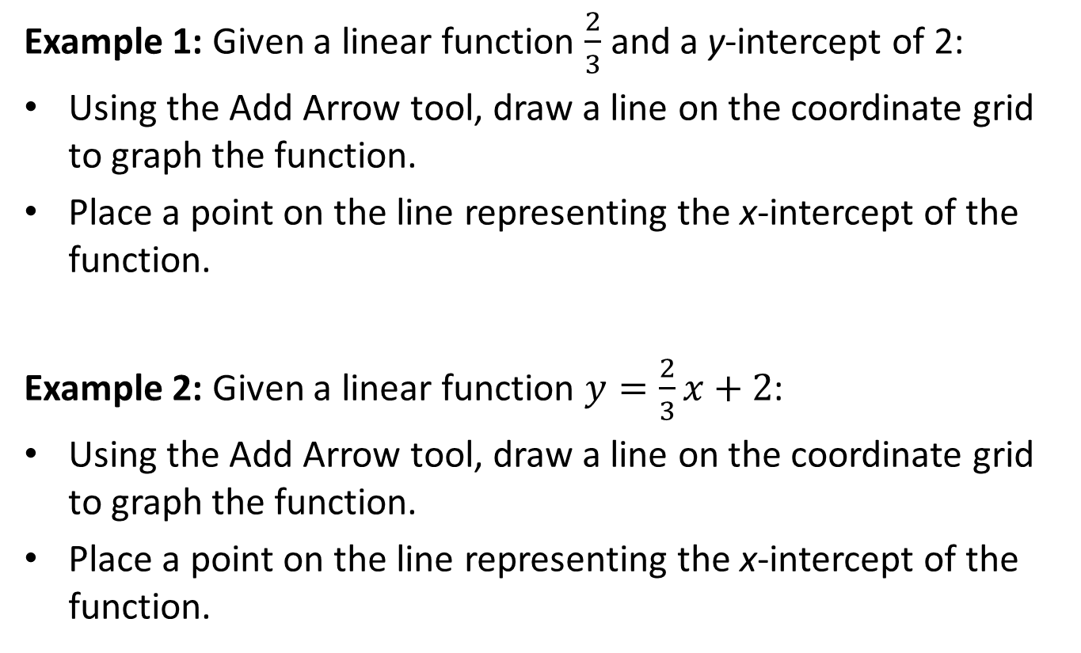
#1
Notes:
‹#›

Slide 3

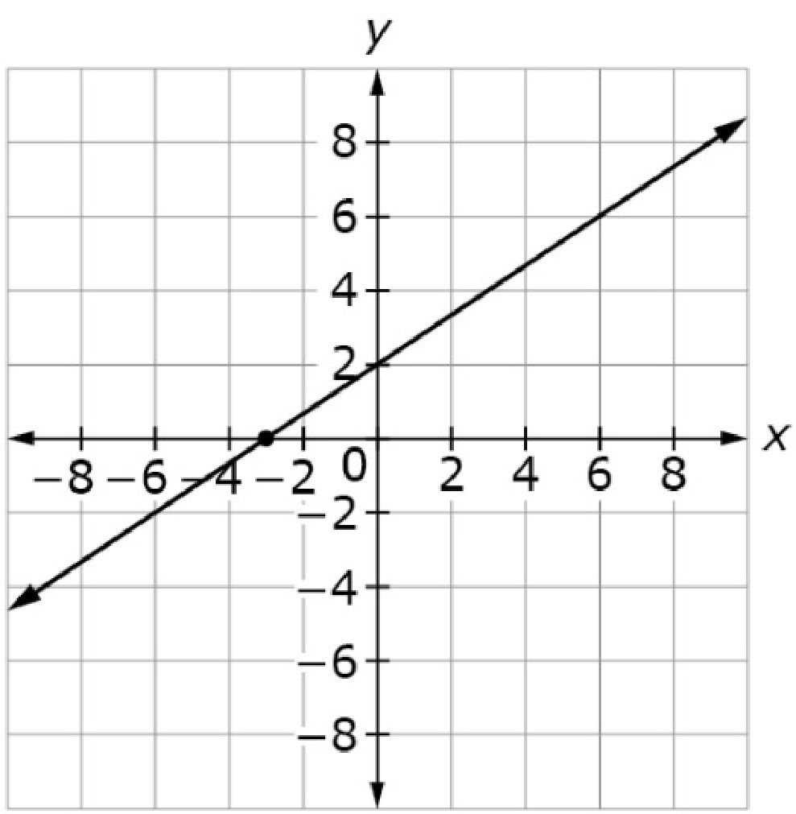
#1 Answer
Rubric:
(2 points) The student graphs the correct line and plots the point at the correct location that represents a key feature; student draws a correct line and plots the x-intercept located at (−3, 0).
(1 point) The student graphs the correct line and plots the point at the correct location that represents a key feature; student draws a correct line or plots the x-intercept located at (−3, 0).
Answers:
Example 1: draws a correct line, (− 3, 0)
Example 2:
Notes:
‹#›

Slide 4
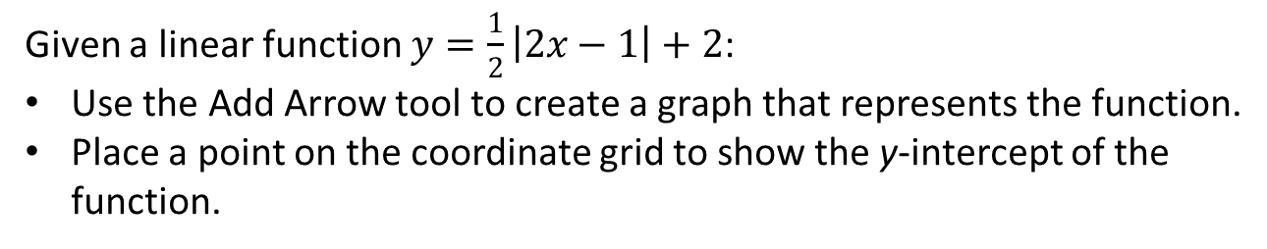
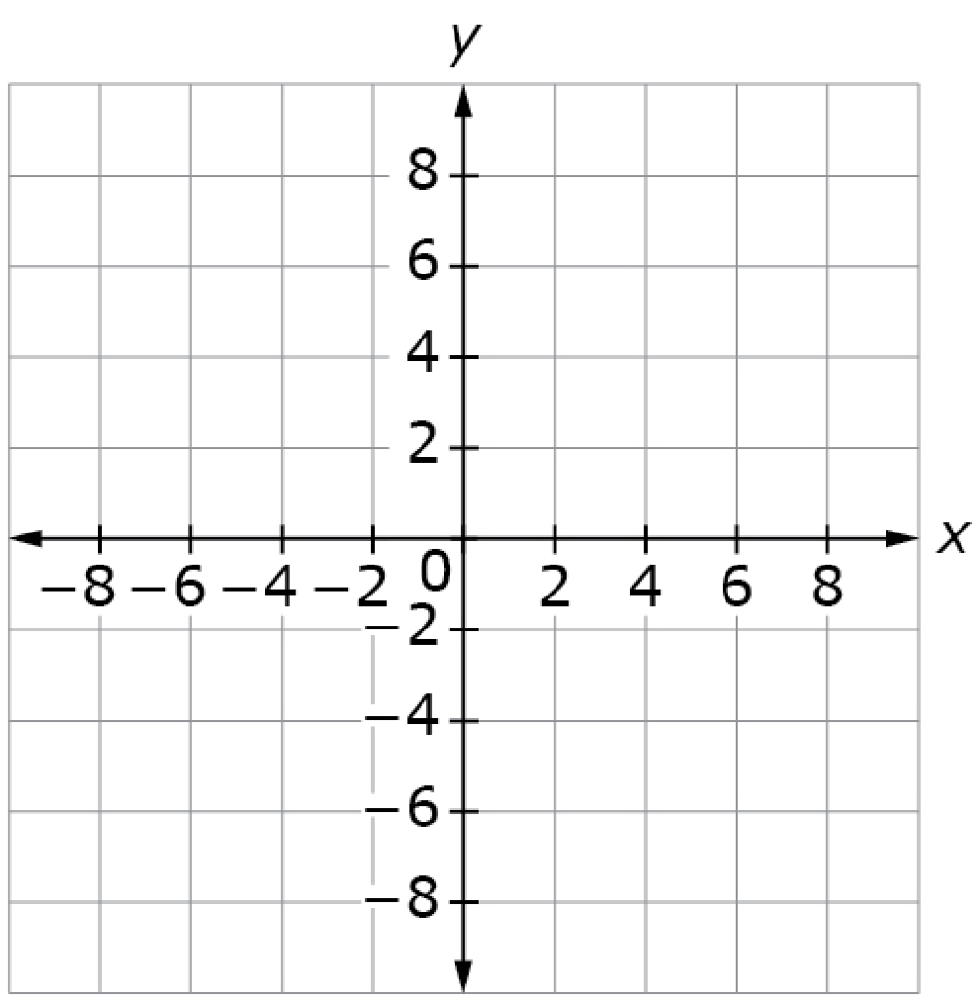
#2

Slide 5
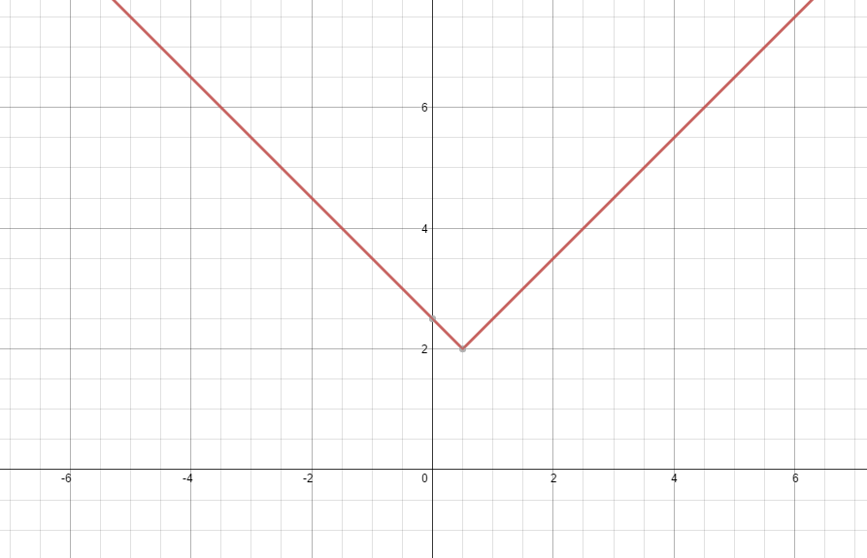
#2 Answer
Rubric:
(1 point) The student graphs the correct function and plots the point at the correct location that represents a key feature
Answer:
Notes:
‹#›

Slide 6

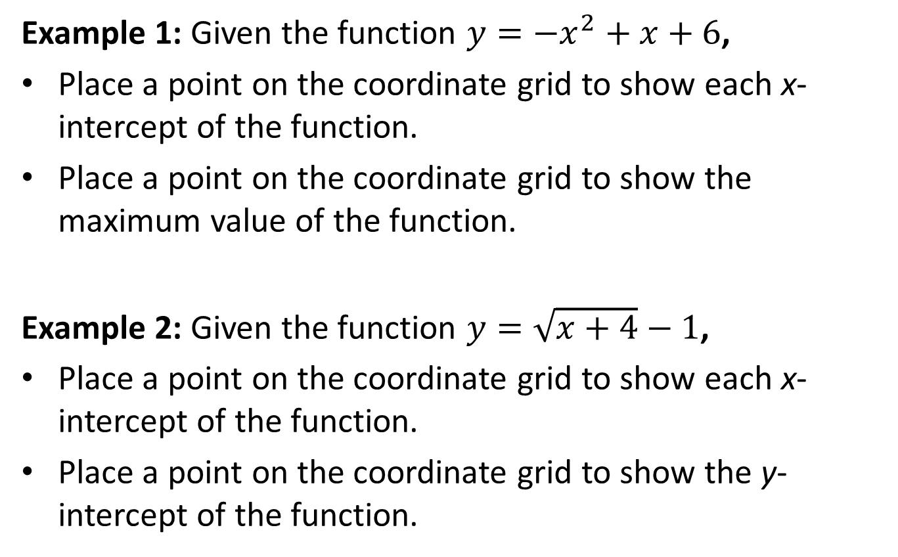
#3
Notes:
‹#›

Slide 7
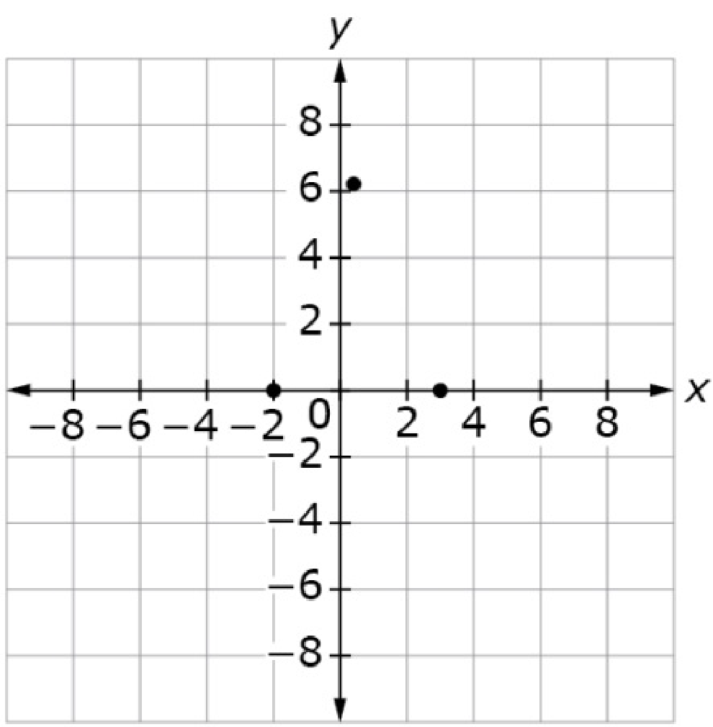
#3 Answer
Rubric:
(2 points) The student plots the correct points that represent each different key feature. (for example: student plots both x-intercepts and the maximum value).
(1 point) The student correctly plots 1 of 2 key features called for OR creates a graph but incorrectly identifies a key feature (e.g., in Example Stem 1, student plots the maximum value only OR both x-intercepts only.)
Note: Both x-intercepts represent one key feature so both are required to earn a point. For example, in Example Stem 1 both x-intercepts represent one key feature (1 point), and the maximum point represents another key feature (1 point).
Answers:
Example 1: Example 2:
Notes:
‹#›

Slide 8
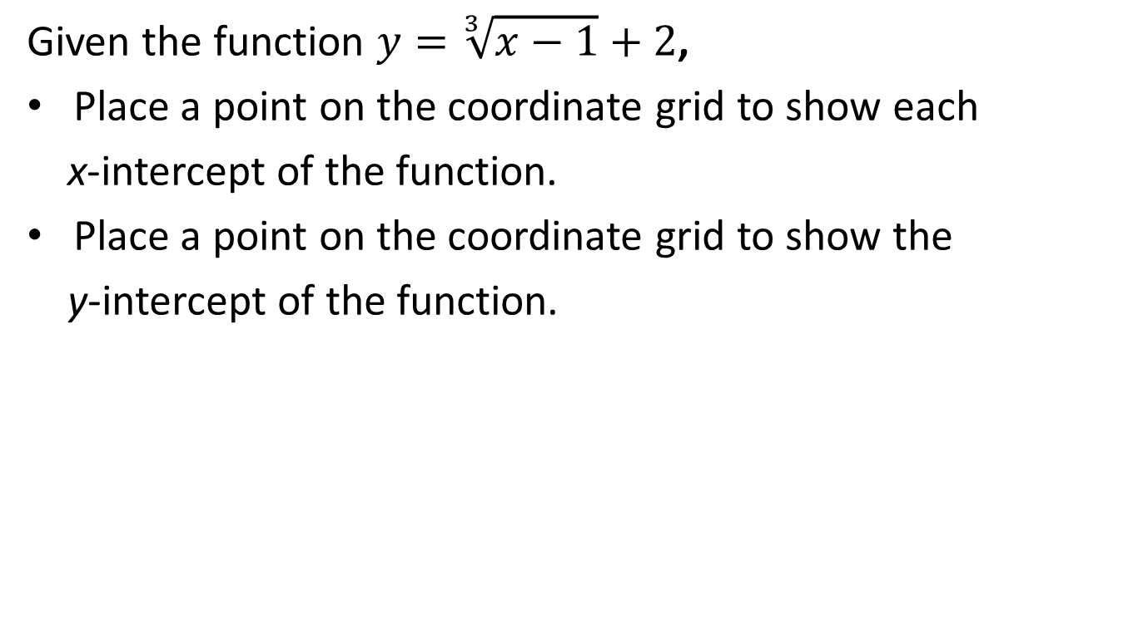
#4

Slide 9
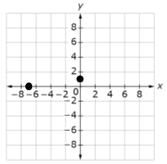
#4 Answer
Rubric:
(2 points) The student plots the correct points that represent each different key feature. (for example: student plots both x-intercepts and the maximum value).
(1 point) The student correctly plots 1 of 2 key features called for OR creates a graph but incorrectly identifies a key feature (e.g., in Example Stem 1, student plots the maximum value only OR both x-intercepts only.)
Note: Both x-intercepts represent one key feature so both are required to earn a point. For example, in Example Stem 1 both x-intercepts represent one key feature (1 point), and the maximum point represents another key feature (1 point).
Answer:

Slide 10
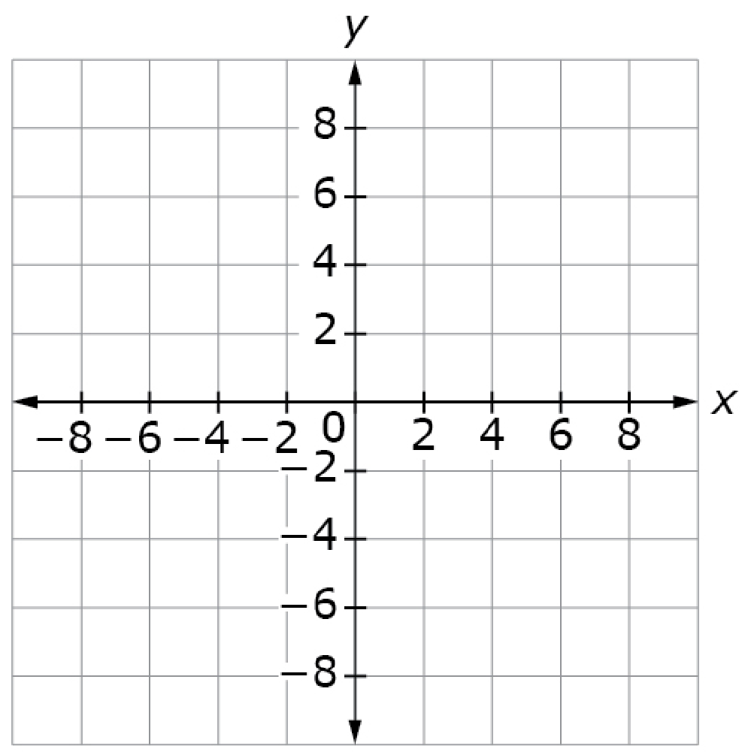
#5
Given the function 𝑦 = 8log(𝑥 + 4),
Place a point on the coordinate grid to show the x-intercept of the function.
Place a point on the coordinate grid to show the y-intercept of the function.
Notes:
‹#›

Slide 11
#5 Answer
Rubric:
(2 points) The student plots the correct points that represent each different key feature. (for example: student plots the x-intercept and the y-intercept).
(1 point) The student correctly plots 1 of 2 key features called for OR creates a graph but incorrectly identifies a key feature
Answer:
Notes:
‹#›

Slide 12
#6
Enter an equation for the line of symmetry for the function
f(x) = −8x² + 16x + 2.
Notes:
‹#›

Slide 13
#6 Answer
Rubric:
(1 point) The student enters the correct equation.
Answer: x = 1
Notes:
‹#›

Slide 14
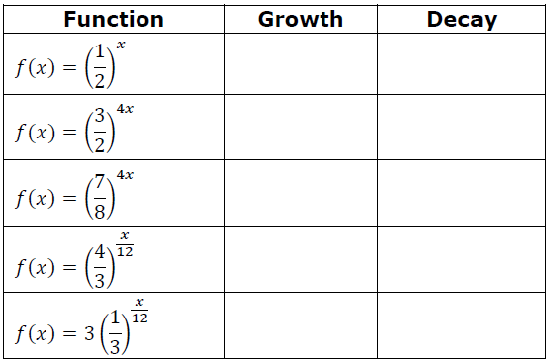
#7
Determine whether each function represents exponential growth or decay. Select the correct option for each function.
Notes:
‹#›

Slide 15
#7 Answer
Rubric:
(1 point) The student correctly sorts the exponential functions.
Answer: Decay, Growth, Decay, Growth, Decay
Notes:
‹#›

Slide 16
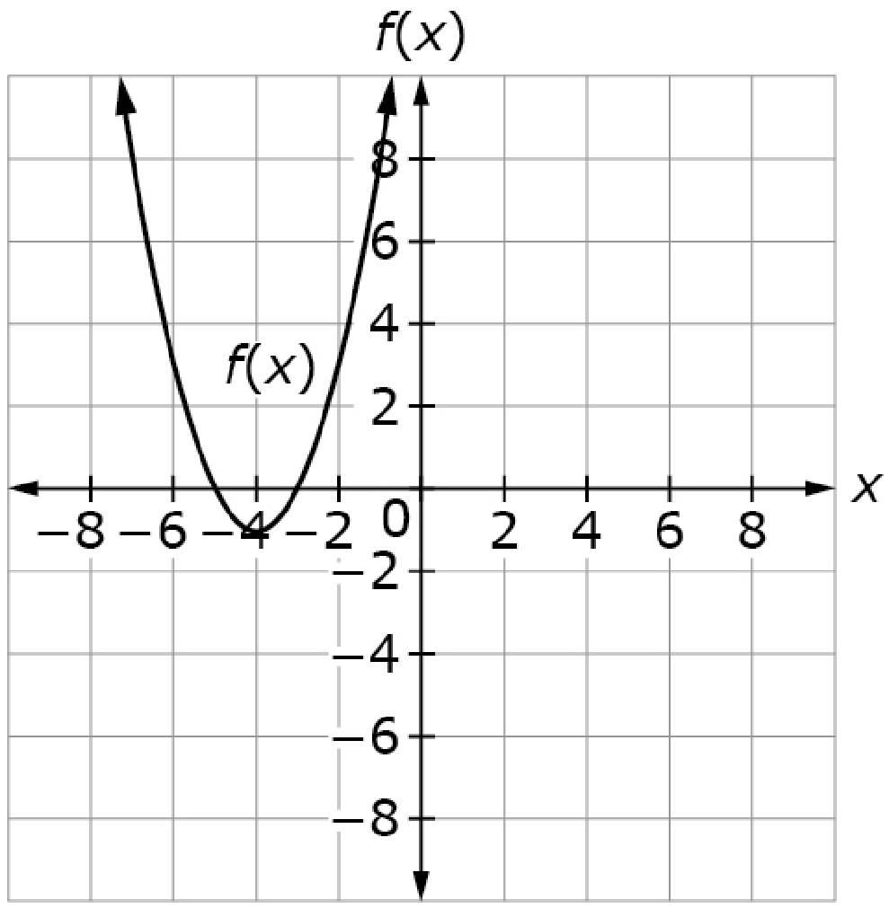
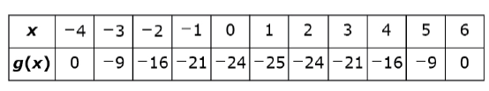
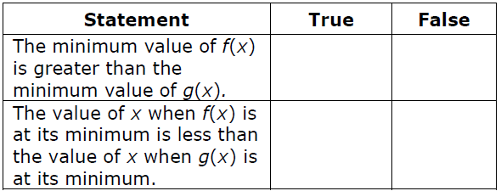
#8
The graph represents f(x) and the table shows some values of another quadratic function g(x).
Select whether each statement is True or False about the given functions.
Notes:
‹#›

Slide 17
#8 Answer
Rubric:
(1 point) The student correctly identifies each statement as True or False.
Answer: T, T
Notes:
‹#›

Slide 18
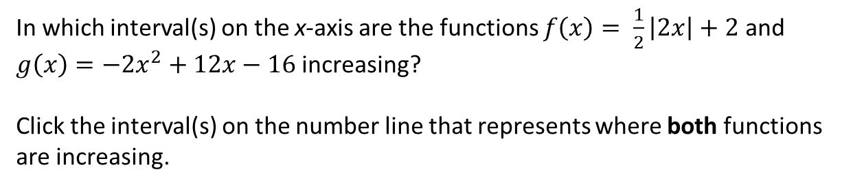
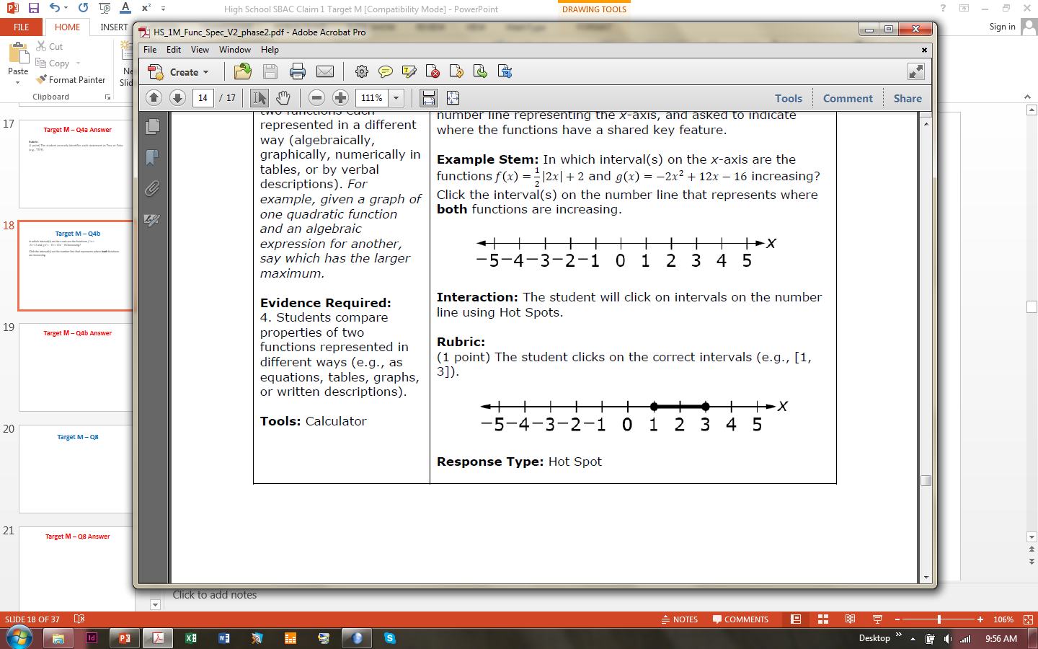
#9
Notes:
‹#›

Slide 19
#9 Answer
Rubric:
(1 point) The student clicks on the correct intervals.
Answer: [1, 3]
Notes:
‹#›

Slide 20
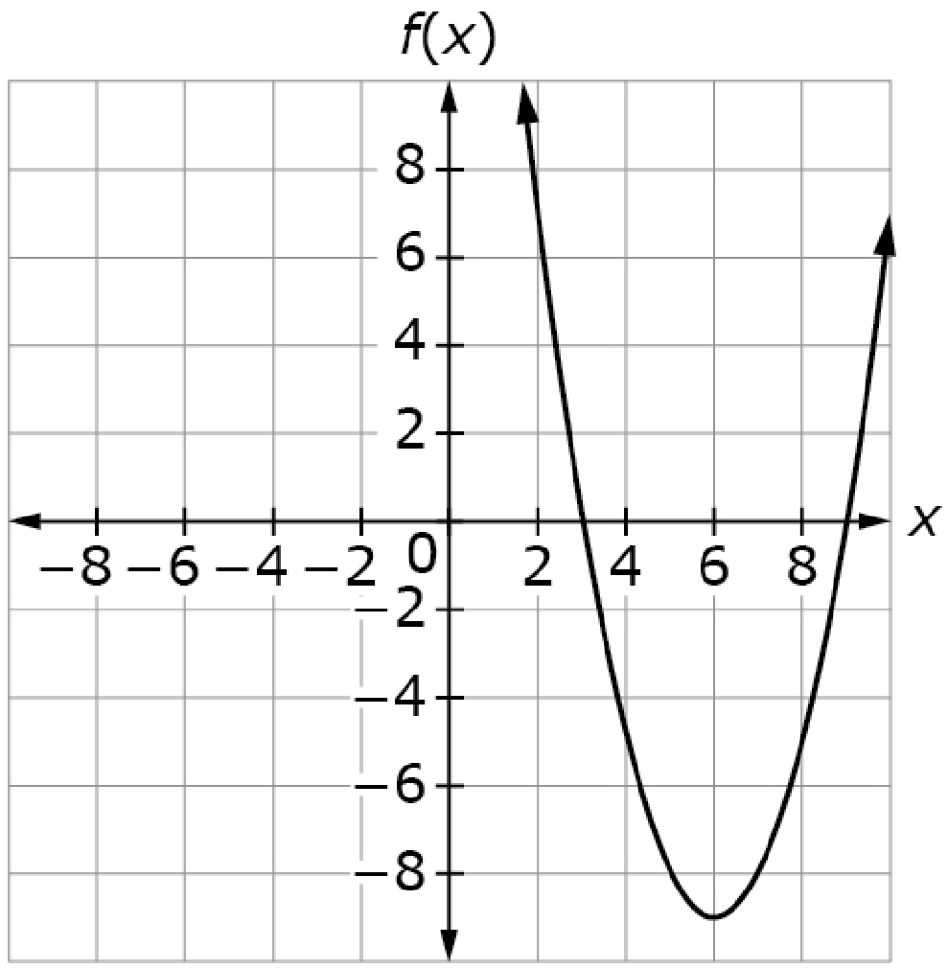
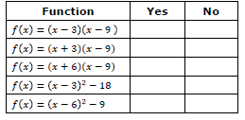
#10
Determine whether each equation in the table represents the graph of the function shown? Select Yes or No for each equation.

Slide 21

#10 Answer
Rubric:
(1 point) Student correctly selects the functions that could be represented by the given graph.
Answer: Y, N, N, N, Y

Slide 22
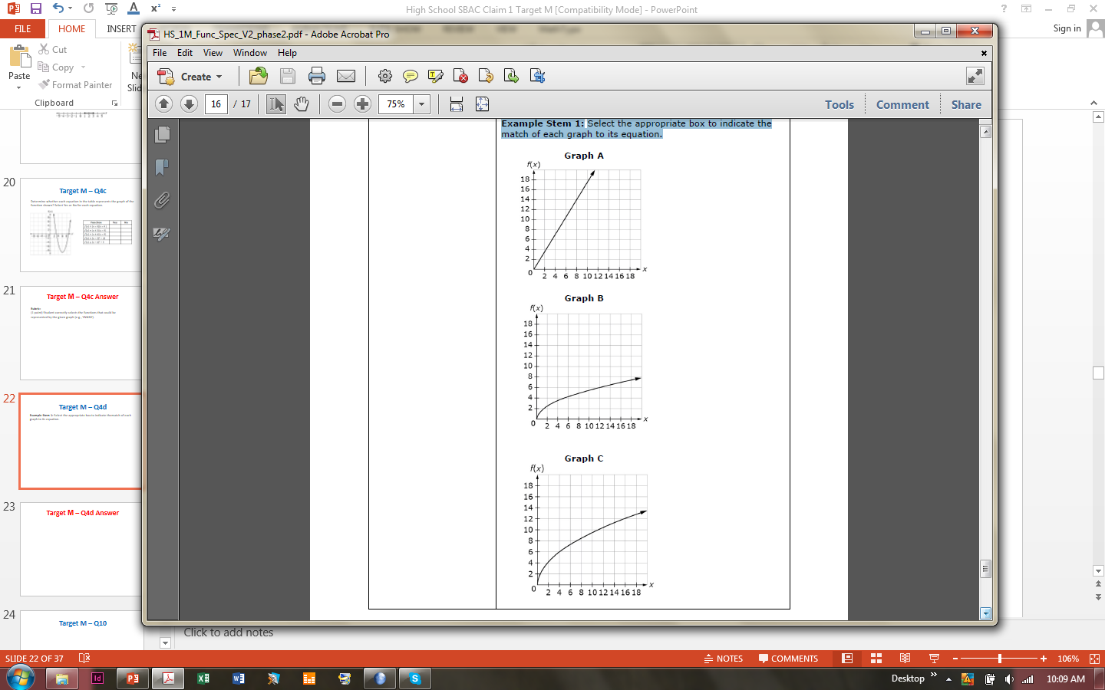
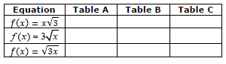
#11
Select the appropriate box to indicate the match of each graph to its equation.

Slide 23
#11 Answer
Rubric:
(1 point) The student correctly matches the functions with the graph.
Answer: Graph A, Graph C, Graph B

Slide 24
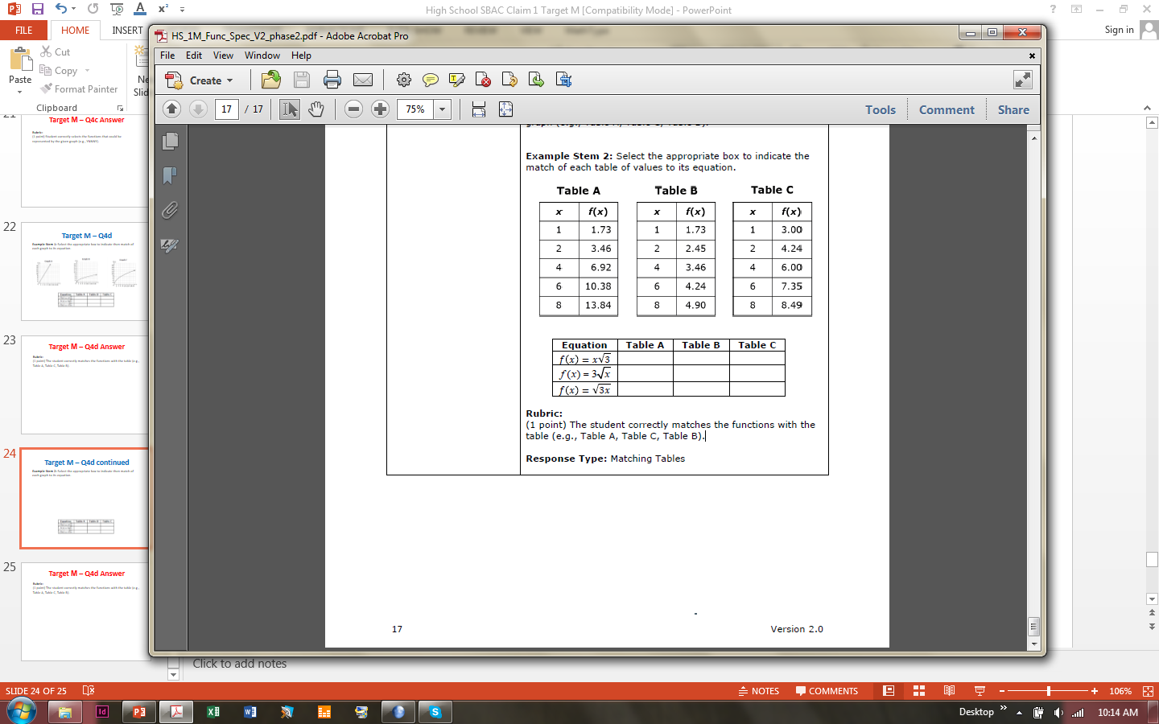
#12
Select the appropriate box to indicate the match of each graph to its equation.

Slide 25
#12 Answer
Rubric:
(1 point) The student correctly matches the functions with the table.
Answer: Table A, Table C, Table B

