Slide 1

Claim 1
Smarter Balanced Sample Items
High School - Target L
Interpret functions that arise in applications in terms of the context.
Questions courtesy of the Smarter Balanced Assessment Consortium Item Specifications – Version 3.0
Slideshow organized by SMc Curriculum – www.ccssmathactivities.com
Notes:
‹#›

Slide 2


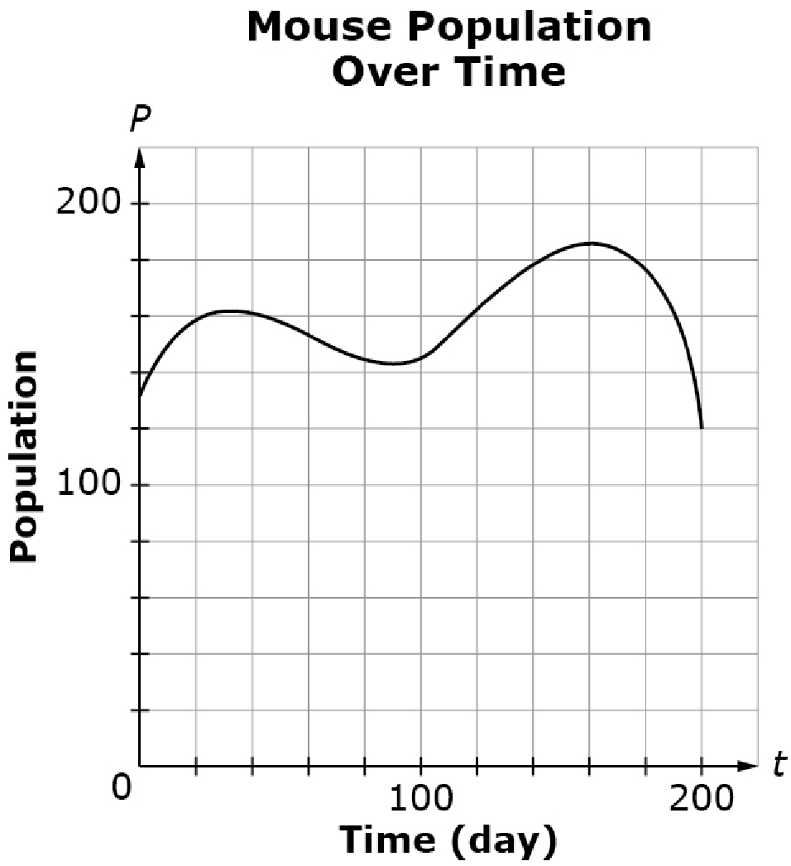
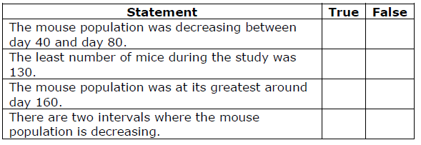
#1
This graph shows the population of mice
in a study, modeled as a function of time.
The study begins on day 0 and ends on day 200.
Determine whether each statement is true
according to the graph. Select True or
False for each statement.
Notes:
‹#›

Slide 3

#1 Answer
Rubric:
(1 point) The student correctly selects the true and false interpretations of key features represented by the graph or table.
Answer: T, F, T, T
Notes:
‹#›

Slide 4
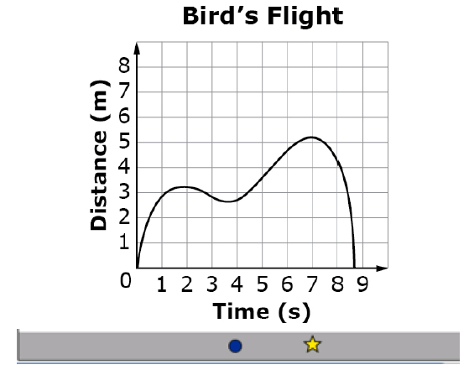
#2
A bird flies out of its nest. This graph represents the distance it flies from its nest (in meters) as a function of time (in seconds).
Drag the star to mark the point on the graph that represents the bird’s greatest distance from its nest. Then drag the circle to mark the point that represents the bird's return to its nest.

Slide 5
#2 Answer
Rubric:
(1 point) The student correctly identifies the point representing the bird’s farthest distance from the nest and the point where the bird returns.
Answer: approximately (7, 5.2) and (8.7, 0)

Slide 6
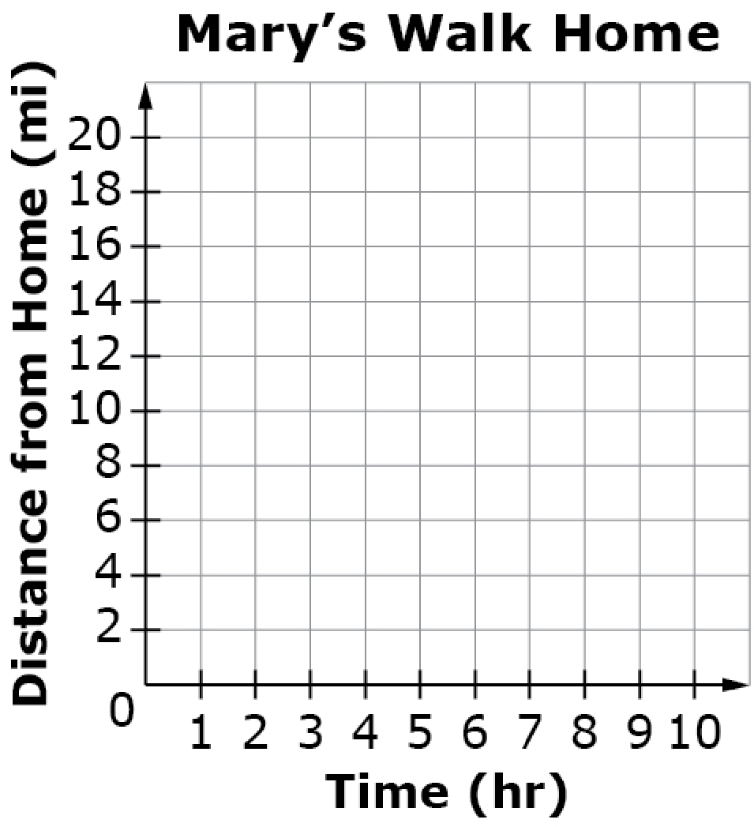
#3
Mary is 10 miles from her home.
• She is returning home, walking at a constant speed of 2 miles per
hour.
• Her distance from home can be modeled as a function of time.
Use the Add Point and Connect Line tools to graph Mary’s distance from home as a function of time.
Notes:
‹#›

Slide 7
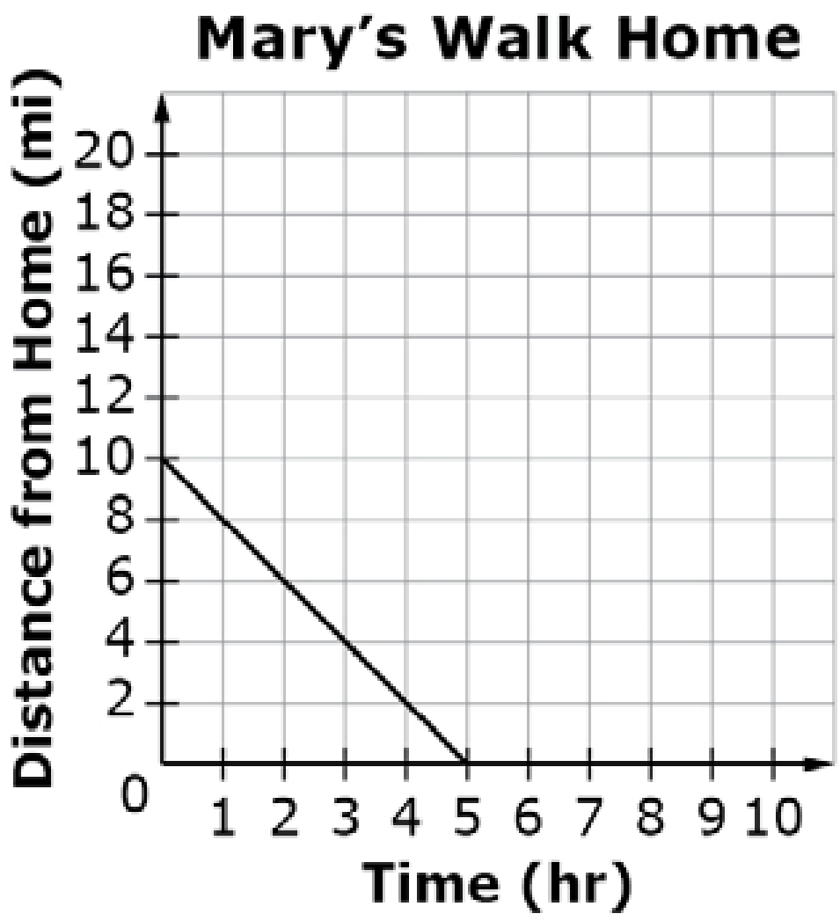
#3 Answer
Rubric:
(1 point) The student creates the graph correctly.
Answer:
Notes:
‹#›

Slide 8
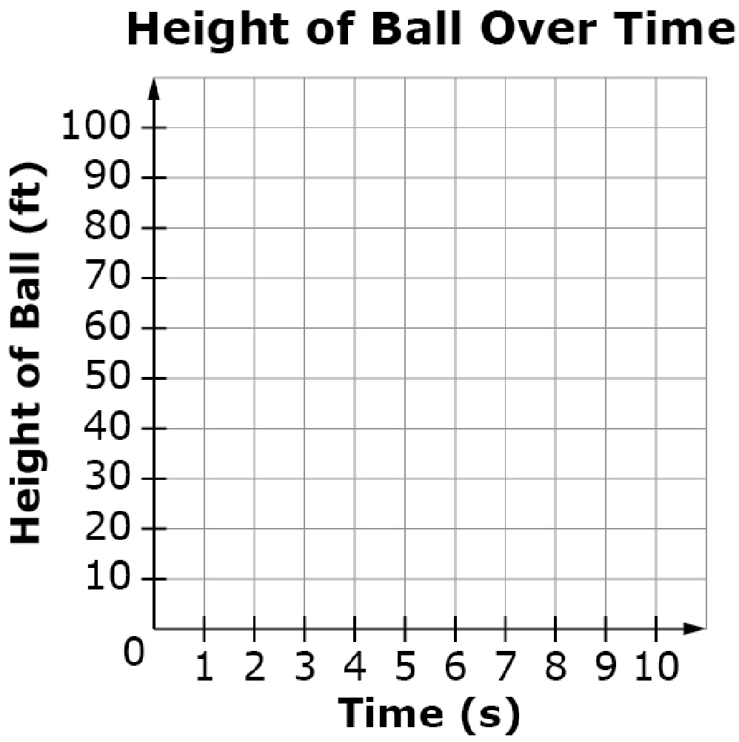
#4
A ball is on the ground. John kicks the ball
into the air at s = 0. Assume that the height of the ball can be modeled as a quadratic function with respect to time. It reaches a maximum height of 64 feet and lands on the ground4 seconds later.
Use the Add Point tool to plot the points
on the grid that represent
• when John kicks the ball,
• the ball at its highest point, and
• when the ball lands on the ground.
Notes:
‹#›

Slide 9
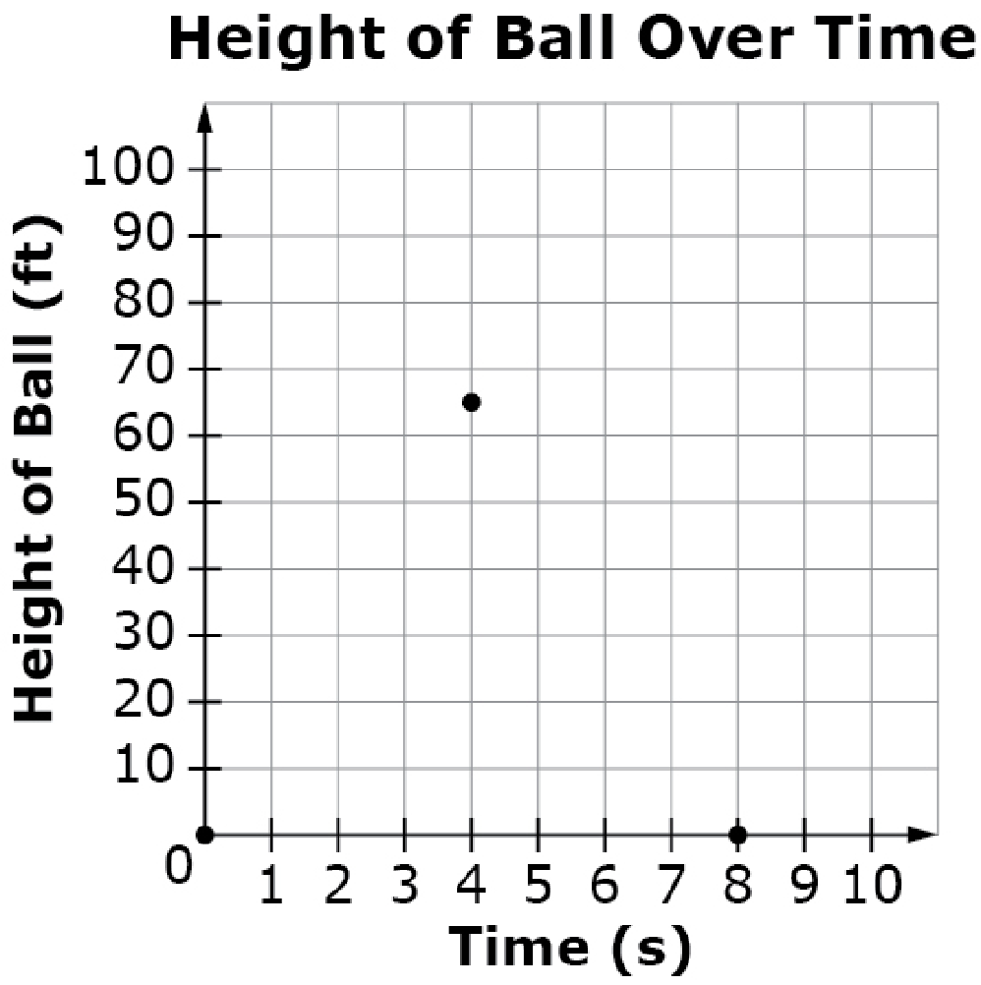
#4 Answer
Rubric:
(1 point) The student plots the points correctly.
Answer:
Notes:
‹#›

Slide 10
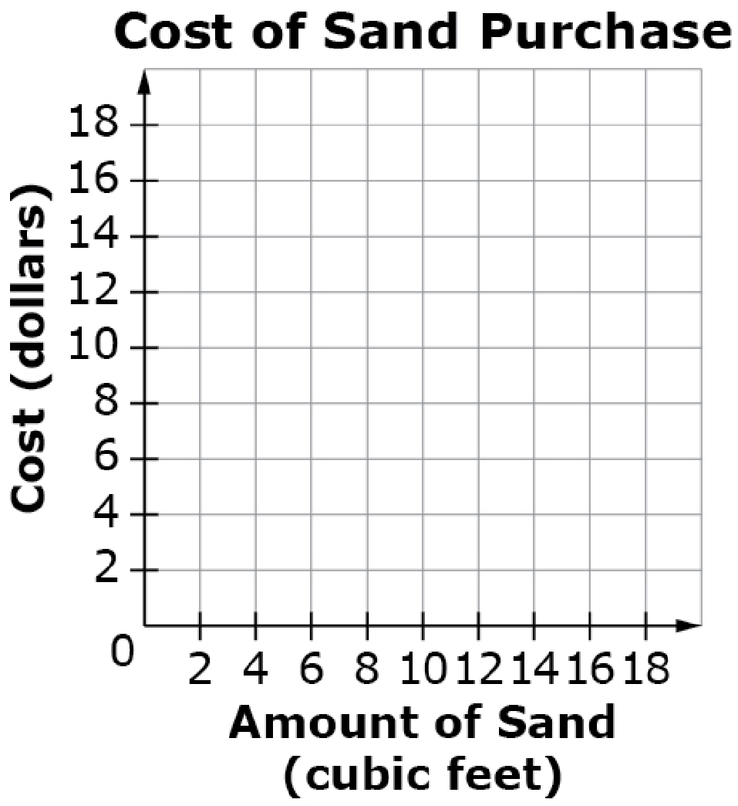
#5
A company is building a playground and needs to buy sand. The cost of sand is a function of the amount of sand purchased.
• The first 5 cubic feet cost $1.50 per cubic
foot.
• An amount greater than 5 cubic feet and
less than or equal to 10 cubic feet costs
$1.25 per cubic foot.
• An amount over 10 cubic feet costs
$1.00 per cubic foot.
Use the Add Point and Connect Line tools to create a graph to show the total cost of the sand (in dollars) as a function of the amount of sand purchased (in cubic feet).
Notes:
‹#›

Slide 11
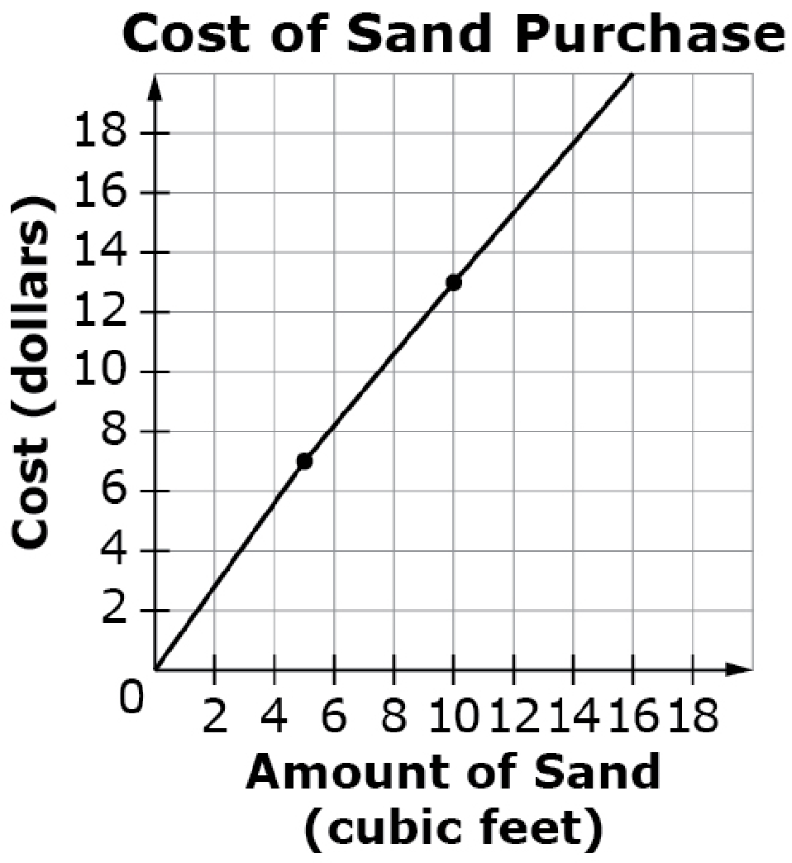
#5 Answer
Rubric:
(1 point) The student creates the graph correctly.
Answer:
Notes:
‹#›

Slide 12
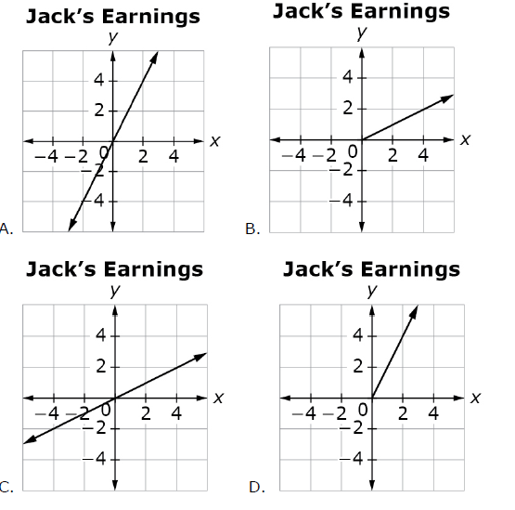
#6
Select the graph that correctly represents the amount of money, y, Jack earns doing chores for x hours at $2 per hour.
Notes:
‹#›

Slide 13
#6 Answer
Rubric:
(1 point) The student identifies the correct graph.
Answer: D
Notes:
‹#›

Slide 14
#7
Billy buys light bulbs in packs of 8 for $20. The shipping cost is $10 regardless of the number of packs bought. Billy has only $120 to spend. If n is the number of packs of lightbulbs bought, then the cost per lightbulb, C, can be modeled as a function of n. Select the statement that correctly describes the domain of the function.
The domain is the set of all real numbers 1 ≤ n ≤ 6.
The domain is the set of all real numbers 1 ≤ n ≤ 5.
The domain is the set of all integers 1 ≤ n ≤ 6.
The domain is the set of all integers 1 ≤ n ≤ 5.
Notes:
‹#›

Slide 15
#7 Answer
Rubric:
(1 point) The student correctly selects the statement describing the domain or range of the function.
Answer: D
Notes:
‹#›

Slide 16
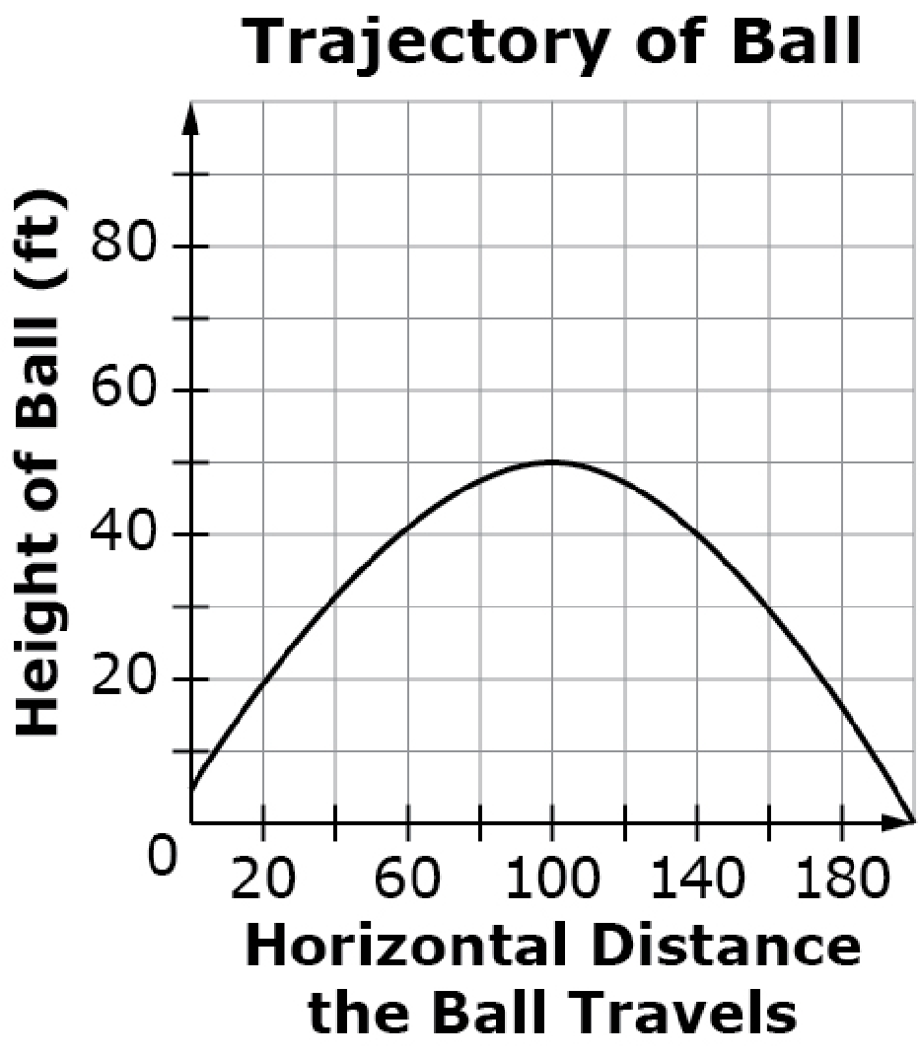
#8
Sue hits a ball from a height of 4 feet. The height of the ball above the ground is a function of the horizontal distance the ball travels until it comes to rest on the ground. Consider this graph of the function.
Select all values that are in the domain
of the function as shown in the graph.
−5 feet
0 feet
60 feet
220 feet
Notes:
‹#›

Slide 17
#8 Answer
Rubric:
(1 point) The student correctly selects the values that are within the domain.
Answer: B, C
Notes:
‹#›

Slide 18
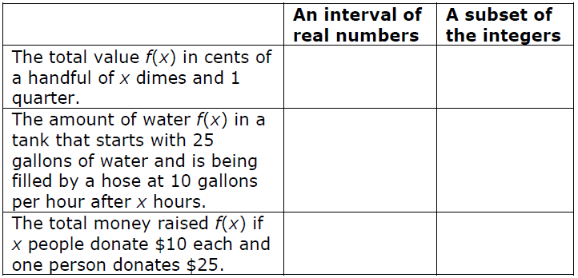
#9
Consider the function f(x) = 10x + 25. Identify an appropriate domain for the function if it is used to model each of the following contexts.

Slide 19
#9 Answer
Rubric:
(1 point) The student correctly identifies the appropriate kind of domain.
Answer: integers, reals, integers

Slide 20
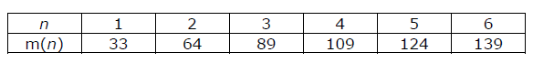
#10
Craig records the number of minutes, m, it takes him to mow n lawns in a table.
Select the average amount of time per lawn it takes Craig to mow the first 4 lawns. Round to the nearest minute per lawn.
A. 25 minutes per lawn
B. 27 minutes per lawn
C. 33 minutes per lawn
D. 74 minutes per lawn
Notes:
‹#›

Slide 21

#10 Answer
Rubric:
(1 point) The student identifies the correct value for the average rate of change.
Answer: B
Notes:
‹#›

Slide 22
#11
During the first years of growth the height of a tree can be modeled with the function
h = −t²+ 12t + 10,
where t is the time in years since being planted and h is the height in inches.
Enter the average rate of change, in inches per year, from year 1 to year 5.
Notes:
‹#›

Slide 23
#11 Answer
Rubric:
(1 point) The student enters the correct answer for the average rate of change given the units.
Answer: 6
Notes:
‹#›

