Slide 1

Claim 1
Smarter Balanced Sample Items
High School - Target K
Understand the concept of a function and use function notation.
Questions courtesy of the Smarter Balanced Assessment Consortium Item Specifications – Version 3.0
Slideshow organized by SMc Curriculum – www.ccssmathactivities.com
Notes:
‹#›

Slide 2


#1
The equation of any line in the coordinate plane can be written in the form Ax + By = C where A, B, and C are real numbers. Select all of the equations below that define y as a function of x.
3x – 4y = -2
-9x + 0y = 78
0x + 56y = -11
-12x – 85y = 0

Slide 3

#1 Answer
Rubric:
(1 point) The student correctly selects all options that represent y as a function of x.
Answer: A, C, D

Slide 4
#2
The height in meters, h, of a model rocket above the ground is given t seconds after launch by the equation
h = -5t² + 40t
where 0 ≤ t ≤ 8 and 0 ≤ h(t) ≤ 80
Select all of the statements below that are true.
A. h(0) = 0
B. h(10) = -100
C. The height of the rocket is 0 meters after 8 seconds from the launch.
D. The rocket reaches a height of 320 feet.

Slide 5
#2 Answer
Rubric:
(1 point) The student correctly selects all valid options based on the stem.
Answer: A, C

Slide 6
#3
A function, f(x), has domain -10 ≤ x ≤ 20 and range –40 ≤ f(x) ≤ –10.
f(1) = –13
f(-10) = –40
Select each statement that must be false about f(x).
f(1) = 13
B. f(–9) = 88
C. f(5) = –40
D. f(0) = 0
E. f(–15) = –20
Notes:
‹#›

Slide 7
#3 Answer
Rubric:
(1 point) The student correctly selects all valid options based on the stem.
Answer: A, B, D, E
Notes:
‹#›

Slide 8
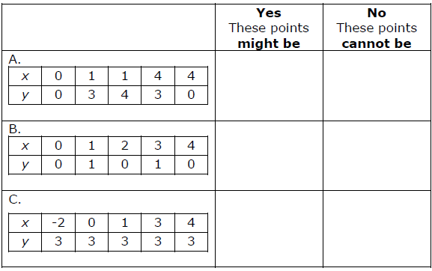
#4
Some students are studying graphs of functions y = f(x) and other equations. Each table contains some points on a particular graph. Decide whether each set of points might be on the graph of a function or cannot be on the graph of a function.
Notes:
‹#›

Slide 9
#4 Answer
Rubric:
(1 point) The student correctly identifies the true statement.
Answer: N, Y, Y
Notes:
‹#›

Slide 10
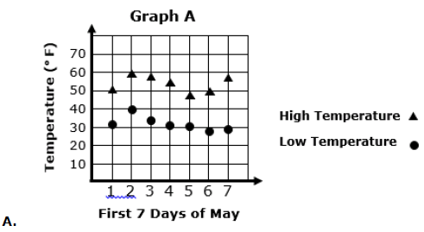
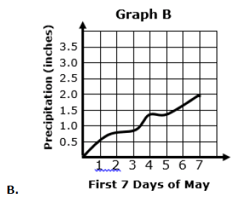
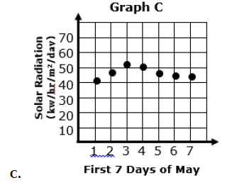
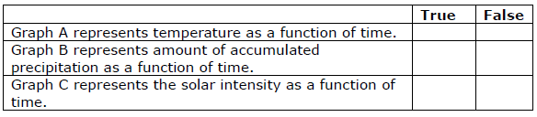
#5
The graphs below show different information about the weather in a large city in the U.S. for one week in May.
Determine whether each graph represents the given quantity as a function of time.

Slide 11
#5 Answer
Rubric:
(1 point) The student chooses the correct responses.
Answer: F, T, T

Slide 12
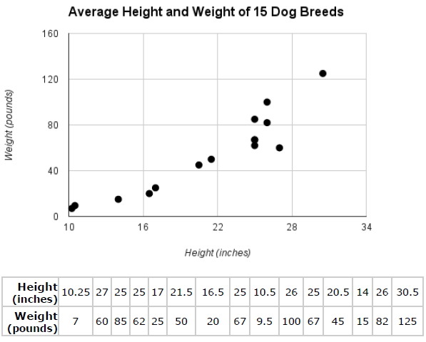
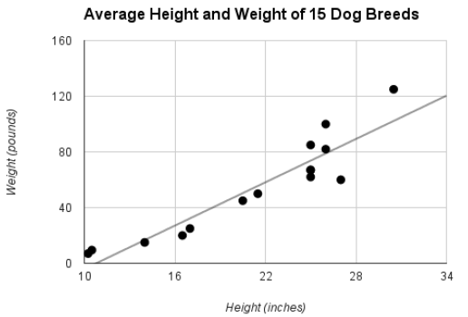
#6
The scatterplot represents the relationship between the average height and weight of 15 different dog breeds.
The second graph shows the same data with a line of best fit.
Which statement best describes the relationship displayed by the scatterplot and line of best fit?
Both the scatterplot and the line of best fit represent a function.
The scatterplot represents a function but the line of best fit does not.
The line of best fit represents a function but the scatterplot does not.
Neither represents a function.
Notes:
‹#›

Slide 13
#6 Answer
Rubric:
(1 point) The student chooses the correct response.
Answer: C
Notes:
‹#›

Slide 14
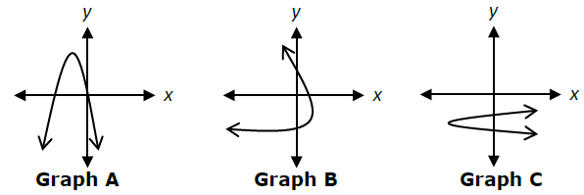
#7
Three different parabolas, each defined by a different equation, are shown in the coordinate plane.
Which graph represents y as a function of x?
Graph A
Graph B
Graph C
None of the graphs
Notes:
‹#›

Slide 15
#7 Answer
Rubric:
(1 point) The student chooses the correct response.
Answer: A
Notes:
‹#›

Slide 16

#8
The height in meters, h, of a model rocket above the ground is given t seconds after launch by the equation
h = -5t² + 40t
Given this information, indicate whether each statement is true or false.
Notes:
‹#›

Slide 17
#8 Answer
Rubric:
(1 point) The student chooses the correct responses.
Answer: T, F
Notes:
‹#›

Slide 18
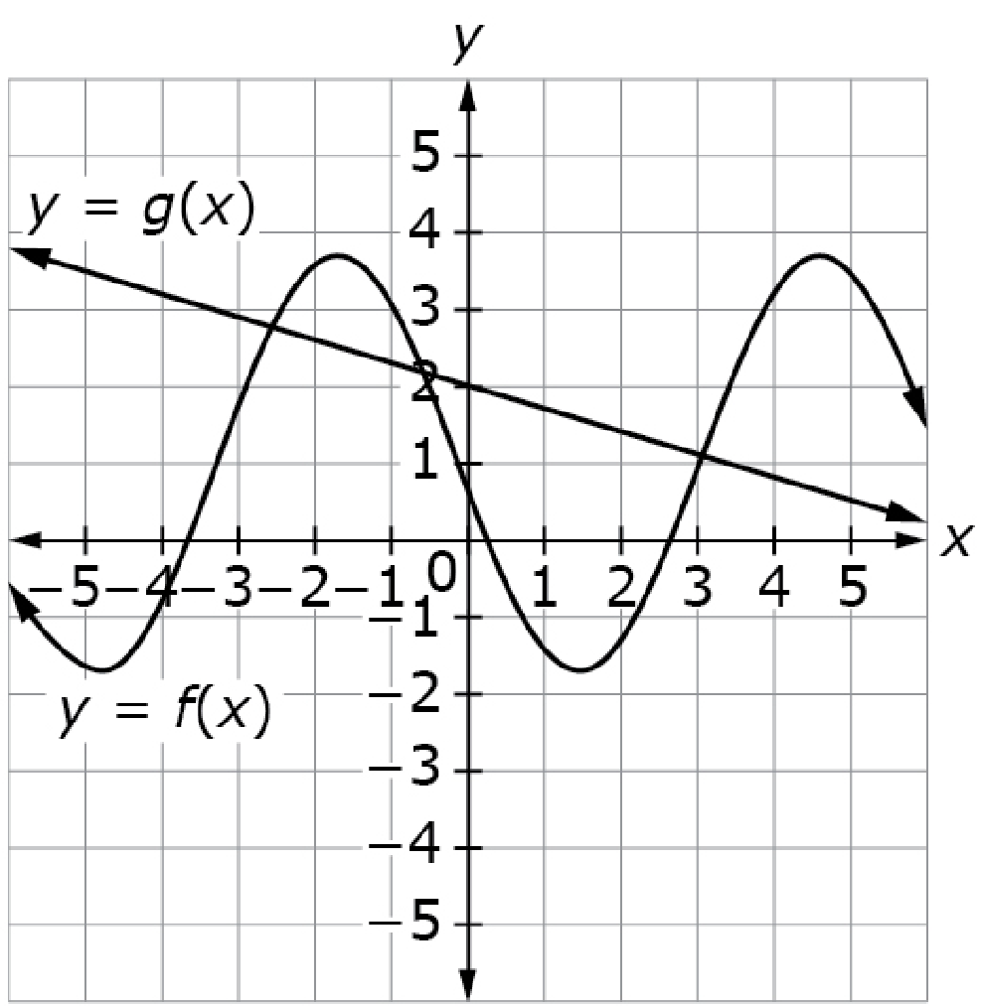
#9
The graphs of y = g(x) and y = f(x) are shown.
Use the “Add Point” tool to add a point that will satisfy each given condition.
A. A point on the graph of g where
x = 0.
B. A point on the graph of g where
f(x) > g(x).
C. A point on the graph of f where
f(x) = 0.
Notes:
‹#›

Slide 19
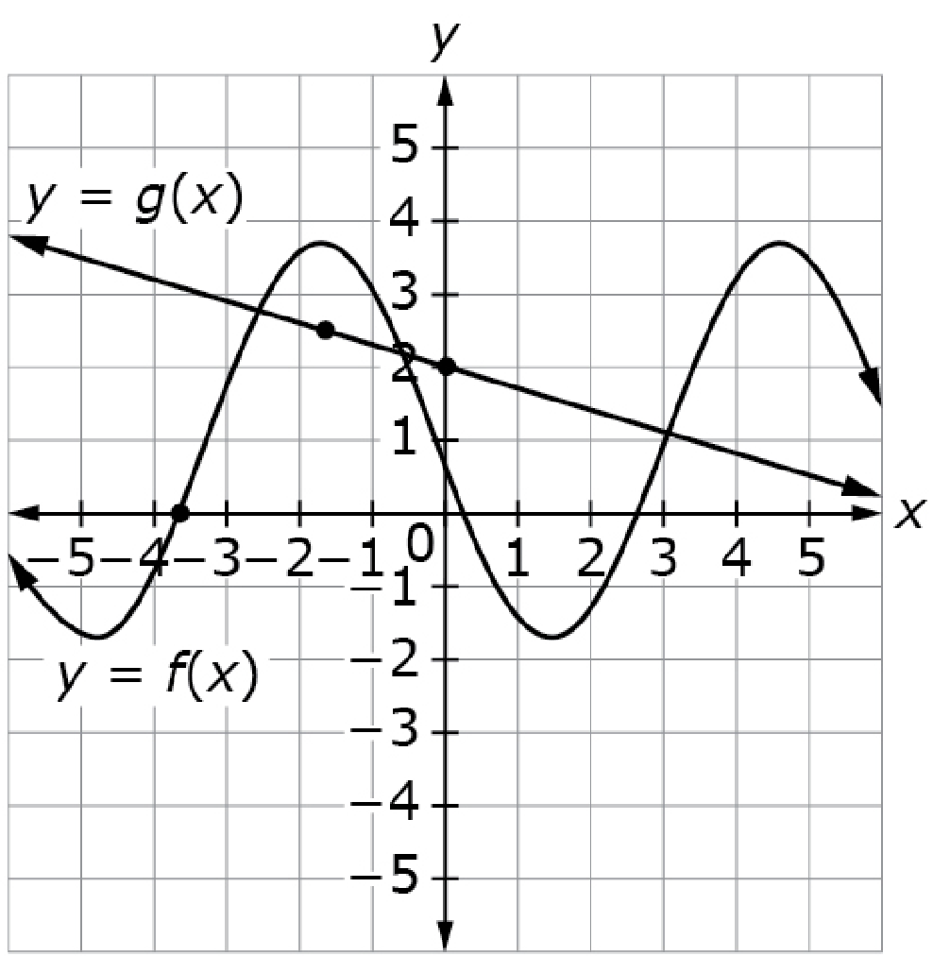
#9 Answer
Rubric:
(2 points) The student correctly plots points defined by the conditions.
(1 point) The student correctly plots two of the three points defined by the conditions.
Answers:
A: The y-intercept of g,
B: Any point on the graph of g
sitting under the graph of f,
C: Any of the three points where
the graph of f crosses the x-axis).
Notes:
‹#›

Slide 20
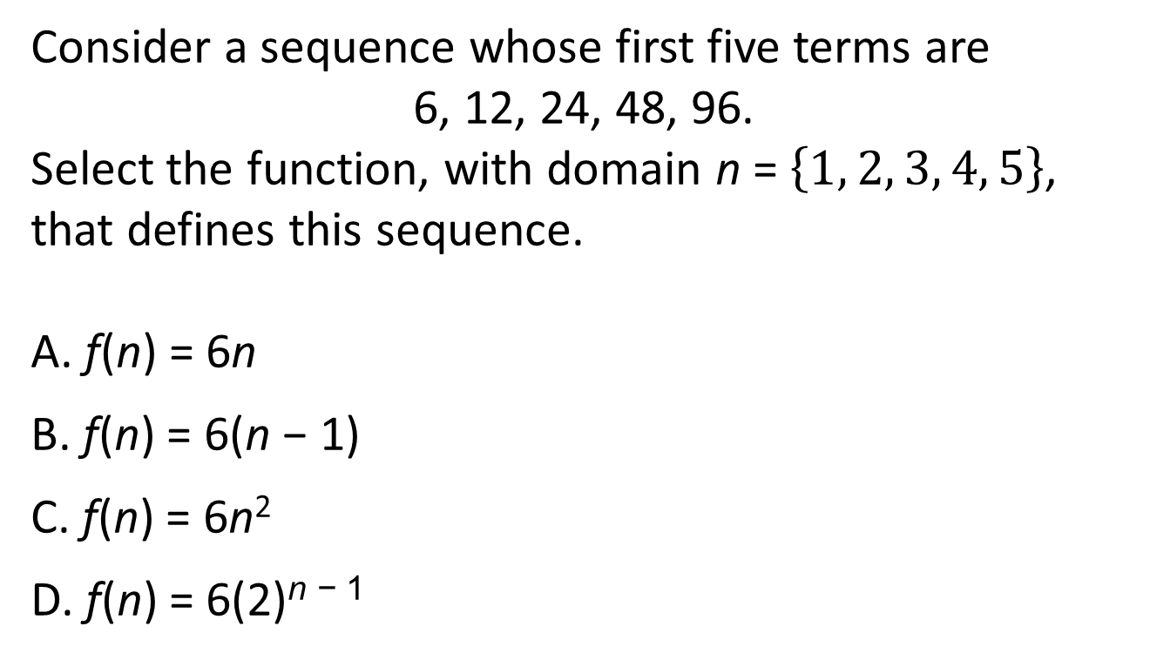
#10
Notes:
‹#›

Slide 21

#10 Answer
Rubric:
(1 point) The student correctly identifies the equation of the function defined by the sequence.
Answer: D
Notes:
‹#›

