Slide 1

Claim 1
Smarter Balanced Sample Items
High School - Target J
Represent and solve equations and inequalities graphically.
Questions courtesy of the Smarter Balanced Assessment Consortium Item Specifications – Version 3.0
Slideshow organized by SMc Curriculum – www.ccssmathactivities.com
Notes:
‹#›

Slide 2


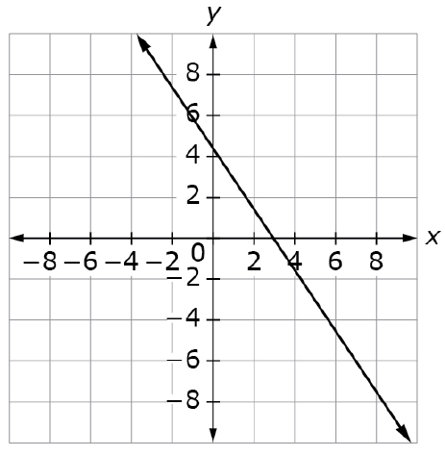
#1
If x = n then y = 6 is a solution to the equation represented by the graph shown.
What is the approximate
value of n?
A. -13.5
B. -1
C. 4.5
D. 7
Notes:
‹#›

Slide 3

#1 Answer
Rubric:
(1 point each) The student identifies the correct value of n.
Answer: B

Slide 4
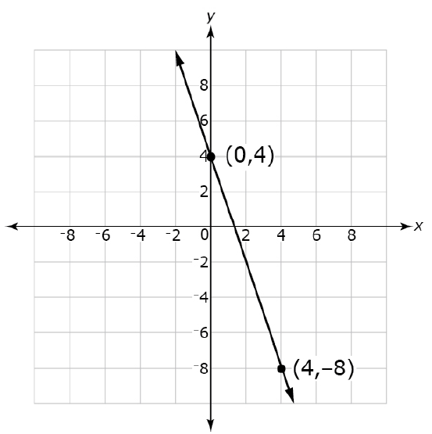
#2
If (8, b) is a solution to the equation represented by the graph below, what is the value of b?

Slide 5
#2 Answer
Rubric:
(1 point each) The student enters the correct value for b.
Answer: -20

Slide 6
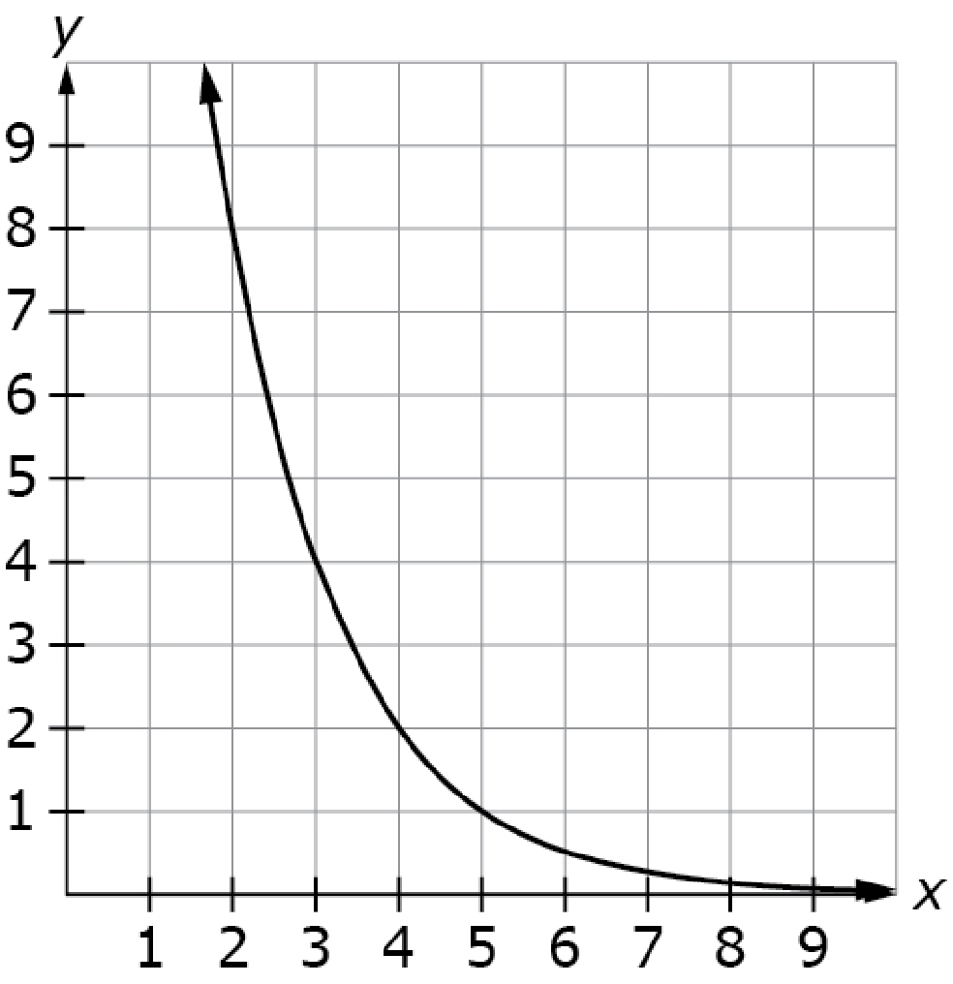
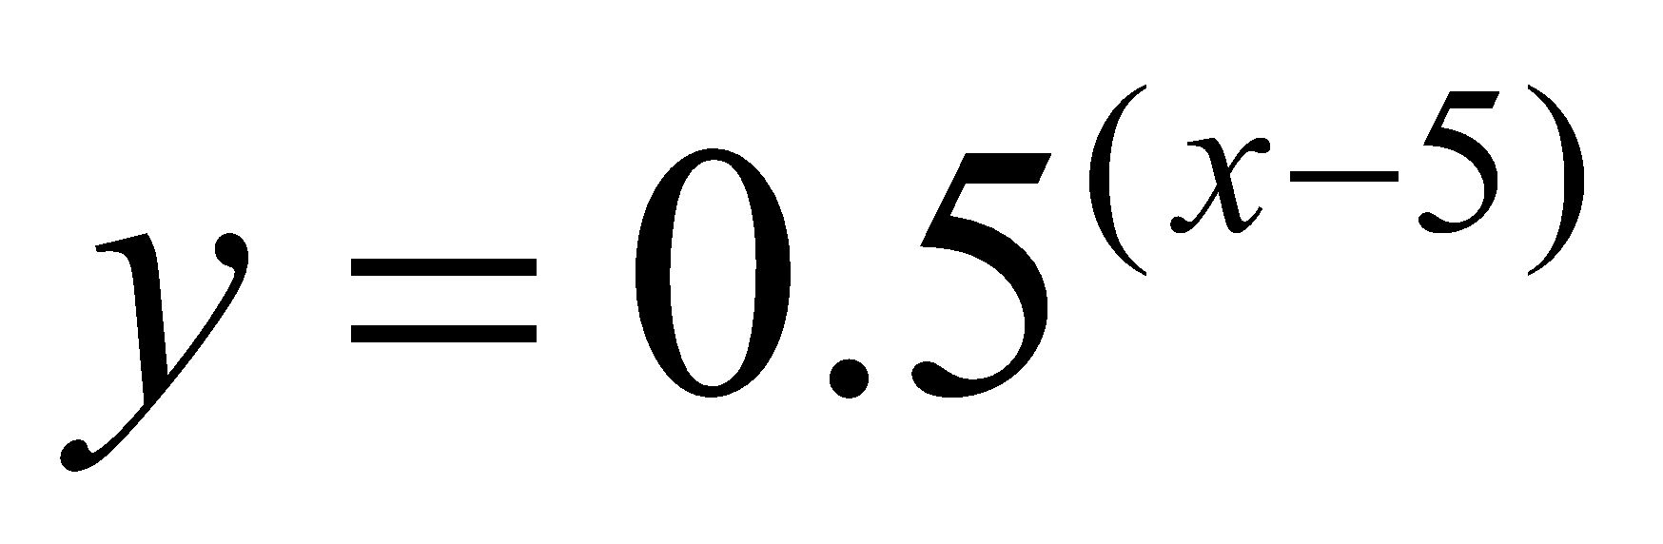
#3
This graph represents the equation
. How many ordered pairs (x, y) for 1 < 𝑥 < 9 satisfy this equation?
No ordered pairs
Exactly one ordered pair
Exactly two ordered pairs
An infinite number of ordered pairs
Notes:
‹#›

Slide 7
#3 Answer
Rubric:
(1 point) The student selects the correct statement about the number of ordered pairs.
Answer: D
Notes:
‹#›

Slide 8
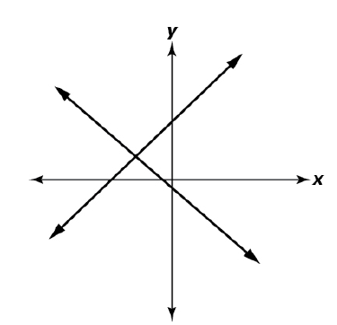
#4
The graph of a system of linear equations is shown.
How many solutions does this system of equations have?
No solutions
Exactly one solution
Exactly two solutions
An infinite number of solutions
Notes:
‹#›

Slide 9
#4 Answer
Rubric:
(1 point) Students selects the correct statement about the number of solutions.
Answer: B
Notes:
‹#›

Slide 10
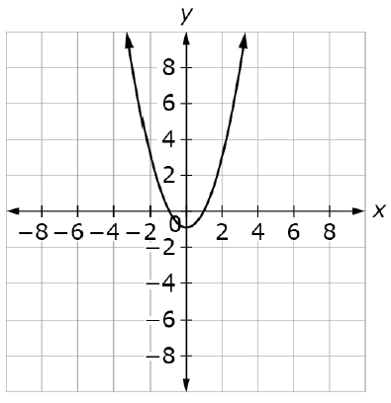

#5
p is a quadratic function. The graph of y = p(x) is shown.
Select one or more intervals with consecutive integer endpoints that contain the solution(s) of the equation 13 = p(x)
Notes:
‹#›

Slide 11
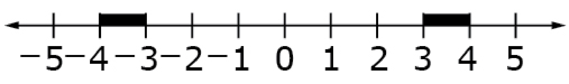
#5 Answer
Rubric:
(1 point) The student chooses only the correct consecutive integer intervals.
Answer:
Notes:
‹#›

Slide 12
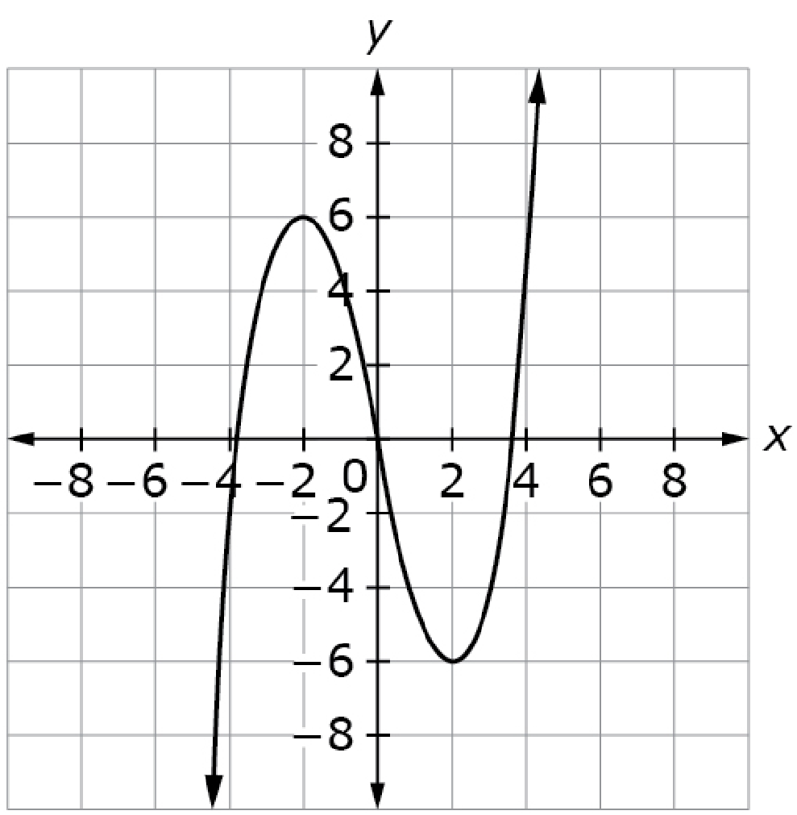

#6
p is a third degree polynomial. The
graph of y = p(x) is shown.
Select one or more intervals with
consecutive even integer endpoints
that contain the solution(s) of the
equation 2 = p(x)
Notes:
‹#›

Slide 13

#6 Answer
Rubric:
(1 point) The student correctly identifies the intervals that contain the solution to the equation.
Answer:
Notes:
‹#›

Slide 14
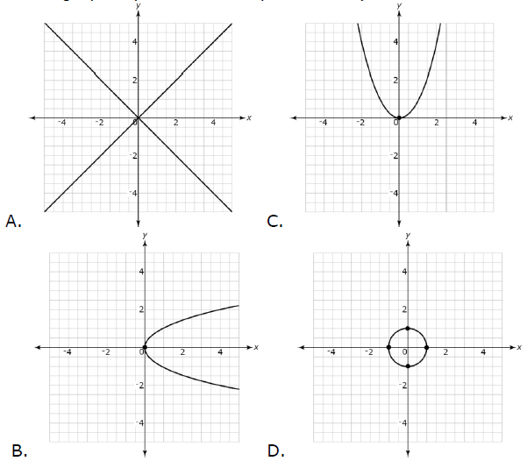
#7
Notes:
‹#›

Slide 15
#7 Answer
Rubric:
(1 point) Student selects the correct graph to match the equation.
Answer: D
Notes:
‹#›

Slide 16
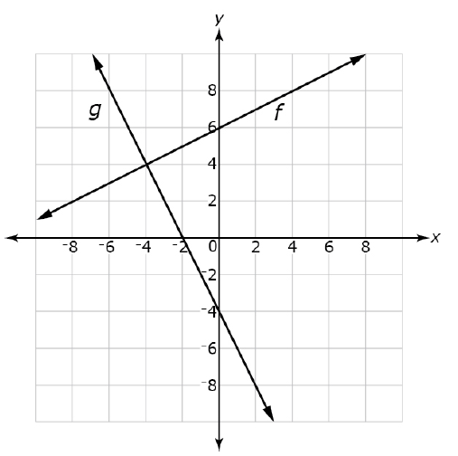
#8
The graphs of the linear functions f and g are shown.
Enter the solution to the equation f(x) = g(x)
Notes:
‹#›

Slide 17
#8 Answer
Rubric: (1 point) The student correctly enters the x-coordinates of the point(s) where the graph of the two functions intersect.
Answer: -4
Notes:
‹#›

Slide 18
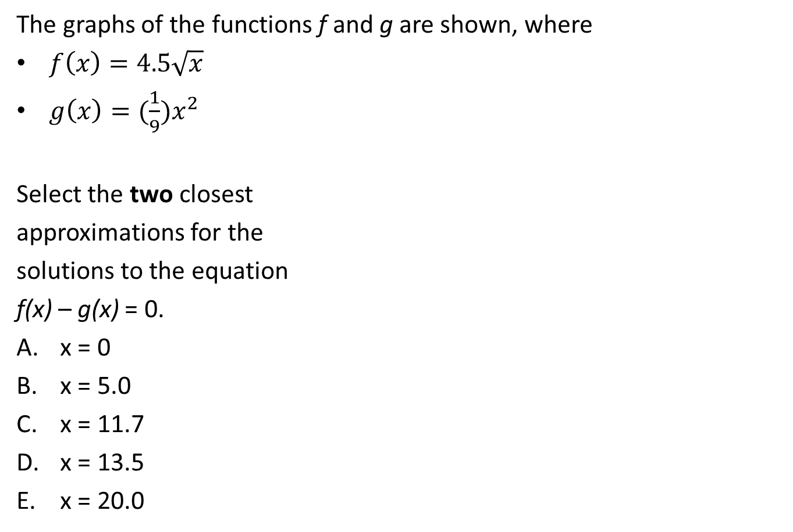
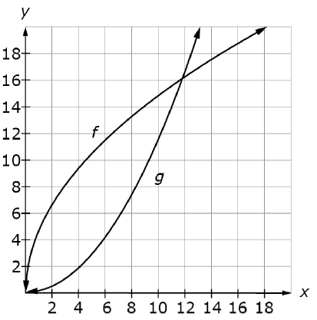
#9
Notes:
‹#›

Slide 19
#9 Answer
Rubric:
(1 point) The student correctly selects the solutions to the equation.
Answer: A, C
Notes:
‹#›

Slide 20
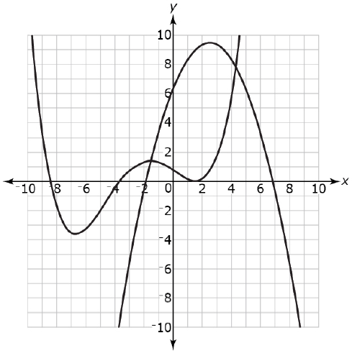
#10
The graphs of two polynomial functions f and g of degree 2 and degree 4 are shown.
How many solutions are there to
the equation f(x) = g(x)? Enter your
answer in the first response box.
Enter one of the solutions to the
equation f(x) = g(x) to the nearest
0.5 in the second response box.
Notes:
‹#›

Slide 21

#10 Answer
Rubric:
(2 points) Student identifies that there are 2 solutions to the equation f(x) = g(x) and enters one of them to the nearest 0.5
Answer: -1.5 +/- 0.4 or 4.5 +/- 0.4
Notes:
‹#›

Slide 22
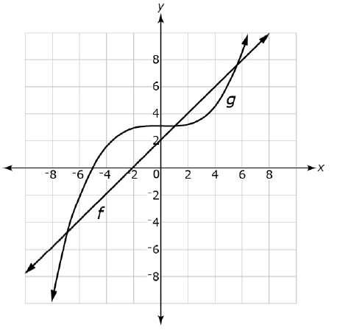
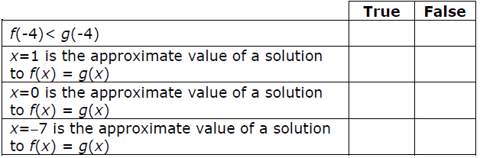
#11
The graphs of y = f(x) and y = g(x) are shown. Indicate whether each statement about these graphs is true or false.
Notes:
‹#›

Slide 23
#11 Answer
Rubric:
(1 point) Student answers each statement correctly.
Answer: T, T, F, T
Notes:
‹#›

Slide 24
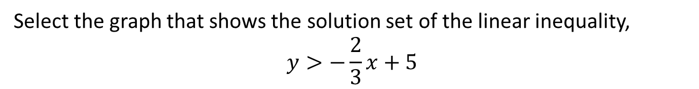
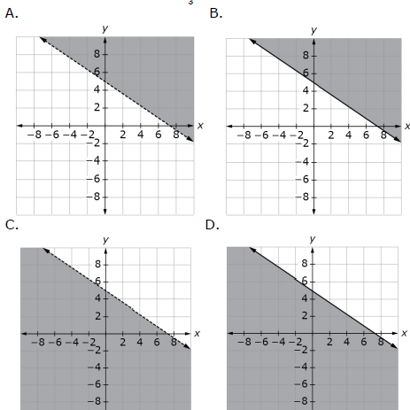
#12
Notes:
‹#›

Slide 25
#12 Answer
Rubric:
(1 point) Student selects the graph for the linear inequality.
Answer: A
Notes:
‹#›

Slide 26
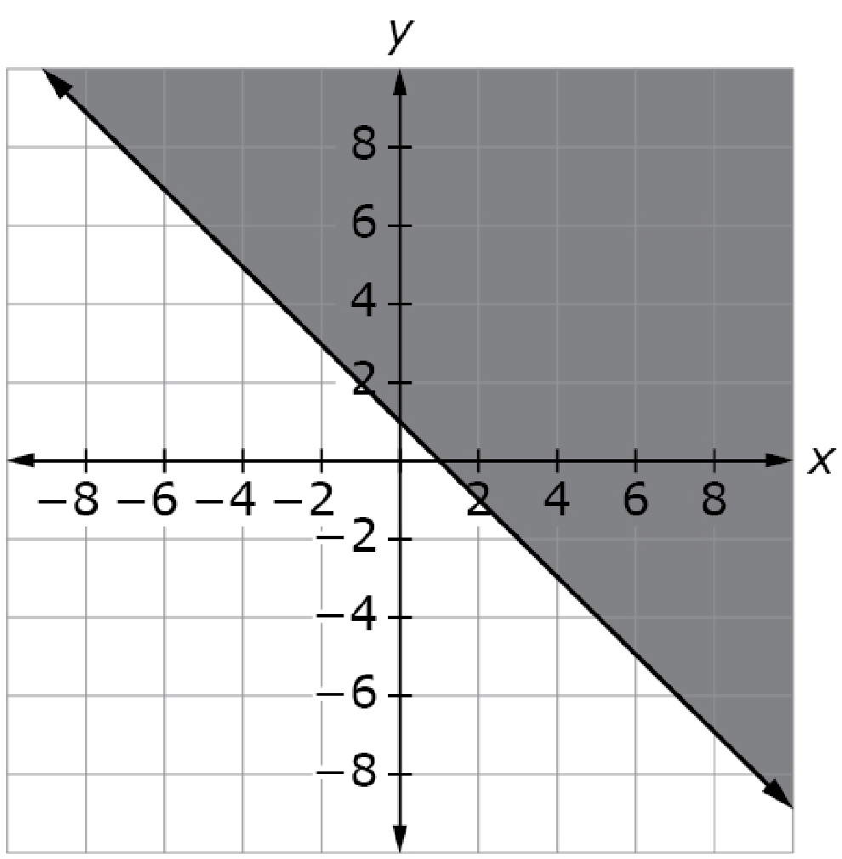
#13
The graph shown represents the set of ordered pairs that are solutions to an inequality.
Enter the inequality that best represents the solution set shown by the line and the shaded region in the plane.

Slide 27
#13 Answer
Rubric:
(1 point) Student enters the inequality.
Answer: y ≥ −x + 1

Slide 28
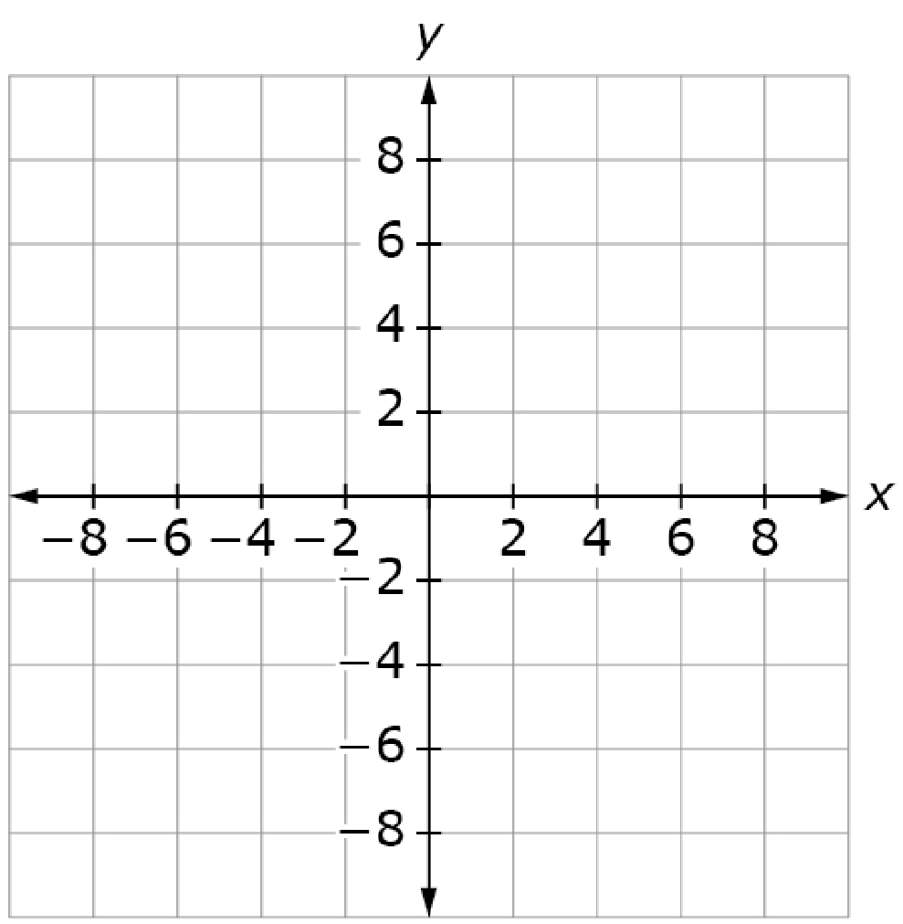
#14
Part A:
Graph the line representing the boundary of the linear inequality, 𝑥 + 𝑦 ≥ 1.
Part B:
Plot a point representing an ordered
pair that is part of the solution set
of this inequality that is not on the
boundary.
Notes:
‹#›

Slide 29
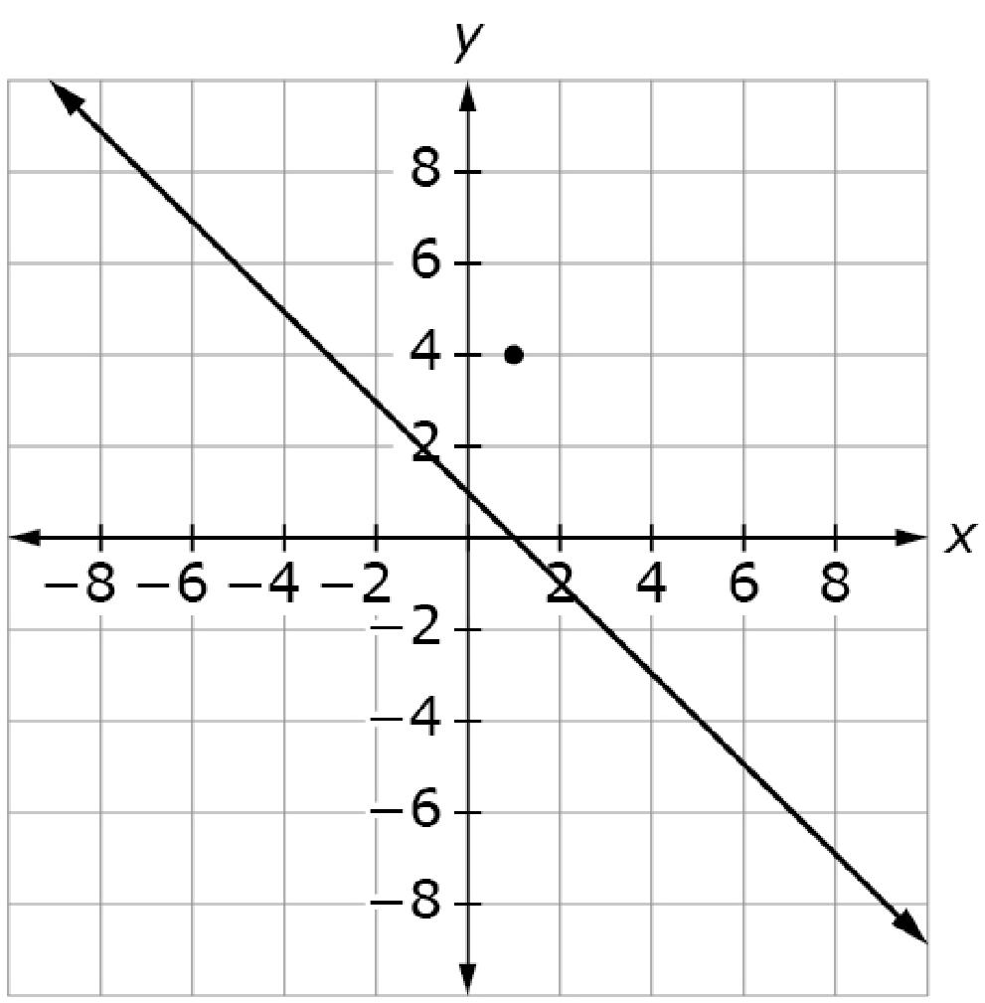
#14 Answer
Rubric:
(1 point) Student graphs the equation and plots a point within the solution set.
Answer:
Notes:
‹#›

Slide 30
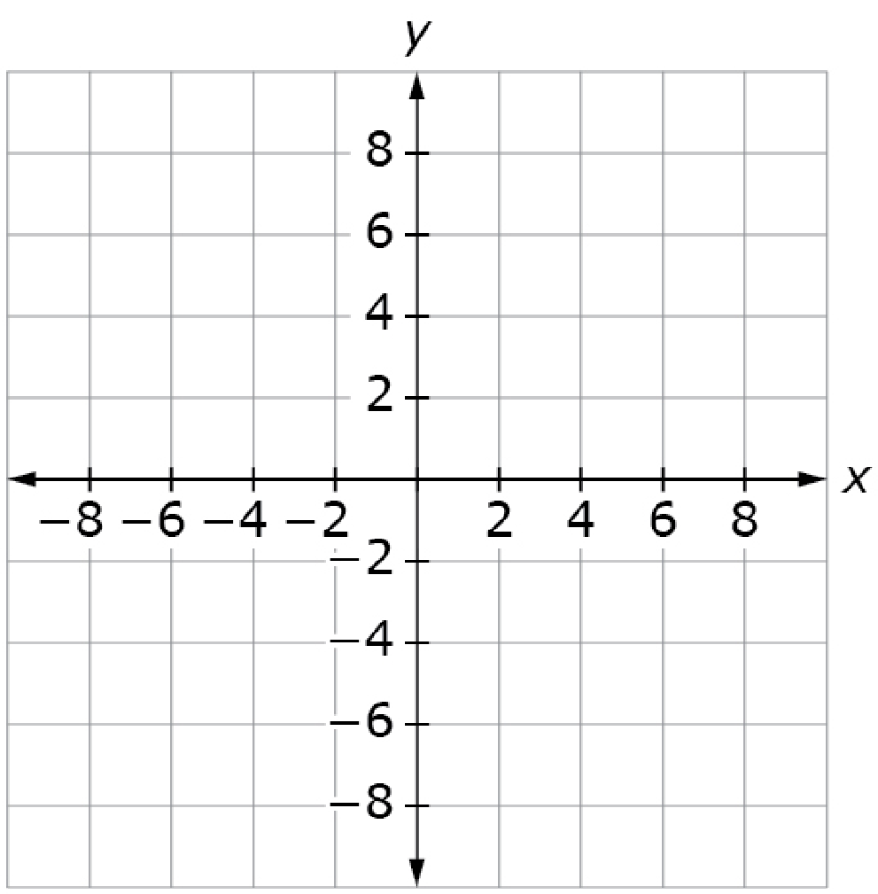
#15
Part A:
Graph the lines representing the boundaries of the system of linear inequalities.
3x + 2y ≤ 6
4x − y ≤ 8
Part B:
Plot a point within the solution set
that is not on either boundary line.

Slide 31
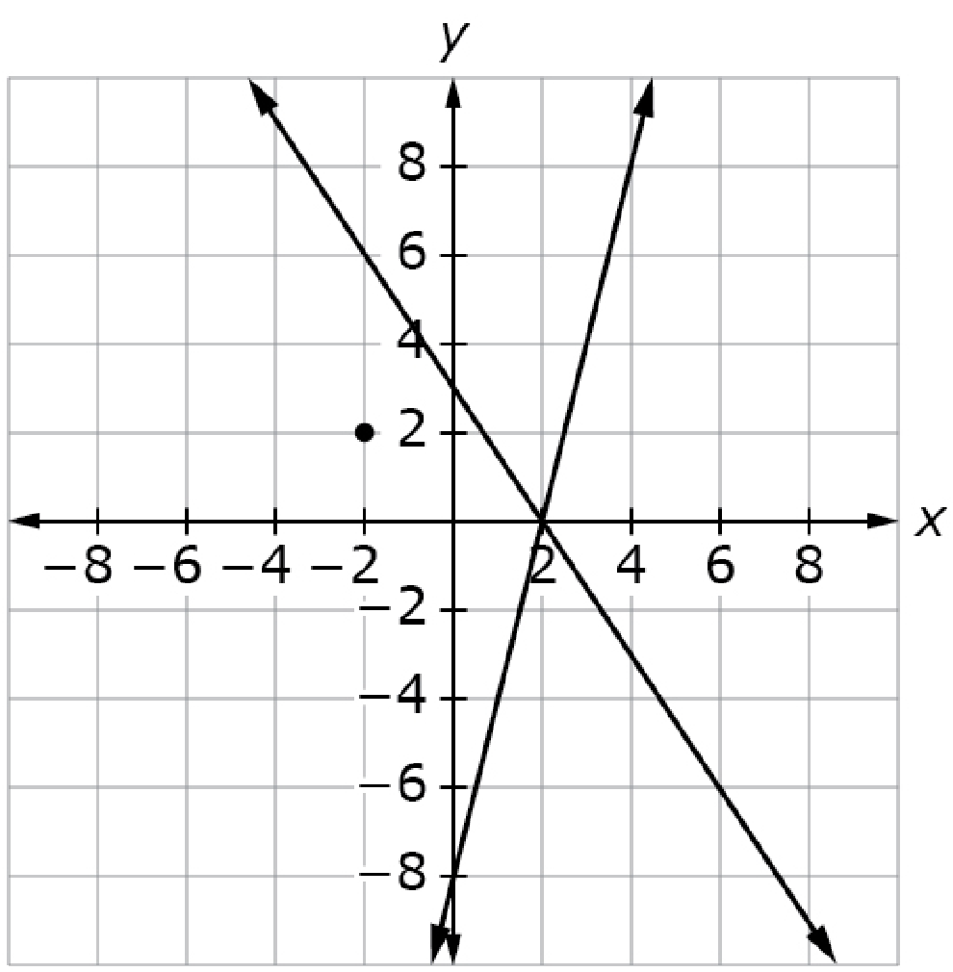
#15 Answer
Rubric:
(1 point) Student graphs the boundary lines for a system of linear inequalities and plots a point in the region containing the solution set.
Answer:

Slide 32
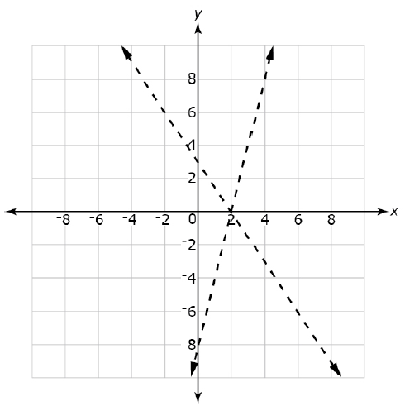
#16
Click on the region of the graph that contains the solution set of the system of linear inequalities.
3x + 2y ≤ 6
4x − y ≤ 8
Notes:
‹#›

Slide 33
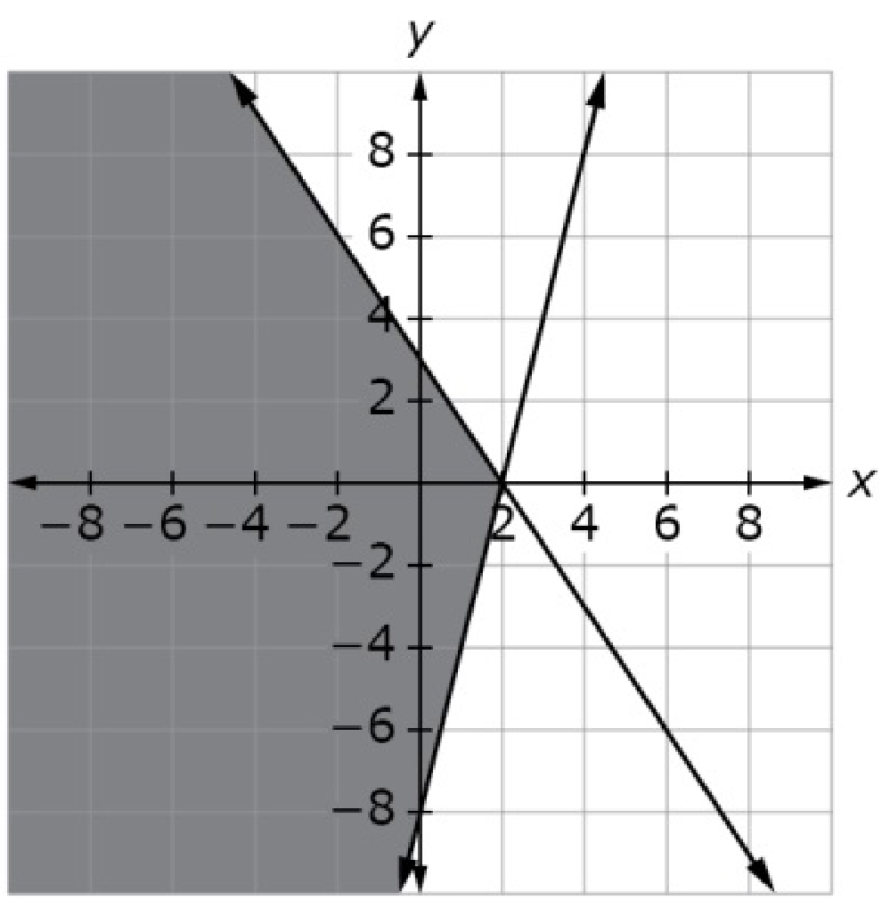
#16 Answer
Rubric:
(1 point) Student correctly selects the region containing the solution set.
Answer:
Notes:
‹#›

Slide 34
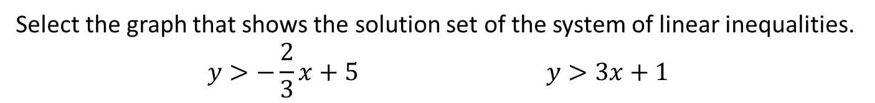
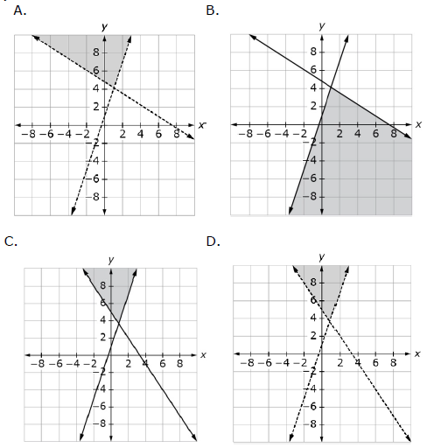
#17
Notes:
‹#›

Slide 35
#17 Answer
Rubric:
(1 point) Student selects the graph given the system of linear inequalities.
Answer: A
Notes:
‹#›

Slide 36
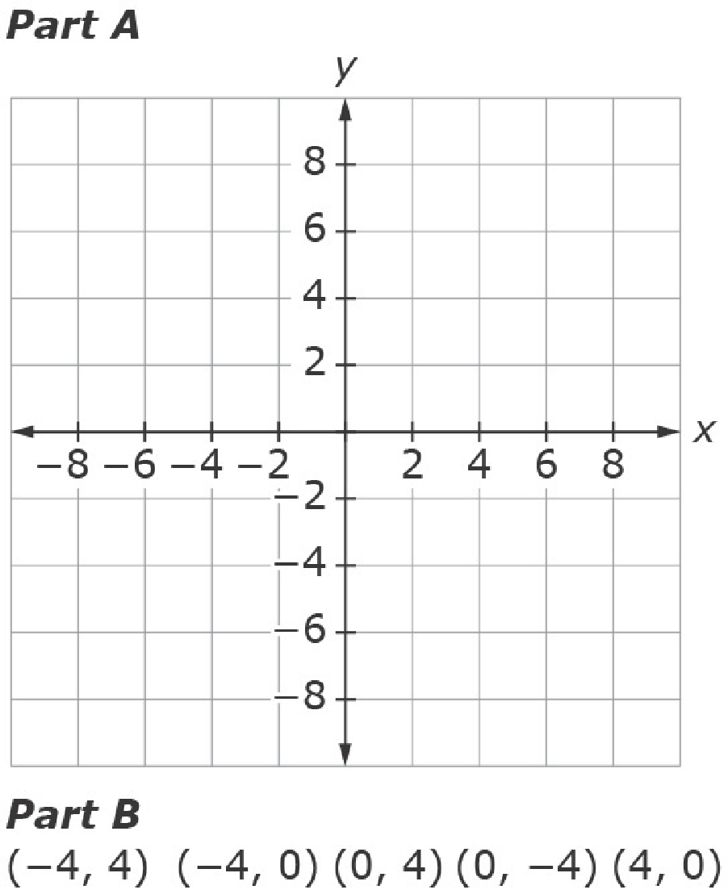
#18
Part A:
Graph the lines representing the
boundaries of the system of linear
inequalities.
3x + 2y ≤ 6
4x − y ≤ 8
Part B:
Determine if each ordered pair is a
part of the solution set of the system of linear inequalities. Select the ordered pair(s) that are in the solution set.
Notes:
‹#›

Slide 37
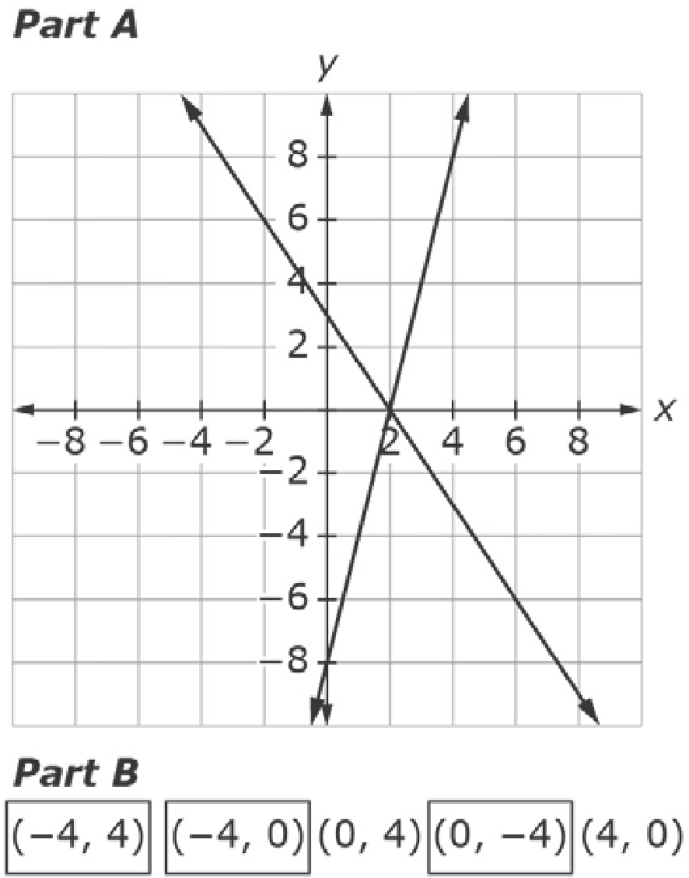
#18 Answer
Rubric: (2 points) The student graphs the boundary lines for a system of linear inequalities correctly and selects the ordered pairs in the solution set.
(1 point) The student graphs the boundary lines for a system of linear inequalities correctly or selects the ordered pairs in the solution set.
Answer:
Notes:
‹#›

