Slide 1

Claim 1
Smarter Balanced Sample Items
High School - Target I
Solve equations and inequalities in one variable.
Questions courtesy of the Smarter Balanced Assessment Consortium Item Specifications – Version 3.0
Slideshow organized by SMc Curriculum – www.ccssmathactivities.com
Notes:
‹#›

Slide 2

#1
Enter the value for x that makes the given equation true.
48 = x − 3
Notes:
‹#›

Slide 3

#1 Answer
Rubric:
(1 point) The student enters the correct value for the variable x.
Answer: 51
Notes:
‹#›

Slide 4
#2
Enter the value for x that makes the given equation true.
20x − 5(6x + 4) = 4x − 6
Notes:
‹#›

Slide 5
#2 Answer
Rubric:
(1 point) The student enters the correct value for the variable x.
Answer: −1
Notes:
‹#›

Slide 6
#3
Solve the inequality for n.
45 ≥ −15n
Notes:
‹#›

Slide 7
#3 Answer
Rubric:
(1 point) The student enters the correct solution to the inequality.
Answer: n ≥ −3
Notes:
‹#›

Slide 8
#4
Solve the inequality for w.
-2w + 17 < 13

Slide 9
#4 Answer
Rubric:
(1 point) The student enters the correct solution to the inequality.
Answer: w > 2

Slide 10
#5
Which inequality represents all possible solutions of −3n < 12?
A. n < −36
B. n < −4
C. n > −36
D. n > −4

Slide 11
#5 Answer
Rubric:
(1 point) The student selects the correct option.
Answer: D

Slide 12
#6
For the given equation, enter the value of B when
x = 10.
Bx = 20

Slide 13
#6 Answer
Rubric:
(1 point) The student enters the correct value.
Answer: 2

Slide 14
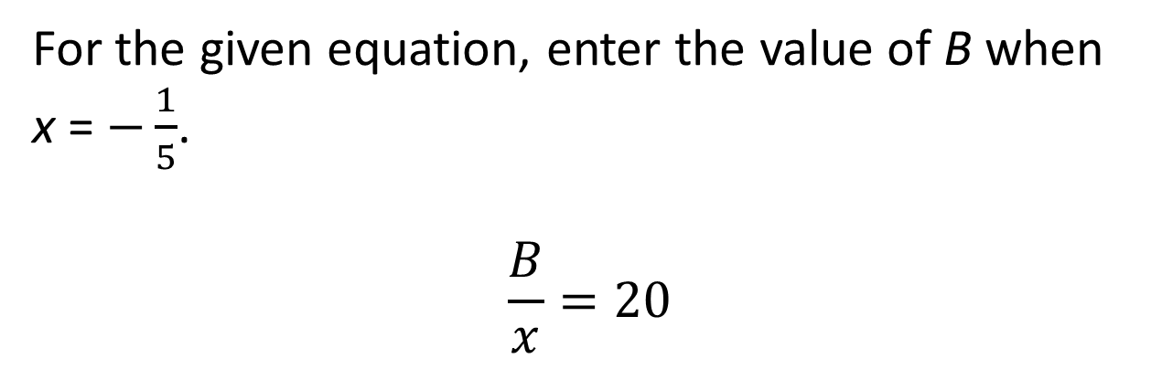
#7

Slide 15
#7 Answer
Rubric:
(1 point) The student enters the correct value.
Answer: -4

Slide 16
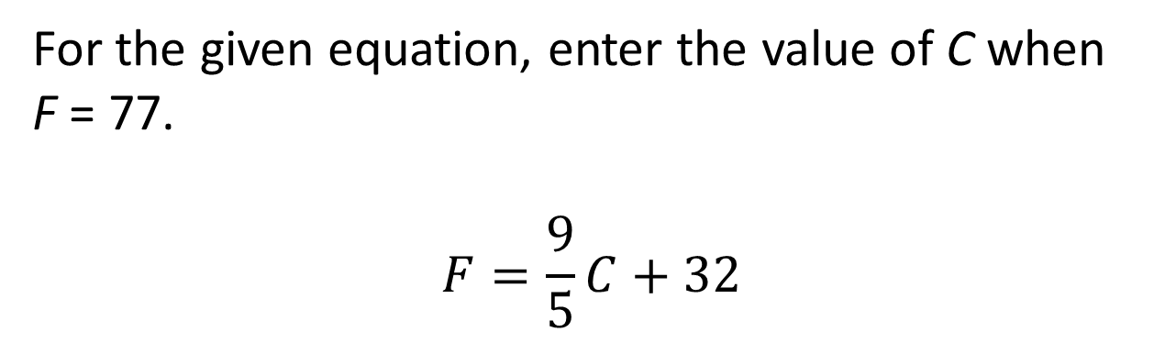
#8

Slide 17
#8 Answer
Rubric:
(1 point) The student enters the correct value.
Answer: 25

Slide 18
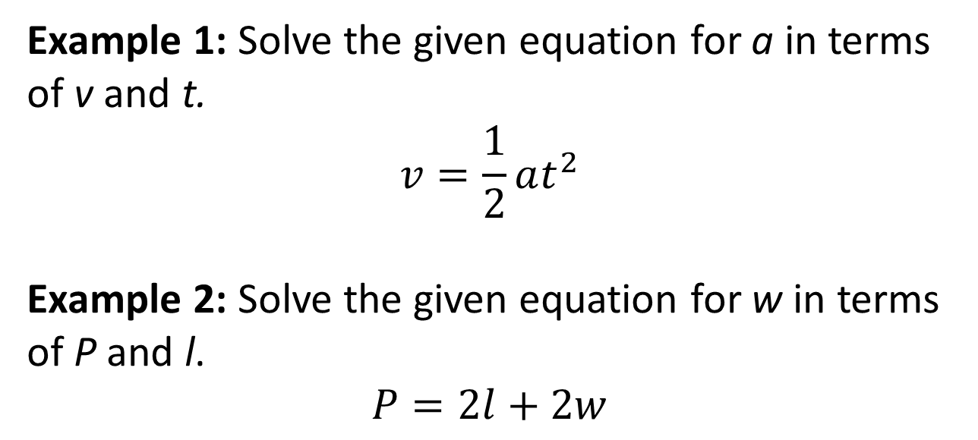
#9

Slide 19
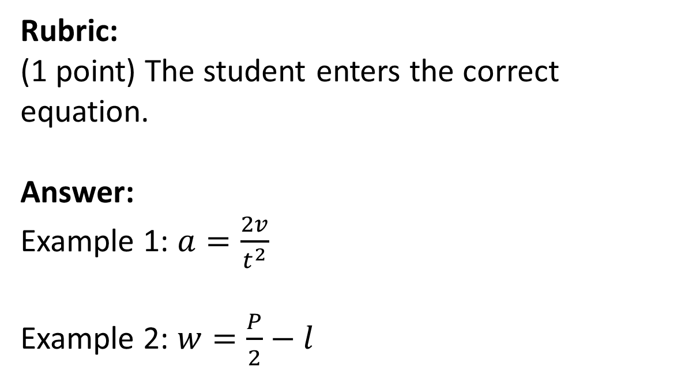
#9 Answer

Slide 20
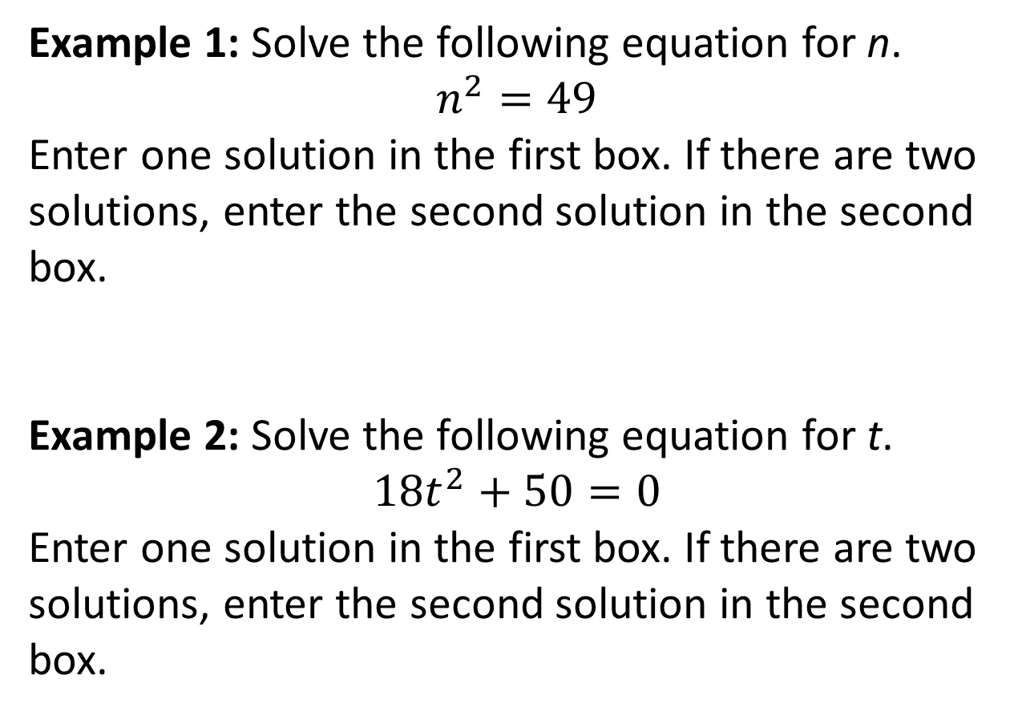
#10

Slide 21

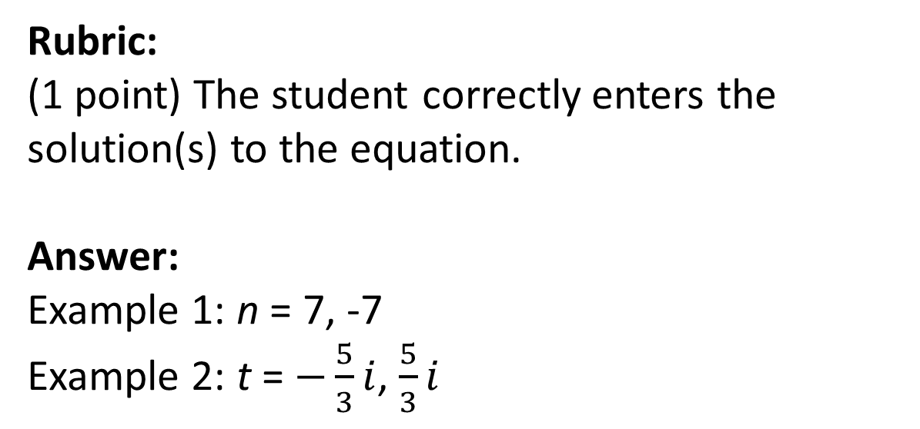
#10 Answer

Slide 22
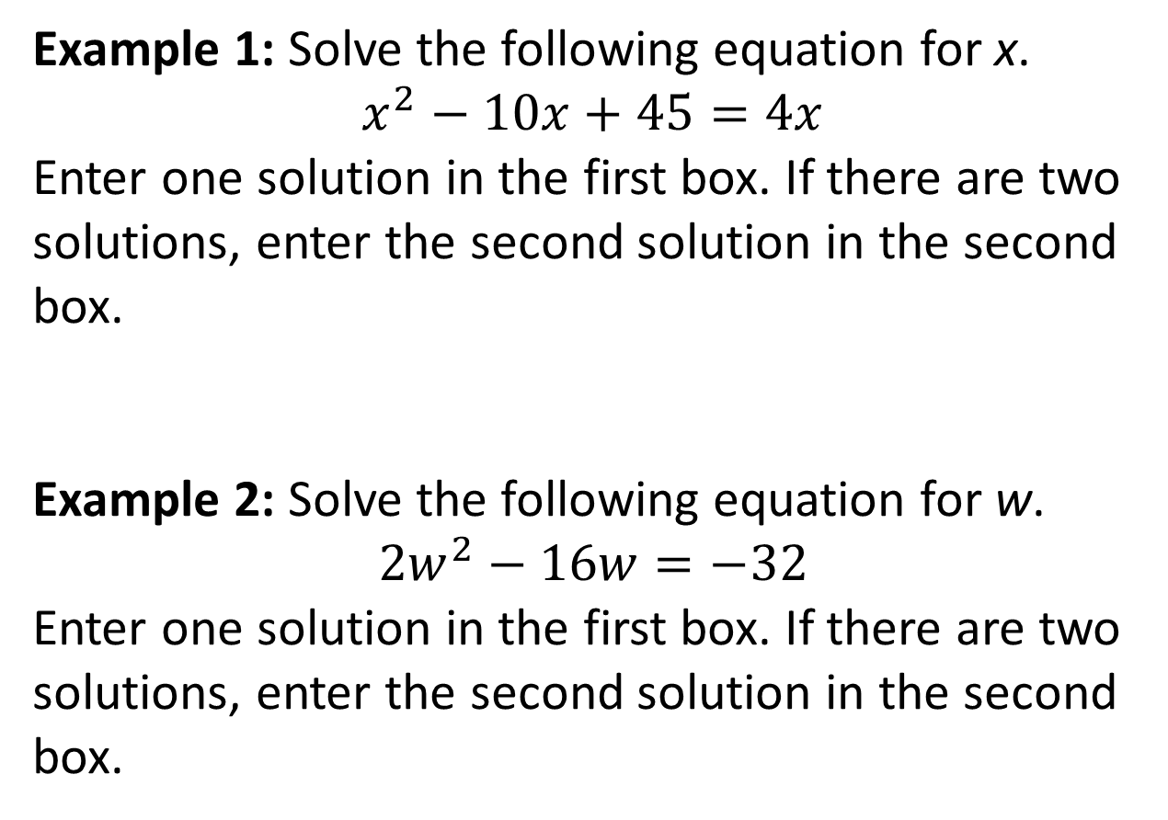
#11

Slide 23
#11 Answer
Rubric:
(1 point) The student correctly enters the solution(s) to the equation.
Answer:
Example 1: x = 9, 5
Example 2: w = 4, --

Slide 24
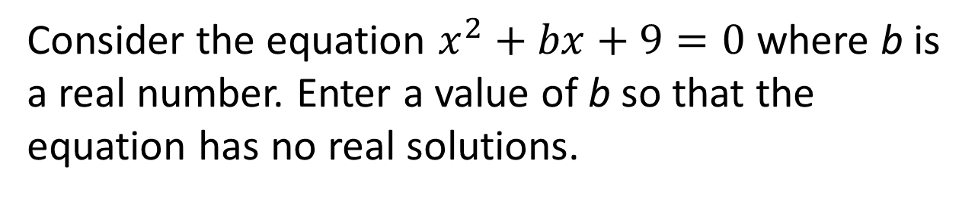
#12

Slide 25
#12 Answer
Rubric:
(1 point) The student enters a correct value for b
Answer: -6 < b < 6

Slide 26
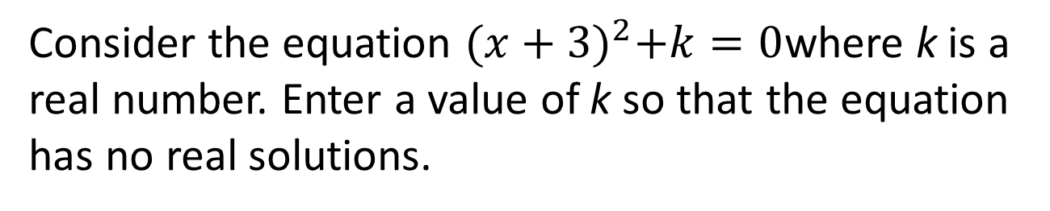
#13

Slide 27
#13 Answer
Rubric:
(1 point) The student enters a correct value for k
Answer: -0 < k

Slide 28
#14
What are the solutions for the given equation?
x² + 4x + 16 = 0
A. x = −2 ± 4i √3
B. x = −2 ± 2 √3
C. x = −2 ± 2i √3
D. x = −2 ± 4 √3

Slide 29
#14 Answer
Rubric:
(1 point) The student selects the correct option.
Answer: C

Slide 30
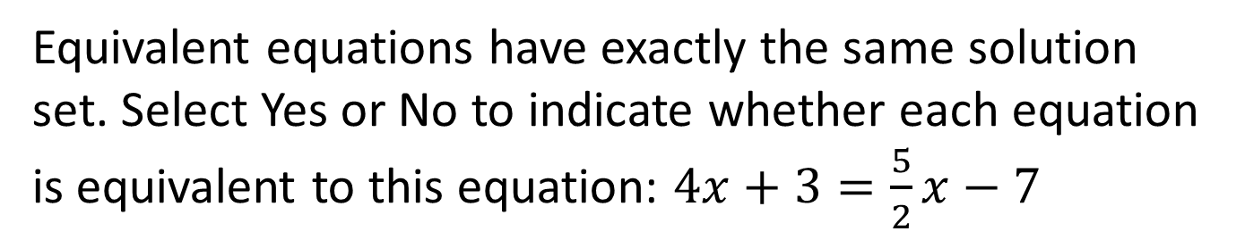
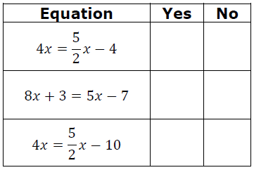
#15

Slide 31
#15 Answer
Rubric:
(1 point) The student correctly determines whether each equation is equivalent to the first.
Answer: N, N, Y

Slide 32
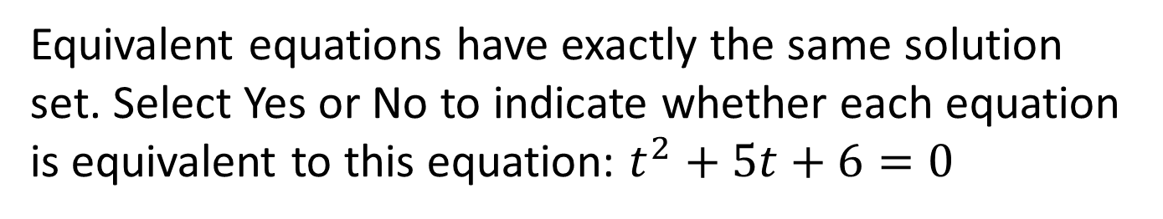
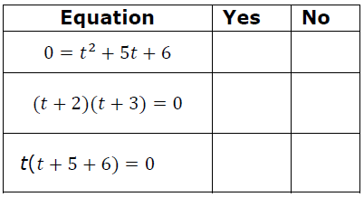
#16

Slide 33
#16 Answer
Rubric:
(1 point) The student correctly determines whether each equation is equivalent to the first.
Answer: Y, Y, N

Slide 34
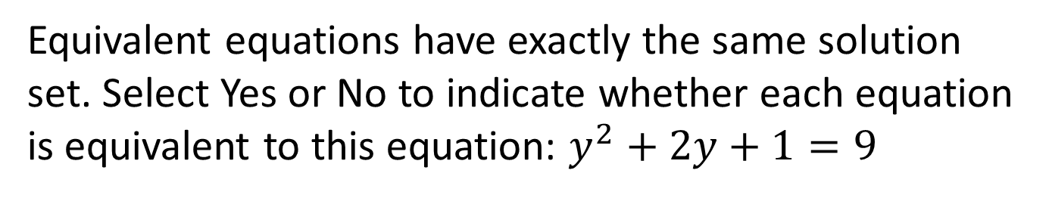
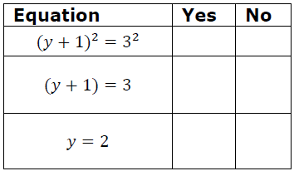
#17

Slide 35
#17 Answer
Rubric:
(1 point) The student correctly determines whether each equation is equivalent to the first.
Answer: Y, N, N

