Slide 1

Claim 1
Smarter Balanced Sample Items
High School - Target H
Understand solving equations as a process of reasoning and explain the reasoning.
Questions courtesy of the Smarter Balanced Assessment Consortium Item Specifications – Version 3.0
Slideshow organized by SMc Curriculum – www.ccssmathactivities.com
Notes:
‹#›

Slide 2

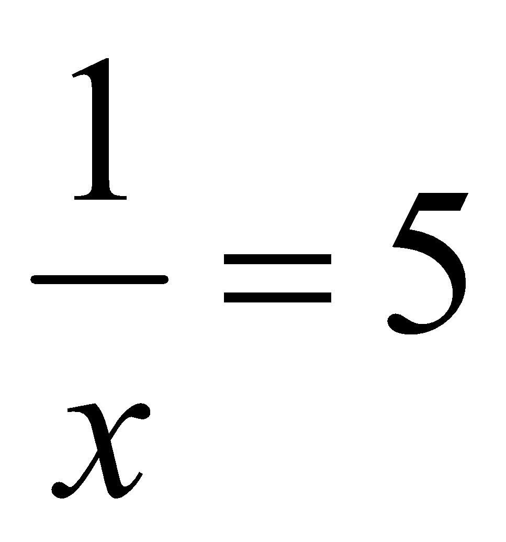
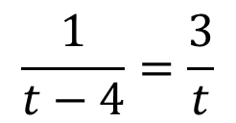
#1
Enter the value of x that makes each equation true.
a.
b.
Notes:
‹#›

Slide 3


#1 Answer
Rubric:
(1 point each) The student enters the correct value of x.
Answer: a.
b. 6
Notes:
‹#›

Slide 4
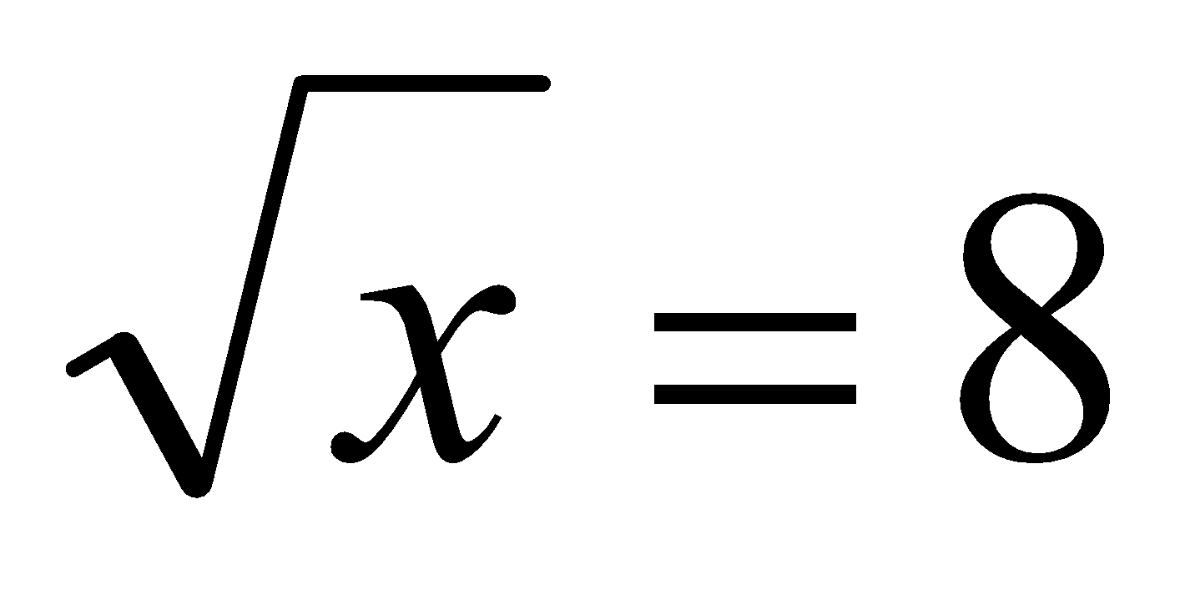
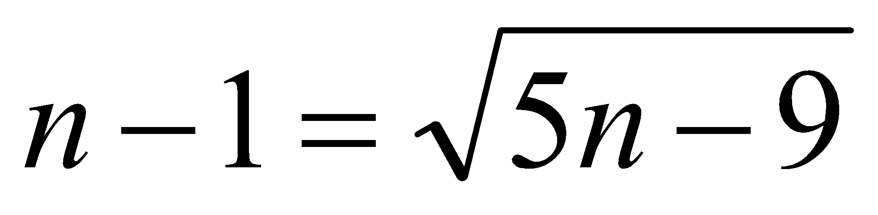
#2
Enter a value of x that makes each equation true.
a.
b.
Notes:
‹#›

Slide 5
#2 Answer
Rubric:
(1 point each) The student enters the correct solution(s).
Answer: a. 64
b. 2, 5
Notes:
‹#›

Slide 6
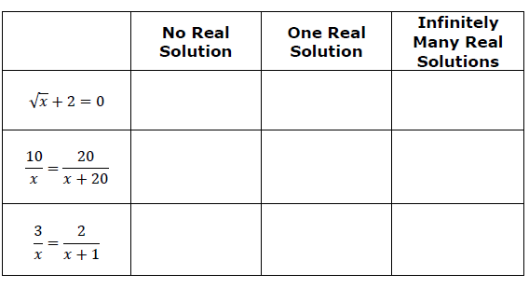
#3
Select whether each equation has no real solutions, one real solution, or infinitely many real solutions.
Notes:
‹#›

Slide 7
#3 Answer
Rubric:
(1 point) The student chooses the correct classification for each equation.
Answer: No Real Solution, One Real Solution, One Real Solution
Notes:
‹#›

Slide 8
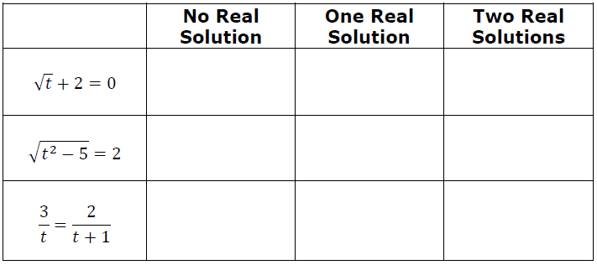
#4
Select whether each equation has no real solution, one real solution, or infinitely many real solutions.
Notes:
‹#›

Slide 9
#4 Answer
Rubric:
(1 point) The student chooses the correct classification for each equation.
Answer: No Real Solution, Two Real Solutions, One Real Solution
Notes:
‹#›

Slide 10
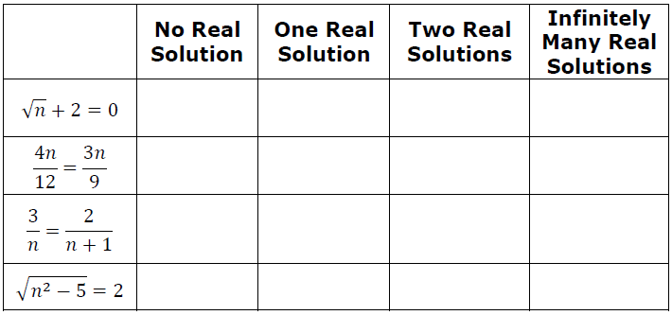
#5
Select whether each equation has no real solution, one real solution, or infinitely many real solutions.
Notes:
‹#›

Slide 11
#5 Answer
Rubric:
(1 point) The student chooses the correct classification for each equation.
Answer: No Real Solution, Infinitely Many Real Solutions, One Real Solution, Two Real Solutions).
Notes:
‹#›

Slide 12
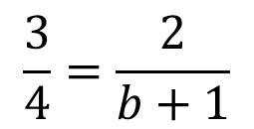
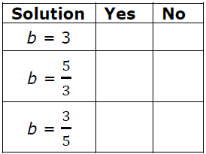
#6
Select Yes or No to indicate whether each value of b is a solution to the given equation.
Notes:
‹#›

Slide 13
#6 Answer
Rubric:
(1 point) The student correctly determines whether each value of x is a solution to the equation.
Answer: N,Y,N
Notes:
‹#›

Slide 14
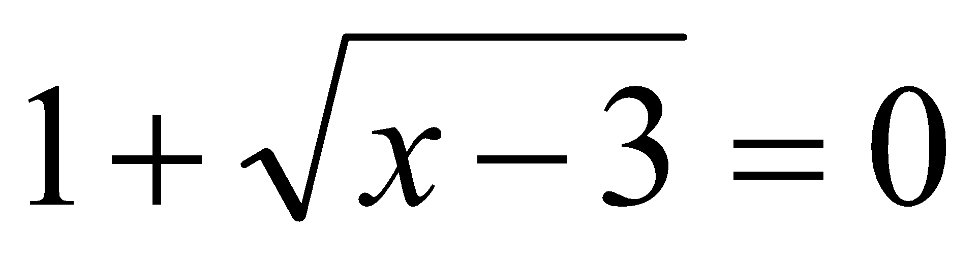
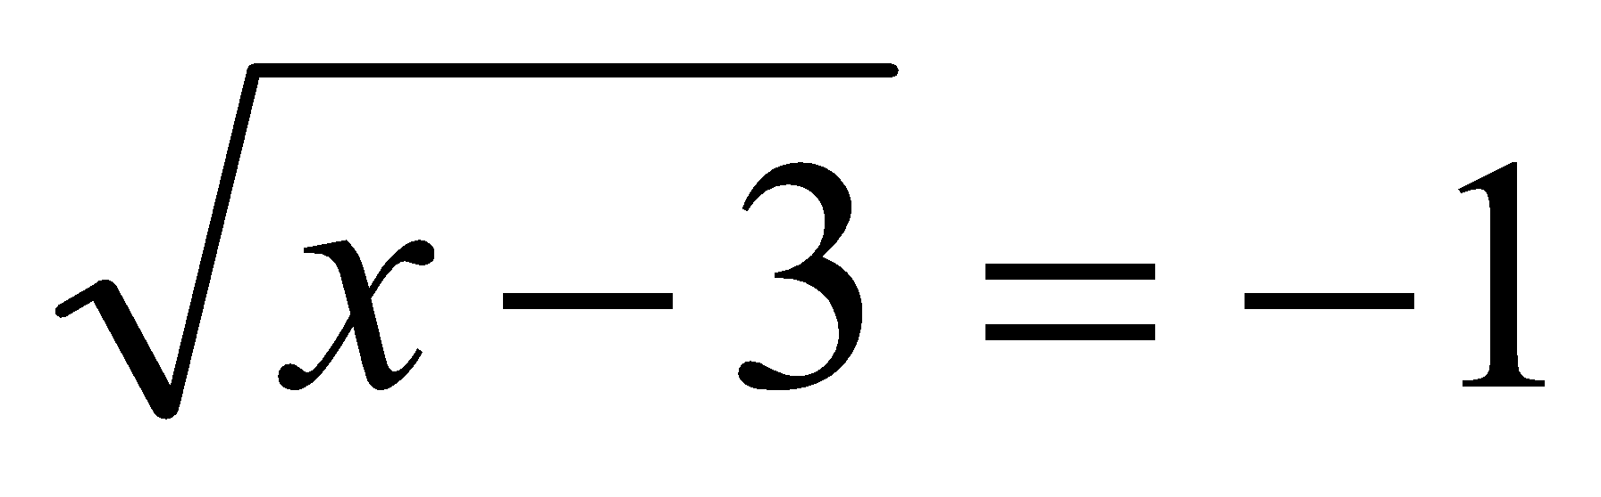
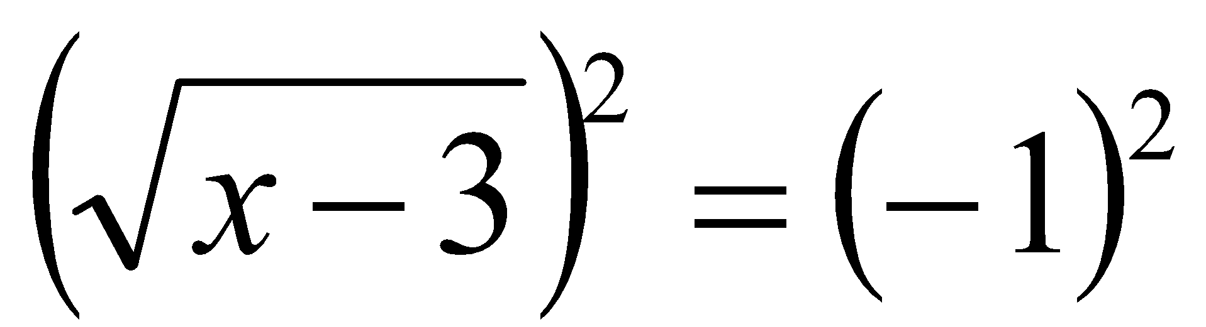
#7
A student was finding the solutions to the equation and wrote the four steps shown.
Step 1:
Step 2:
Step 3: x  3 = 1
Step 4: x = 4
Which statement is an accurate interpretation of the student’s work?
The student made an error in Step 1.
The student made an error in Step 3.
The student found the correct solution to the original equation, x = 4.
x = 4 is a solution to the equation in Step 2, but not to the original equation.
Notes:
‹#›

Slide 15
#7 Answer
Rubric:
(1 point) The student selects the correct statement.
Answer: D
Notes:
‹#›

Slide 16
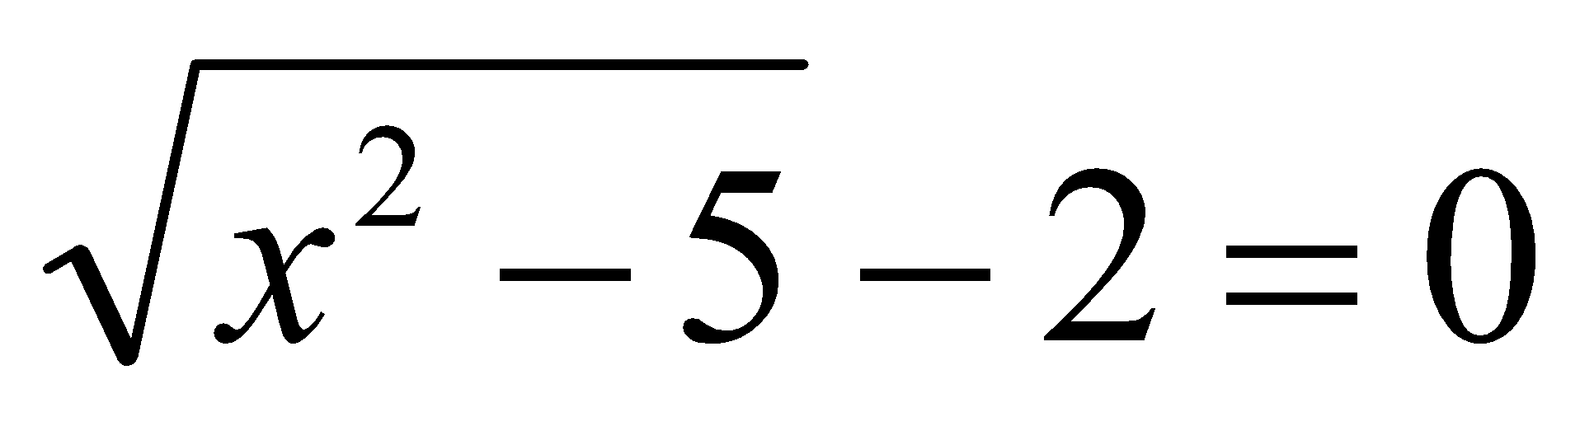
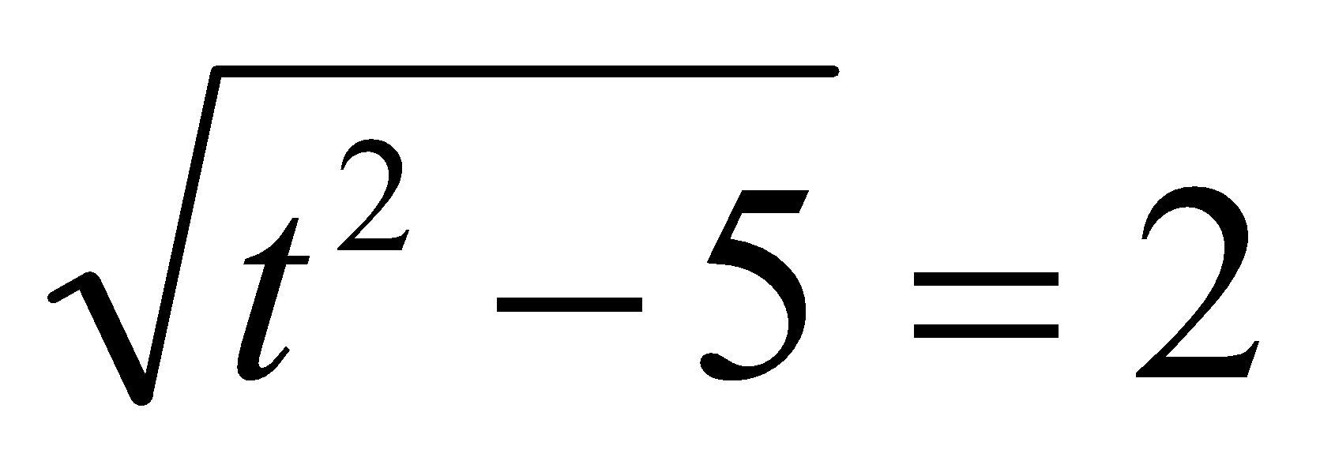
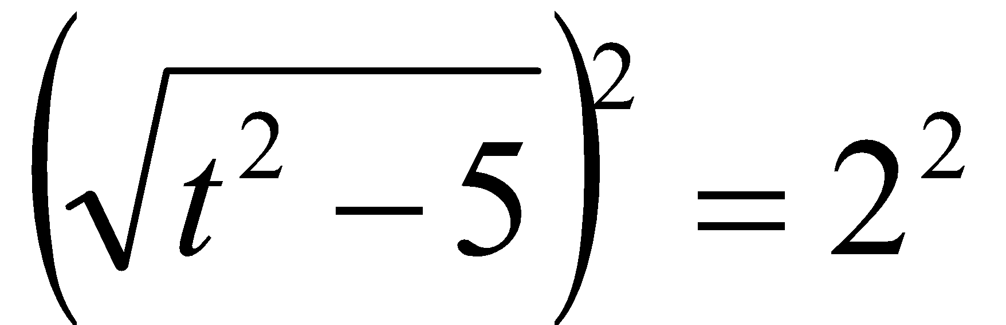
#8
A student was finding the solutions to the equation and wrote the five steps shown.
Step 1:
Step 2:
Step 3: t²  5 = 4
Step 4: t² = 9
Step 5: t = 3, t = 3
Which statement is an accurate interpretation of the student’s work?
The student made an error is Step 1.
The student made an error in Step 3.
C. The student made an error is Step 4.
D. t = 3 and t = -3 are solutions to the equation in Step 2, but not to the original equation.
Notes:
‹#›

Slide 17
#8 Answer
Rubric:
(1 point) The student selects the correct statement.
Answer: D
Notes:
‹#›

Slide 18
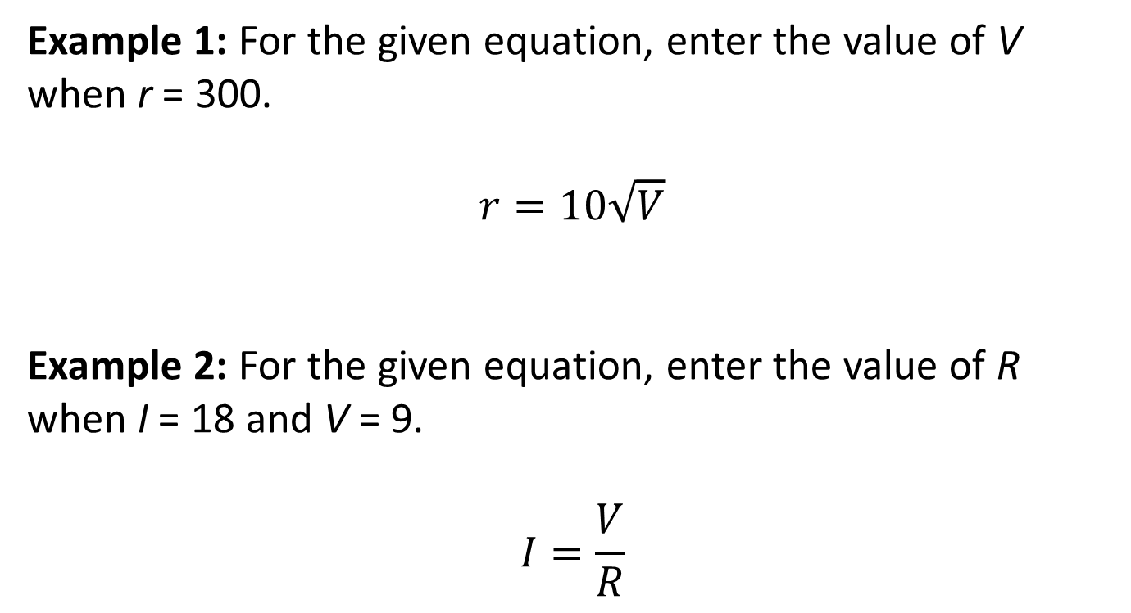
#9
Notes:
‹#›

Slide 19
#9 Answer
Rubric:
(1 point) The student enters the correct solutions.
Answer:
Example 1: 900
Example 2: ½ or 0.5
Notes:
‹#›

Slide 20
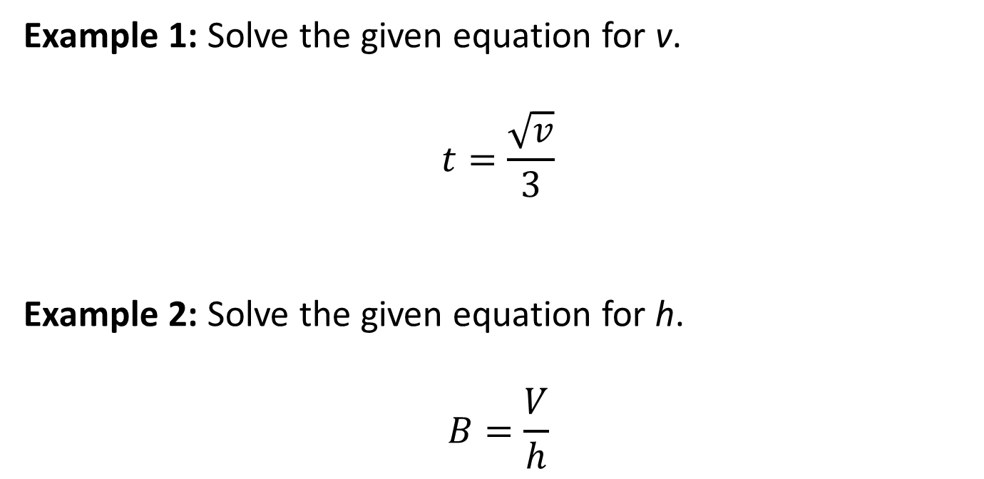
#10
Notes:
‹#›

Slide 21

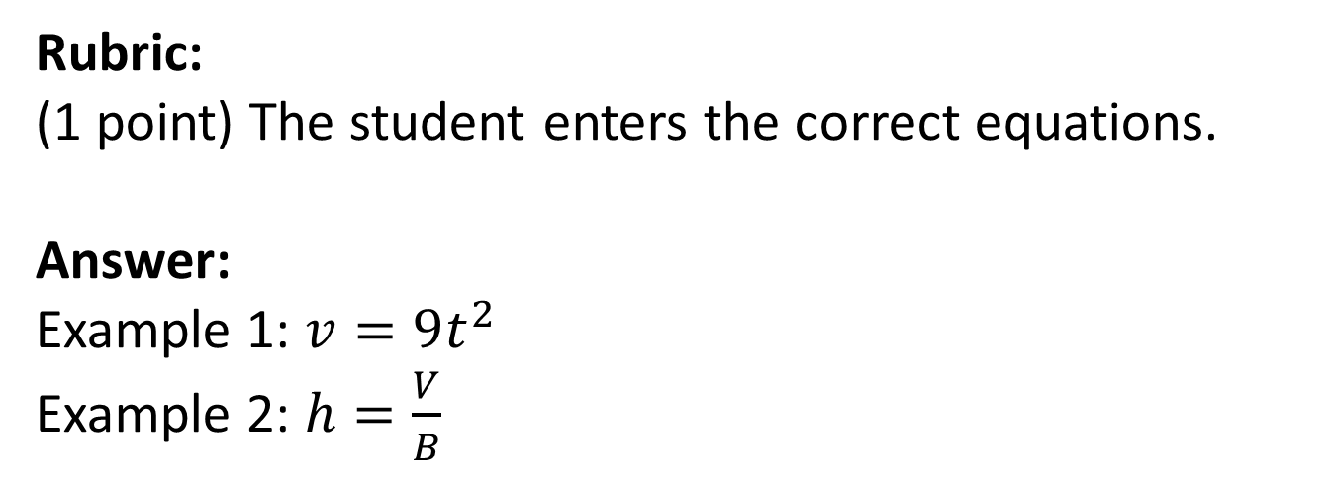
#10 Answer
Notes:
‹#›

Slide 22
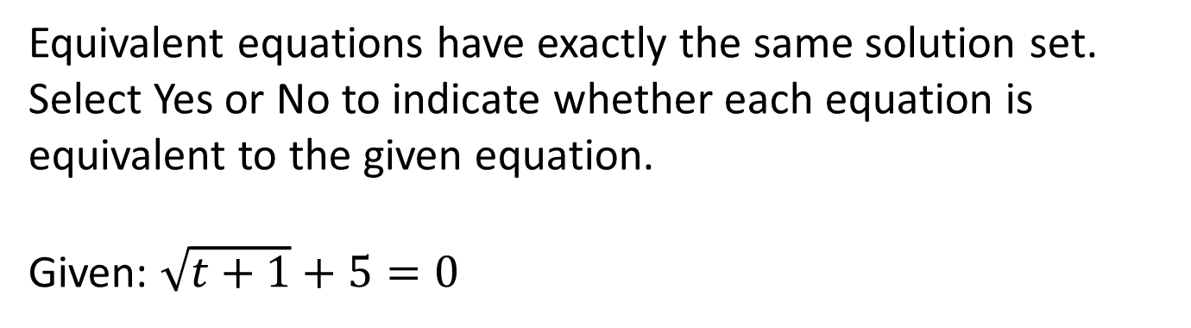
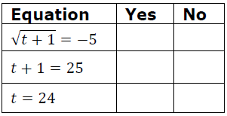
#11
Notes:
‹#›

Slide 23
#11 Answer
Rubric:
(1 point) The student correctly determines whether each equation is equivalent.
Answer: Y, N, N
Notes:
‹#›

