Slide 1

Claim 1
Smarter Balanced Sample Items
High School - Target G
Create equations that describe numbers or relationships.
Questions courtesy of the Smarter Balanced Assessment Consortium Item Specifications – Version 3.0
Slideshow organized by SMc Curriculum – www.ccssmathactivities.com
Notes:
‹#›

Slide 2


#1
Consider the equation that models a train’s distance from its departing station, where:
• y represents the distance in miles
• x represents the speed of the train in miles per hour, and
• t represents the time traveled from the departing station in hours.
𝑦=𝑥𝑡
Enter an equation for which the solution is the speed of the train, in miles per hour, where the train’s distance
from the departing station is 162 miles and it has traveled for 3 hours.
Notes:
‹#›

Slide 3

#1 Answer
Rubric:
(1 point) The student correctly enters an equation.
Answer: equation equivalent to 𝑥 = 54
Notes:
‹#›

Slide 4
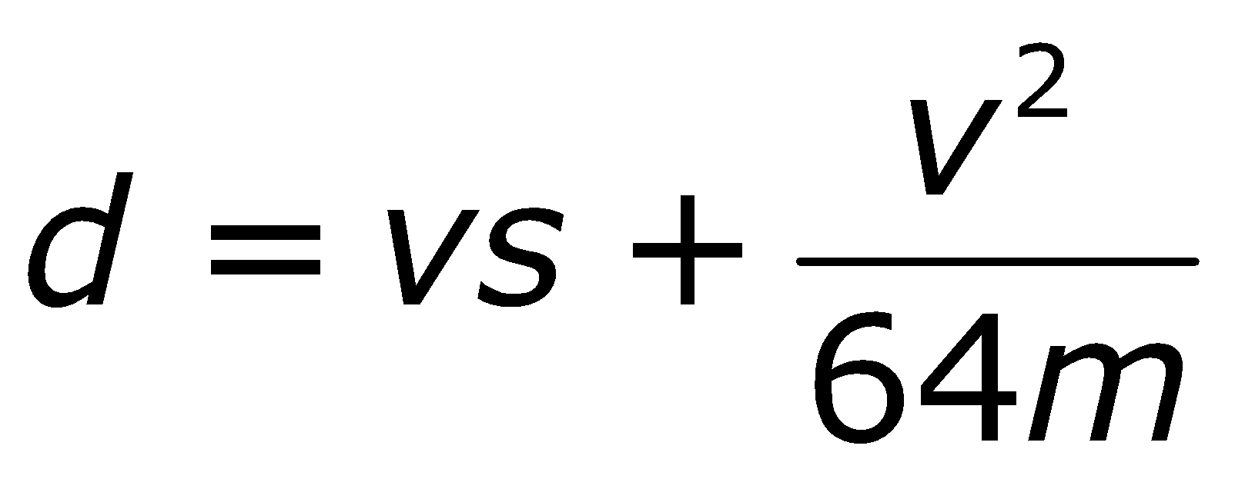
#2
Consider the equation that gives the minimum stopping distance, d, in feet, for an automobile, where:
v represents the automobile speed, in feet per second,
s represents the driver’s response time, in seconds, before applying the brakes, and
𝑚 represents the coefficient of friction between the tires and the road.
Enter an equation for which the solution is the speed, in feet per second, of an automobile with a stopping distance of 200 feet, a driver's response time of 0.5 second, and a coefficient of friction equal to 0.8.
Notes:
‹#›

Slide 5
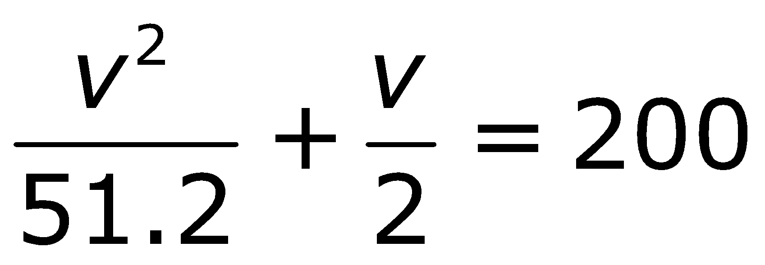
#2 Answer
Rubric:
(1 point) The student correctly enters an equation.
Answer: equation equivalent
Notes:
‹#›

Slide 6

#3
A sales clerk’s daily earnings include $125 per day plus commission equal to x percent of his daily sales.
Enter an equation that can be used to find the commission percentage (x), if the clerk’s daily sales are $1375 and his total earnings for that day are $180.
Notes:
‹#›

Slide 7
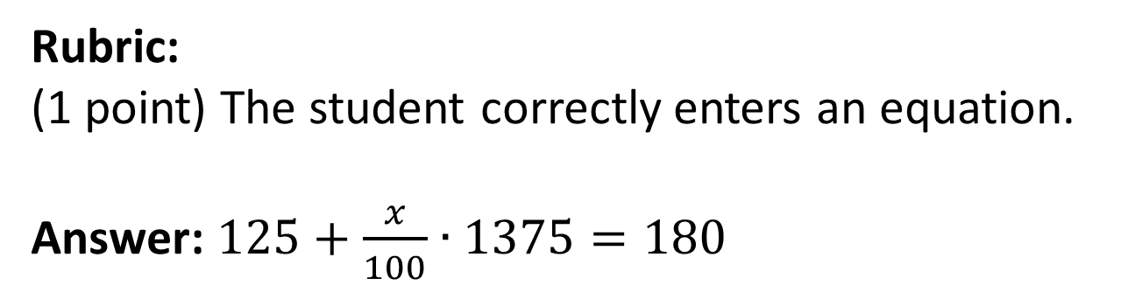
#3 Answer
Notes:
‹#›

Slide 8
#4
Jim can paint a house in 12 hours. Alex can paint the same house in 8 hours.
Enter an equation that can be used to find the time in hours, t, it would take Alex and Jim to paint the house together assuming they both work at the rates they work when working alone.
Notes:
‹#›

Slide 9
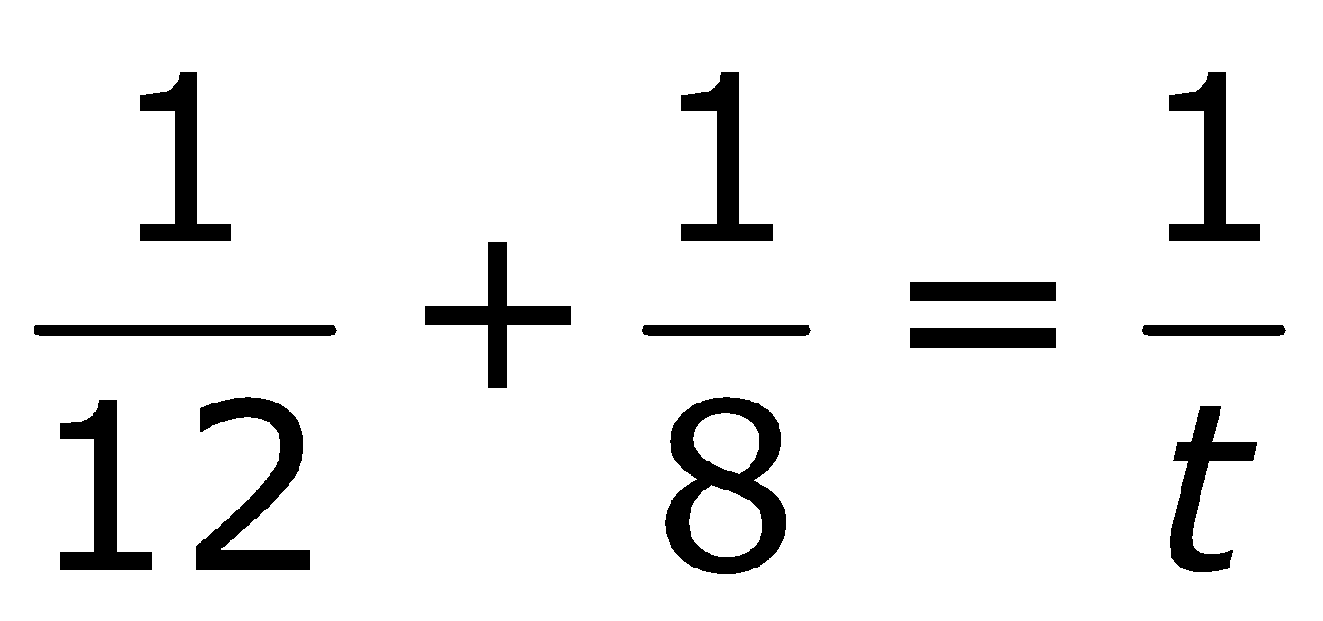
#4 Answer
Rubric:
(1 point) The student correctly enters an equation.
Answer:
Notes:
‹#›

Slide 10
#5
A clerk earns $125 per day, plus a commission equal to 10% of her sales, s. The clerk earns less than $180 on Monday.
Enter an inequality that represents all possible values for the clerk’s sales, s, on Monday.
Notes:
‹#›

Slide 11
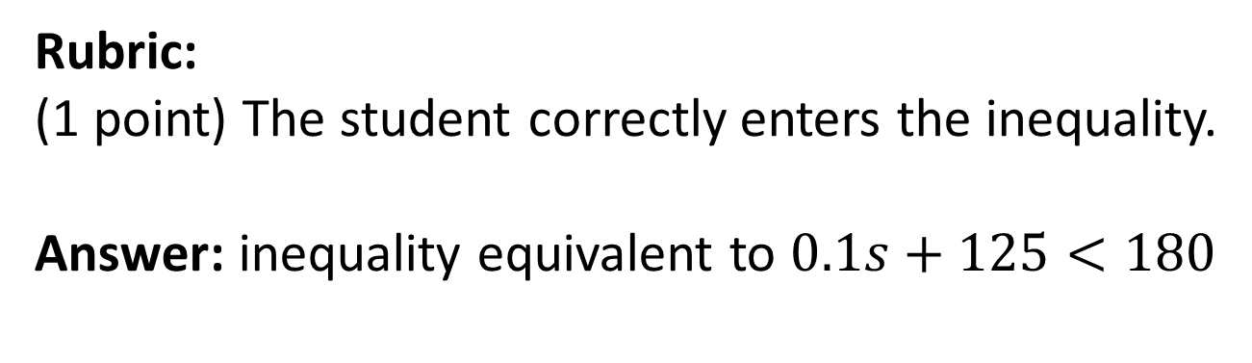
#5 Answer
Notes:
‹#›

Slide 12
#6
A rectangular garden measuring 13 meters by 15 meters is to have a gravel pathway of constant width built all around it. There is enough gravel to cover 80 square meters.
Enter an inequality that represents all possible widths (w), in meters, of the pathway.
Notes:
‹#›

Slide 13
#6 Answer
Rubric:
(1 point) The student correctly enters an equivalent inequality.
Answer: (13 + 2𝑤)(15 + 2𝑤) − 13(15) ≤ 80
Notes:
‹#›

Slide 14
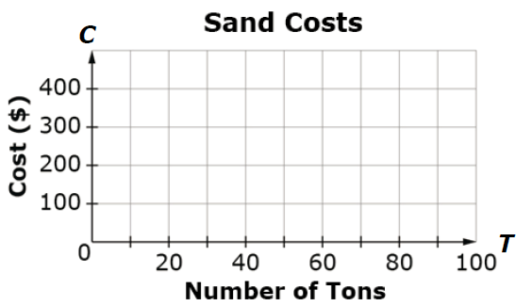
#7
An elementary school is having sand delivered for the playground. Sadie’s Sand charges $5.00 per ton of sand plus a delivery fee of $200. Greg’s Sand Pit charges $12.00 per ton of sand plus a delivery fee of $50. Use the Add Arrow tool to represent functions that show the cost C of buying T tons of sand from each company.
Notes:
‹#›

Slide 15
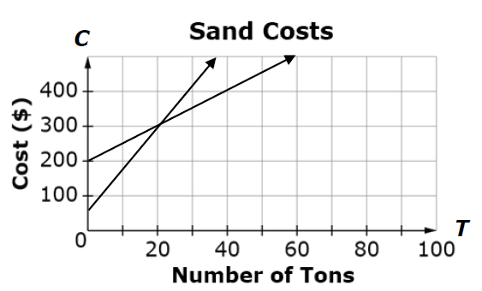
#7 Answer
Rubric:
(1 point) The student correctly graphs the functions.
Answer:
Notes:
‹#›

Slide 16
#8
Malik and Nora are playing a video game.
• Malik starts with m points and Nora starts n points.
• Then Malik gets 150 more points, while Nora loses 50 points.
• Finally, Nora gets a bonus and her score is doubled.
• Nora now has 50 more points than Malik.
Enter an equation that represent the relationship between m and n given the information above.
Notes:
‹#›

Slide 17
#8 Answer
Rubric:
(1 point) The student correctly enters the equation.
Answer: any equation equivalent to
2(𝑛 − 50) = (𝑚 + 150) + 50
Notes:
‹#›

