Slide 1

Claim 1
Smarter Balanced Sample Items
High School - Target F
Perform arithmetic operations on polynomials.
Questions courtesy of the Smarter Balanced Assessment Consortium Item Specifications – Version 3.0
Slideshow organized by SMc Curriculum – www.ccssmathactivities.com
Notes:
‹#›

Slide 2

#1
Enter an expression equivalent to
(4x² − 5x + 6) + (9x² − 2x) − (11x − 3), combining like terms.
Notes:
‹#›

Slide 3

#1 Answer
Rubric:
(1 point each) The student enters a correct expression.
Answer: 13x² − 18x + 9
Notes:
‹#›

Slide 4
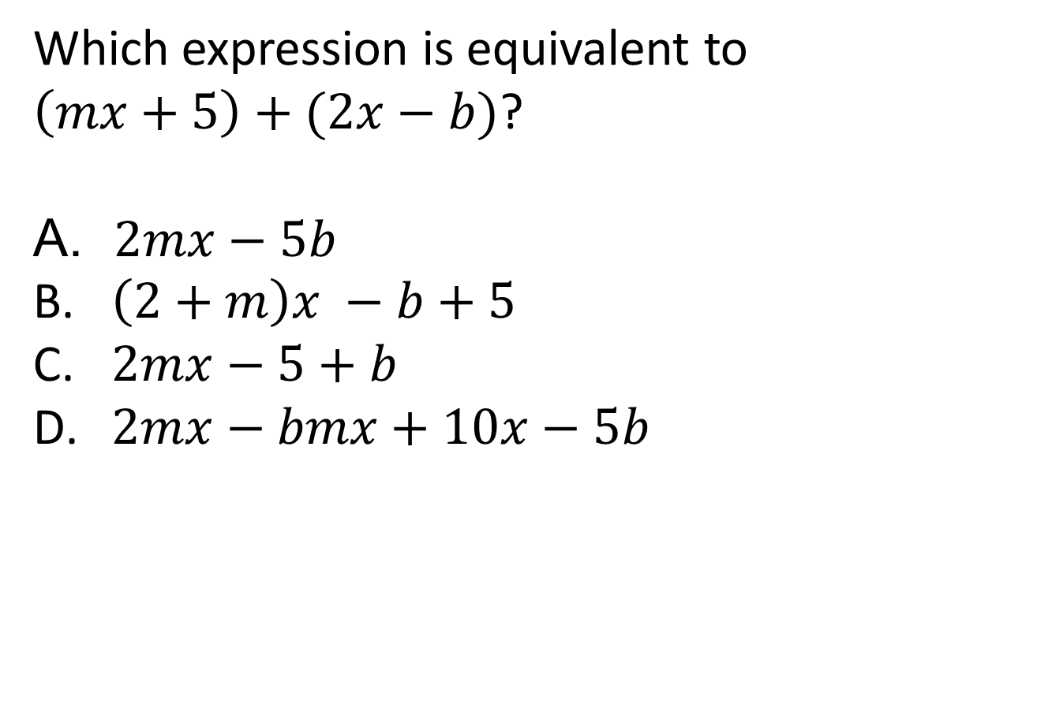
#2
Notes:
‹#›

Slide 5
#2 Answer
Rubric:
(1 point each) The student selects the correct expression.
Answer: B
Notes:
‹#›

Slide 6
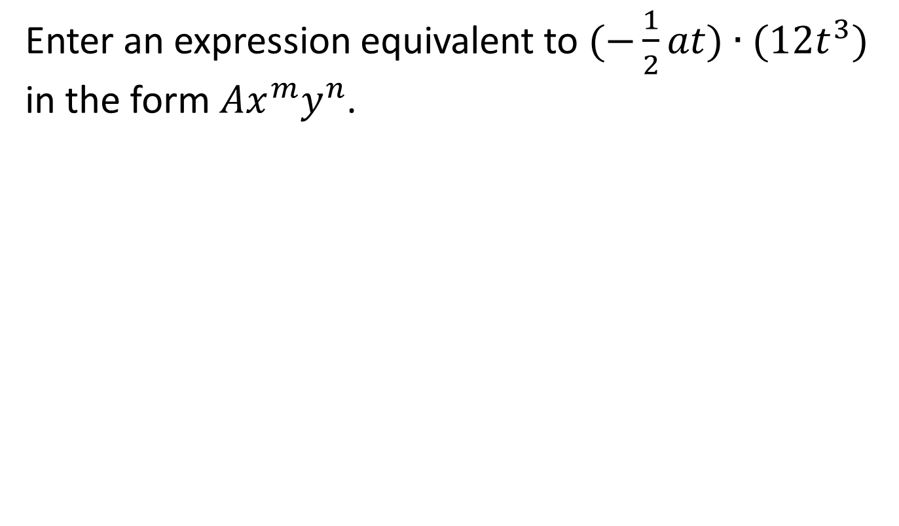
#3
Notes:
‹#›

Slide 7
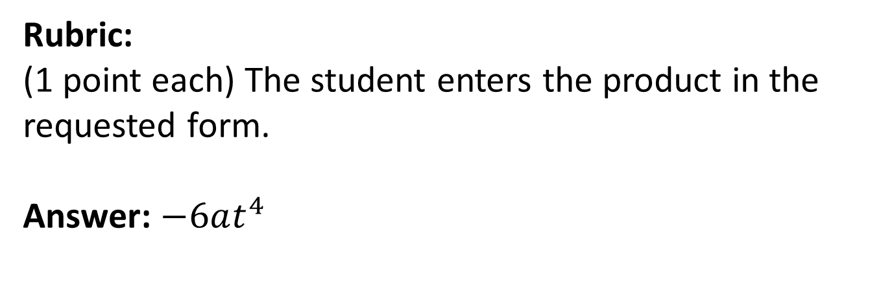
#3 Answer
Notes:
‹#›

Slide 8
#4
Multiply and combine like terms to determine the product of these polynomials. (2n − 3)(5n + 6)
Notes:
‹#›

Slide 9
#4 Answer
Rubric:
(1 point each) The student correctly multiplies and combines like terms.
Answer: 10n² − 3n − 18
Notes:
‹#›

Slide 10
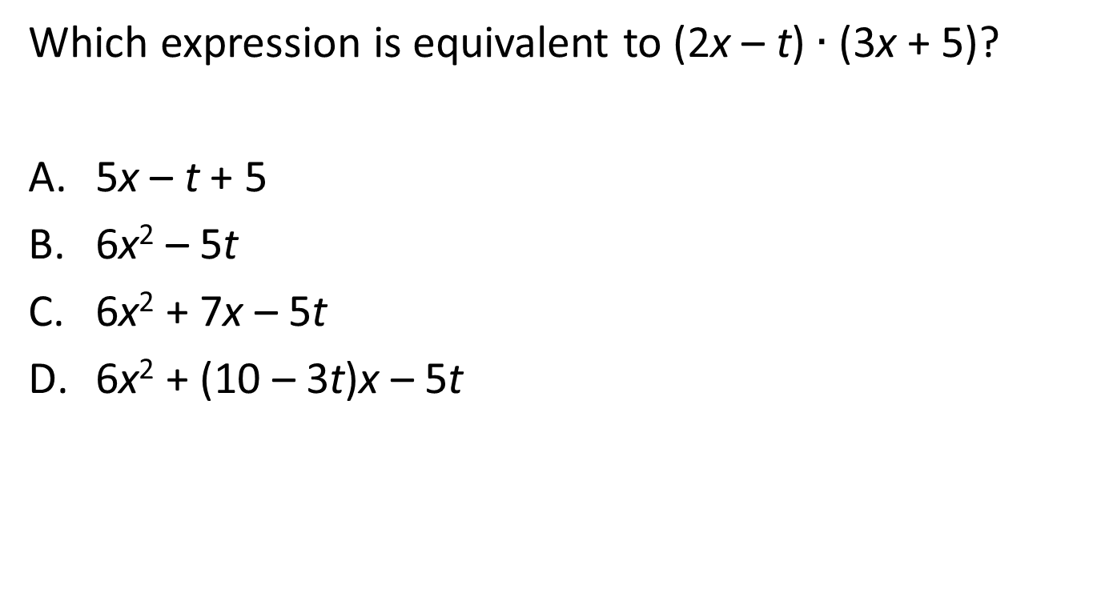
#5
Notes:
‹#›

Slide 11
#5 Answer
Rubric:
(1 point each) The student selects the correct expression.
Answer: C
Notes:
‹#›

Slide 12
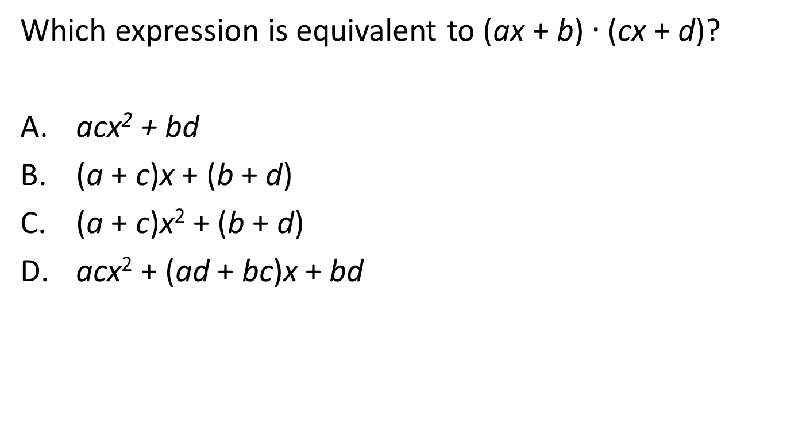
#6
Notes:
‹#›

Slide 13
#5 Answer
Rubric:
(1 point each) The student selects the correct expression.
Answer: D
Notes:
‹#›

