Slide 1

Claim 1
Smarter Balanced Sample Items
High School - Target E
Write expressions in equivalent forms to solve problems.
Questions courtesy of the Smarter Balanced Assessment Consortium Item Specifications – Version 3.0
Slideshow organized by SMc Curriculum – www.ccssmathactivities.com
Notes:
‹#›

Slide 2

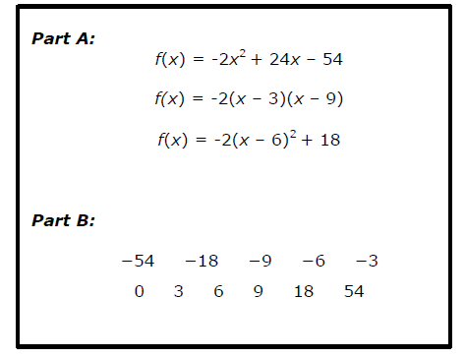
#1
Part A: Three equivalent equations for f(x) are shown. Select the form that reveals the zeros of f(x) without changing the form of the equation.
Part B: Select all values of x for which f(x) = 0.
Notes:
‹#›

Slide 3

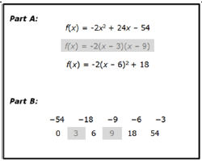
#1 Answer
Rubric:
(1 point) The student selects the correct equation for f(x) and selects the correct zeros.
Answer:
Notes:
‹#›

Slide 4
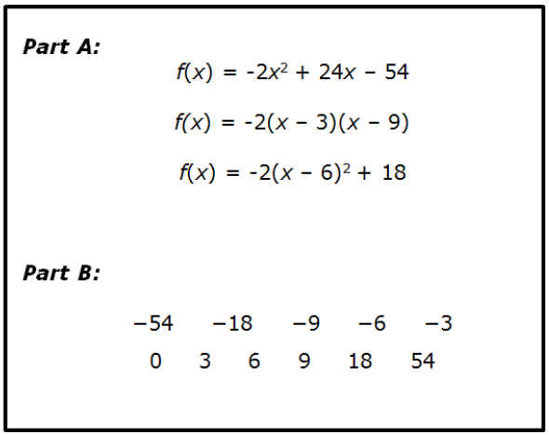
#2
Part A: Three equations that all represent the same function f are shown. Select the equation that includes the value of f(0) as a number that appears in the equation.
Part B: Identify f(0).
Notes:
‹#›

Slide 5
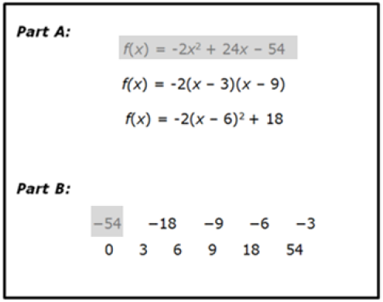
#2 Answer
Rubric:
(1 point) The student selects the correct equation for f(x) and selects f(0).
Answer:
Notes:
‹#›

Slide 6
#3
Part A: Three equations that all represent the same function f are shown. Select the equation that includes the maximum value of f as a number that appears in the equation.
Part B: Select the maximum value of f(x).
Notes:
‹#›

Slide 7
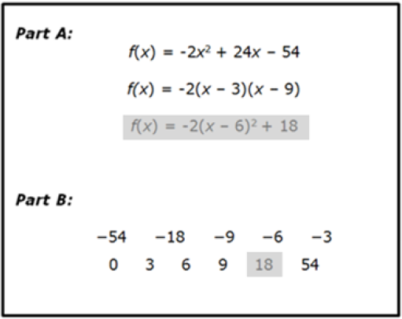
#3 Answer
Rubric:
(1 point) The student selects the correct equation for f(x) and selects the maximum value.
Answer:
Notes:
‹#›

Slide 8
#4
Which equation includes the minimum or maximum value of f(x) as a number that appears in the equation?
𝑓(𝑥)=(𝑥−1)²−4
B. 𝑓(𝑥)=𝑥²−2𝑥−3
C. 𝑓(𝑥)=𝑥²−3𝑥+𝑥−3
D. 𝑓(𝑥)=(𝑥+1)(𝑥−3)
Notes:
‹#›

Slide 9
#4 Answer
Rubric:
(1 point) The student correctly chooses the equation that reveals the maximum or minimum of the quadratic function.
Answer: A
Notes:
‹#›

Slide 10
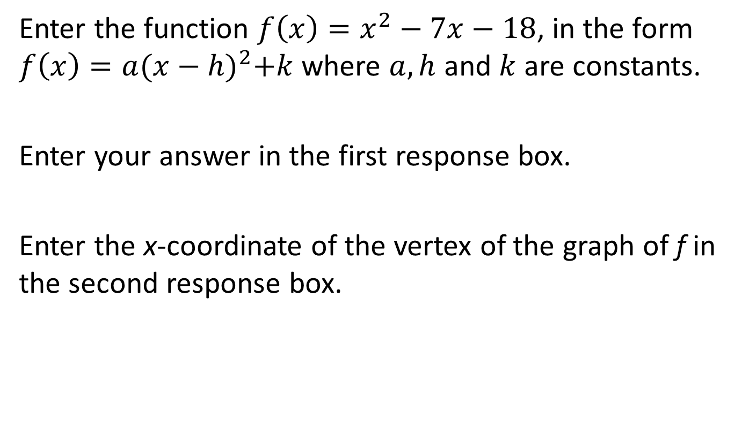
#5
Notes:
‹#›

Slide 11
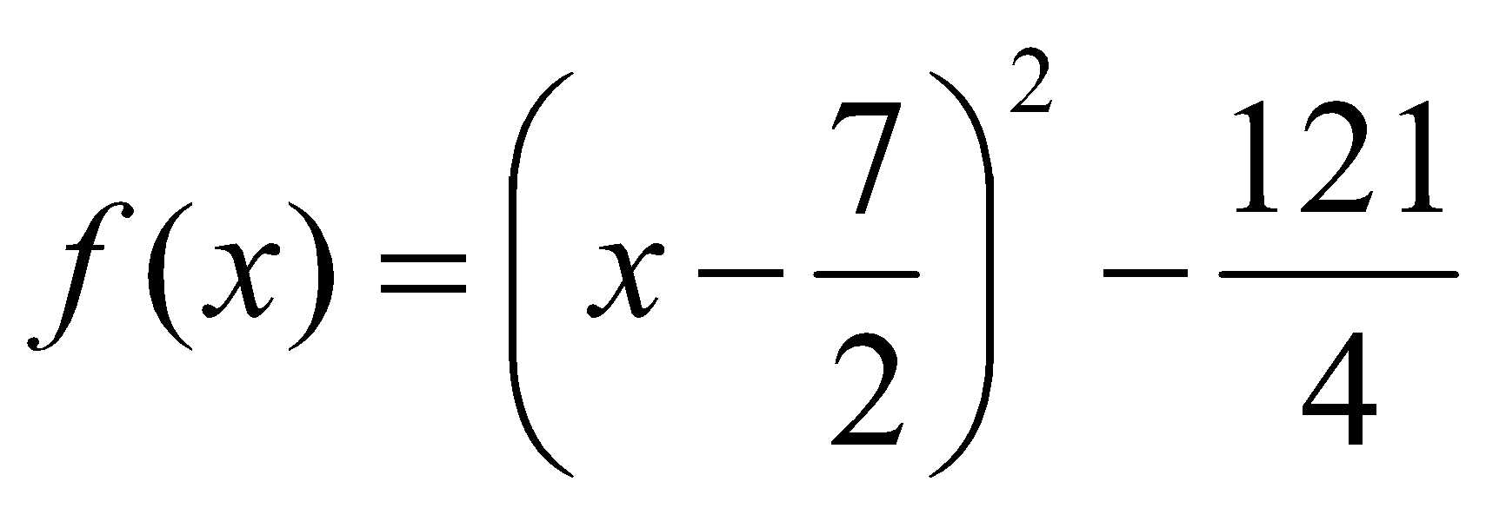

#5 Answer
Rubric:
(2 points) The student correctly enters the function in the equivalent form and enters the x-coordinate of the vertex of the graph.
(1 point) The student correctly enters the function in the equivalent form or enters the x-coordinate of the vertex of the graph.
Answer: or ;
Notes:
‹#›

Slide 12
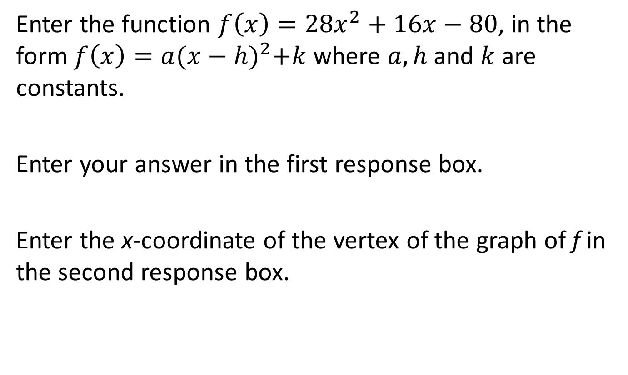
#6
Notes:
‹#›

Slide 13
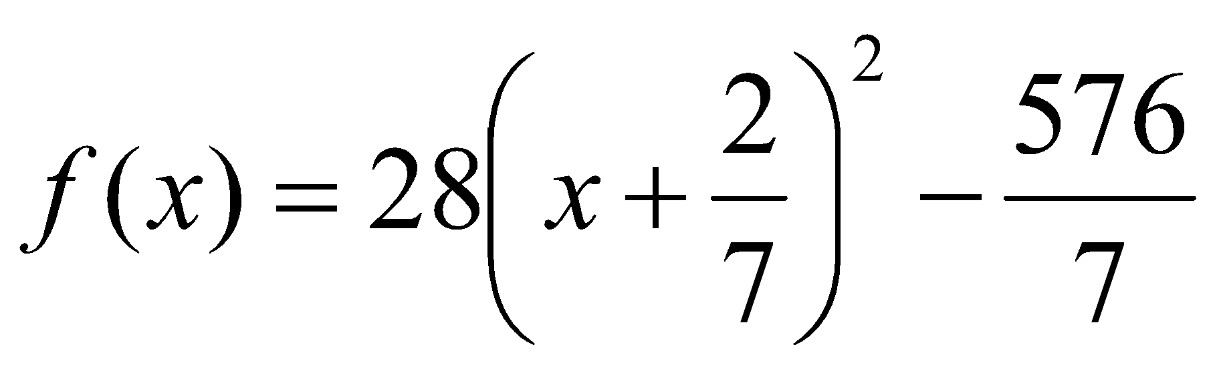
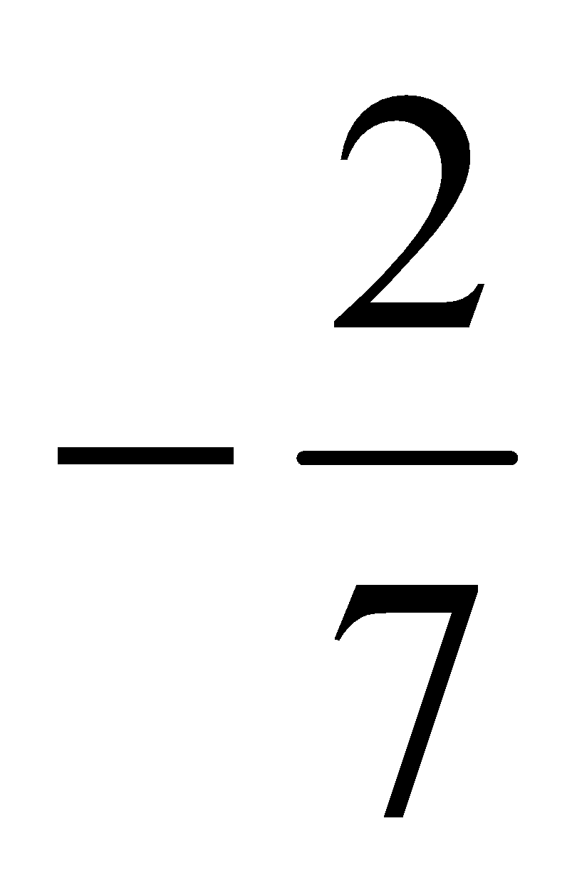
#6 Answer
Rubric:
(2 points) The student correctly enters the function in the equivalent form and enters the x-coordinate of the vertex of the graph.
(1 point) The student correctly enters the function in the equivalent form or enters the x-coordinate of the vertex of the graph.
Answer: and
Notes:
‹#›

Slide 14
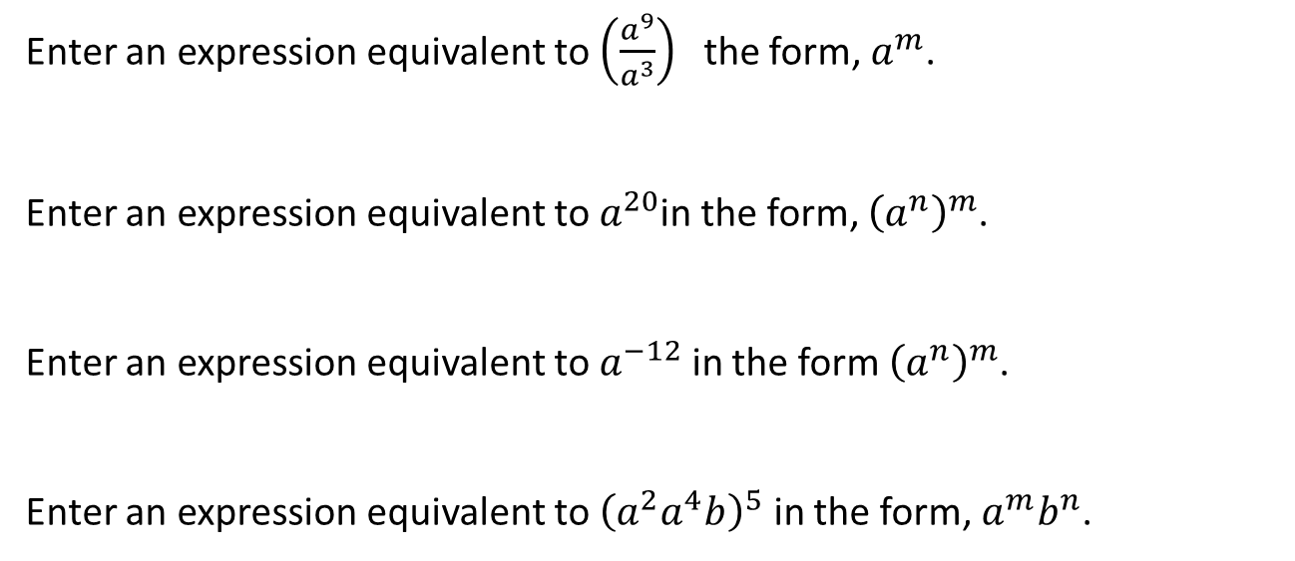
#7
Notes:
‹#›

Slide 15
#7 Answer
Rubric:
(1 point) The student correctly enters an equivalent expression in the given form. Multiple correct answers may be possible for some items.
Answer: 𝑎⁶, (𝑎⁴)⁵, (𝑎⁻³)⁴, 𝑎³⁰𝑏⁵
Notes:
‹#›

Slide 16

#8
This expression defines a function that models the future population of wolves in a park after t years.
3280(1.15)^{t}
Which expression best defines the function that represents the wolf population after x months?
A. 3280(1.0125)^{x}
B. 3280(1.0117)^{x}
C. 3280(1.12)^{x}
D. 3280(1.2)^{x}
Notes:
‹#›

Slide 17
#8 Answer
Rubric:
(1 point) Student selects the correct expression.
Answer: B
Notes:
‹#›

Slide 18
#9
This expression defines a function that models the future population of wolves in a park after x months.
3280(1.0117)^{x}
Enter the yearly growth rate for the wolf population as a percent. Round to the nearest hundredth.
Notes:
‹#›

Slide 19
#9 Answer
Rubric:
(1 point) Student produces the correct growth or decay rate.
Answer: 14.98%
Notes:
‹#›

