Slide 1

Claim 1
Smarter Balanced Sample Items
High School - Target D
Interpret the structure of expressions.
Questions courtesy of the Smarter Balanced Assessment Consortium Item Specifications – Version 3.0
Slideshow organized by SMc Curriculum – www.ccssmathactivities.com
Notes:
‹#›

Slide 2

#1
Select the expression that is equivalent to 𝑥² − 4.
A. (𝑥 − 2)²
B. (𝑥 − 2)(𝑥 + 2)
C. 𝑥² + 2𝑥 + 4
D. 𝑥² − 2𝑥 + 4
Notes:
‹#›

Slide 3

#1 Answer
Rubric:
(1 point) The student selects the correct option.
Answer: B
Notes:
‹#›

Slide 4
#2
Select the expression that is equivalent to
(𝑥 + 4)²− (𝑥 − 2)(𝑥 + 4).
A. 4(𝑥 + 4)
B. 2(𝑥 + 1)(𝑥 + 4)
C. (𝑥 + 4)−(𝑥 − 2)
D. (𝑥 + 4)[(𝑥 + 4)−(𝑥 − 2)]
Notes:
‹#›

Slide 5
#2 Answer
Rubric:
(1 point) The student selects the correct option.
Answer: D
Notes:
‹#›

Slide 6
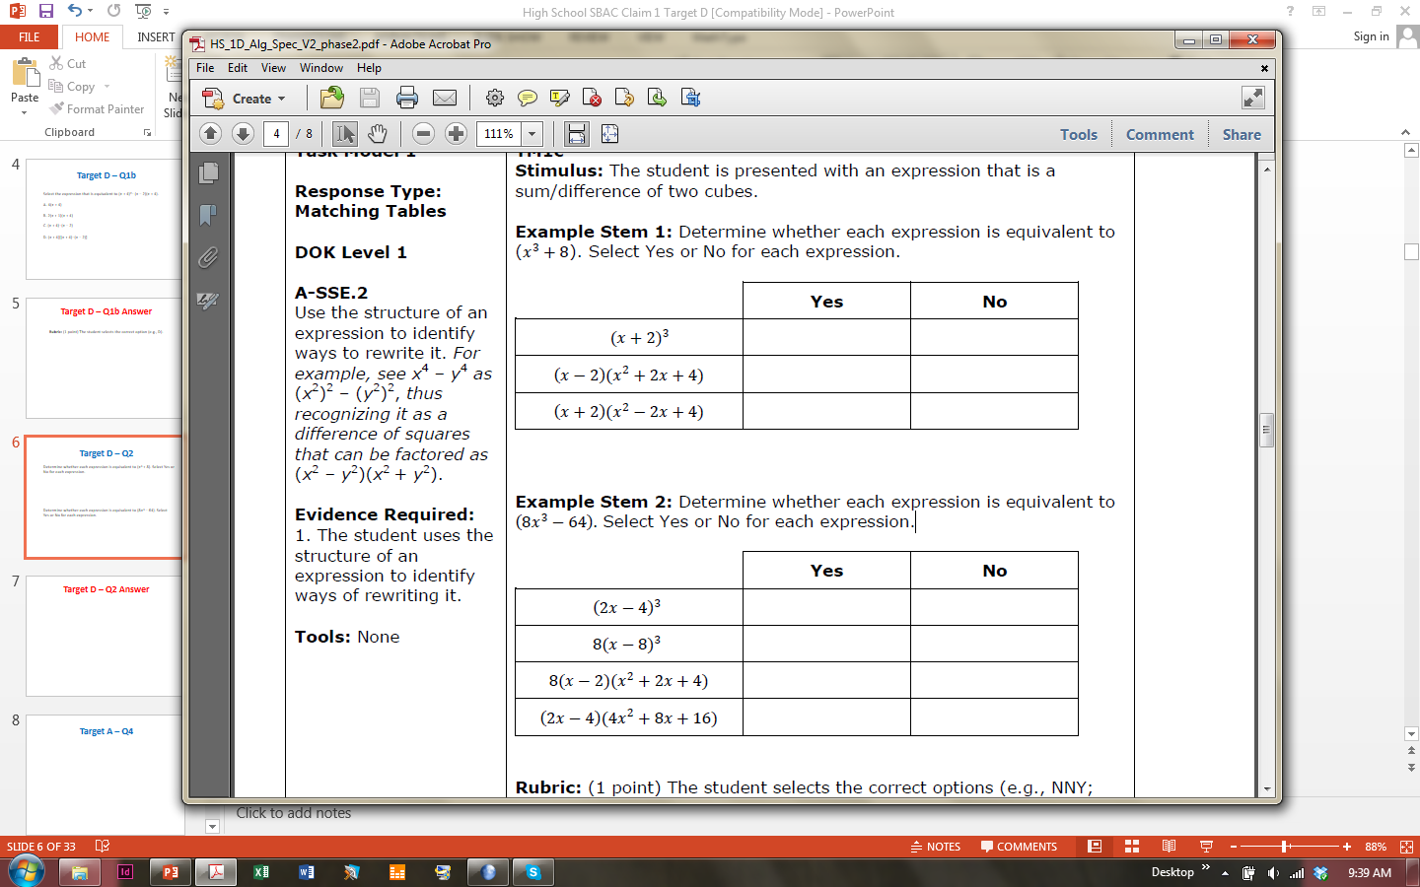
#3
Determine whether each expression is equivalent to (𝑥³ + 8). Select Yes or No for each expression.
Determine whether each expression is equivalent to (8𝑥³ − 64). Select Yes or No for each expression.
Notes:
‹#›

Slide 7
#3 Answer
Rubric:
(1 point each) The student selects the correct options.
Answers:
N, N, Y
N, N, Y, Y
Notes:
‹#›

Slide 8
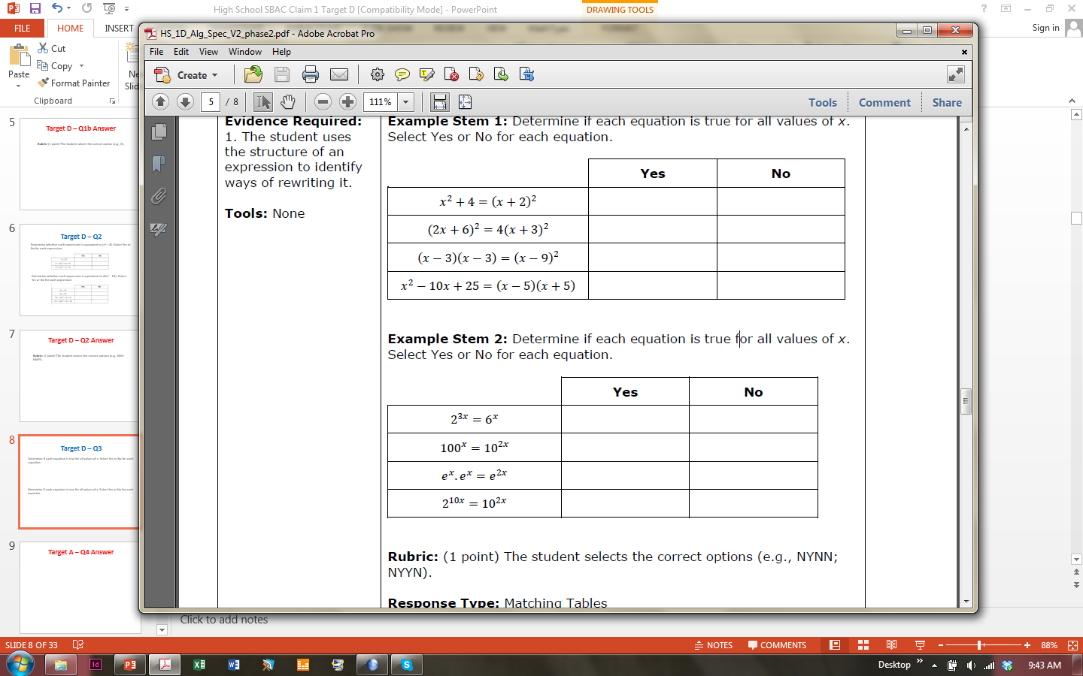
#4
Determine if each equation is true for all values of x. Select Yes or No for each equation.
Notes:
‹#›

Slide 9
#4 Answer
Rubric:
(1 point each) The student selects the correct options.
Answers: N, Y, N, N
Notes:
‹#›

Slide 10
#5
Determine if each equation is true for all values of x. Select Yes or No for each equation.
Notes:
‹#›

Slide 11
#5 Answer
Rubric:
(1 point each) The student selects the correct options.
Answers: N, Y, Y, N
Notes:
‹#›

Slide 12
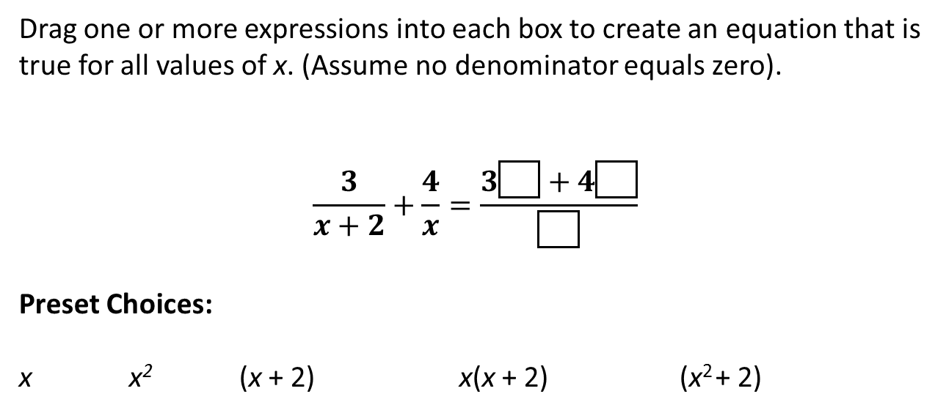
#6
Notes:
‹#›

Slide 13
#6 Answer
Rubric:
(1 point) The student drags the correct options.
Answer: x, (x + 2), x(x + 2)
Notes:
‹#›

Slide 14
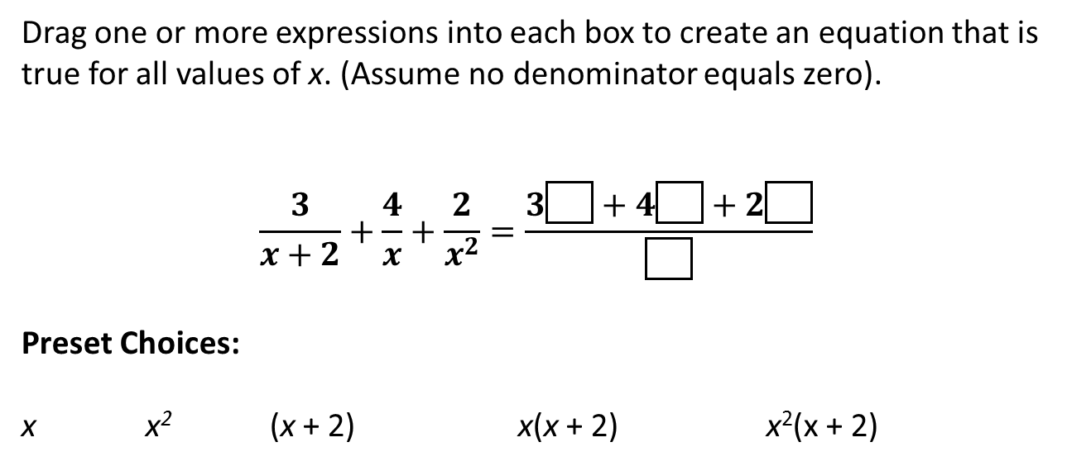
#7
Notes:
‹#›

Slide 15
#7 Answer
Rubric:
(1 point) The student drags the correct options.
Answers: x², x(x + 2), (x + 2), x²(x + 2)

Slide 16
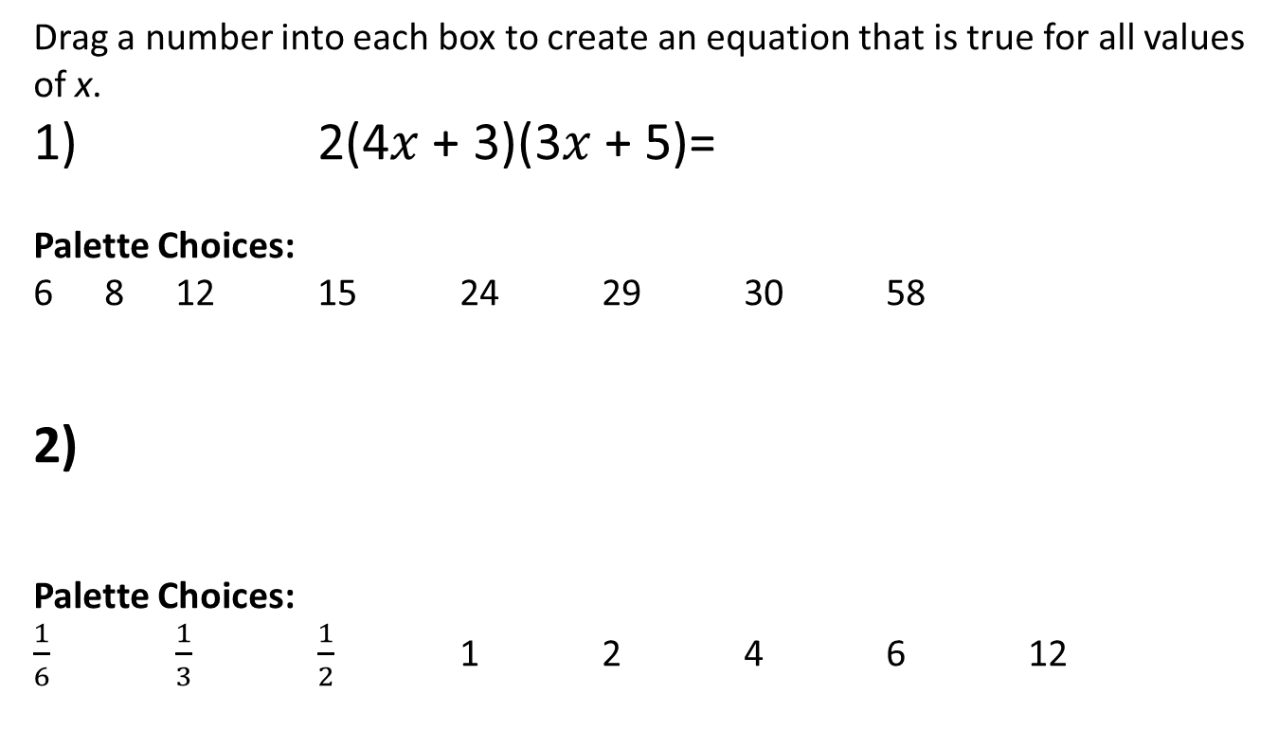

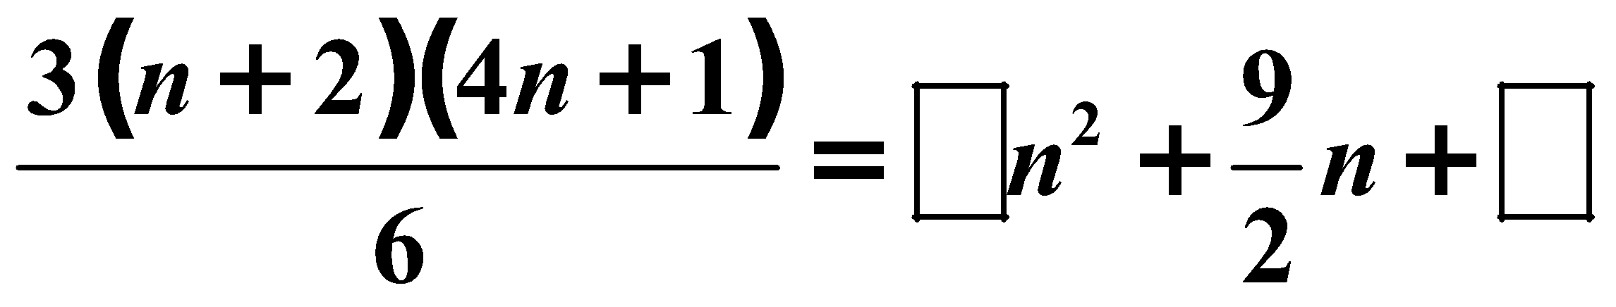
#8
Notes:
‹#›

Slide 17
#8 Answer
Rubric:
(1 point each) The student places the correct number in the box(es).
Answers:
Example 1: 24, 30
Example 2: 2, 1

Slide 18
#9
Drag a number into the box to create an equation that is true for all values of x.
1) (𝑥 + 2)² − 5 = 𝑥² + 4𝑥 +
Choices:
− 4 − 1 4 9
2) (𝑥 − 7)² + 51 = 𝑥² + 𝑥 + 100
Choices:
− 14 0 2 14 49
Notes:
‹#›

Slide 19
#9 Answer
Rubric:
(1 point each) The student places the correct number in the box(es).
Answers:
Example 1: −1
Example 2: −14
Notes:
‹#›

Slide 20
#10
Drag a number into the box to create an equation that is true for all values of x.
(𝑥 − 10)(x + 12) = 3(𝑥 + 1)² − 363
Choices:
− 12 − 1 1 3 10
Notes:
‹#›

Slide 21

#10 Answer
Rubric:
(1 point each) The student places the correct number in the box(es).
Answer: 3
Notes:
‹#›

