Slide 1

Claim 1
Smarter Balanced Sample Items
High School - Target C
Reason quantitatively and use units to solve problems.
Questions courtesy of the Smarter Balanced Assessment Consortium Item Specifications – Version 3.0
Slideshow organized by SMc Curriculum – www.ccssmathactivities.com

Slide 2

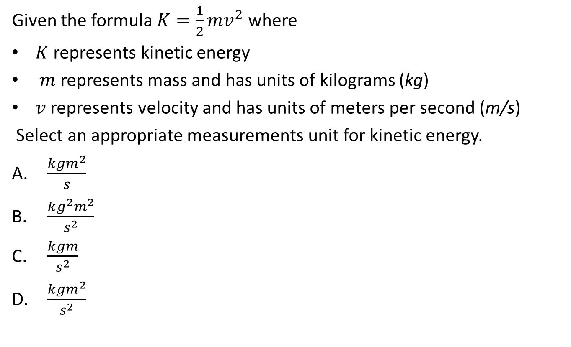
#1

Slide 3
#1 Answer
Rubric:
(1 point) Student selects the correct response.
Answer: D

Slide 4
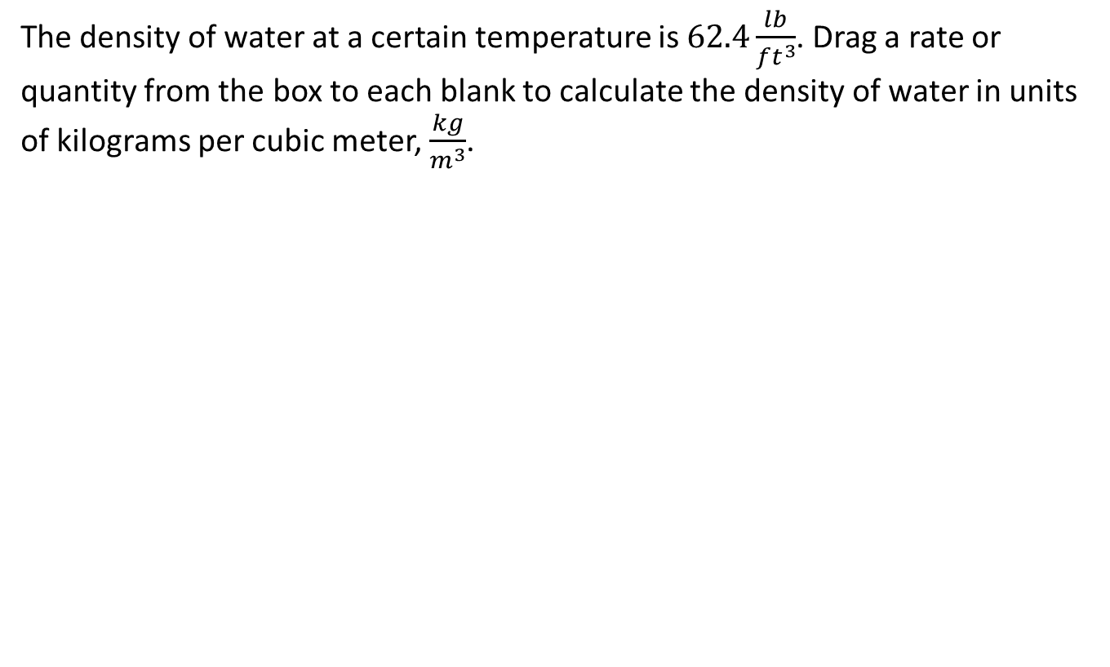
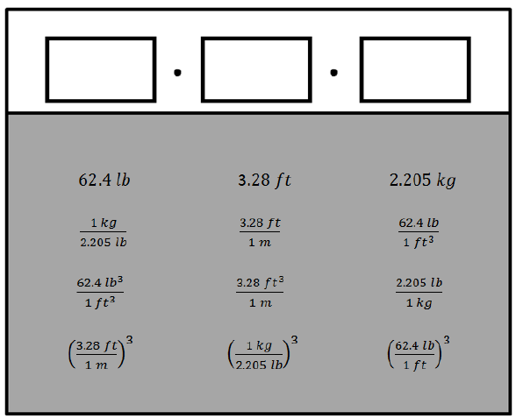
#2

Slide 5
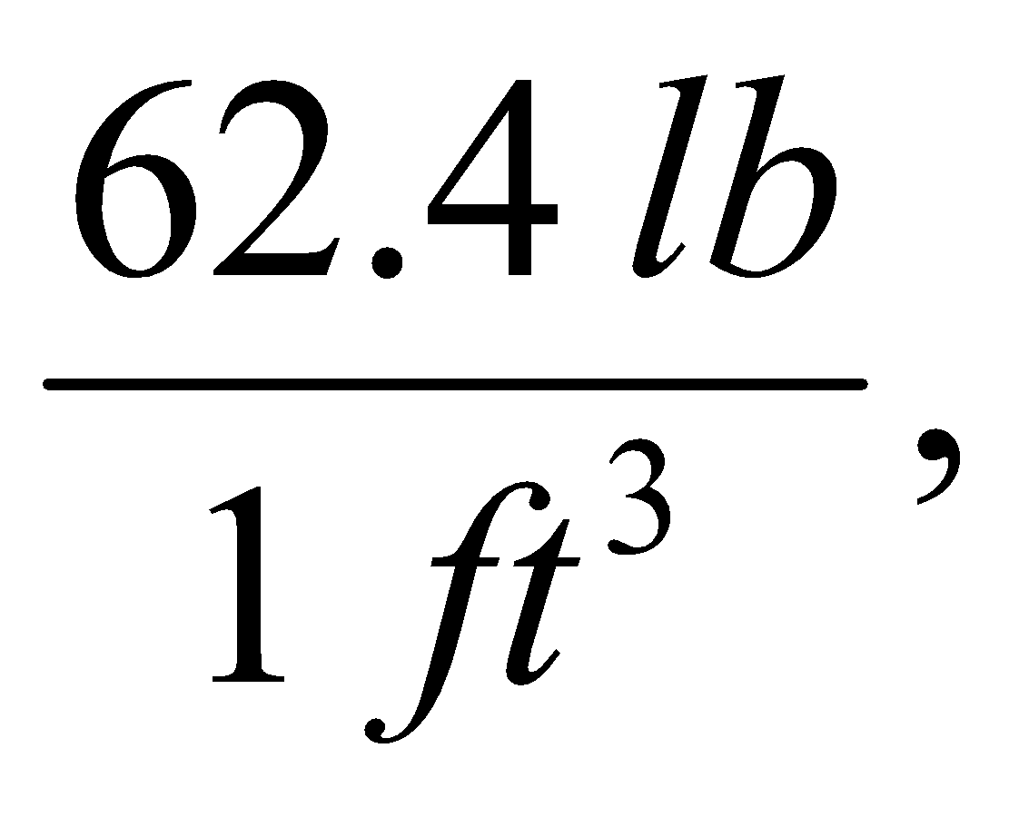
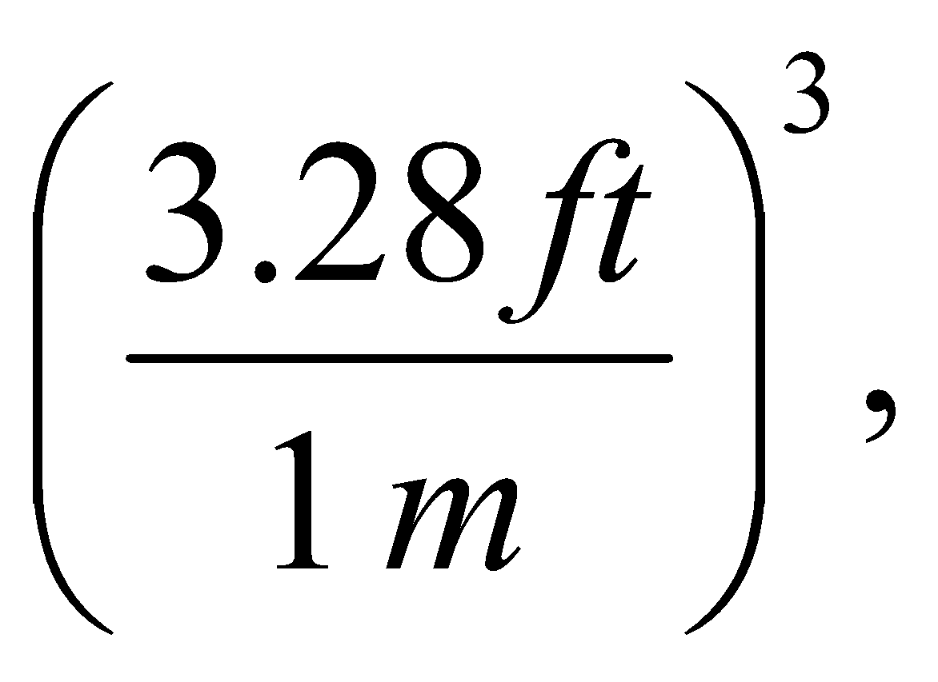
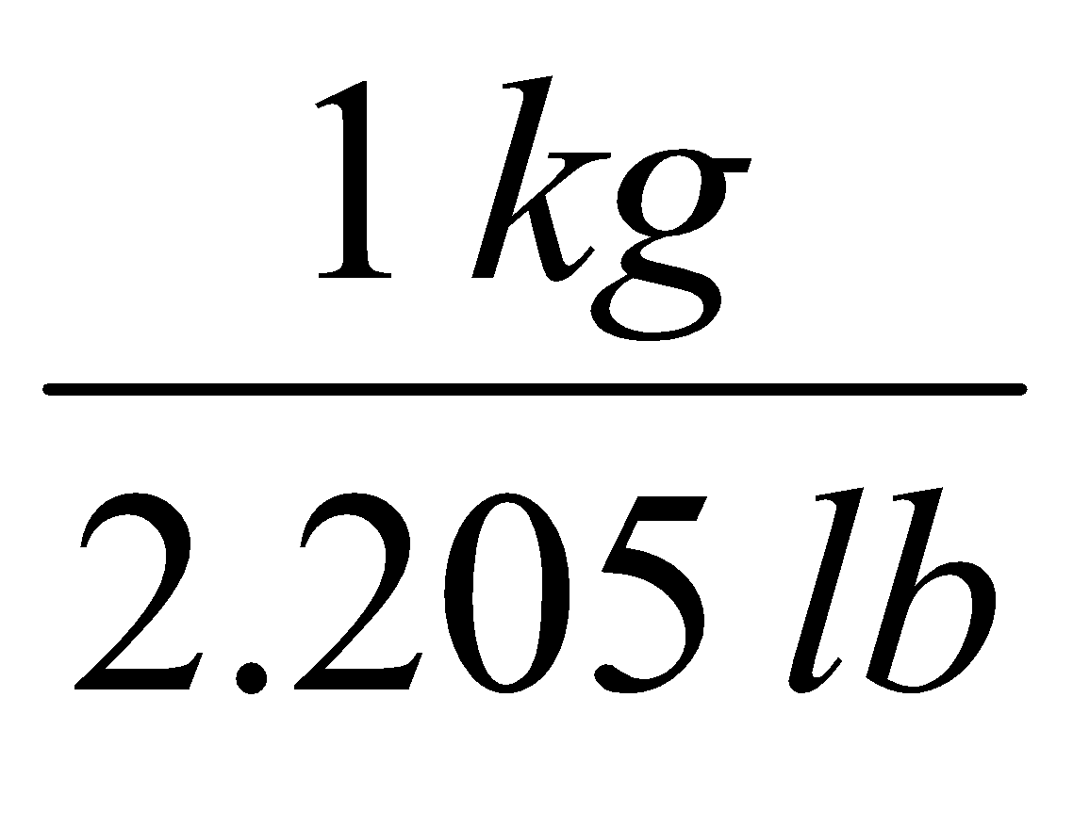
#2 Answer
Rubric:
(1 point) The student chooses the following correct three rates or quantities (order does not matter).
Answer:

Slide 6
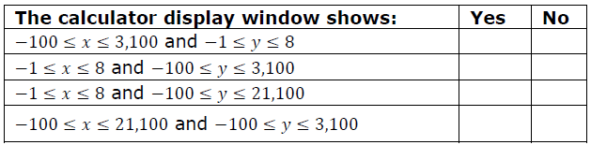
#3
A company makes 3,000 liters of juice per day. Let y represent the total amount of juice, in liters, made in x days. An equation representing this situation is entered into a graphing calculator. Determine whether a graph created with each calculator display window defined in the table will show all points representing the total amount of juice made in 0 to 7 days. Select Yes or No for each display window.

Slide 7
#3 Answer
Rubric:
(1 point) The student selects the correct response for each display window.
Answer: N, N, Y, N

Slide 8
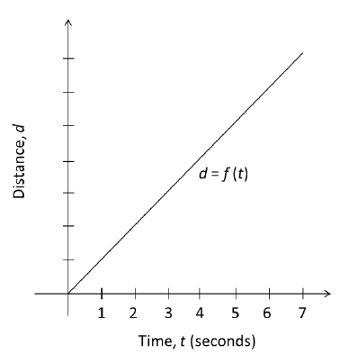
#4
The speed of sound at sea level is approximately 340 meters per second. The graph shows the distance, d, a sound wave created by a loud noise at sea level has traveled after t seconds. Each of the following sets of numbers represents meters. Assuming the graph is correct, which set of numbers is most appropriate to label the seven tick marks along the vertical axis (distance)?
1, 2, 3, 4, 5, 6, 7
50, 100, 150, 200, 250, 300, 350
100, 200, 300, 400, 500, 600, 700
340, 680, 1020, 1360, 1700, 2040, 2380

Slide 9
#4 Answer
Rubric:
(1 point) The student selects the correct list of numbers.
Answer: D

Slide 10
#5
A farmer is comparing costs for different fertilizers to use on her 45-acre field. Different brands of fertilizer come in different sizes that cover different areas of land. Choose two or more quantities that, when multiplied together, would give a quantity that could be used as a single measure to decide which fertilizer would be least expensive for her to use on her field.
The cost per bag of fertilizer in dollars.
The cost per cubic foot of fertilizer in dollars.
The volume of each bag of fertilizer in cubic feet.
The number of bags needed to fertilize one acre.
The number of acres a bag of fertilizer can cover.

Slide 11
#5 Answer
Rubric:
(1 point) The student selects the correct combination of options.
Answer: A and D or B, C, and D

