Slide 1

Claim 1
Smarter Balanced Sample Items
High School - Target B
Use properties of rational and irrational numbers.
Questions courtesy of the Smarter Balanced Assessment Consortium Item Specifications – Version 3.0
Slideshow organized by SMc Curriculum – www.ccssmathactivities.com
Notes:
‹#›

Slide 2


#1
Example 1: Click on two number whose sum, when added, would be irrational.
Example 2: Click on two number whose sum, when added, would be rational.
Notes:
‹#›

Slide 3


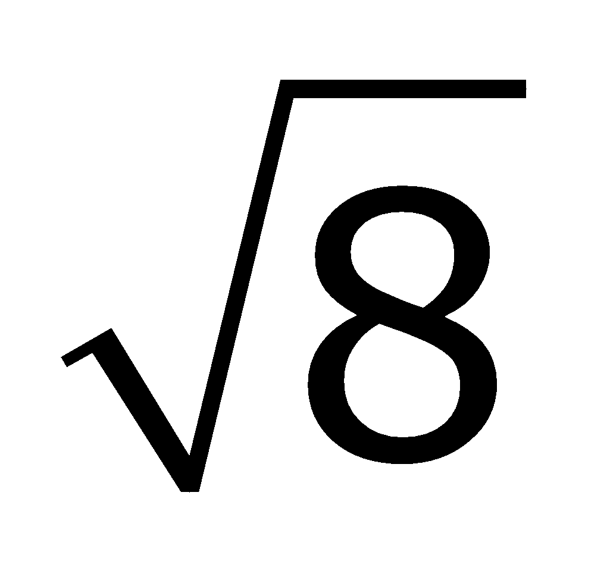
#1 Answer
Rubric: 1 point each
Answers:
Example 1: ,
Example 2: −5,
Notes:
‹#›

Slide 4
#2
Example 1: Click on two number whose product, when mutiplied, would be irrational.
Example 2: Click on two number whose product, when multiplied, would be rational.
Notes:
‹#›

Slide 5
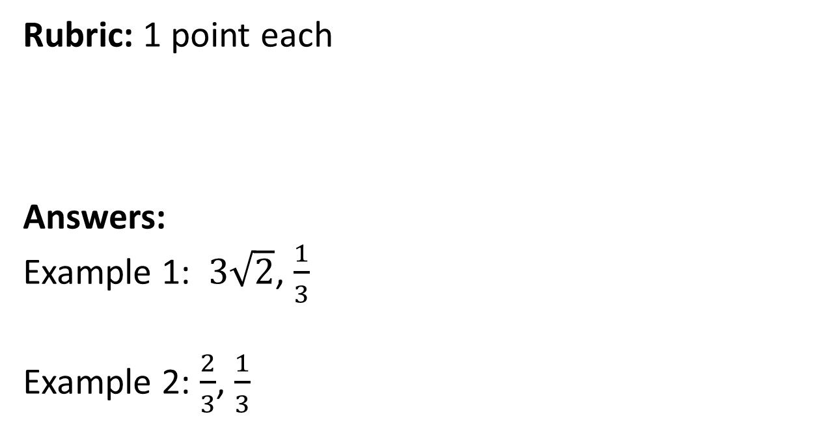
#2 Answer
Notes:
‹#›

Slide 6
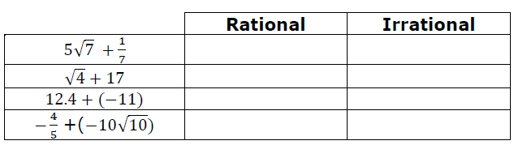
#3
Select the appropriate box to identify each expression as having either a rational or irrational sum.
Notes:
‹#›

Slide 7
#3 Answer
Rubric:
(1 point) The student correctly identifies the sum as rational or irrational.
Answer: Irrational, Rational, Rational, Irrational
Notes:
‹#›

Slide 8
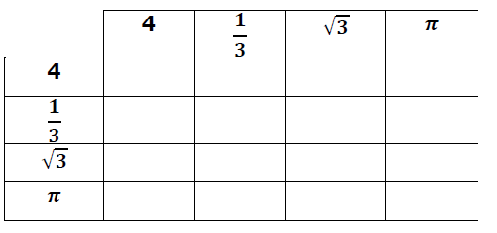
#4
Select each box in the table where the numbers from corresponding rows and columns will have a rational sum.
Notes:
‹#›

Slide 9
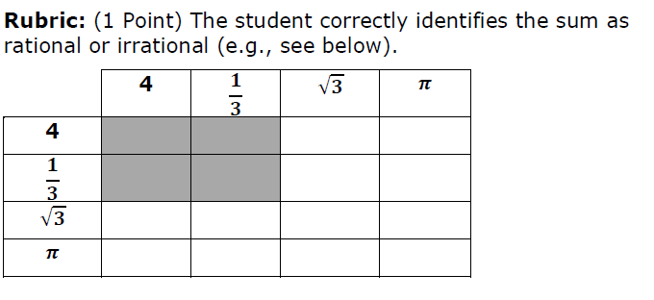
#4 Answer
Rubric:
(1 point) The student correctly identifies the sum as rational or irrational.
Answer:
Notes:
‹#›

Slide 10
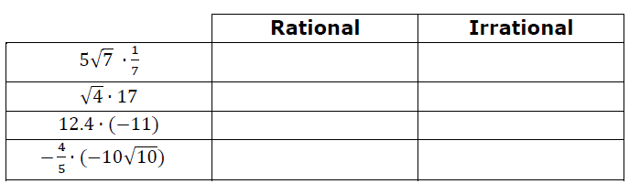
#5
Select the appropriate box to identify each expression as having either a rational or irrational product.
Notes:
‹#›

Slide 11
#5 Answer
Rubric:
(1 point) The student correctly identifies the product as rational or irrational.
Answer: Irrational, Rational, Rational, Irrational
Notes:
‹#›

Slide 12
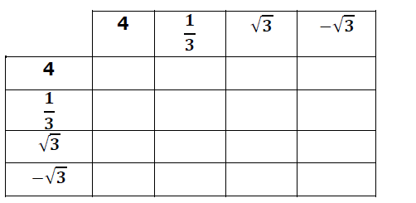
#6
Select each box in the table where the numbers from corresponding rows and columns will have a rational product.
Notes:
‹#›

Slide 13
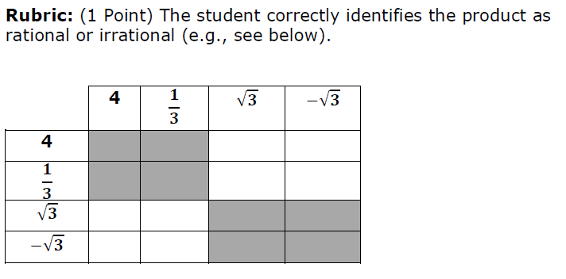
#6 Answer
Rubric:
(1 point) The student correctly identifies the product as rational or irrational.
Answer:
Notes:
‹#›

Slide 14
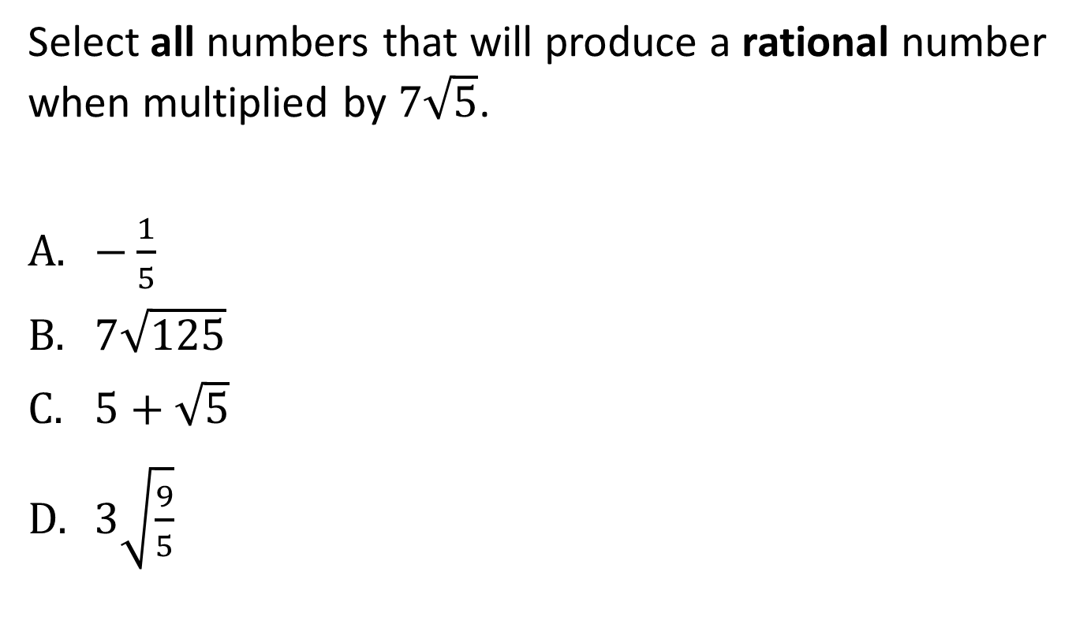
#7
Notes:
‹#›

Slide 15
#7 Answer
Rubric:
(1 point) The student correctly identifies the product as rational.
Answer: B, D
Notes:
‹#›

Slide 16
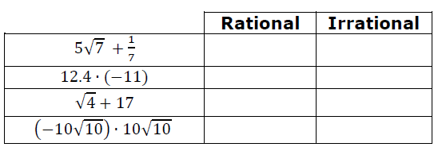
#8
Select the appropriate box to identify the value of each expression as being rational or irrational.
Notes:
‹#›

Slide 17
#8 Answer
Rubric:
(1 point) Student correctly identifies all sums and products correctly.
Answer: Irrational, Rational, Rational, Rational
Notes:
‹#›

