Slide 1

Claim 1
Smarter Balanced Sample Items
High School - Target A
Extend the properties of exponents to rational exponents.
Questions courtesy of the Smarter Balanced Assessment Consortium Item Specifications – Version 3.0
Slideshow organized by SMc Curriculum – www.ccssmathactivities.com

Slide 2
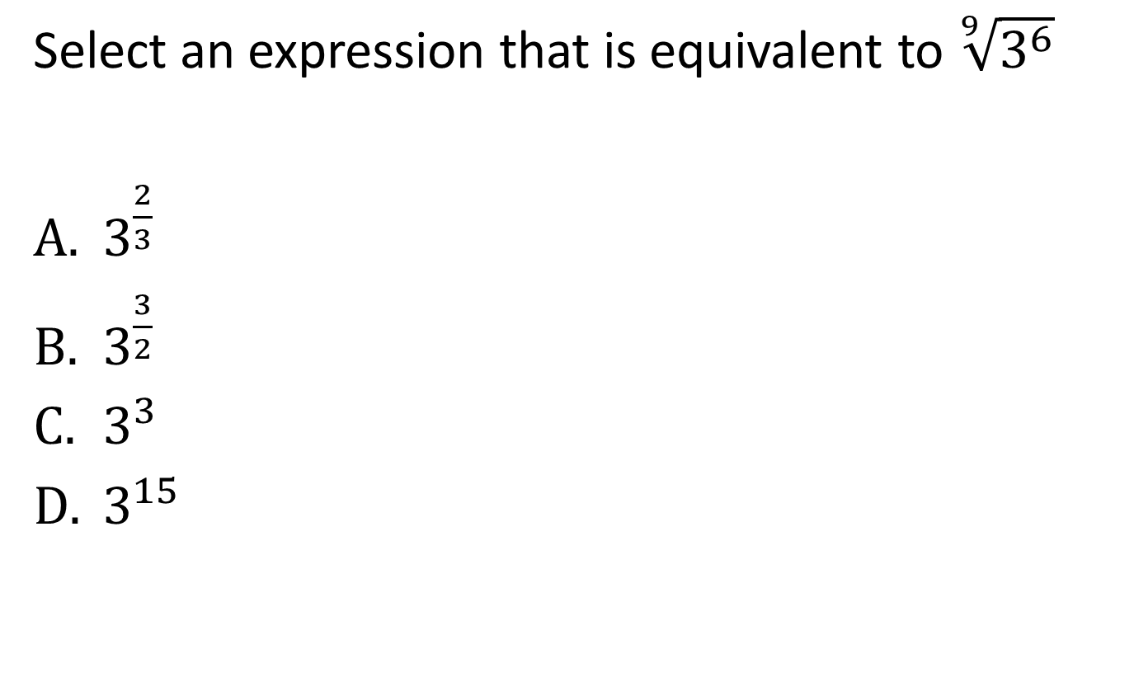
#1

Slide 3
#1 Answer
Rubric:
(1 point) The student correctly selects the equivalent rational form.
Answer: A

Slide 4
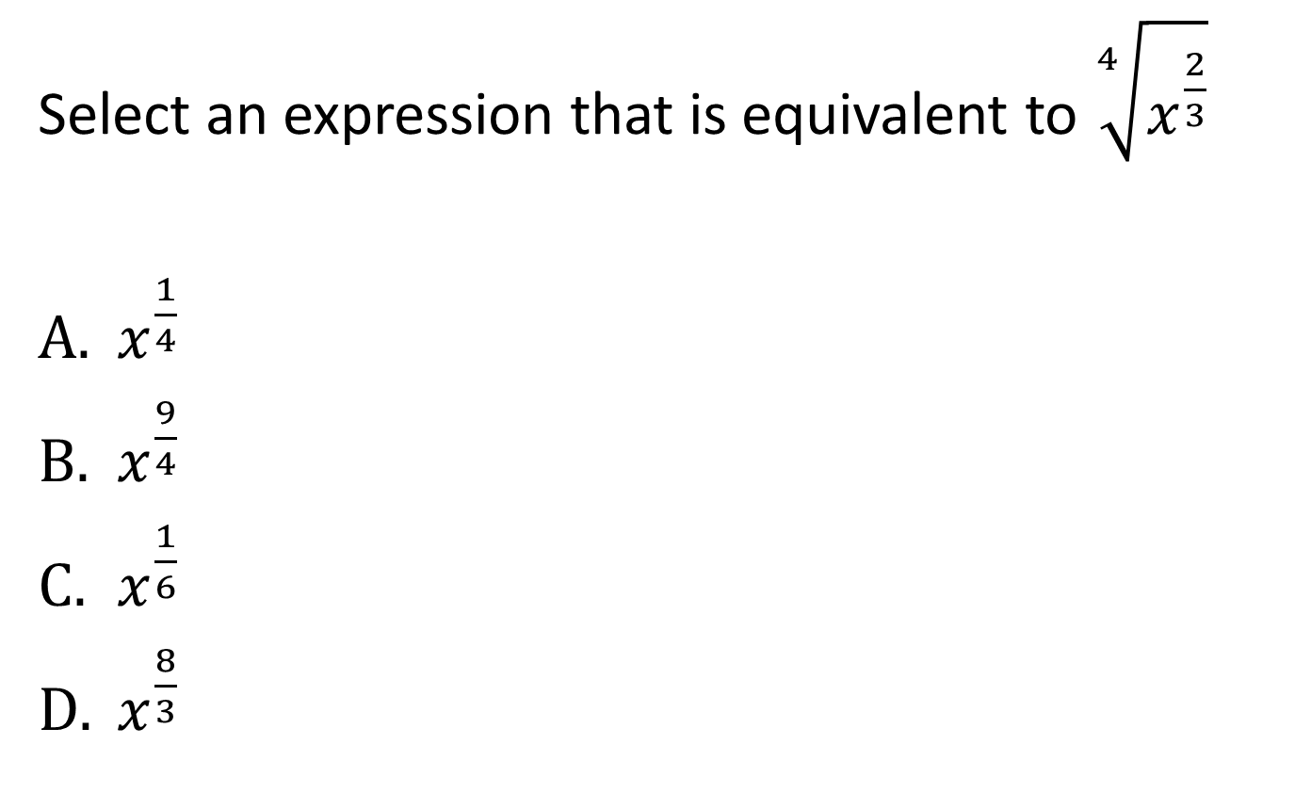
#2

Slide 5
#2 Answer
Rubric:
(1 point) The student correctly selects the equivalent rational form.
Answer: C

Slide 6
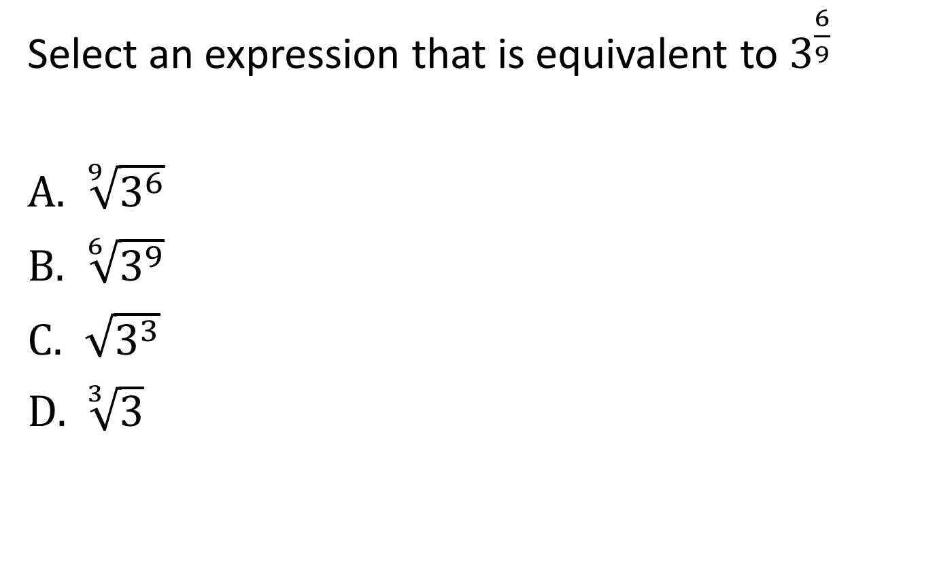
#3

Slide 7
#3 Answer
Rubric:
(1 point) The student correctly selects the equivalent radical form.
Answer: A

Slide 8
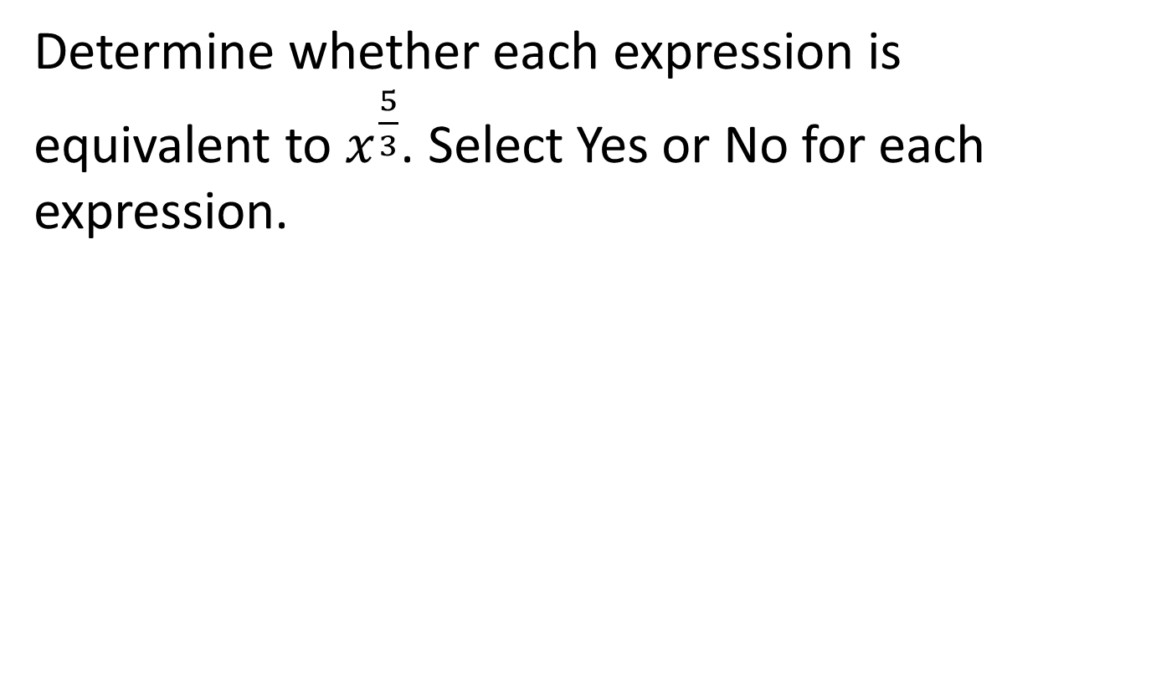
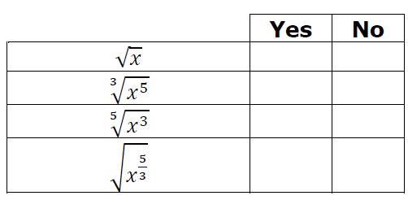
#4

Slide 9
#4 Answer
Rubric:
(1 point) The student correctly identifies the equivalent expressions.
Answer: N, Y, N, N

Slide 10
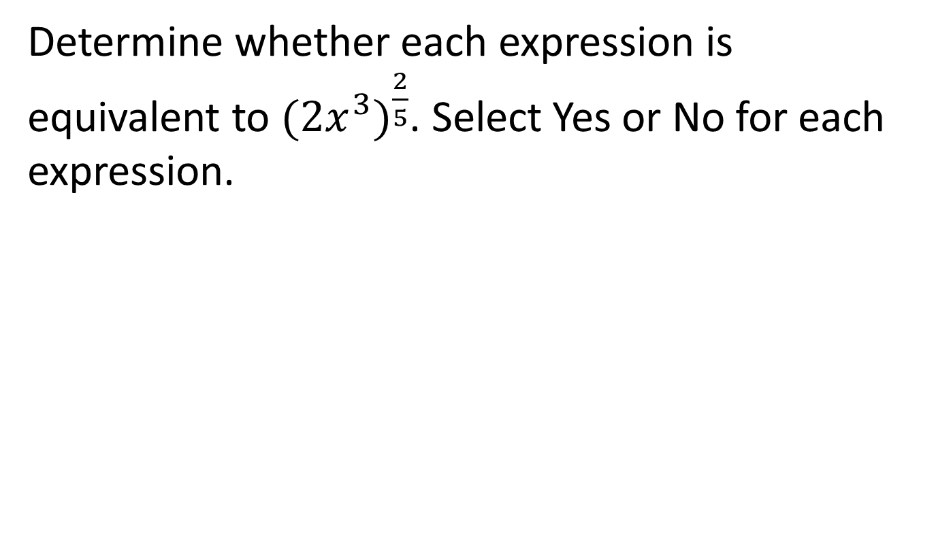
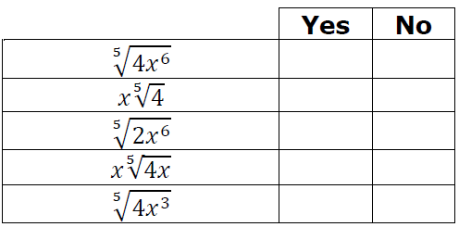
#5

Slide 11
#5 Answer
Rubric:
(1 point) The student correctly identifies the equivalent expressions.
Answer: Y, N, N, Y, N

Slide 12
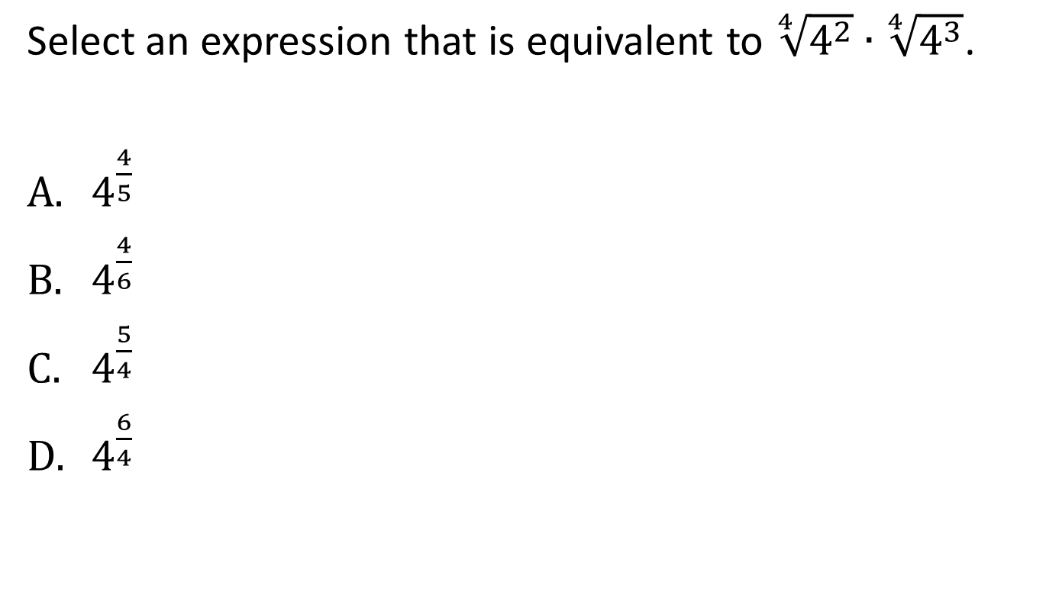
#6

Slide 13
#6 Answer
Rubric:
(1 point) The student correctly selects the equivalent rational form.
Answer: C

Slide 14
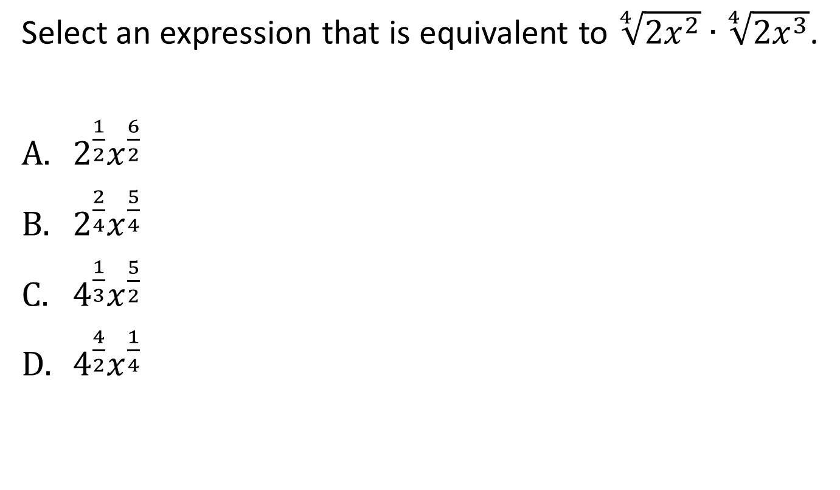
#7

Slide 15
#7 Answer
Rubric:
(1 point) The student correctly selects the equivalent rational form.
Answer: B

Slide 16
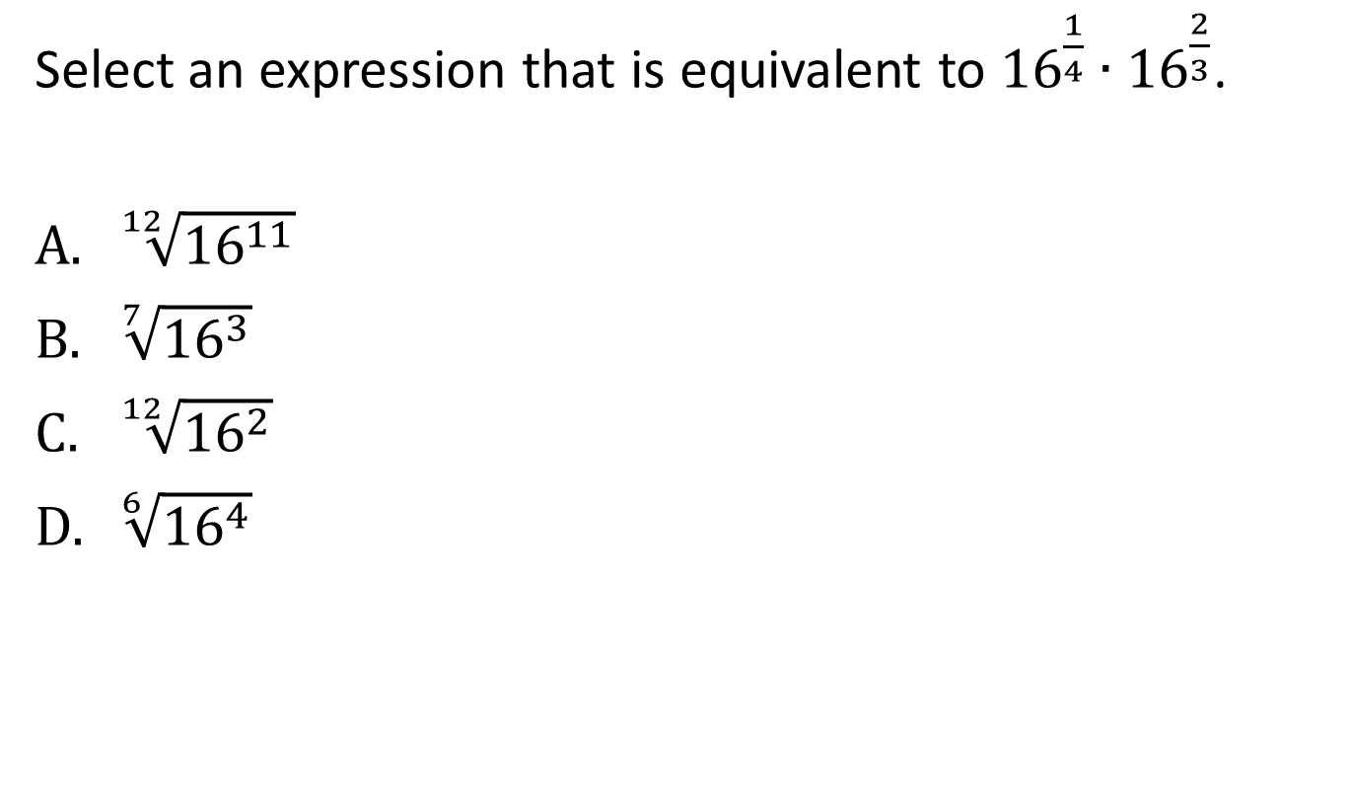
#8

Slide 17
#8 Answer
Rubric:
(1 point) The student correctly selects the equivalent radical form.
Answer: A

Slide 18
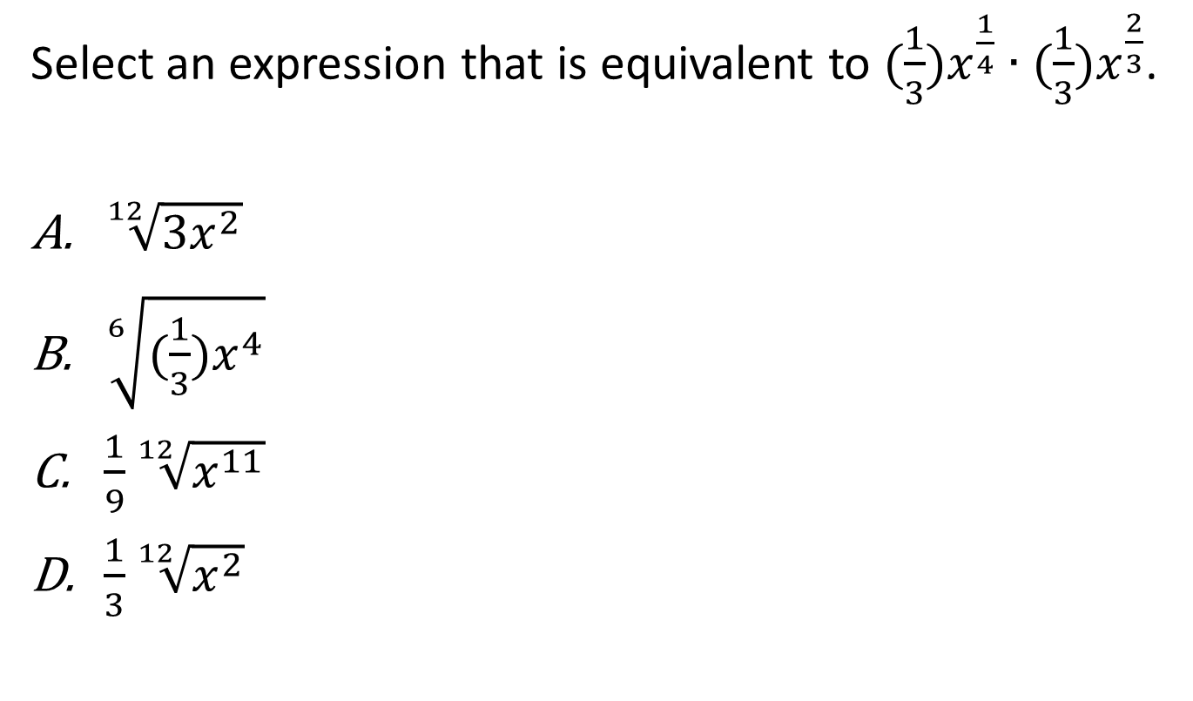
#9

Slide 19
#9 Answer
Rubric:
(1 point) The student correctly selects the equivalent radical form.
Answer: C

Slide 20
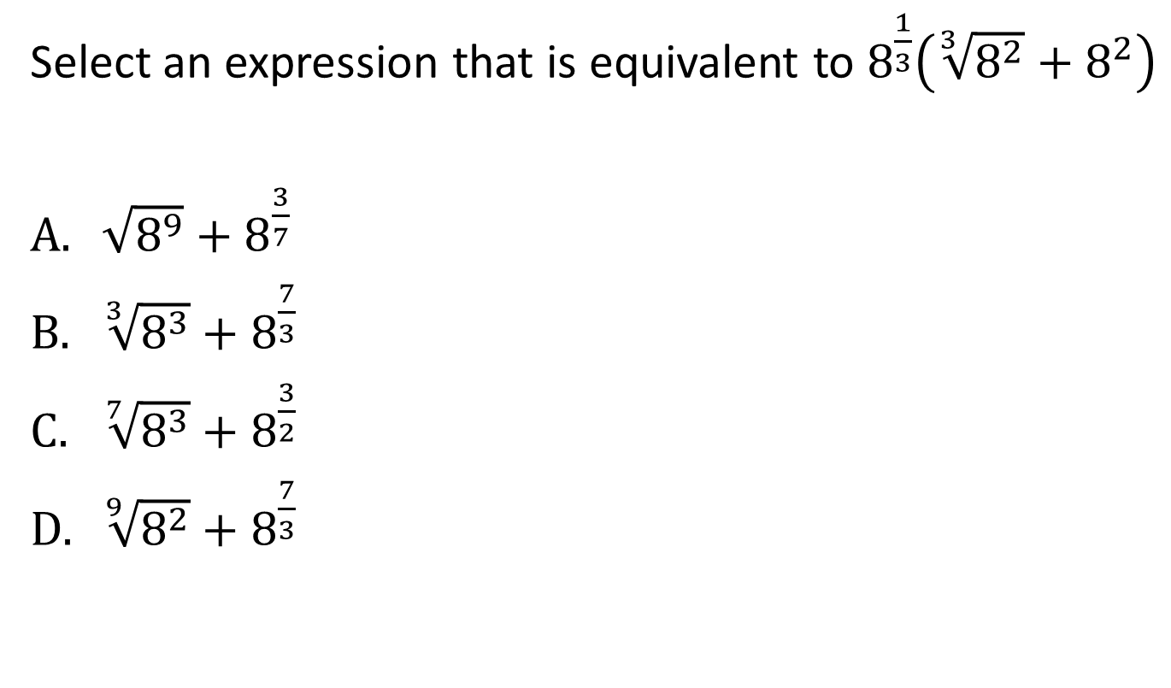
#10

Slide 21
#10 Answer
Rubric:
(1 point) The student correctly selects the equivalent radical form.
Answer: C

Slide 22
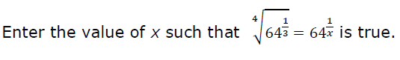
#11

Slide 23
#11 Answer
Rubric:
(1 point) The student enters the correct value of the variable.
Answer: 12

Slide 24
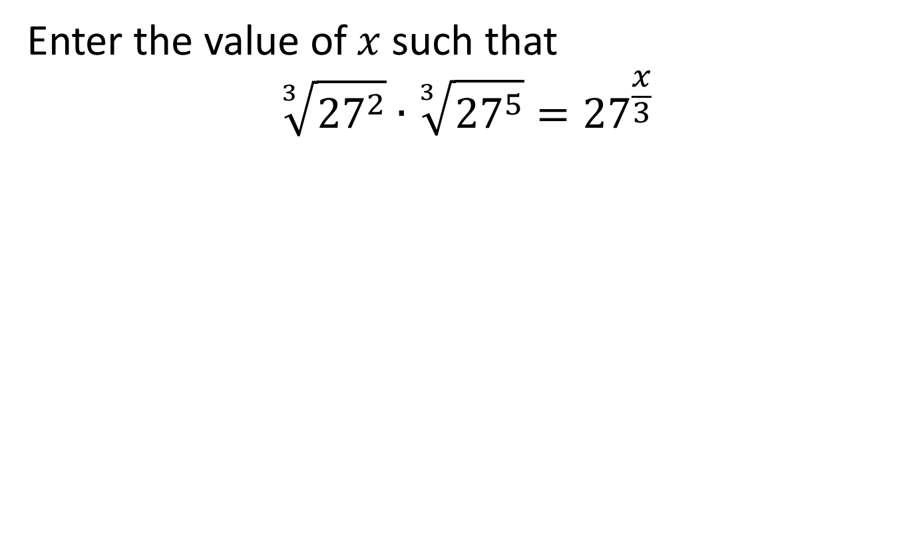
#12

Slide 25
#12 Answer
Rubric:
(1 point) The student enters the correct value of the variable.
Answer: 7

Slide 26
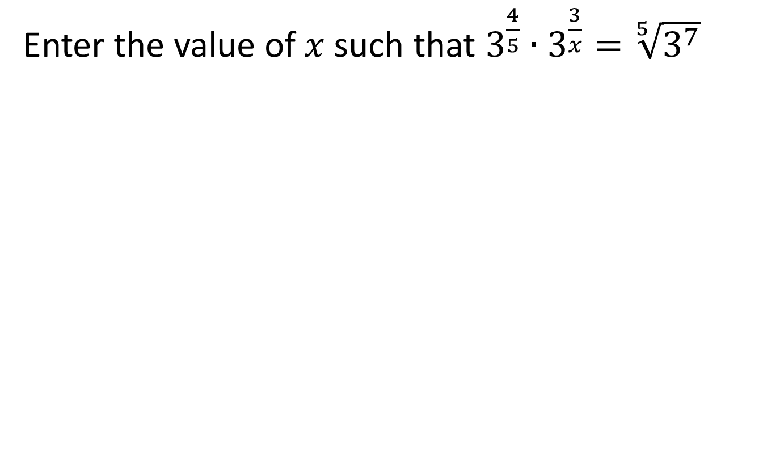
#13

Slide 27
#13 Answer
Rubric:
(1 point) The student enters the correct value of the variable.
Answer: 5

Slide 28
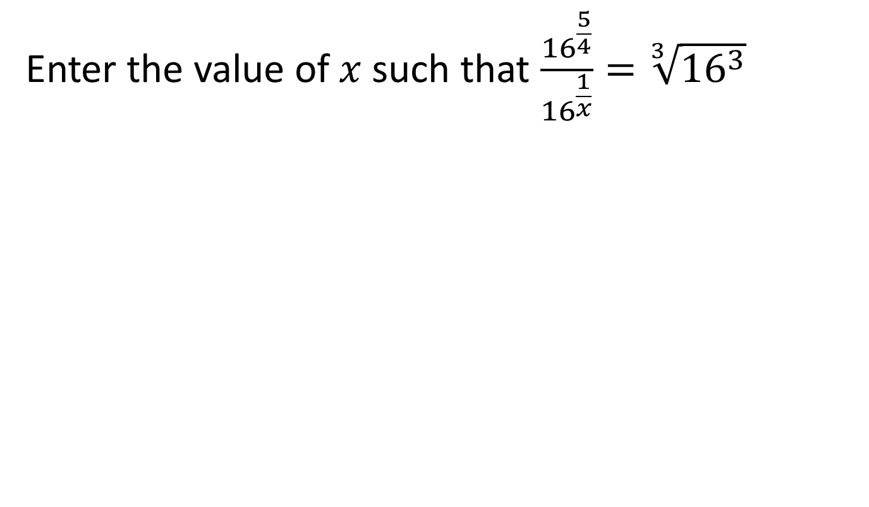
#14

Slide 29
#14 Answer
Rubric:
(1 point) The student enters the correct value of the variable.
Answer: 4

Slide 30
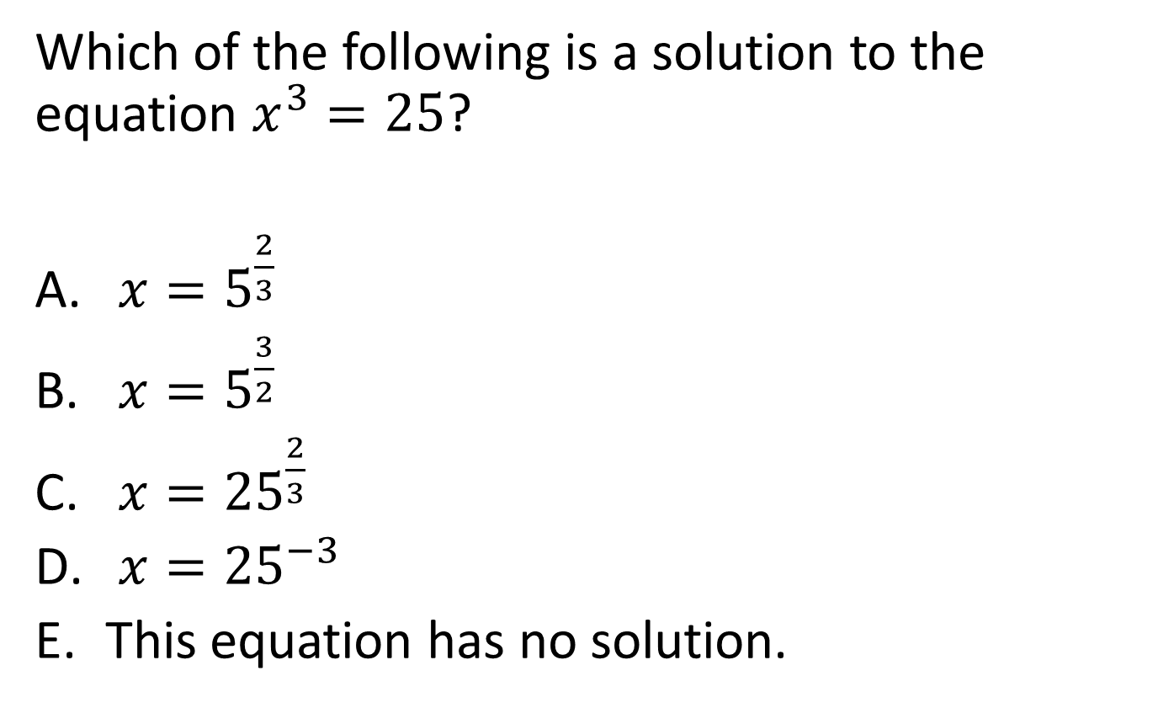
#15

Slide 31
#15 Answer
Rubric:
(1 point) The student selects the correct option.
Answer: A

Slide 32
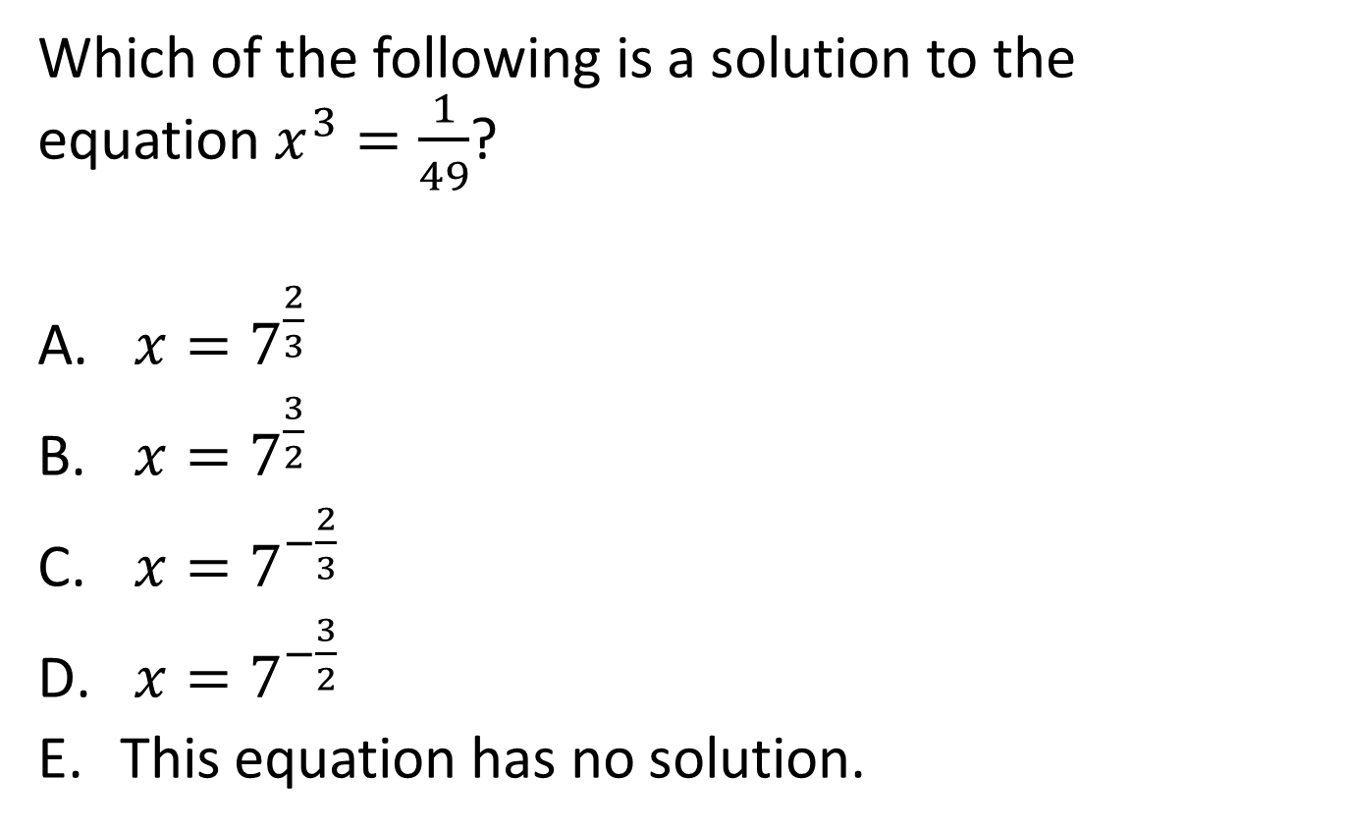
#16

Slide 33
#16 Answer
Rubric:
(1 point) The student selects the correct option.
Answer: C

Slide 34
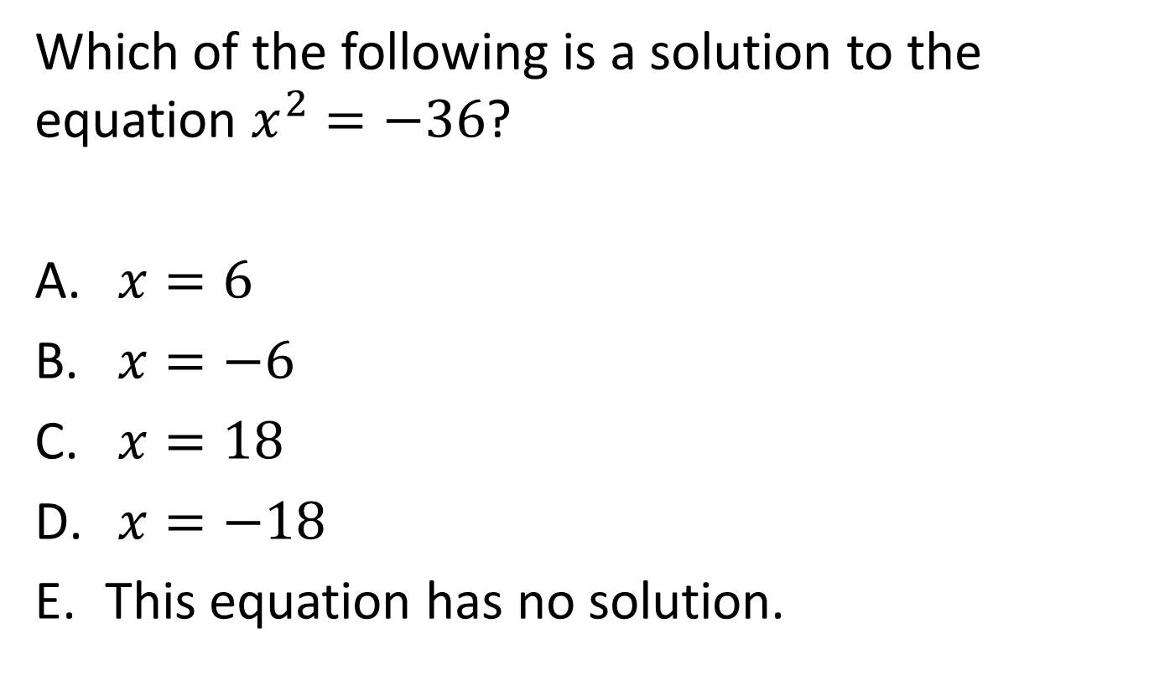
#17

Slide 35
#17 Answer
Rubric:
(1 point) The student selects the correct option.
Answer: E

Slide 36
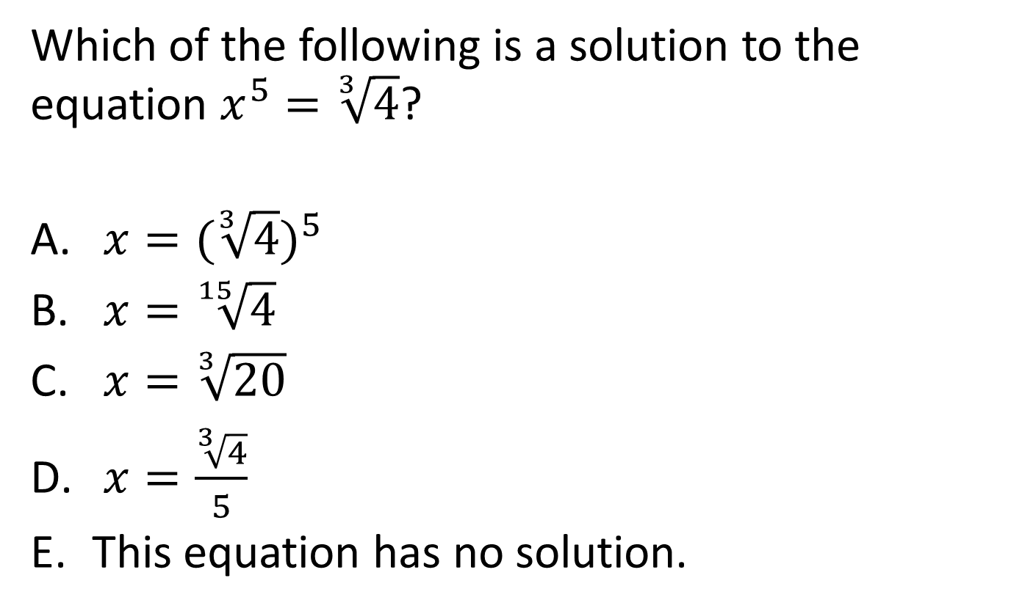
#18

Slide 37
#18 Answer
Rubric:
(1 point) The student selects the correct option.
Answer: B

Slide 38
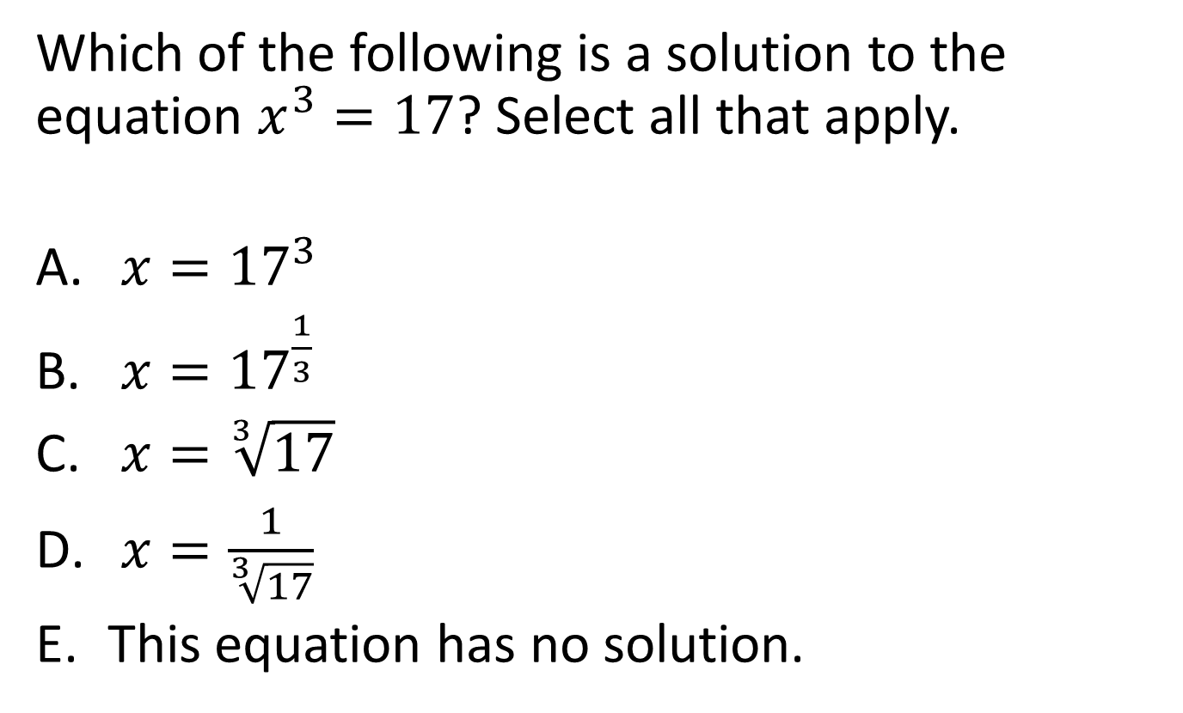
#19

Slide 39
#19 Answer
Rubric:
(1 point) The student selects the correct options.
Answer: B, C

Slide 40
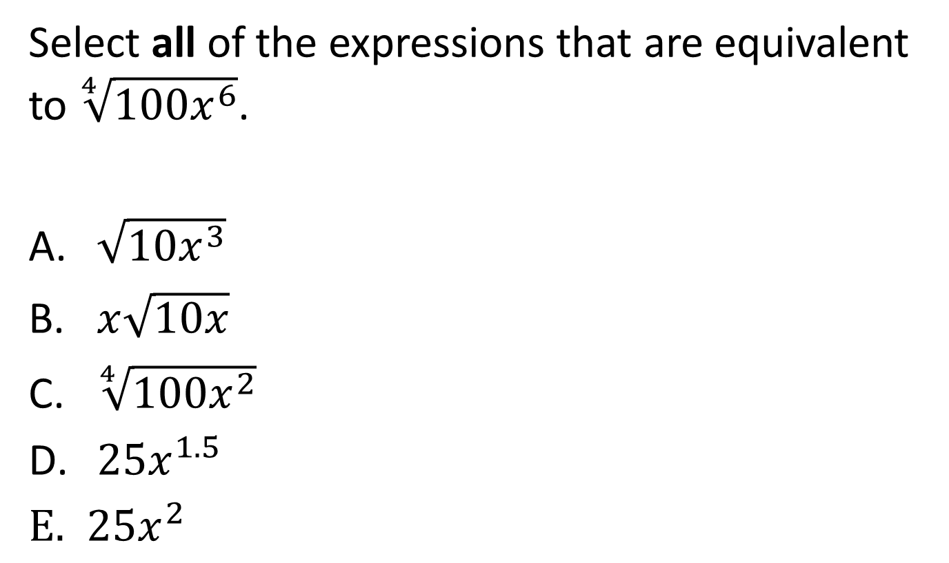
#20

Slide 41
#20 Answer
Rubric:
(1 point) The student correctly selects the equivalent expressions.
Answer: A, B, C

Slide 42
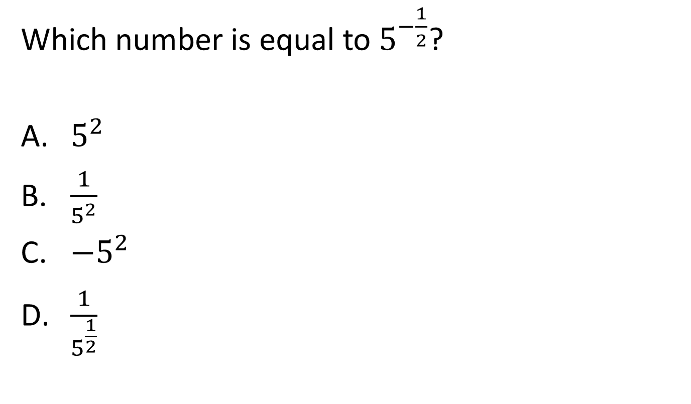
#21

Slide 43
#21 Answer
Rubric:
(1 point) The student correctly selects the equivalent expression.
Answer: D

Slide 44
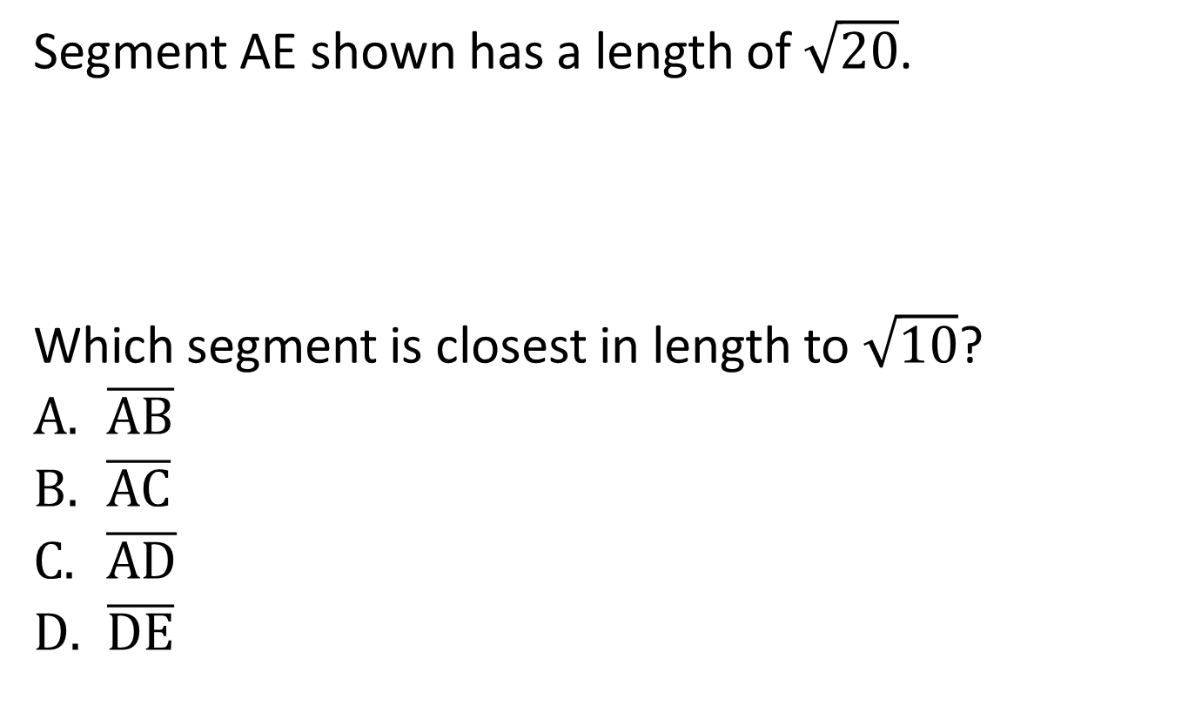
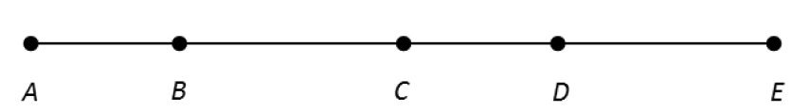
#22

Slide 45
#22 Answer
Rubric:
(1 point) The student selects the correct segment.
Answer: C

Slide 46
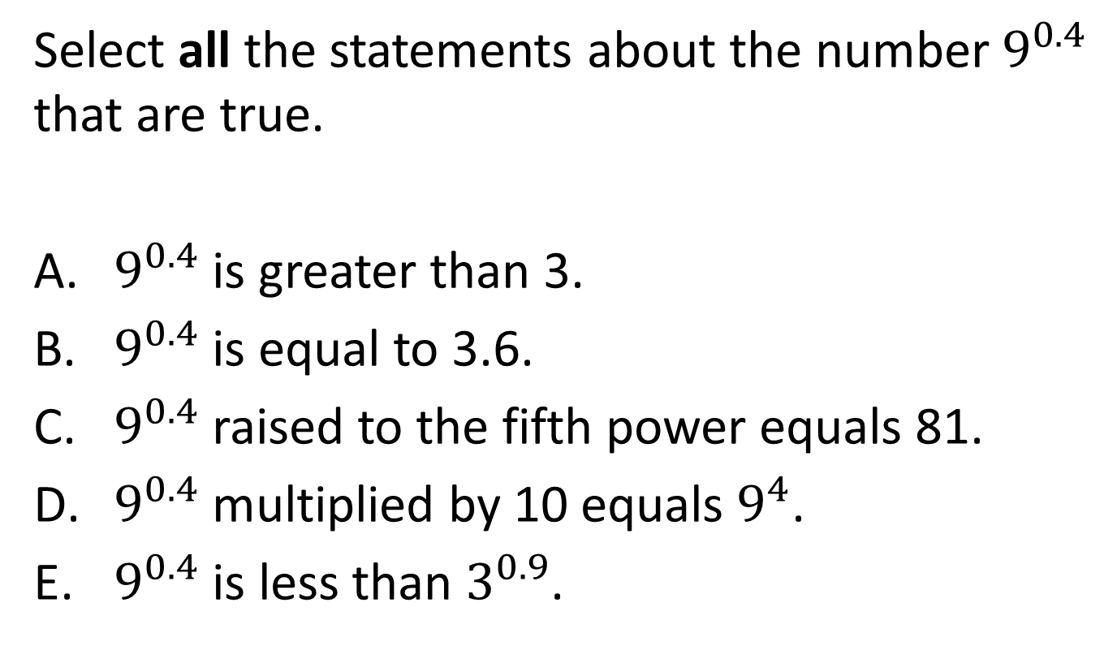
#23

Slide 47
#23 Answer
Rubric:
(1 point) The student correctly selects the true statements.
Answer: B, E

