Slide 1

Claim 3
Smarter Balanced Sample Items
Grade 8
Communicating Reasoning
Questions courtesy of the Smarter Balanced Assessment Consortium Item Specifications – Version 3.0
Slideshow organized by SMc Curriculum – www.ccssmathactivities.com

Slide 2
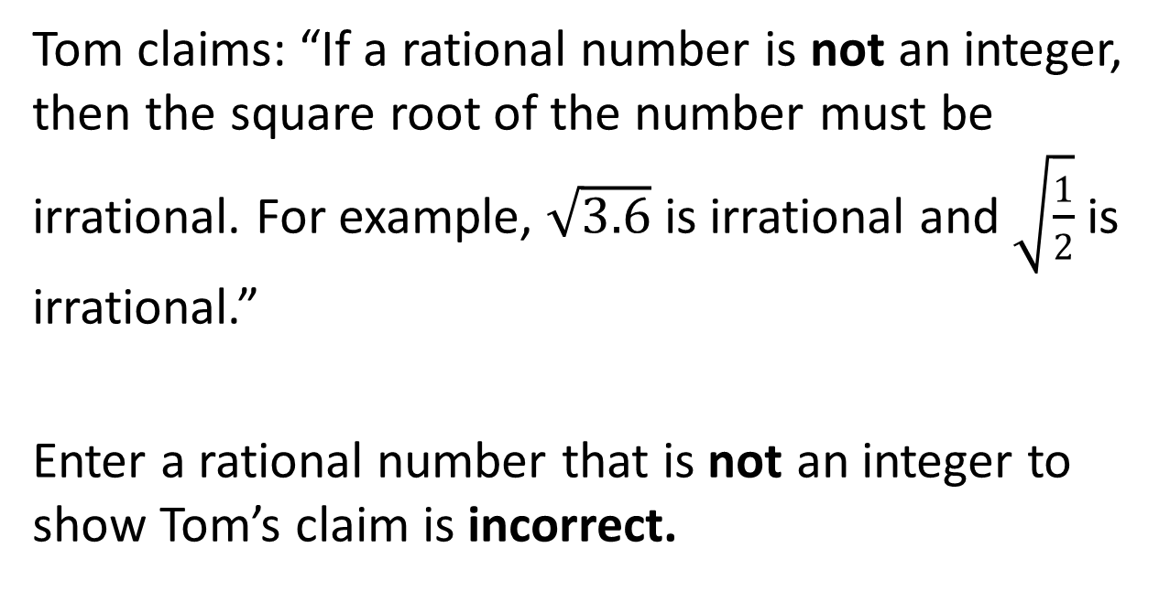
#1

Slide 3
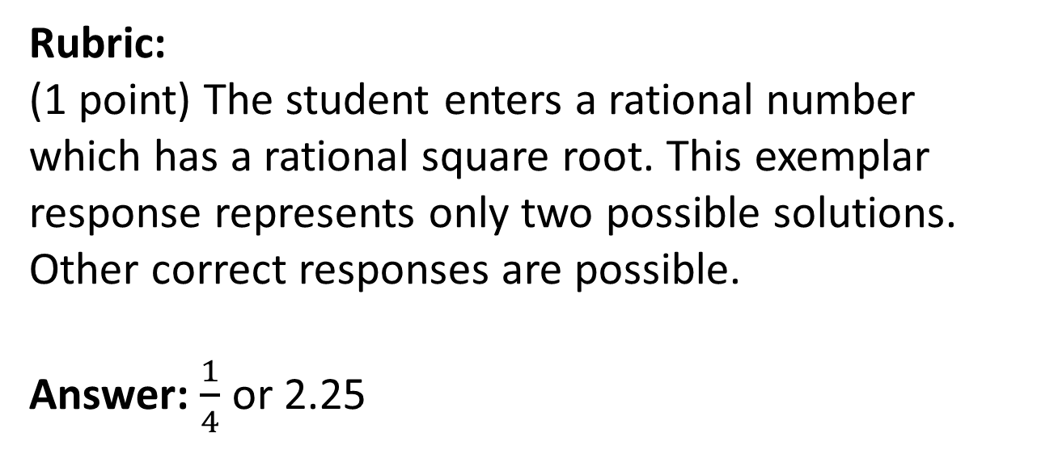
#1 Answer

Slide 4
#2
Franco said that for any values a, b, and c the equation a² + b² = c² is always true. Mary disagrees.
Which of the following values for a, b, and c support Mary’s claim? Select all that apply.
a = 6, b = 8, c = 10
a = 2, b = 4, c = 6
a = b = c = 0
a = -2, b = 2, c = 0

Slide 5
#2 Answer
Rubric:
(1 point) The student selects all of the correct values that support Mary’s claim.
Answer: B, D

Slide 6
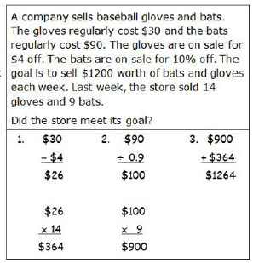
#3
Kyle had to solve a problem. The problem and his work are shown in the box. Select the part of Kyle’s work that has a mistake. Select the part of the problem Kyle should read again to fix his mistake.

Slide 7
#3 Answer
Rubric:
(1 point) The student selects the flawed work.
Answer: $90/0.9 = $100 and highlights “The bats are on sale for 10% off.”

Slide 8
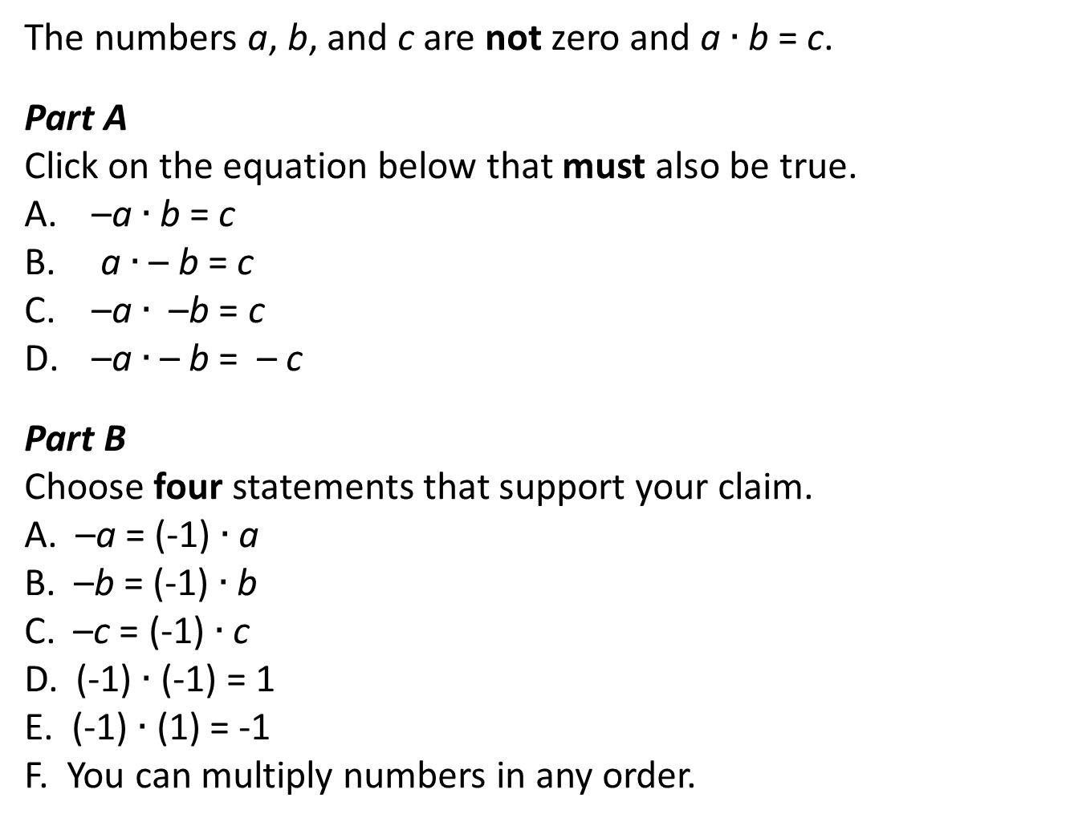
#4

Slide 9
#4 Answer
Rubric:
(2 points) The student selects the correct equation and selects four statements that support the claim.
(1 point) The student does one or the other.
Answer: Equation: C; Four statements: A, B, D, F

Slide 10
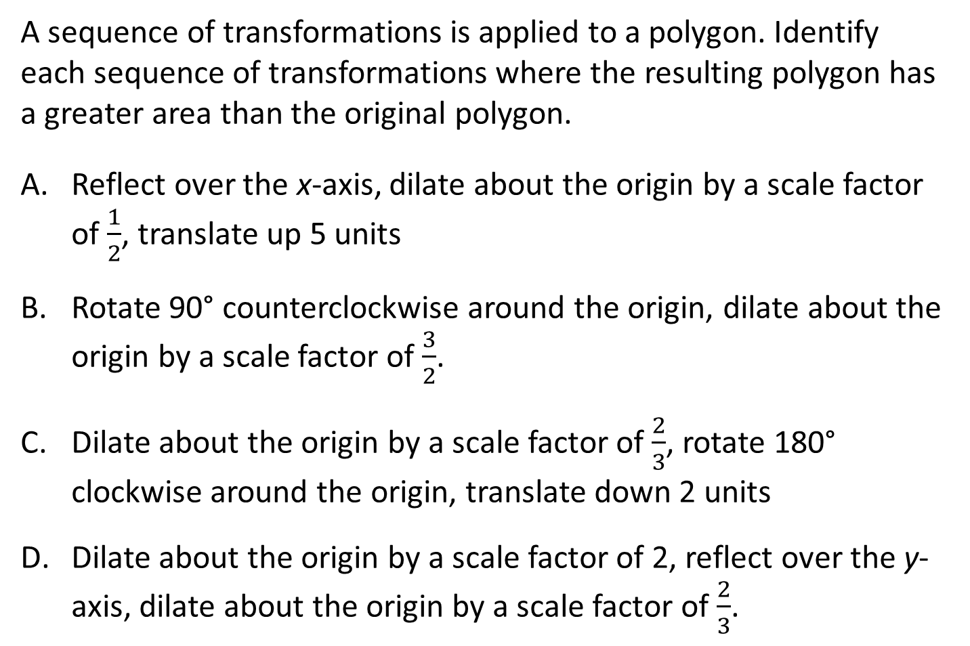
#5

Slide 11
#5 Answer
Rubric:
(1 point) The student identifies all the correct conditions that make the argument true.
Answer: B, D

Slide 12
#6
Part A
Is it possible for three linear equations in x and y to have a solution common to all three?
Yes No
Part B
If yes, use the Arrow Tool to draw the graphs of three equations that have a common solution. Add a point that represents the common solution.
If no, explain why this is not possible in the response box.

Slide 13
#6 Answer
Rubric:
(1 point) The student selects “yes” and draws three lines that intersect in a single point and places a point at the intersection of the three lines (it is allowable for the lines to coincide, but they have to draw three graphs).

Slide 14
#7
A car is traveling at a constant speed and drove 75 miles in 1.5 hours. One mile is approximately 1.6 kilometers. Approximately how fast is the car traveling in kilometers per hour?
Explain or show clear steps for how you determined your answer.

Slide 15
#7 Answer
Rubric:
(2 points) The student includes the correct numeric value (80) in the response and provides a coherent, complete explanation or sequence of computations that shows where this comes from.
(1 point) The student enters the correct numeric value but does not provide a coherent explanation OR the student provides an incorrect speed and includes an explanation that shows an understanding of how the answer could be found, but with some computational errors or a small misstep in reasoning.
Answer: Examples:
Going 75 miles in 1.5 hours is the same as going 50 miles per hour. 50 miles is 50 x 1.6 = 80 km. A car driving 50 miles per hour is driving 80 kilometers per hour.
75 miles in 1.5 hours is 75/1.5 = 50 mi/hr. 50 mi/hr x 1.6 km/mi = 80 km/hr. The car is traveling at 80 kilometers per hour.

Slide 16
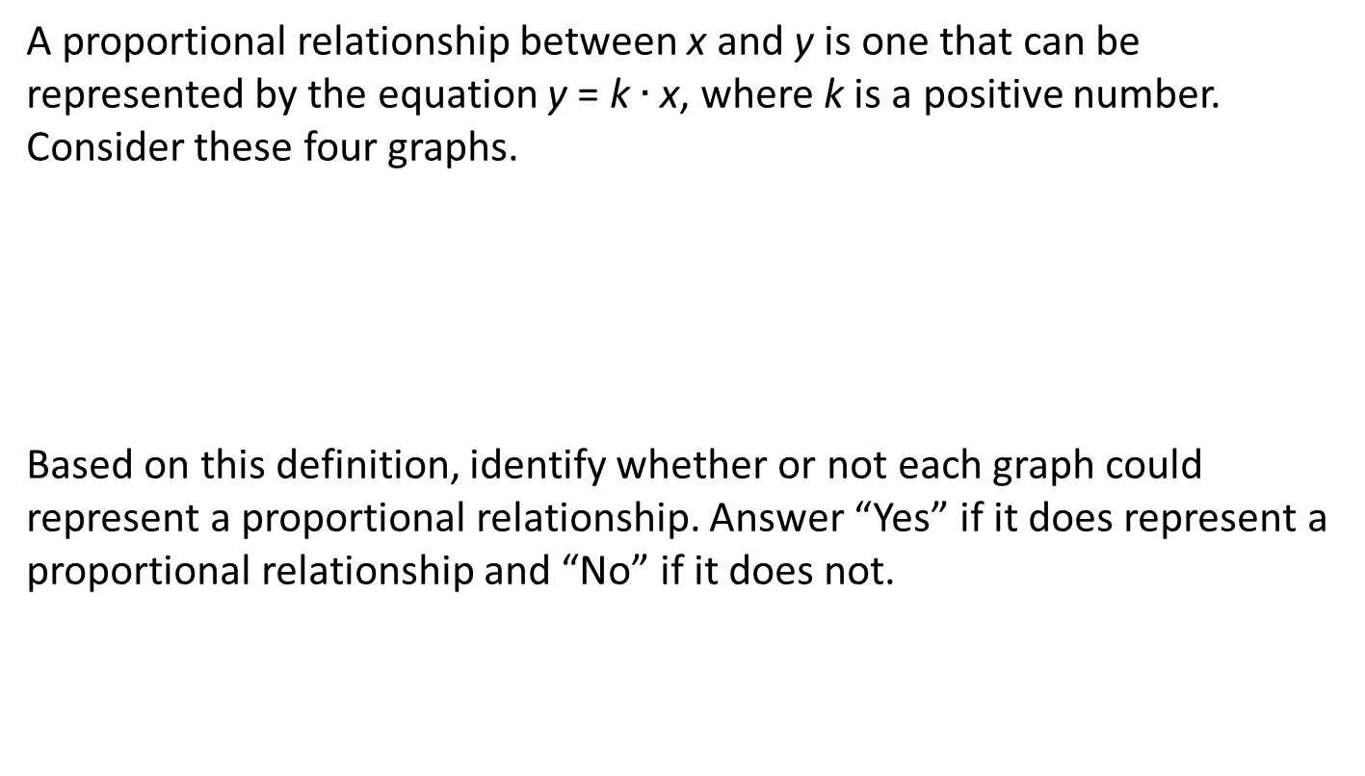
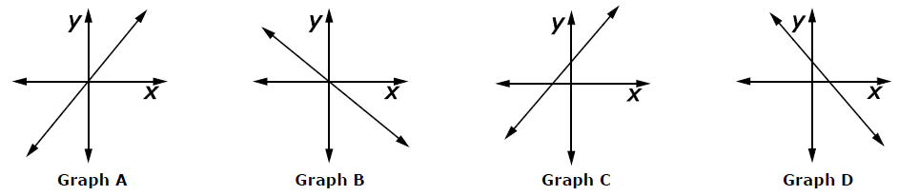
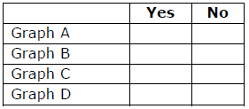
#8

Slide 17
#8 Answer
Rubric:
(1 point) The student identifies the correct graphs.
Answer: Y, N, N, N

Slide 18
#9
Select all of the following situations that show that Figure P is congruent to Figure Q.
There is a translation that takes Figure P to Figure Q.
There is a rotation that takes Figure P to Figure Q.
There is a reflection that takes Figure P to Figure Q.
There is a dilation that takes Figure P to Figure Q.

Slide 19
#9 Answer
Rubric:
(1 point) The student selects the correct transformations.
Answer: A, B, C

Slide 20
#10
Maggie claims that when you raise a whole number to a power, the result is always a greater number. That is, s^{n} > s. For example:
4³ > 4
5⁴ > 5
10⁹ > 10
Maggie’s claim is not true for all values of n and s. For what values of n and s is Maggie’s claim true? Complete the inequalities.
s >
n >

Slide 21
#10 Answer
Rubric:
(1 point) The student enters the correct values in the response boxes.
Answers: 1; 1

Slide 22
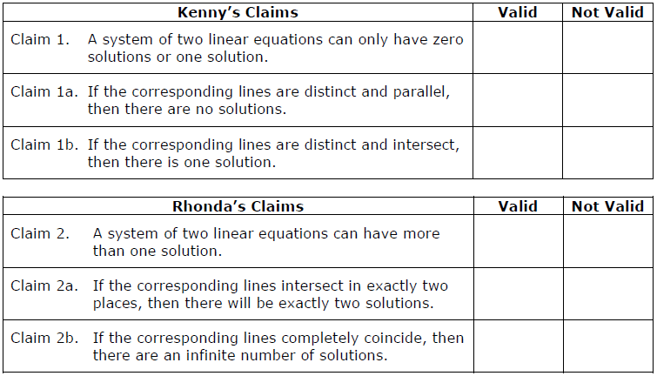
#11
The students in Mr. Martin’s class are learning about linear equations. Kenny made a claim and two supporting claims about the possible number of solutions to a system of linear equations. Rhonda made a different claim with two supporting claims. Indicate whether each claim is valid or not valid.

Slide 23
#11 Answer
Rubric:
(1 point) The student selects the correct claims.
Answer: NVV; VNV

Slide 24
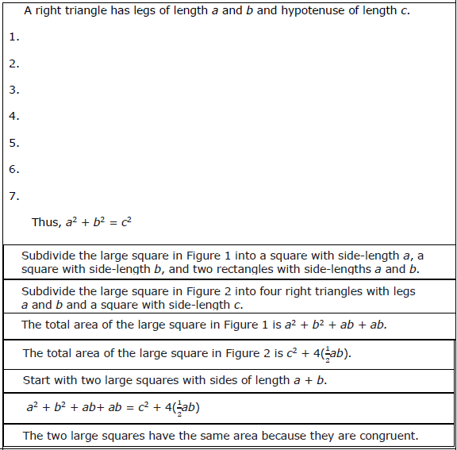
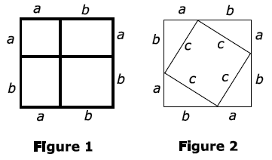
#12
The Pythagorean Theorem states that if a right triangle has legs of length a and b and hypotenuse of length c, then a² + b² = c². Figures 1 and 2 represent the key ideas in a proof of the Pythagorean Theorem.
Create an outline of a proof for the Pythagorean Theorem based on Figures 1 and 2, by dragging the seven statements shown into a logical sequence.

Slide 25
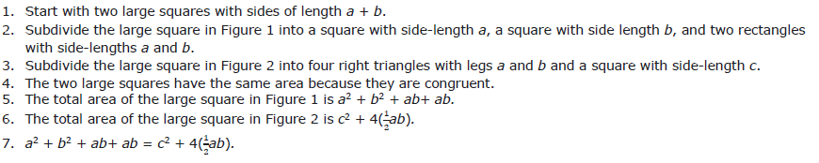
#12 Answer
Rubric:
(2 points) The student drags the steps of the proof into a logical order. Note that 1 must be first and 7 must be last and 2 must precede 5 and 3 must precede 6, but any other permutations are allowed as long as they are consistent with these constraints.
(1 point) The student gets the steps in an order consistent with the constraints described above, but has at most one step out of order.
Answer: Example:

