Slide 1

Claim 2
Smarter Balanced Sample Items
Grade 8
Problem Solving
Questions courtesy of the Smarter Balanced Assessment Consortium Item Specifications – Version 3.0
Slideshow organized by SMc Curriculum – www.ccssmathactivities.com

Slide 2
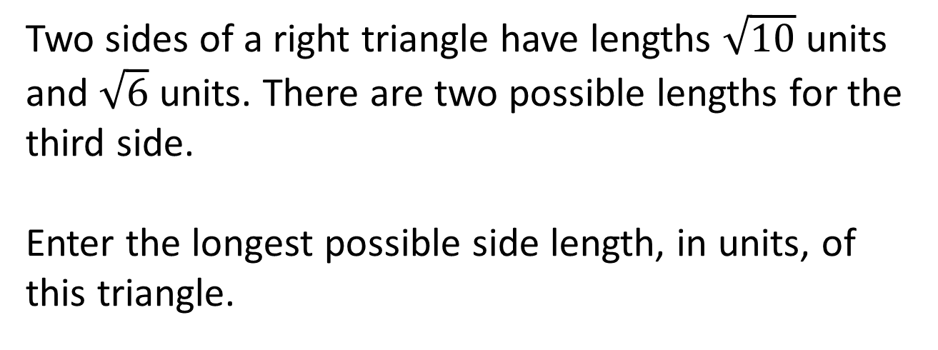
#1

Slide 3
#1 Answer
Rubric:
(1 point) The student correctly enters the longest side of the triangle.
Answer: 4

Slide 4
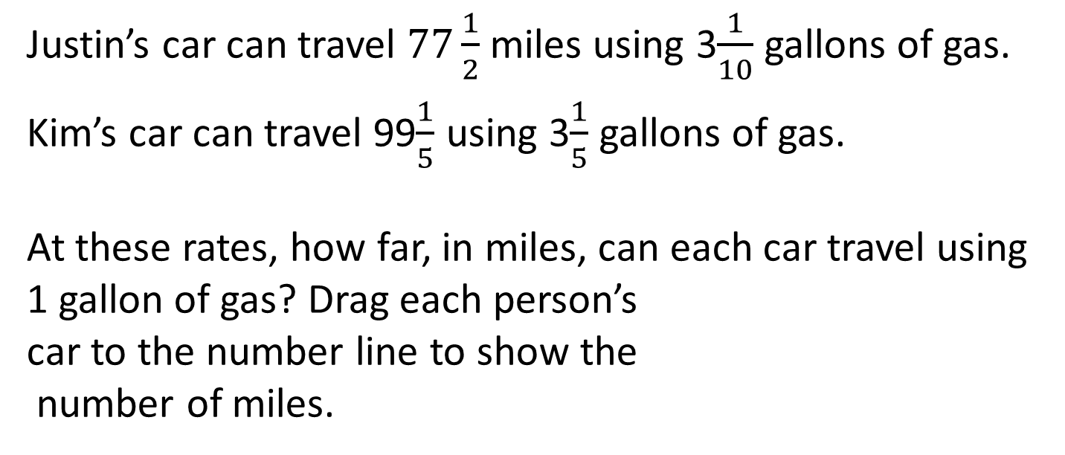
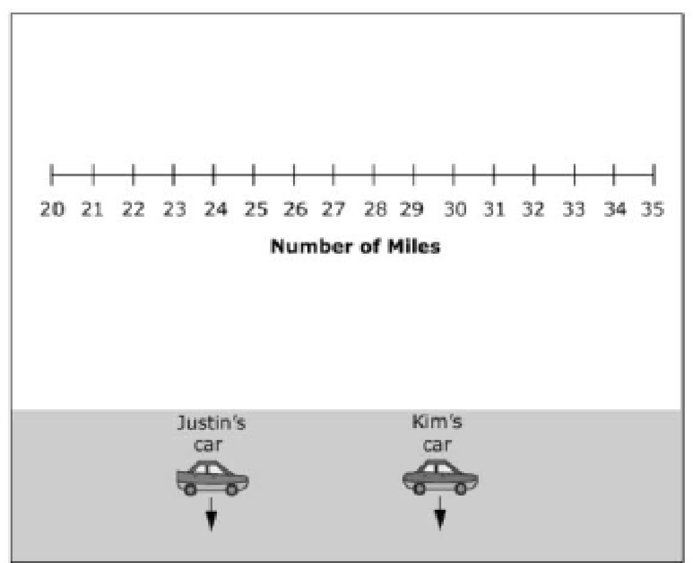
#2

Slide 5
#2 Answer
Rubric:
(2 points) The student places both cars at the correct point.
(1 point) The student places only one car at the correct point.
Answer: Justin’s car at the 25-mile mark and Kim’s car at the 31 mile mark

Slide 6
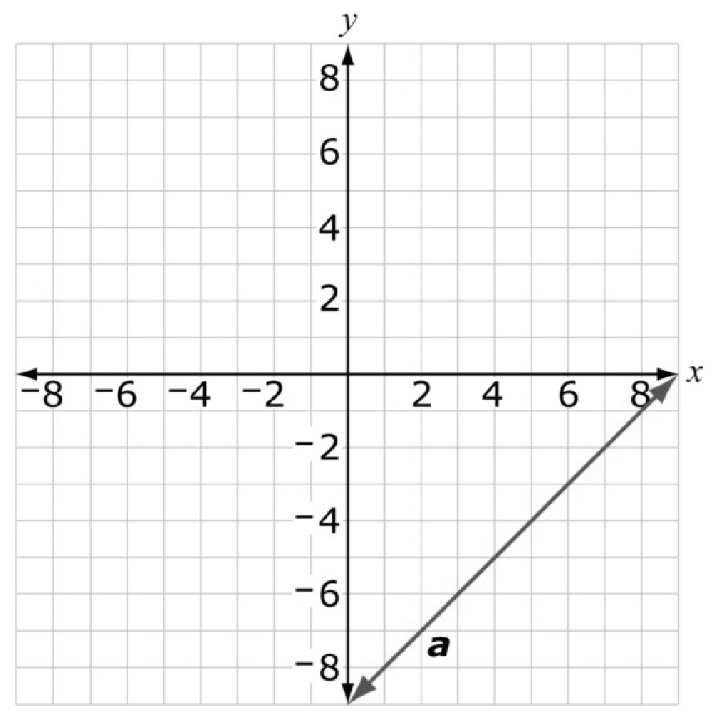
#3
Line a is shown on the graph. Use the Add Arrow tool to
construct line b on the graph so that:
Line a and line b represent a system of linear equations with a solution of (7, −2).
The slope of line b is greater than −1 and less than 0.
The y-intercept of line b is positive.

Slide 7
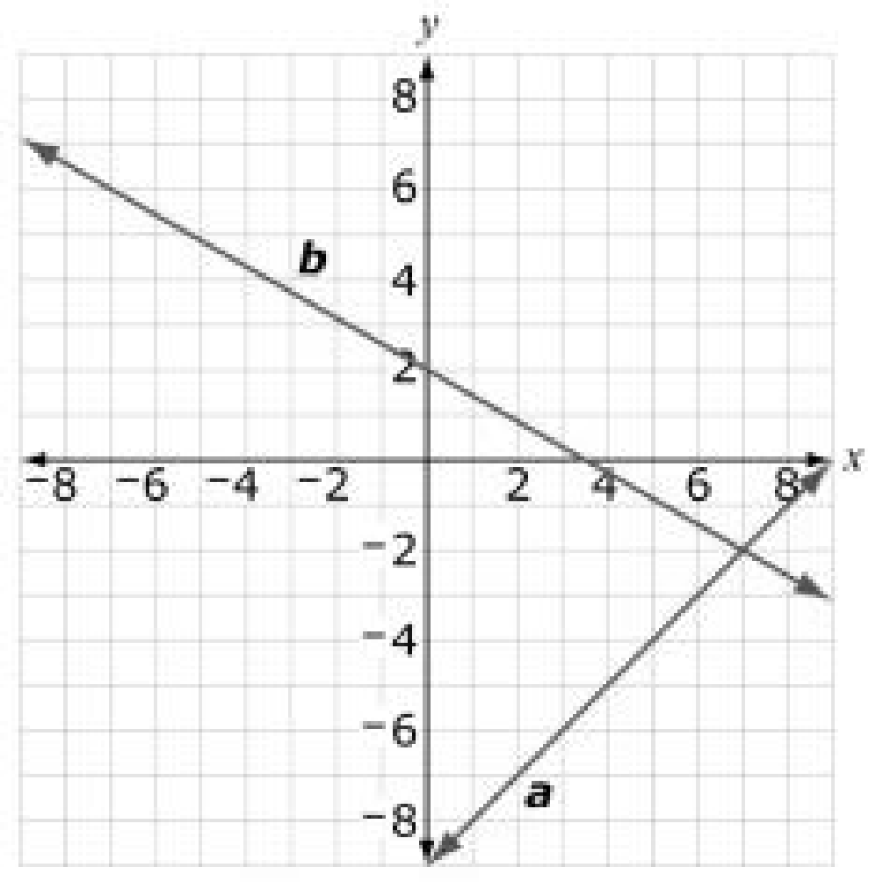
#3 Answer
Rubric:
(1 point) The student is able to construct a line that meets the requirements.
Answer:

Slide 8
#4
A cylindrical tank has a height of 10 feet and a radius of 4 feet. Jane fills this tank with water at a rate of
8 cubic feet per minute. Using this rate, determine the number of minutes it will take Jane to completely fill the tank without overflowing.
Enter your answer, rounded to the nearest minute, in the response box.

Slide 9
#4 Answer
Rubric:
(1 point) The student enters the correct number of minutes.
Answer: 63

Slide 10
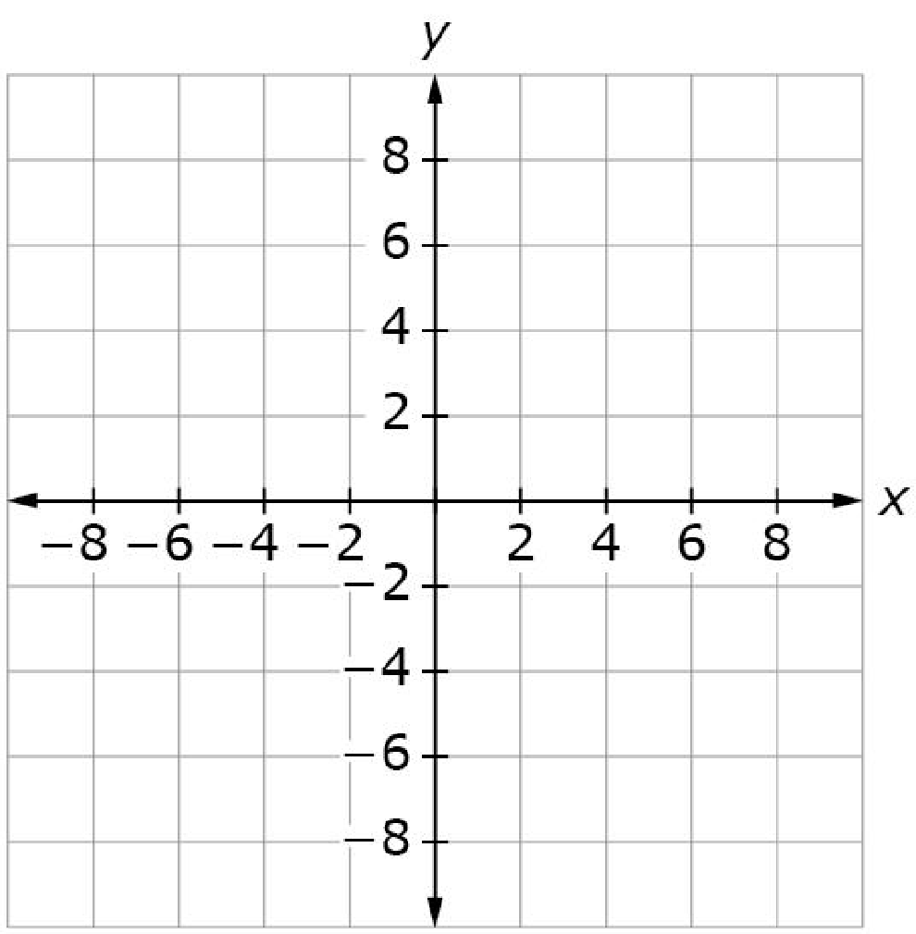
#5
The table shows some values from a linear function.
Use the Add Arrow tool to create a
graph of a different function that
has the same rate of change as the
one shown by the table of values.
x | y
−1 | −5
1
3 | 3

Slide 11
#5 Answer
Rubric:
(1 point) The student draws a line with the correct slope and does not pass through the points shown in the function table.
Answer: slope of 2, passes through any y-intercept except (0, -3)

Slide 12
#6
Helga wants to have a lot of helium-filled balloons at her party.
The helium tank costs $58 to rent.
Balloons cost $0.29 each.
She wants to have 5 helium-filled balloons for each party guest.
Enter an equation that represents the total cost, C, in dollars of the helium-filled balloons for n party guests.

Slide 13
#6 Answer
Rubric:
(1 point) The student enters a correct equation in the response box.
Answer: E.g., C = 58 + 1.45n

Slide 14
#7
A sphere and the base of a cone have a radius of 3 inches. The volume of the sphere equals the volume of the cone. What is the height of the cone, in inches?
Enter the height, in inches.

Slide 15
#7 Answer
Rubric:
(1 point) The student enters the correct radius in the response box.
Answer: 12

Slide 16
#8
A comet is orbiting the sun. The equation d = 130,000t represents the relationship between d, the distance traveled by the comet in kilometers and t, the time, in hours, since astronomers first spotted the comet.
What does the 130,000 in the equation tell us about the comet?
The comet will travel 130,000 kilometers in a year.
The comet is traveling at 130,000 kilometers per hour.
The comet has traveled 130,000 kilometers since astronomers spotted it.
The comet has been traveling for 130,000 hours since astronomers spotted it.

Slide 17
#8 Answer
Rubric:
(1 point) The student selects the correct interpretation.
Answer: B

