Slide 1

Claim 1
Smarter Balanced Sample Items
Grade 8 - Target J
Investigate patterns of association in bivariate data.
Questions courtesy of the Smarter Balanced Assessment Consortium Item Specifications – Version 3.0
Slideshow organized by SMc Curriculum – www.ccssmathactivities.com
Notes:
‹#›

Slide 2


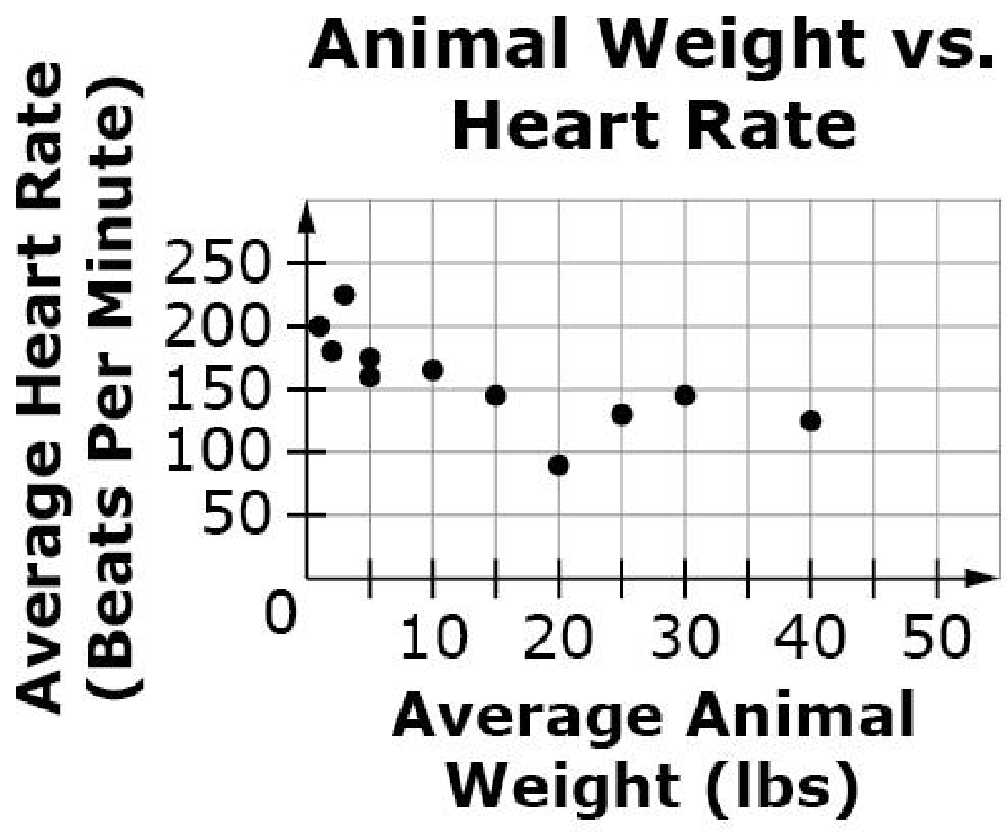
#1
This scatter plot shows the relationship between the average weight and average heart rate for 11 different animals. Select True or False for each statement based on the scatter plot.
Statement | True | False
There is a positive association between average weight and average heart rate for animals.
Animals with higher body weights tend to have lower heart rates than animals with lower body weights.
There is a linear association between average weight and average heart rate for animals.
Notes:
‹#›

Slide 3

#1 Answer
Rubric:
(1 point) Student determines each statement as being either true or false. Each statement that interprets the scatter plot and may involve clustering in reference to the line of best fit, positive or negative associations, linear associations, nonlinear associations, or the effect of outliers.
Answer: F, T, T
Notes:
‹#›

Slide 4
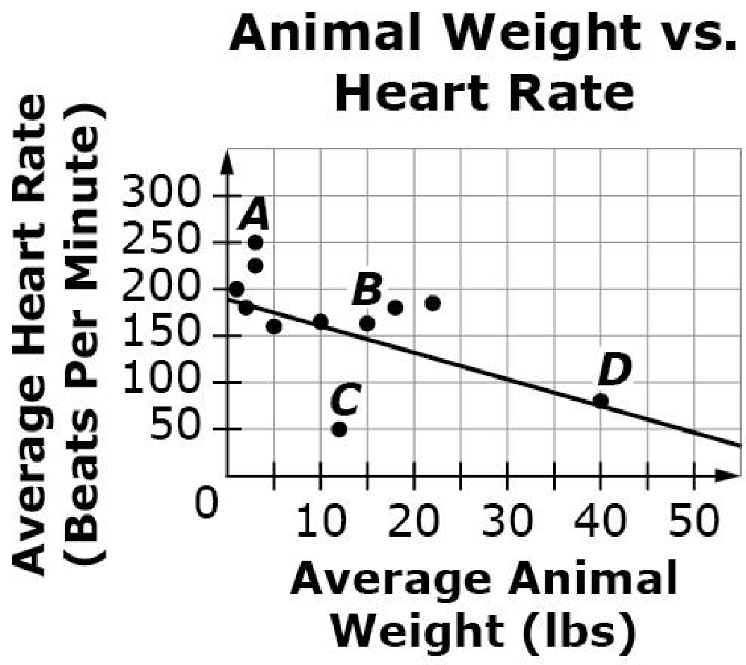
#2
This scatter plot shows the relationship between the average weight and average heart rate for 11 different animals. The line of best fit is shown on the graph. Select True or False for each statement based on the graph.
Statement | True | False
The line of best fit provides a good estimate of an animal’s average heart rate based on its weight for all animals.
The y-intercept is at approximately (0, 185).
Point D is one outlier because it is far away from the other data points.
Notes:
‹#›

Slide 5
#2 Answer
Rubric:
(1 point) Student determines each statement as being either true or false. Each statement interprets the scatter plot and may involve clustering in reference to the line of best fit, positive or negative associations, linear associations, nonlinear associations, the effect of outliers, the identification or the interpretation of the slope or y-intercept in terms of the context.
Answer: F, T, F
Notes:
‹#›

Slide 6
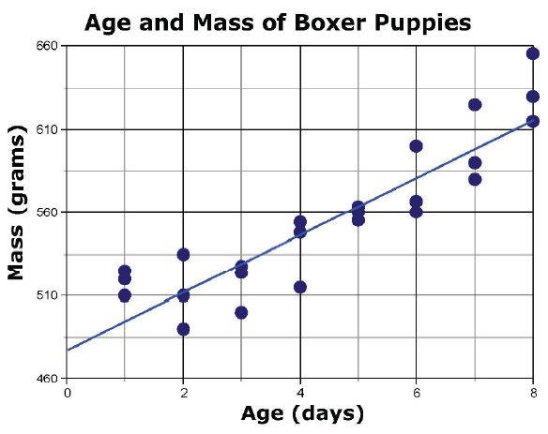
#3
Every boxer puppy in a litter is weighed each day. The scatter plot shows the age and mass recorded at each weighing. The line of best fit has equation y = a + bx, where a and b are constants. What does the y-intercept tell you about the puppies in the litter?
The predicted change in mass of a puppy each day.
The predicted mass of a puppy at birth.
The number of puppies born on day 0.
The mass of the entire litter of puppies.
Notes:
‹#›

Slide 7
#3 Answer
Rubric:
(1 point) Student selects the correct answer.
Answers: B
Notes:
‹#›

Slide 8
#4
Every boxer puppy in a litter is weighed each day. The scatter plot shows the age and mass recorded at each weighing. The line of best fit is shown on the scatter plot. What does the slope of the line tell you about the puppies in the litter?
The predicted change in mass of a puppy each day.
The predicted mass of a puppy at birth.
The number of puppies born on day 0.
The mass of the entire litter of puppies.
Notes:
‹#›

Slide 9
#4 Answer
Rubric:
(1 point) Student selects the correct answer.
Answers: A
Notes:
‹#›

Slide 10
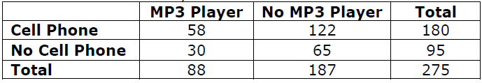
#5
All 8th-grade students at a school answered Yes or No to the two survey questions shown.
Do you have a cell phone? Yes No
Do you have an MP3 player? Yes No
The results of the survey are shown in the table.
What percentage of the students have both a cell phone and an MP3 player?
21%
32%
66%
68%

Slide 11
#5 Answer
Rubric:
(1 point) Student selects the correct answer.
Answer: A

Slide 12
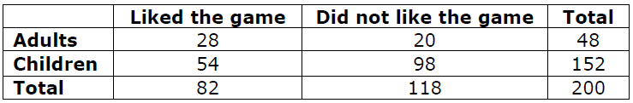
#6
A company surveyed both adults and children about whether or not they liked a particular game. The survey results are shown in the table.
Which of the following correctly compares the proportion of adults who liked the game with the proportion of children who liked the game?
They are approximately the same.
The proportion of adults who liked the game is greater than the proportion of children who liked the game.
The proportion of adults who liked the game is less than the proportion of children who liked the game.
It is not possible to compare these proportions with the information given.

Slide 13
#6 Answer
Rubric:
(1 point) Student selects the correct answer
Answer: B

Slide 14
#7
All 8th-grade students at a school answered Yes or No to the two survey questions shown.
Do you have a cell phone? Yes No
Do you have an MP3 player? Yes No
The results of the survey are shown in the table.
Is there an association between owning a cell phone and owning an MP3 Player for the students at this school?
Yes, because more than half of the students who own a cell phone but less than half own an MP3 player.
Yes, because the proportion of students who own an MP3 player is almost the same for students who own a cell phone and for students who do not.
No, because more than half of the students who own a cell phone but less than half own an MP3 player.
No, because the proportion of students who own an MP3 player is almost the same for students who own a cell phone and for students who do not.

Slide 15
#7 Answer
Rubric:
(1 point) Student selects the correct answer.
Answer: D

Slide 16
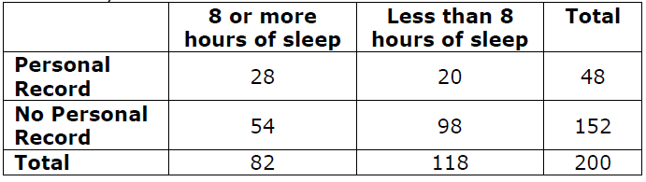
#8
A coach of a cross country team asked all 200 of the runners who ran at a meet two questions:
Did you get less than 8 hours of sleep last night? Yes No
Did you achieve a personal record in this meet? Yes No
A summary of the data is shown in the table.
The coach saw an association between the amount of sleep and achieving a personal record for the runners. Which statement provides evidence for this association?
About 34% of the runners who got more than 8 hours of sleep achieved a personal record, but only 17% of those who got less than 8 hours of sleep did.
More than 50% of the runners who achieved a personal record got 8 or more hours of sleep.
Only 25% of the runners achieved a personal record at the meet.
There is no evidence for an association

Slide 17
#8 Answer
Rubric:
(1 point) Student selects the correct percent
Answer: A

