Slide 1

Claim 1
Smarter Balanced Sample Items
Grade 8 - Target H
Solve real-world and mathematical problems involving volume of cylinders, cones, and spheres.
Questions courtesy of the Smarter Balanced Assessment Consortium Item Specifications – Version 3.0
Slideshow organized by SMc Curriculum – www.ccssmathactivities.com
Notes:
‹#›

Slide 2


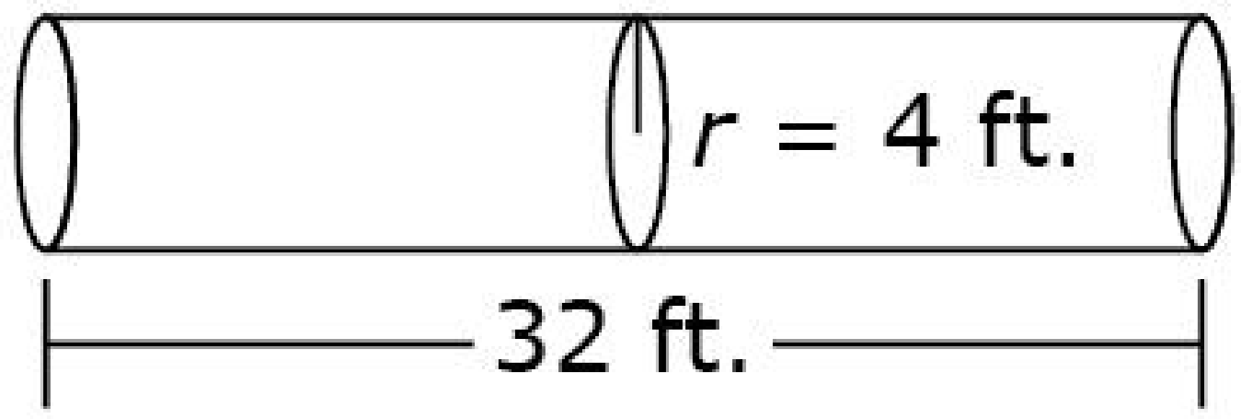
#1
This figure shows the dimensions of a tanker truck. The tank forms a cylinder with a length of 32 feet and radius of 4 feet. What is the volume, in cubic feet, of the tank? Round your answer to the nearest hundredth.
Notes:
‹#›

Slide 3

#1 Answer
Rubric:
(1 point) The student gives the correct volume within a range to accommodate different acceptable values of pi.
Answer: 1608.50
Notes:
‹#›

Slide 4
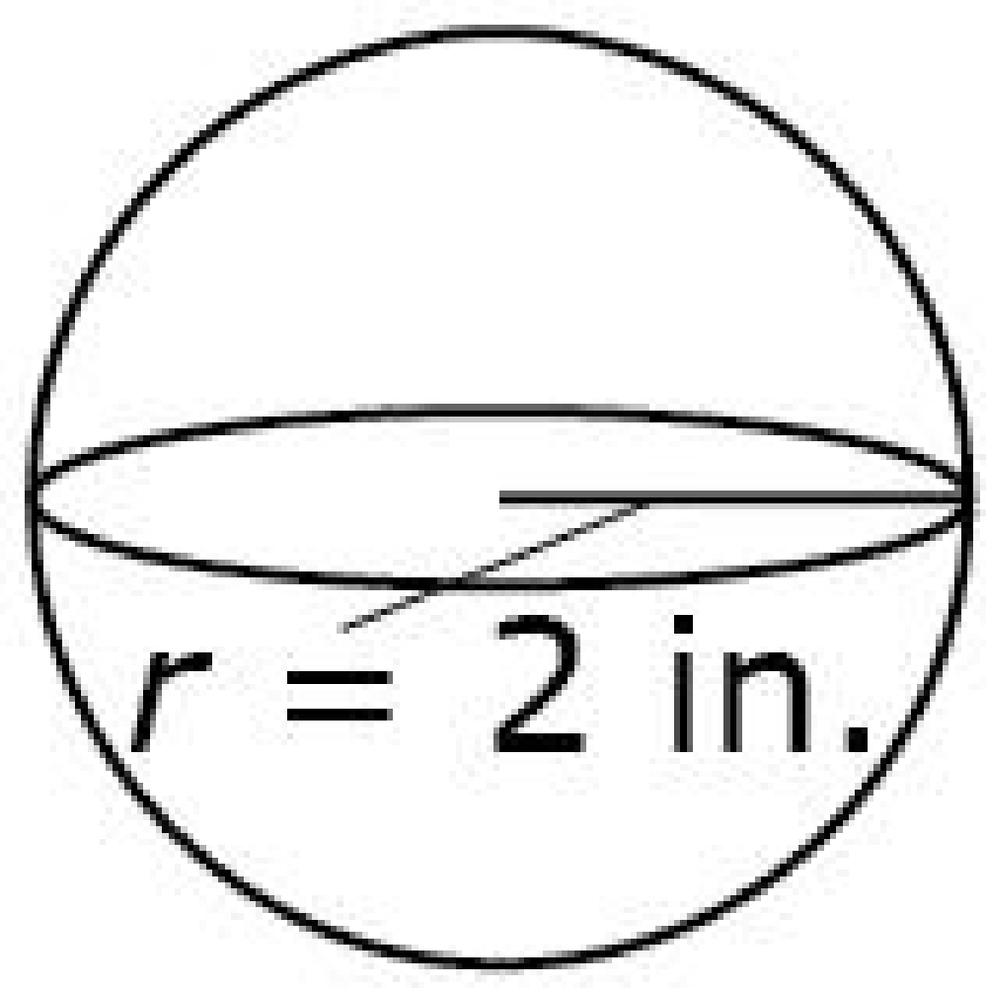
#2
A spherical baseball has a radius of 2 inches, as shown in the diagram. What is the volume, in cubic inches, of the baseball? Round your answer to the nearest hundredth.
Notes:
‹#›

Slide 5
#2 Answer
Rubric:
(1 point) The student gives the correct volume within a range to accommodate different acceptable values of pi.
Answer: 33.51
Notes:
‹#›

Slide 6
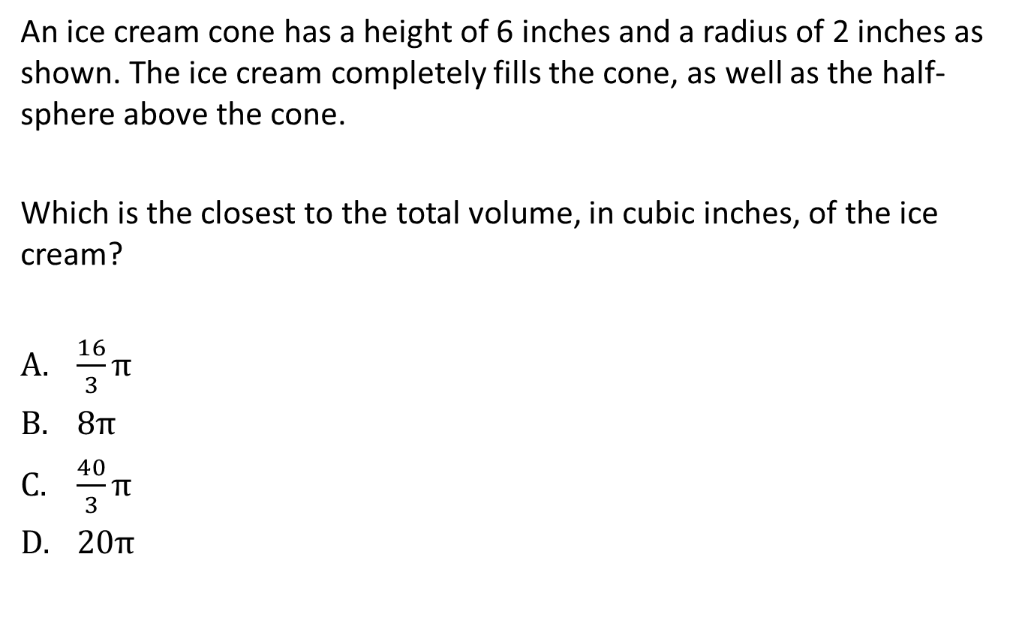
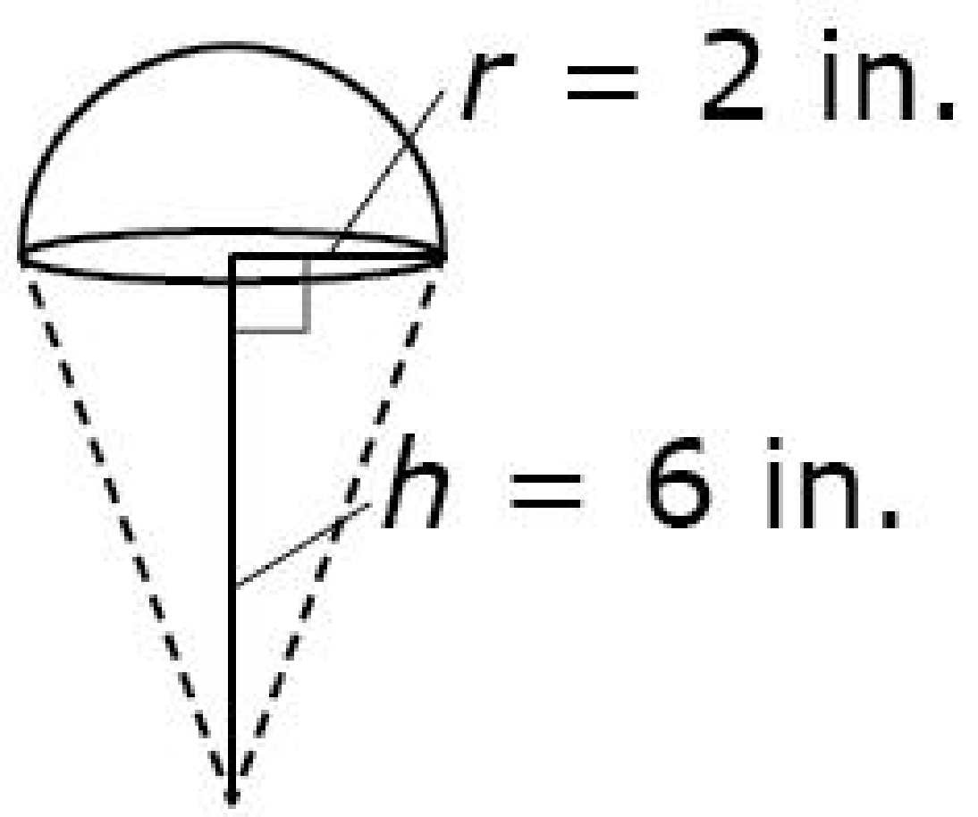
#3
Notes:
‹#›

Slide 7
#3 Answer
Rubric:
(1 point) The student gives the correct solution.
Answer: C
Notes:
‹#›

Slide 8
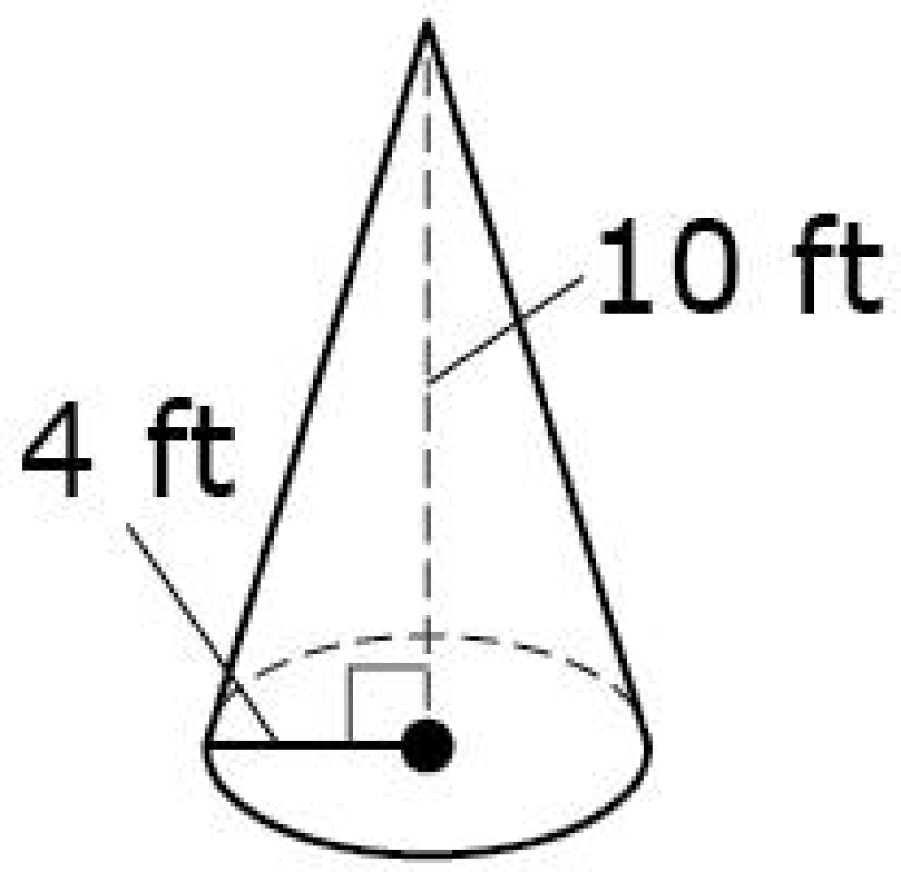
#4
A cone with radius 4 feet and height 10 feet is shown. Enter the volume of the cone, in cubic feet. Round your answer to the nearest hundredth.
Notes:
‹#›

Slide 9
#4 Answer
Rubric:
(1 point) The student gives the correct value within a range to accommodate different acceptable values of pi.
Answer: 167.47
Notes:
‹#›

Slide 10
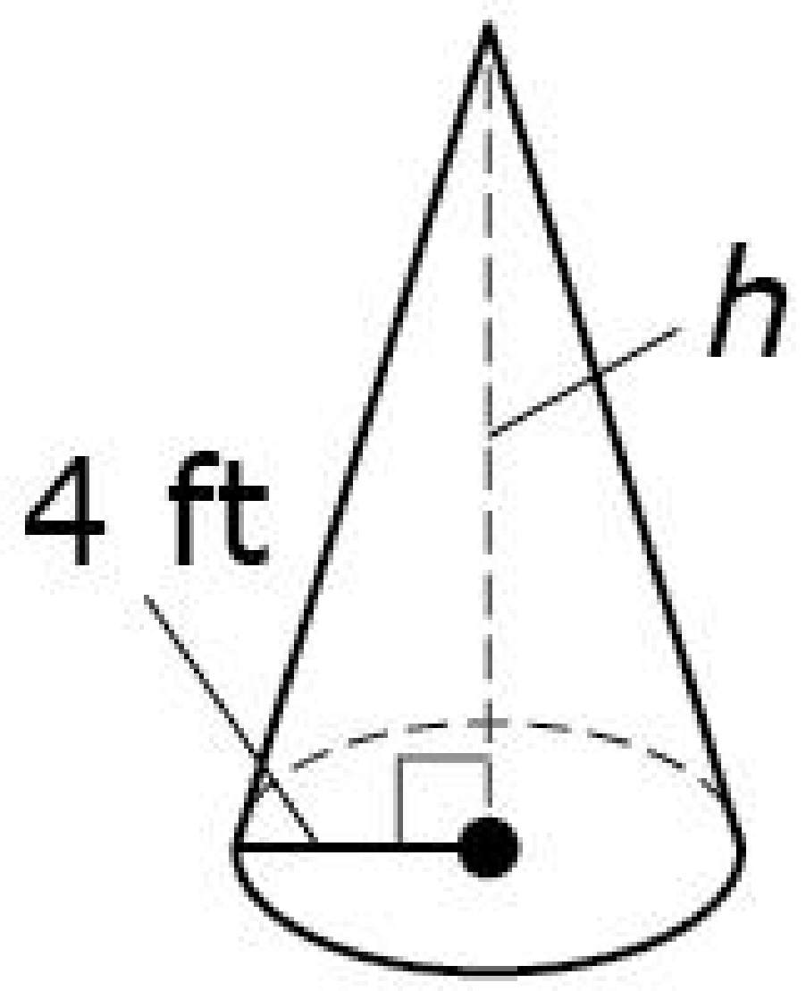
#5
A cone with radius 4 feet is shown. Its approximate volume is 165 cubic feet. Enter the height of the cone, in feet. Round your answer to the nearest hundredth.
Notes:
‹#›

Slide 11
#5 Answer
Rubric:
(1 point) The student gives the correct value within a range to accommodate different acceptable values of pi.
Answer: 9.85
Notes:
‹#›

