Slide 1

Claim 1
Smarter Balanced Sample Items
Grade 8 - Target H
Understand and apply the
Pythagorean Theorem.
Questions courtesy of the Smarter Balanced Assessment Consortium Item Specifications – Version 3.0
Slideshow organized by SMc Curriculum – www.ccssmathactivities.com
Notes:
‹#›

Slide 2


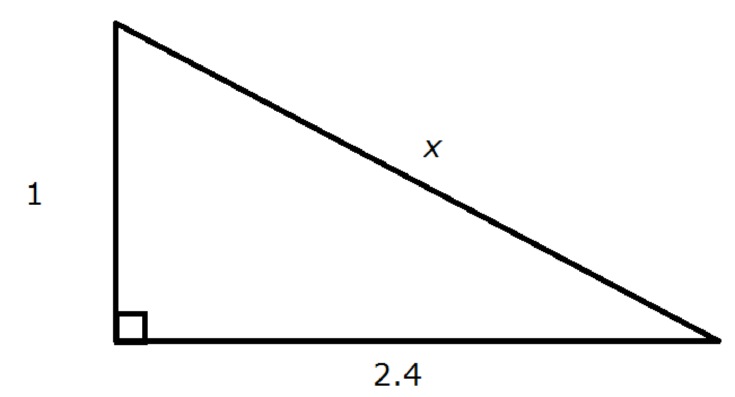
#1
A right triangle is shown. Enter the value of x.
Notes:
‹#›

Slide 3

#1 Answer
Rubric:
(1 point) Student enters correct value.
Answer: 2.6

Slide 4
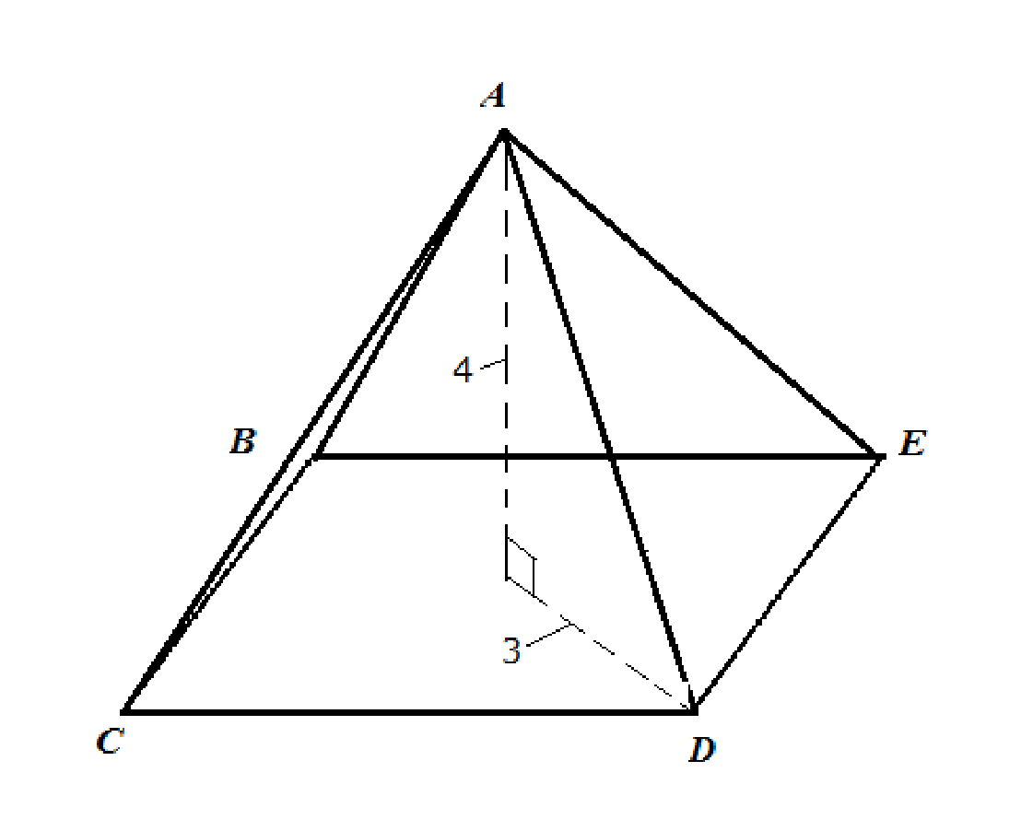
#2
A right square pyramid is shown. The height of the pyramid is 4 units. The distance from the center of the base of the pyramid to vertex D is 3 units, as shown. Enter the length of segment AD, in units.
Notes:
‹#›

Slide 5
#2 Answer
Rubric:
(1 point) Student enters correct value.
Answer: 5
Notes:
‹#›

Slide 6
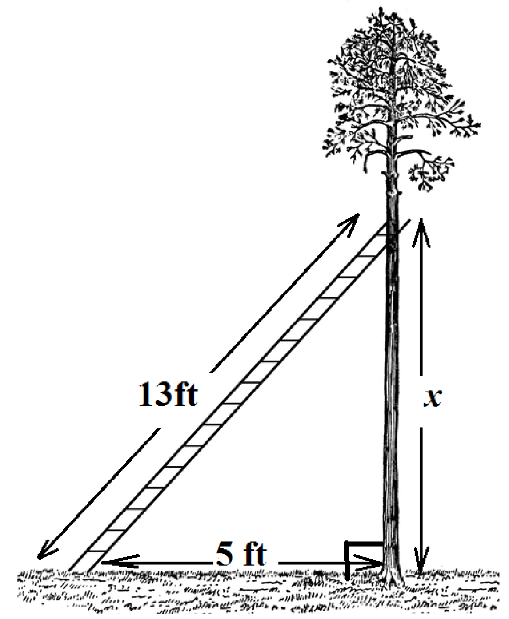
#3
A 13-foot ladder is leaning on a tree. The bottom of the ladder is on the ground at a distance of 5 feet from the base of the tree. The base of the tree and the ground form a right angle as shown. Enter the distance between the ground and the top of the ladder, x, in feet.
Notes:
‹#›

Slide 7
#3 Answer
Rubric:
(1 point) Student enters correct value.
Answer: 12
Notes:
‹#›

Slide 8
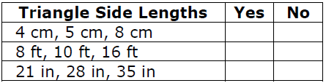
#4
The table shows the side lengths for some triangles. Determine whether the side lengths define a right triangle. Select Yes if it is a right triangle. Select No if it cannot be a right triangle.
Notes:
‹#›

Slide 9
#4 Answer
Rubric:
(1 point) Student correctly classifies triangles.
Answer: N, N, Y
Notes:
‹#›

Slide 10
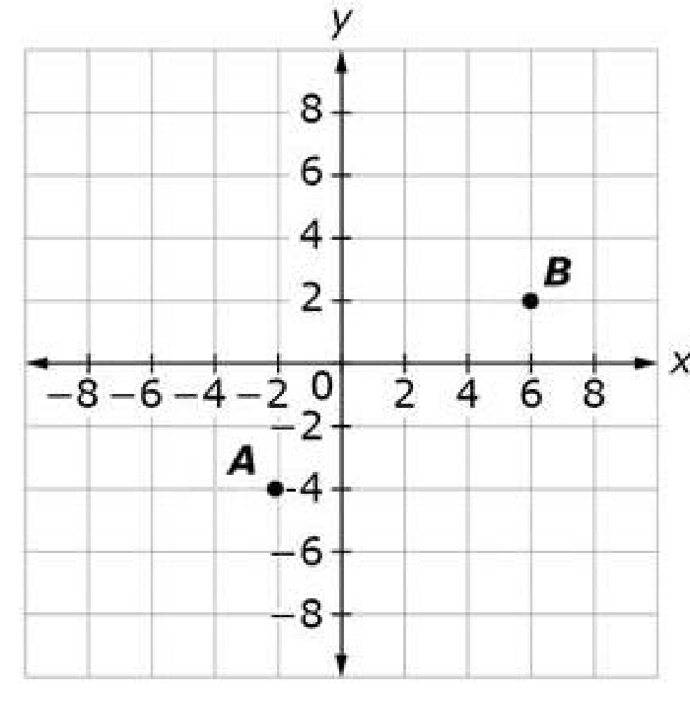
#5
A coordinate plane is shown with labeled points. What is the distance between point A and point B on the coordinate plane?
A. 5
B. 6
C. 10
D. 14
Notes:
‹#›

Slide 11
#5 Answer
Rubric:
(1 point) Student selects the distance between point A and point B.
Answer: C
Notes:
‹#›

Slide 12
#6
What is the distance between points
(5, 2) and (-3, -4) on the coordinate plane?
5
6
10
14
Notes:
‹#›

Slide 13
#6 Answer
Rubric:
(1 point) Student selects the distance between point A and point B.
Answer: C
Notes:
‹#›

Slide 14
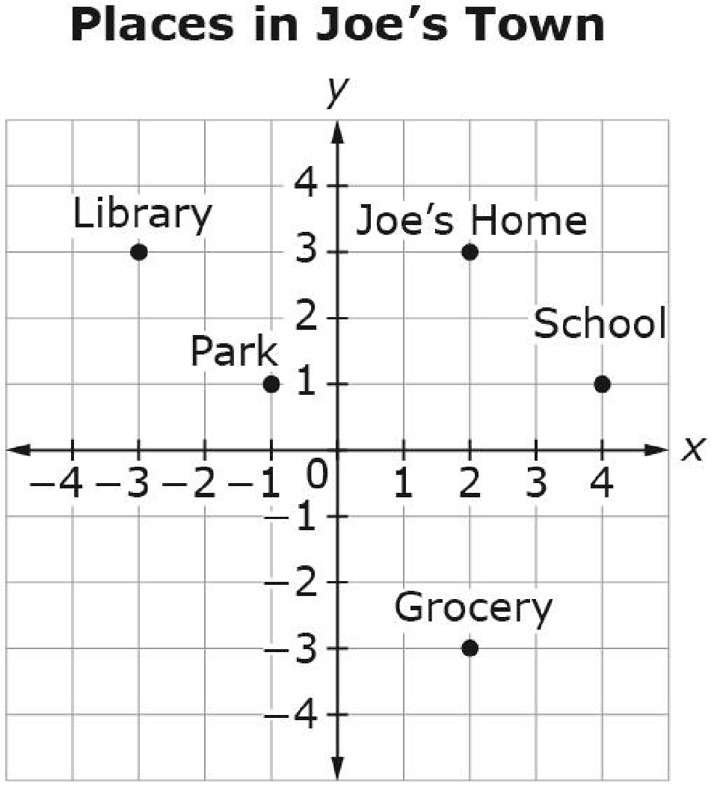
#7
The points show different locations in Joe’s town. Each unit represents 1 mile. What is the distance, in miles, between Joe’s Home and the Park? Round your answer to the nearest tenth.
Notes:
‹#›

Slide 15
#7 Answer
Rubric:
(1 point) The student finds the distance.
Answer: 3.6
Notes:
‹#›

