Slide 1

Claim 1
Smarter Balanced Sample Items
Grade 8 - Target G
Understand congruence and similarity using physical models, transparencies, or geometry software.
Questions courtesy of the Smarter Balanced Assessment Consortium Item Specifications – Version 3.0
Slideshow organized by SMc Curriculum – www.ccssmathactivities.com
Notes:
‹#›

Slide 2


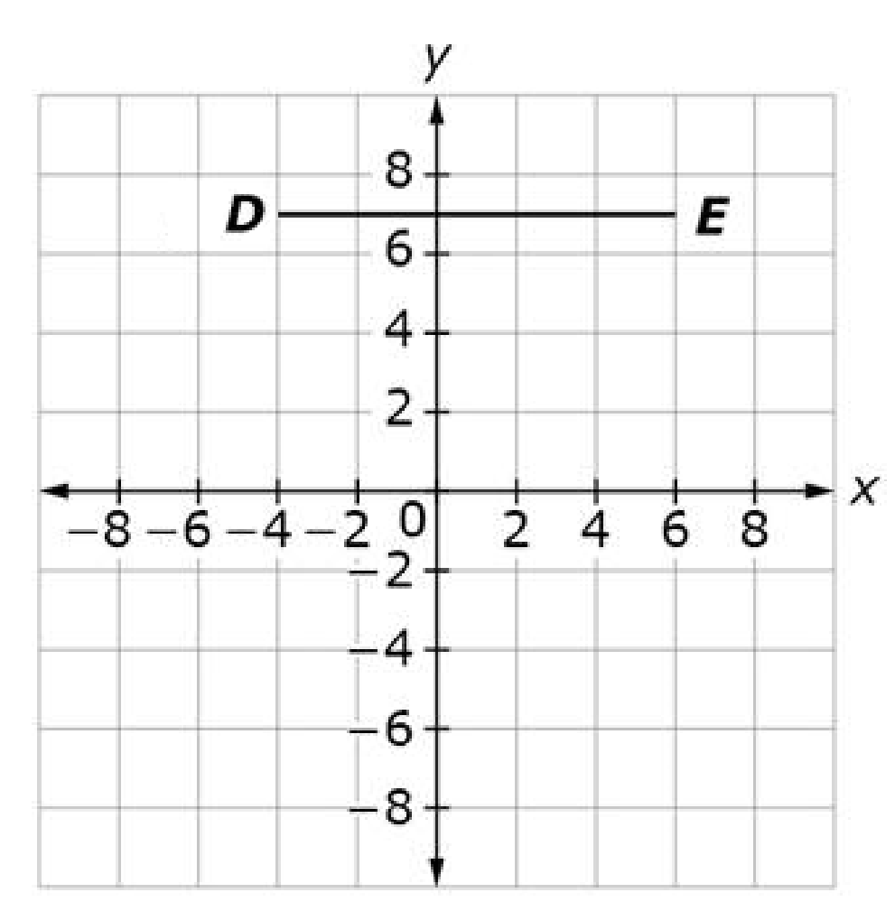
#1
Example 1: Line segment DE is translated left 3 units and down 2 units to form line segment D’E’. Enter the distance, in units, between point D’ and point E’.
Example 2: Line segment FG begins at (-2, 4) and ends at (-2, -3). The segment is translated left 3 units and up 2 units to form line segment F’G’. Enter the length, in units, of line segment F’G’.
Notes:
‹#›

Slide 3

#1 Answer
Rubric:
(1 point each) The student gives the correct measure.
Answers:
Example 1: 10
Example 2: 7
Notes:
‹#›

Slide 4
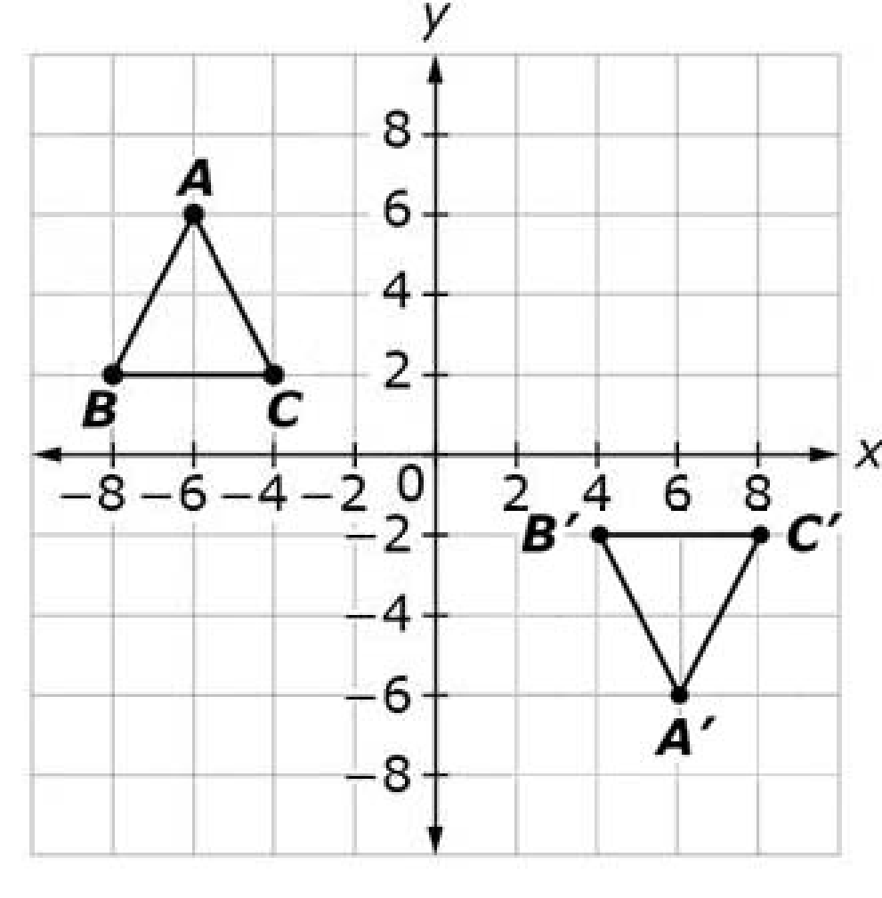
#2
Triangle ABC is reflected across the x-axis and then translated right 12 units to form triangle A’B’C’. Select True or False for each statement.
Statement | True | False
Angle B has the same measure as angle B’.
Side AC is longer than side A’C’.
Side BC is the same length as side B’C’.
Notes:
‹#›

Slide 5
#2 Answer
Rubric:
(1 point) The student correctly identifies all statements as True or False.
Answer: T, F, T
Notes:
‹#›

Slide 6
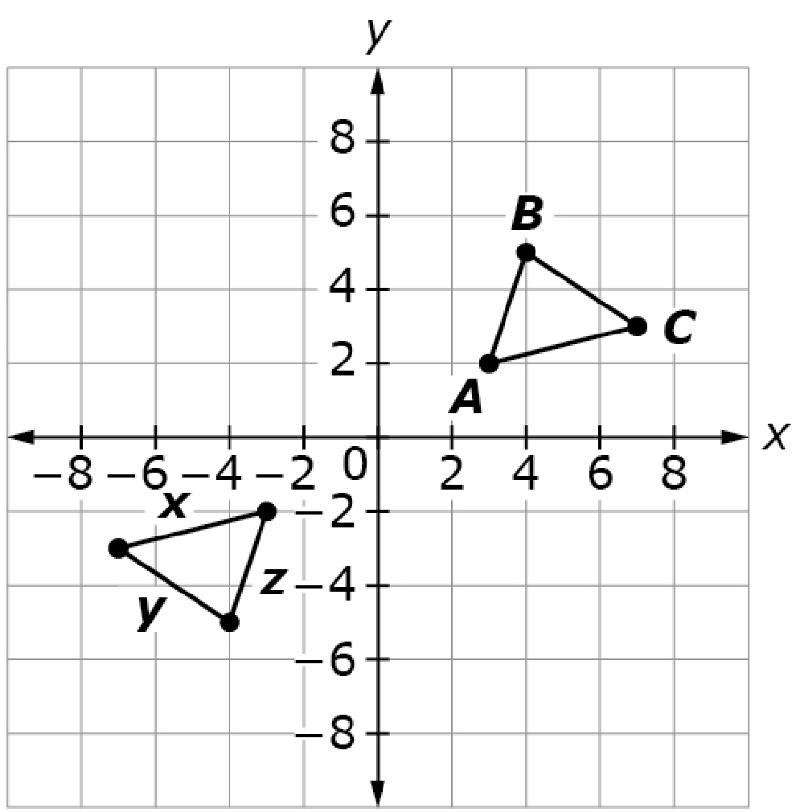
#3
Triangle ABC was created by joining points A(3, 2), B(4, 5), and C(7, 3) with line segments. Triangle ABC is reflected over the
x-axis and then reflected over the y-axis to form the triangle where x, y, and z represent the lengths of the sides of the triangle. Click in the table to show which side lengths are equal.
 | x | y | z
AB
AC
BC
Notes:
‹#›

Slide 7
#3 Answer
Rubric:
(1 point) The student correctly matches the sides of both triangles.
Answer: AB = z, AC = x, BC = y
Notes:
‹#›

Slide 8
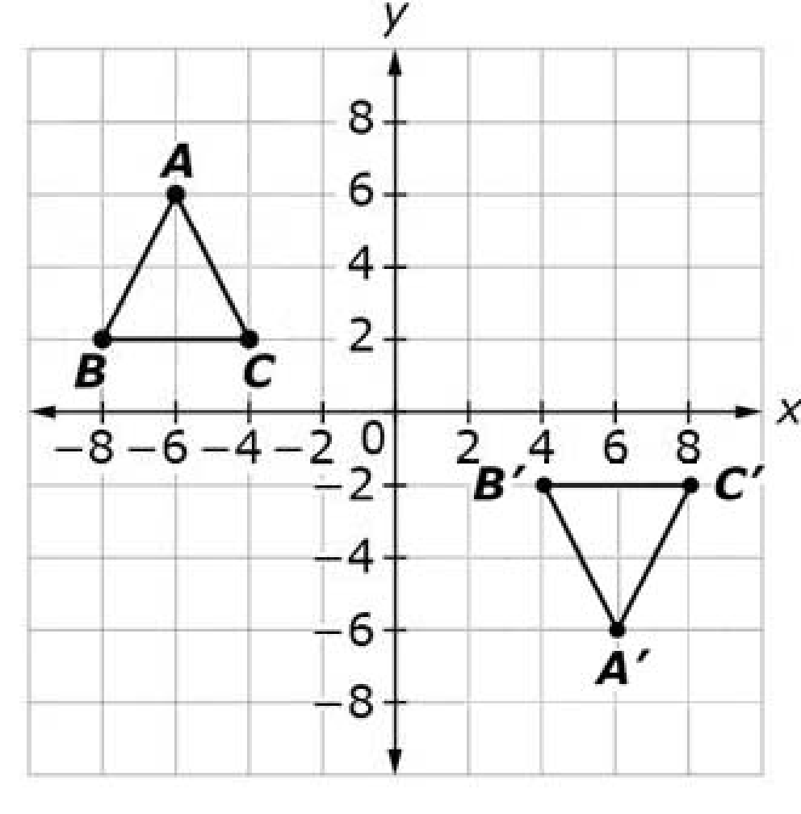
#4
Consider this figure. Consider the statements in the table shown. Select True or False for each statement about the sequences of transformations that can verify that triangle ABC is congruent to triangle A’B’C’.
Statement | True | False
Triangle ABC is translated 12 units to the right, followed by a reflection across the x–axis.
Triangle ABC is a reflected across the y–axis, followed by a translation 12 units down.
Triangle ABC is reflected across the x–axis, followed by a translation 12 units to the right.
Notes:
‹#›

Slide 9
#4 Answer
Rubric:
(1 point) The student selects True or False for the correct sequence of transformations for the figure.
Answer: T, F, T
Notes:
‹#›

Slide 10
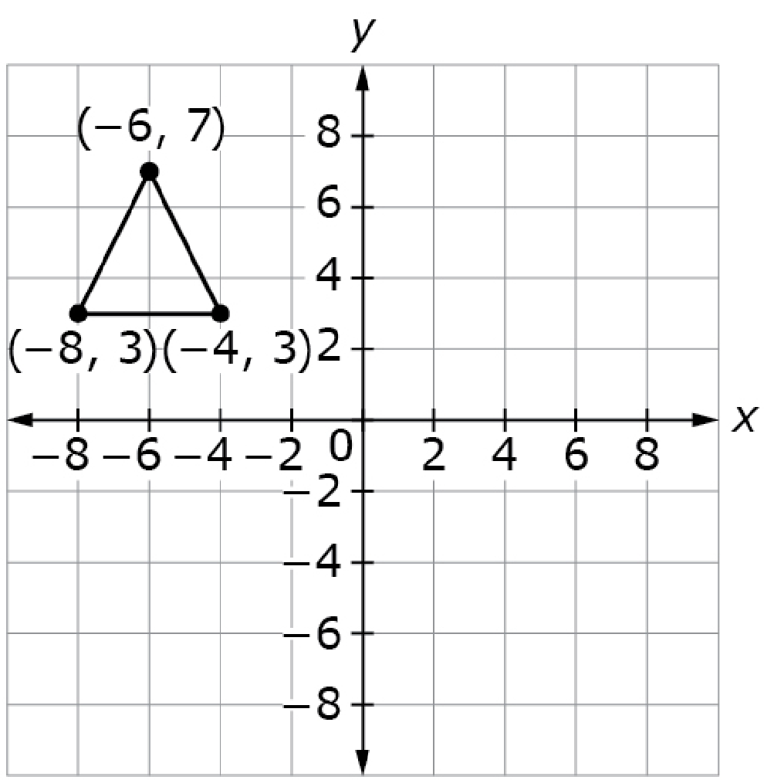
#5
The figure on the coordinate plane is reflected across the y-axis. Use the Connect Line tool to draw the resulting image of the figure.
Notes:
‹#›

Slide 11
#5 Answer
Rubric:
(1 point) The student draws the triangle in the correct location.
Notes:
‹#›

Slide 12
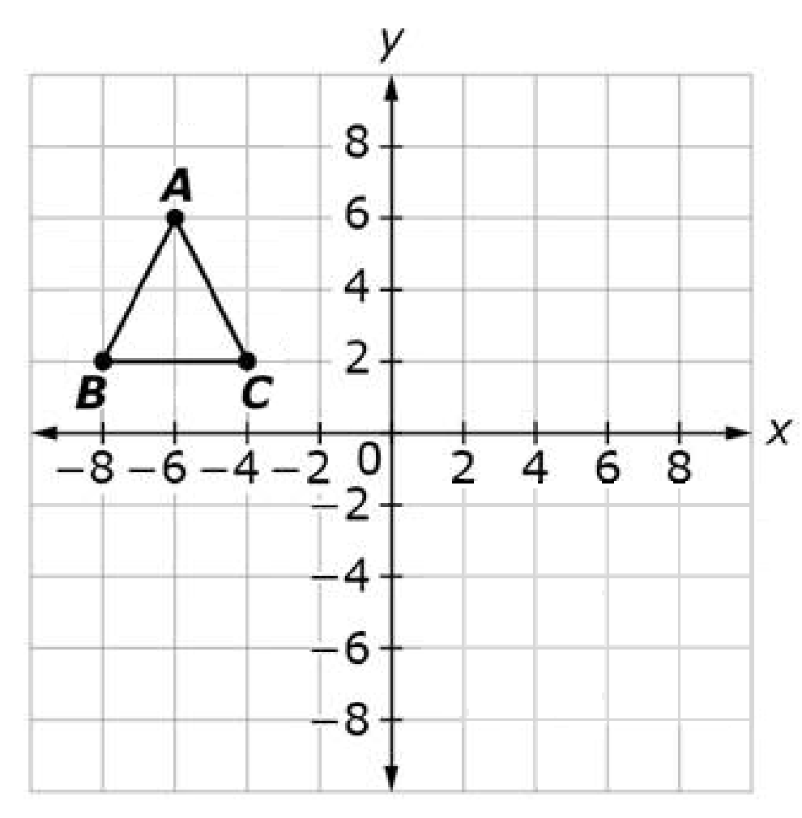
#6
Triangle ABC is reflected across the x-axis, and dilated by a scale factor of 2, with the origin as the center of the dilation. Click the numbers to give the coordinates of vertices A’B’C’.
A’ = ( , )
B’ = ( , )
C’ = ( , )
Notes:
‹#›

Slide 13
#6 Answer
Rubric:
(1 point) The student identifies all 3 points correctly.
Answer: A’= (–12, –12), B’= (–16, –4), C’=(–8, –4)
Notes:
‹#›

