Slide 1

Claim 1
Smarter Balanced Sample Items
Grade 8 - Target F
Use functions to model relationships between quantities.
Questions courtesy of the Smarter Balanced Assessment Consortium Item Specifications – Version 3.0
Slideshow organized by SMc Curriculum – www.ccssmathactivities.com
Notes:
‹#›

Slide 2

#1
This table of values represents a linear function. Enter an equation in the form y = mx + b that represents the function defined by this table of values.
x | y
2 | −6
3 | −6.5
8 | −9
Notes:
‹#›

Slide 3
#1 Answer
Rubric:
(1 point) Student enters the correct equation.
Answer: y = –0.5x – 5
Notes:
‹#›

Slide 4
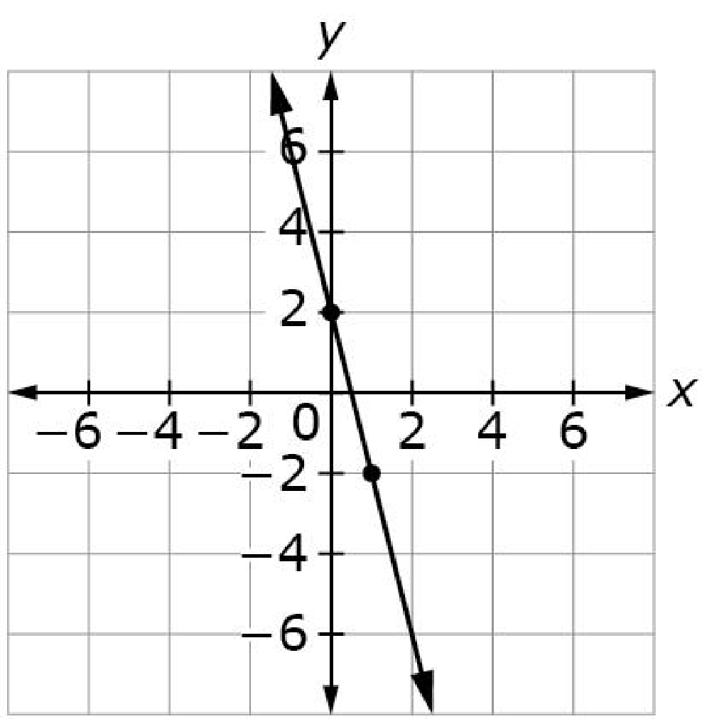
#2
This graph represents a linear function. Enter an equation in the form y = mx + b that represents the function defined by the graph.
Notes:
‹#›

Slide 5
#2 Answer
Rubric:
(1 point each) Student enters the correct equation.
Answer: y = –4x + 2
Notes:
‹#›

Slide 6
#3
A swimming pool with 1600 gallons of water is emptied at a constant rate of 300 gallons every 2 hours. Enter an equation in the form y = mx + b that represents the amount of water (y), in gallons, remaining in the pool after x hours.
Notes:
‹#›

Slide 7
#3 Answer
Rubric:
(1 point each) Student enters the correct equation.
Answer: y = –150x + 1600
Notes:
‹#›

Slide 8
#4
This table of values represents a linear function. Enter the rate of change of this function.
x | y
0 | 50
2 | 40
4 | 30
6 | 20
Notes:
‹#›

Slide 9
#4 Answer
Rubric:
(1 point) The student enters the correct initial value or rate of change.
Answer: –5
Notes:
‹#›

Slide 10
#5
This table shows the linear relationship of the water level in a tank and time. Enter the rate of change of the water level, in feet per hour.
Time (hr) | Water Level (ft)
0 | 50
2 | 40
4 | 30
6 | 20
Notes:
‹#›

Slide 11
#5 Answer
Rubric:
(1 point) The student enters the correct initial value or rate of change.
Answer: –5
Notes:
‹#›

Slide 12
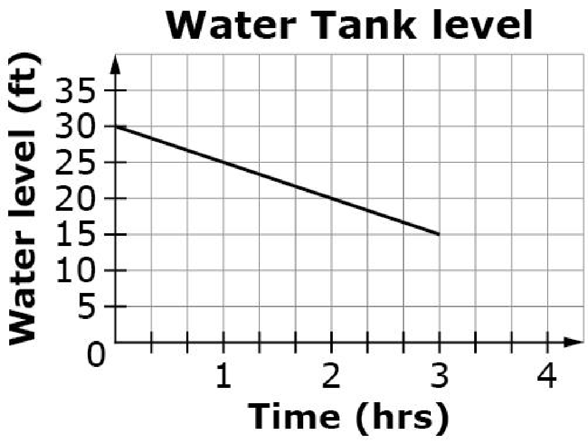
#6
This graph shows water level in a tank as a linear function of time. Enter the initial water level, in feet, of the water tank.
Notes:
‹#›

Slide 13
#6 Answer
Rubric:
(1 point) The student enters the correct initial value or rate of change.
Answer: 30
Notes:
‹#›

Slide 14
#7
A swimming pool containing 1600 gallons of water is emptied at a rate of 300 gallons every 2 hours. Determine whether each statement about the amount of water in the pool is true. Select True or False for each statement.
Statement | True | False
The initial amount of water in the pool is increased 1600 gallons.
The amount of water in the pool decreases by 150 gallons every 1 hour.
The amount of water in the pool at 3 hours is 450 gallons.
Notes:
‹#›

Slide 15
#7 Answer
Rubric:
(1 point) Student determines each statement as being either true or false. Each statement is a sentence describing the initial value or rate of change in the context.
Answer: T, T, F
Notes:
‹#›

Slide 16
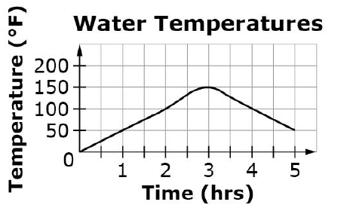
#8
This graph shows the change in water temperature over time. Based on the graph, determine whether each statement is true. Select True or False for each statement.
Statement | True | False
The water temperature is increasing between hour 1 and hour 2.
The water temperature is increasing between hour 3 and hour 4.
The water temperature is constant between hour 0 and hour 1.
Notes:
‹#›

Slide 17
#8 Answer
Rubric:
(1 point) Student determines each statement as being either true or false. Each statement is a sentence describing the behavior of the graph. False statements should be statements that use wrong behaviors of the graph.
Answer: T, F, F
Notes:
‹#›

Slide 18
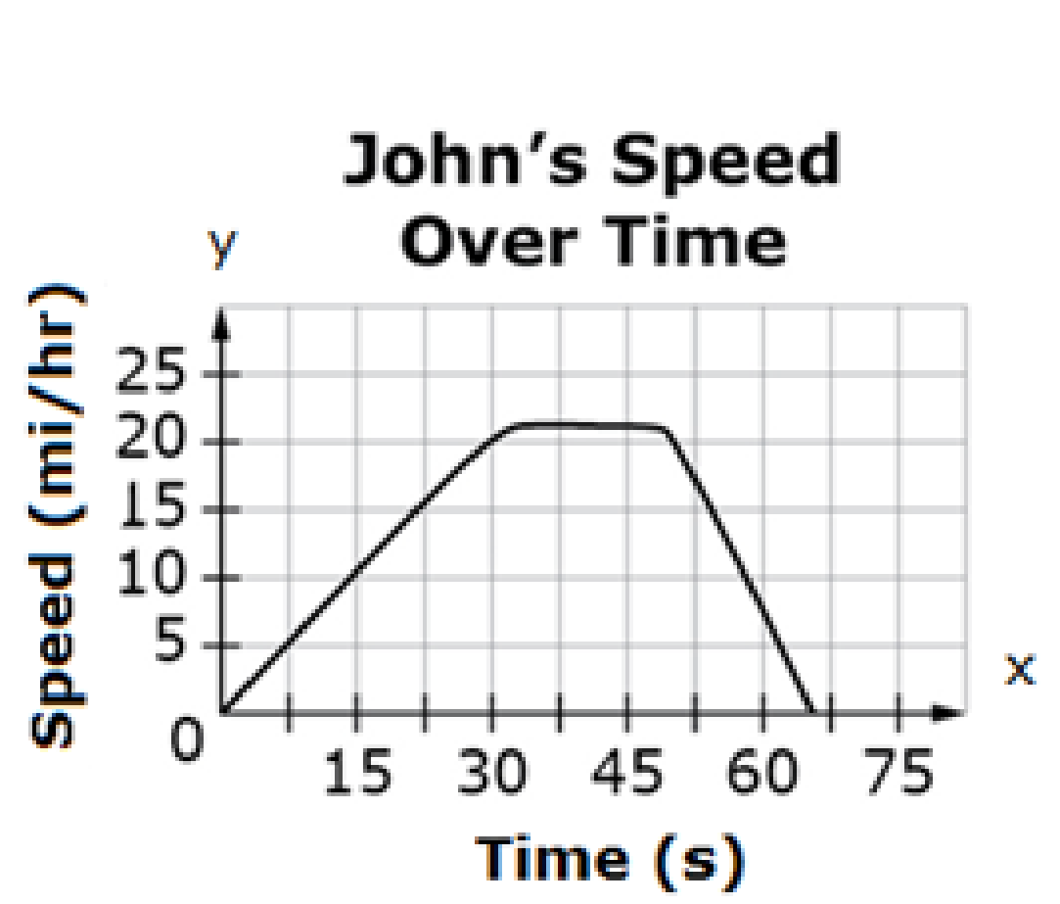
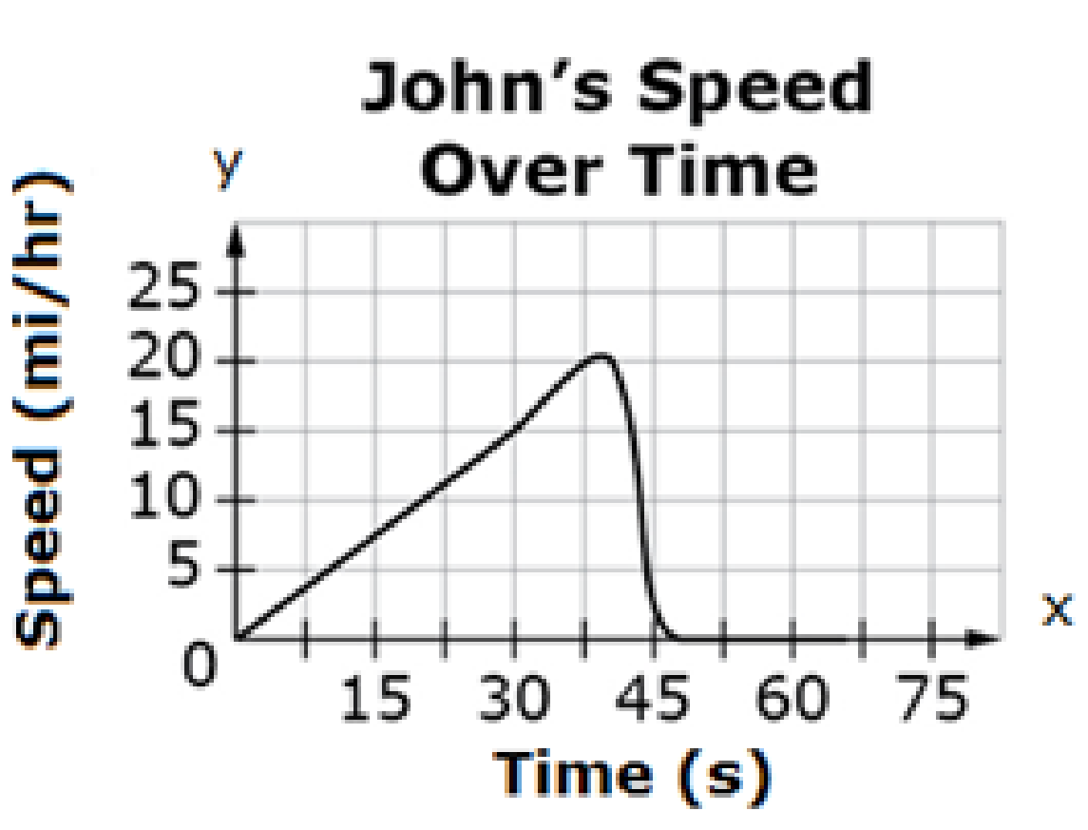
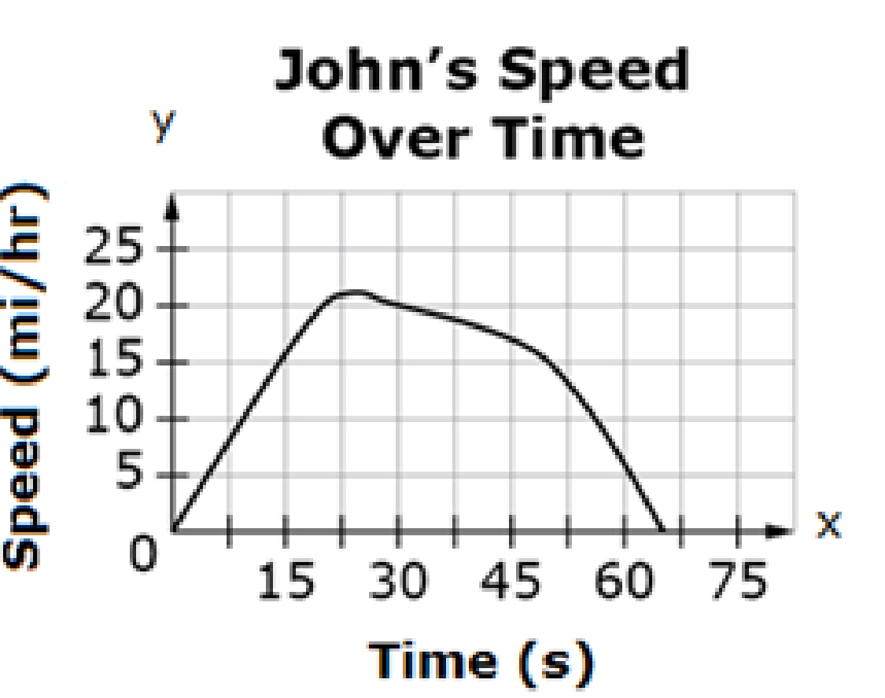
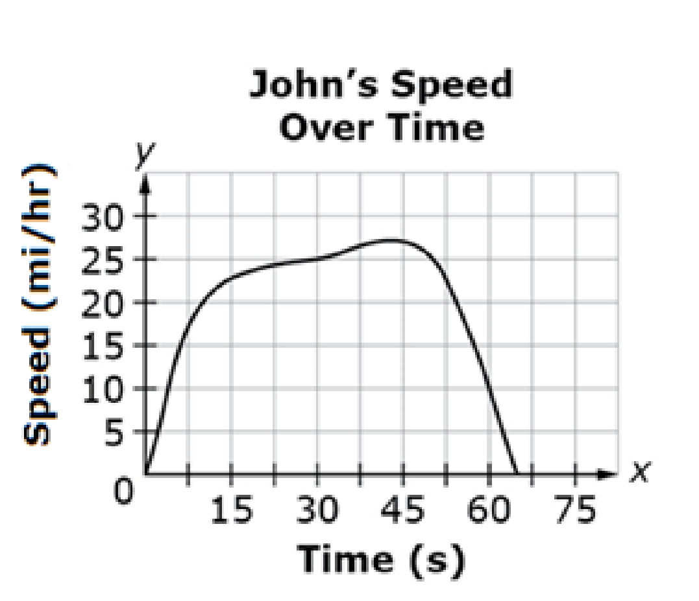
#9
John is riding his bike.
He increases his speed for 30 seconds.
He stays approximately the same speed for the next 20 seconds.
He slows down to a stop during the last 15 seconds.
Select the graph that best represents John’s speed over time.
A. B.
C. D.
Notes:
‹#›

Slide 19
#9 Answer
Rubric: (1 point) The student selects the correct graph that represents John’s speed over time.
Answer: A
Notes:
‹#›

Slide 20
#10
John is riding his bike.
He increases his speed for 30 seconds.
He stays at the same speed for the next 20 seconds.
He slows down to a stop during the last 15 seconds.
Use the Connect Line tool to draw a graph that represents John’s speed over time.
Notes:
‹#›

Slide 21
#10 Answer
Rubric:
(1 point) The student correctly draws a graph that represents the relationship.
Answer:
Notes:
‹#›

