Slide 1

Claim 1
Smarter Balanced Sample Items
Grade 8 - Target E
Define, evaluate, and compare functions.
Questions courtesy of the Smarter Balanced Assessment Consortium Item Specifications – Version 3.0
Slideshow organized by SMc Curriculum – www.ccssmathactivities.com
Notes:
‹#›

Slide 2

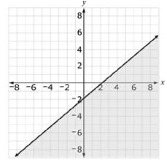
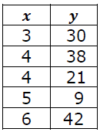
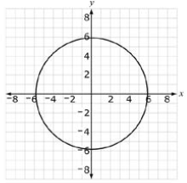
Which relation defines y as a function of x?
#1
A. The proportional relationship
y = 2.4x
B. The table showing the age in
years, x, and weight in pounds, y,
of five dogs.
C. The graph of an inequality as
shown by the shaded region.
D. The graph of x² + y² = 36 as shown.
Notes:
‹#›

Slide 3
#1 Answer
Rubric:
(1 point each) The student selects the relation that is a function.
Answer: A
Notes:
‹#›

Slide 4
#2
Which equation defines p as a function of t?
p = 3t + 2
t = 3p + 2
p = 0t + 2
t = 0p + 2
Notes:
‹#›

Slide 5
#2 Answer
Rubric:
(1 point each) Student selects correct values
Answers: A, B, C
Notes:
‹#›

Slide 6
#3
Select all ordered pairs that correspond to input-output pairs for the function y = -6x + 7.
(1, 1)
(-1, 1)
(-6, 7)
(3, -11)
Notes:
‹#›

Slide 7
#3 Answer
Rubric:
(1 point each) The student selects all correct ordered pairs.
Answers: A and D
Notes:
‹#›

Slide 8
#4
A swimming pool had 30 gallons of water in it. Then water was added to the pool at a rate of 5 gallons per second. The function y = 5t + 30 describes the relationship between the number of gallons, y, and the number of seconds water was added, t.
Select all of the ordered pairs that correspond to input-output pairs for the function.
(45, 3)
(3, 45)
(0, 30)
(30, 0)
Notes:
‹#›

Slide 9
#4 Answer
Rubric:
(1 point each) The student selects all correct ordered pairs.
Answers: B and C
Notes:
‹#›

Slide 10
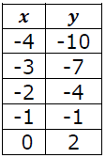
#5
Consider the function represented by this table of values.
Which function could have produced the values in the table?
y = -x – 14
y = -3x + 2
y = 3x – 22
y = 3x + 2
Notes:
‹#›

Slide 11
#5 Answer
Rubric:
(1 point each) The student selects the correct answer choice.
Answer: D
Notes:
‹#›

Slide 12
#6
A swimming pool has 30 gallons of water in it. Water is added to the pool at a rate of 5 gallons per second. Select the equation that models the relationship between the amount of water (W), in gallons, in the swimming pool after t seconds.
A. W = 30t + 5
B. W = 5t + 30
C. W = 6t + 30
D. W = 30t + 6
Notes:
‹#›

Slide 13
#6 Answer
Rubric:
(1 point) The student selects the correct answer.
Answer: B
Notes:
‹#›

Slide 14
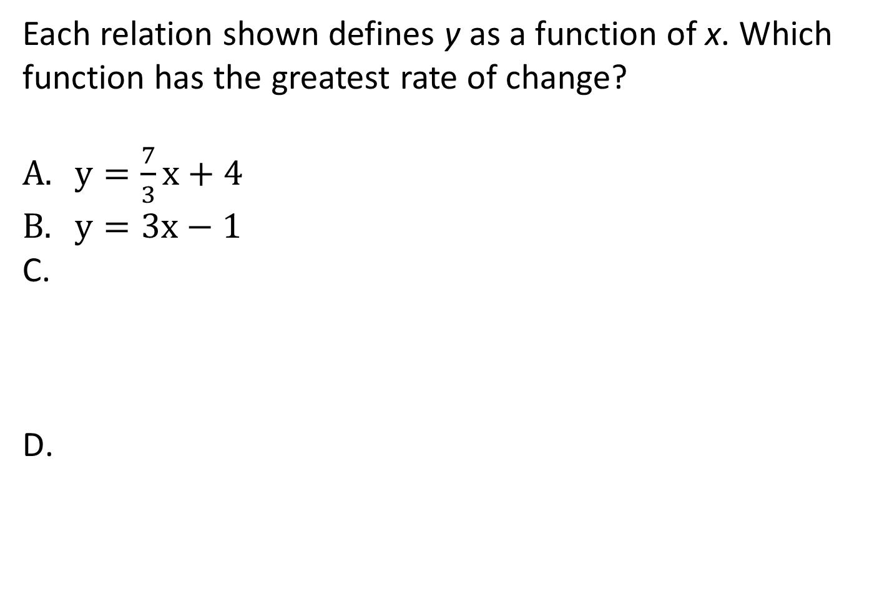
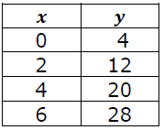
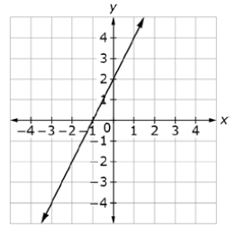
#7
Notes:
‹#›

Slide 15
#7 Answer
Rubric:
(1 point) The student identifies the correct function.
Answer: C
Notes:
‹#›

Slide 16
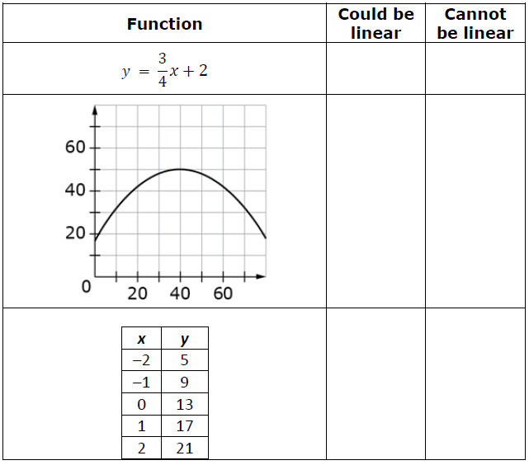
#8
Several functions are represented in the table.
Determine whether each function could be linear.
Notes:
‹#›

Slide 17
#8 Answer
Rubric:
(1 point) The student selects the correct box to identify whether the functions are linear or nonlinear.
Answer: L, N, L
Notes:
‹#›

