Slide 1

Claim 1
Smarter Balanced Sample Items
Grade 8 - Target D
Analyze and solve linear equations and pairs of simultaneous linear equations.
Questions courtesy of the Smarter Balanced Assessment Consortium Item Specifications – Version 3.0
Slideshow organized by SMc Curriculum – www.ccssmathactivities.com
Notes:
‹#›

Slide 2



#1
Example 1: Drag a number into each box to create an equation that has exactly one real solution.
Example 2: Drag a number into each box to create an equation that has no real solution.
Example 3: Drag a number into each box to create an equation that has an infinite number of solutions.
Notes:
‹#›

Slide 3

#1 Answer
Rubric:
Example 1: (1 point) Correct answer is any number that does not have a coefficient of 5 and any number as the constant.
Example 2:(1 point) Correct answer has a coefficient of 5 with any number other than 15 as the constant.
Example 3:(1 point) Correct answer has a coefficient of 5 and a constant of 15.
Notes:
‹#›

Slide 4
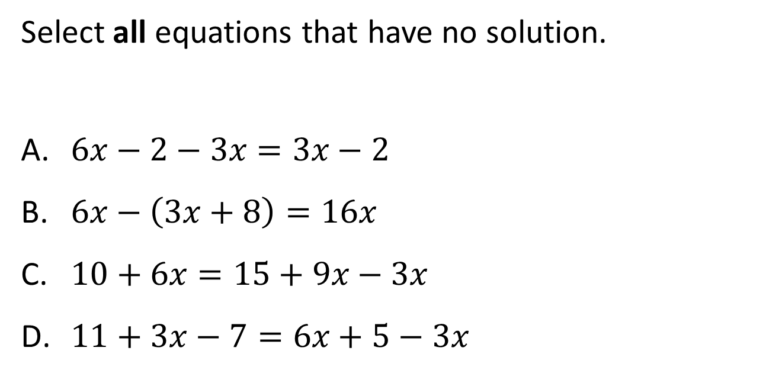
#2
Notes:
‹#›

Slide 5
#2 Answer
Rubric:
(1 point) Student selects all the correct equations and no incorrect equations.
Answer: C and D
Notes:
‹#›

Slide 6
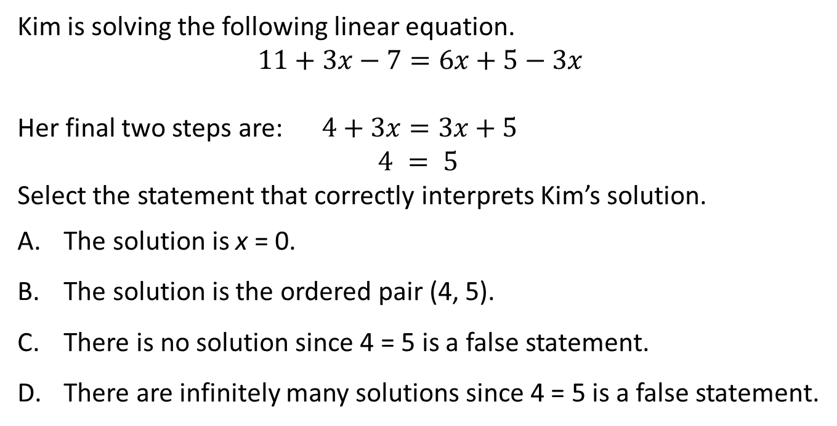
#3
Notes:
‹#›

Slide 7
#3 Answer
Rubric:
(1 point) Correct answer is the statement that describes the solution to the system of equations.
Answer: C
Notes:
‹#›

Slide 8
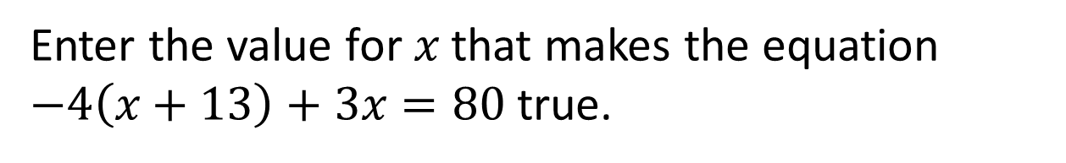
#4
Notes:
‹#›

Slide 9
#4 Answer
Rubric:
(1 point) Correct answer is the numerical solution to and all its equivalent values.
Answer: –132
Notes:
‹#›

Slide 10
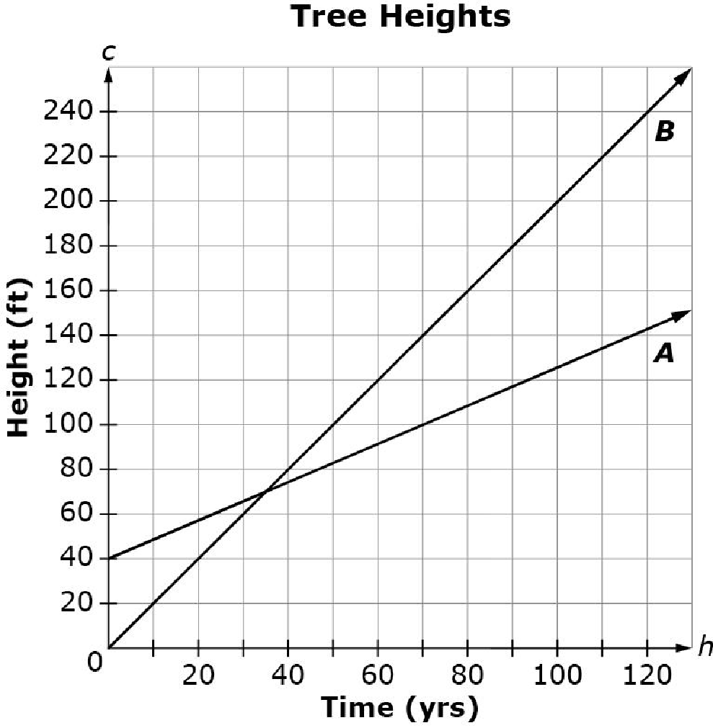
#5
The graph shown compares the height of Tree A and the height Tree B over time (in years).
How many years after Tree B was planted did Tree A and Tree B have the same height?
Notes:
‹#›

Slide 11
#5 Answer
Rubric:
(1 point) Student correctly gives the appropriate value from the coordinate point.
Answer: 35 years
Notes:
‹#›

Slide 12
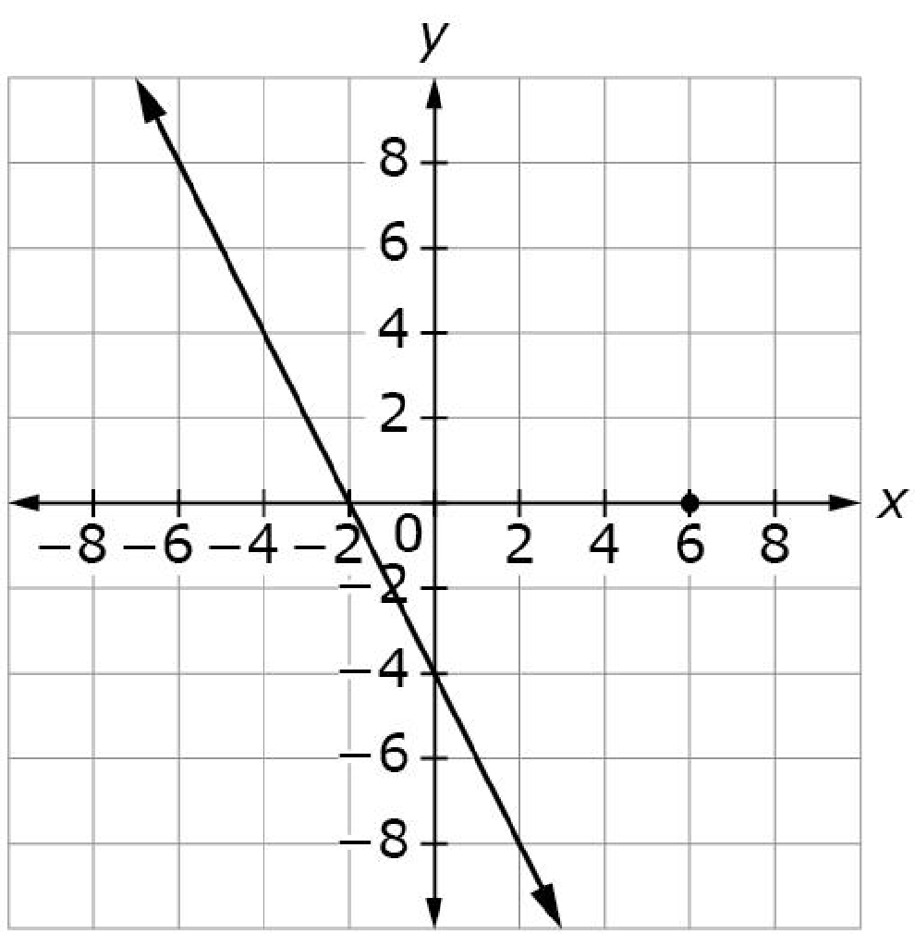
#6
The graph of -2x – y = 4 is shown.
Use the Add Arrow tool to graph the equation
y = 3x – 2 on the same coordinate plan. Use the Add Point tool to plot the solution to this system of linear equations.

Slide 13
#6 Answer
Rubric:
(1 point) The student plots the line correctly and places a point on the point of intersection.

Slide 14
#7
A system of two linear equations has no solution. The first equation is 3x + y = 2. Select the second equation that would make this system have no solution.
2x + y = 4
2x + y = 5
3x + y = 4
4x + y = 5

Slide 15
#7 Answer
Rubric:
(1 point) Correct answer is the linear equation in two variables that satisfies the given condition for the number of solutions.
Answer: C

Slide 16
#8
Select the statement that correctly describes the solution to this system of equations.
3x + y = −2
x − 2y = 4
There is no solution.
There are infinitely many solutions.
There is exactly one solution at (−2, −4).
There is exactly one solution at (0, −2).

Slide 17
#8 Answer
Rubric:
(1 point) Correct answer is the statement that describes the solution to the system of equations.
Answer: D

Slide 18
#9
Enter the y-coordinate of the solution to this system of equations.
3x + y = –2
x – 2y = 4

Slide 19
#9 Answer
Rubric:
(1 point) Student enters the correct numerical solution.
Answer: –2

Slide 20

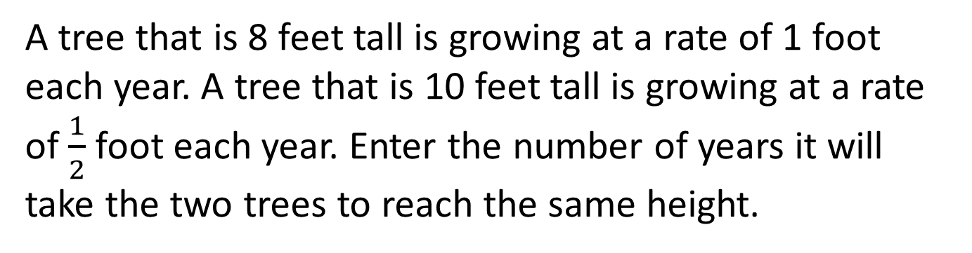
#10

Slide 21

#10 Answer
Rubric:
(1 point) Student enters the correct numerical solution.
Answer: 4

