Slide 1

Claim 1
Smarter Balanced Sample Items
Grade 8 - Target C
Understand the connections between proportional relationships, lines, and linear equations.
Questions courtesy of the Smarter Balanced Assessment Consortium Item Specifications – Version 3.0
Slideshow organized by SMc Curriculum – www.ccssmathactivities.com
Notes:
‹#›

Slide 2

#1
The cost (c) for p pounds of meat is shown in the table. Use the Add Arrow tool to graph the proportional relationship between the number of pounds of meat and the total cost.
p | c
3 | 15
5 | 25
7 | 35
9 | 45
10 | 50
Notes:
‹#›

Slide 3

#1 Answer
Rubric:
(1 point) Student creates a line with the slope of 5.
Notes:
‹#›

Slide 4
#2
Meat costs $5.00 per pound at a store. Use the Add Arrow tool to graph the proportional relationship between the number of pounds of meat and the total cost.
Notes:
‹#›

Slide 5
#2 Answer
Rubric:
(1 point) Student creates a line with a slope of 6.
Notes:
‹#›

Slide 6
#3
The cost (c) for p pounds of meat can be represented by the equation c = 5p. Use the Add Arrow tool to graph the proportional relationship between the number of pounds of meat and the total cost.
Notes:
‹#›

Slide 7
#3 Answer
Rubric:
(1 point) Student creates a line with a slope of 4.5.
Notes:
‹#›

Slide 8
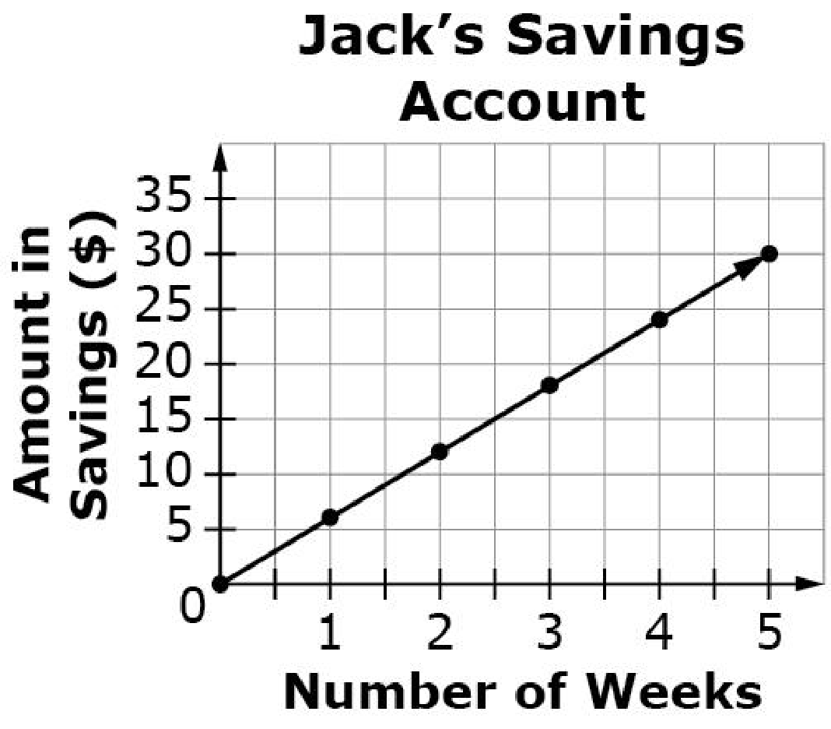
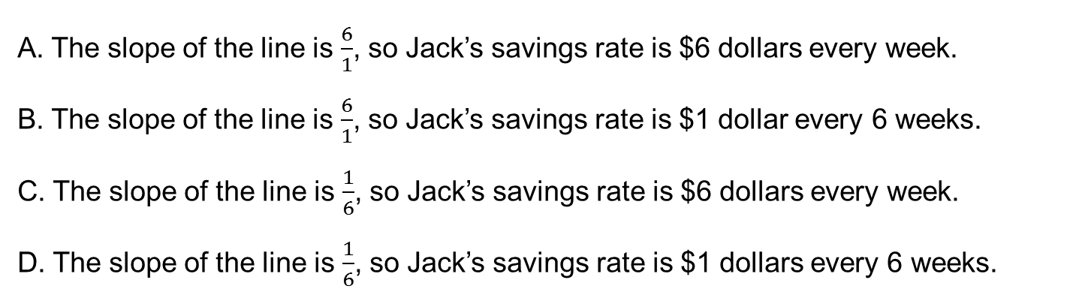
#4
This graph shows a proportional relationship between the amount of money in Jack’s savings account and the number of weeks Jack has been saving money. Which statement identifies the correct slope, and the correct interpretation of the slope for this situation?

Slide 9
#4 Answer
Rubric:
(1 point) Student identifies the correct statement of the slope of the graph.
Answer: A

Slide 10
#5
The table shows the proportional relationship between the cost (c) of meat and the weight in pounds (p) at Lane Grocery Store.
Select the equation which shows a cost of meat per pound that is twice the cost of meat per pound than at Lane Grocery Store.
A. c = 5p
B. c = 6p
C. c = 10p
D. c = 30p
p | c
3 | 15
5 | 25
7 | 35
9 | 45
10 | 50
Notes:
‹#›

Slide 11
#5 Answer
Rubric:
(1 point) Student correctly identifies the equation.
Answer: A

Slide 12
#6
This graph shows the amount of money (s) in Jack’s account after w weeks. Enter an equation to represent the amount of money (s) in Jack's account after w weeks.

Slide 13
#6 Answer
Rubric:
(1 point) The student gives the correct equation. Slope may be written as an integer, fraction, or decimal.
Answer: s = 6w

Slide 14
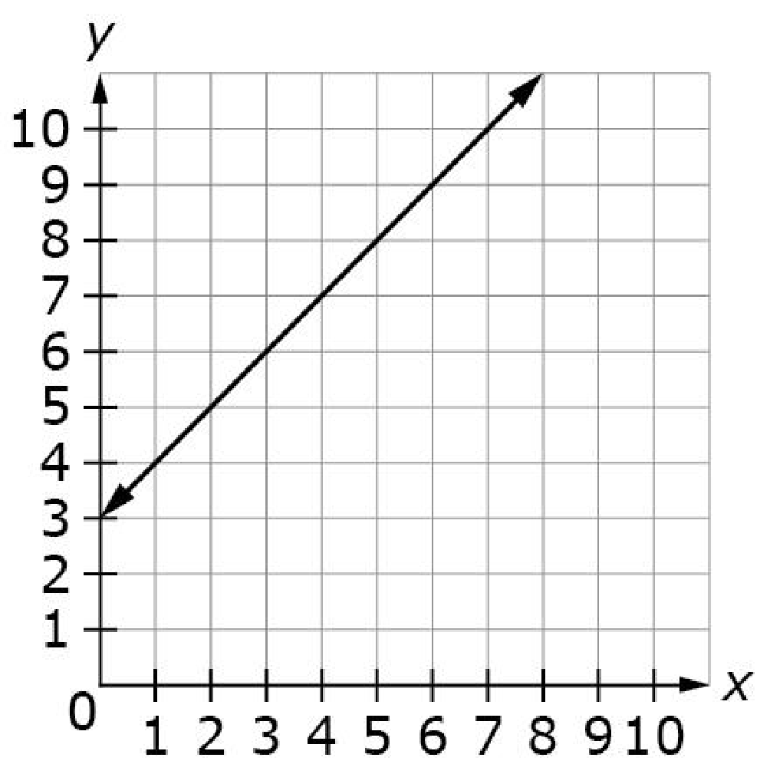
#7
Consider the line shown on the graph. Enter the equation of the line in the form y = mx + b where m is the slope and b is the y-intercept.

Slide 15
#7 Answer
Rubric:
(1 point) The student gives the correct equation. Slope may be written as an integer, fraction, or decimal.
Answer: y = x +3

