Slide 1

Claim 1
Smarter Balanced Sample Items
Grade 8 - Target B
Work with radicals and integer exponents.
Questions courtesy of the Smarter Balanced Assessment Consortium Item Specifications – Version 3.0
Slideshow organized by SMc Curriculum – www.ccssmathactivities.com
Notes:
‹#›

Slide 2

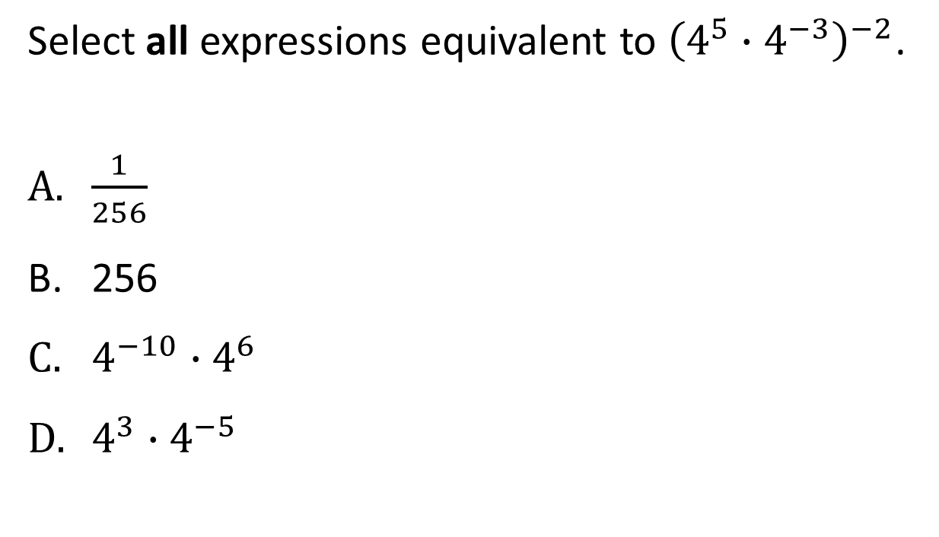
#1
Notes:
‹#›

Slide 3

#1 Answer
Rubric:
(1 point) Student selects all equivalent expressions.
Answer: A and C
Notes:
‹#›

Slide 4
#2
Notes:
‹#›

Slide 5
#2 Answer
Rubric:
(1 point) Student applies properties of exponents correctly and enters the correct response.
Answer: 10
Notes:
‹#›

Slide 6
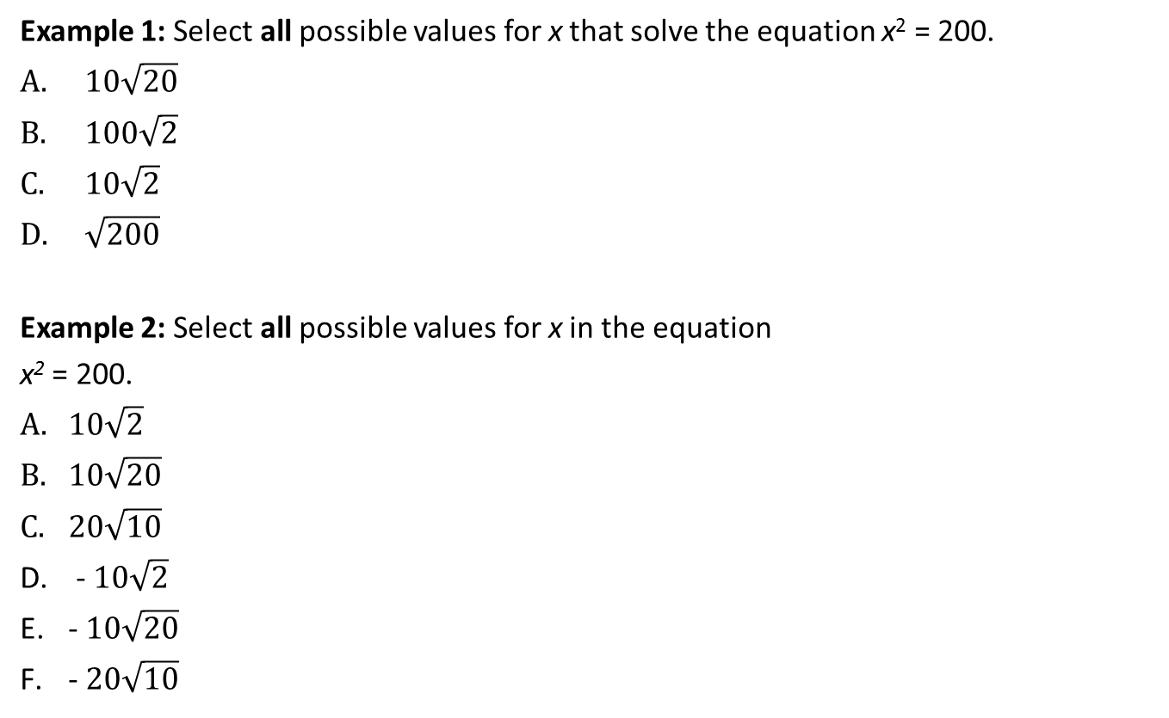
#3

Slide 7
#3 Answer
Rubric:
(1 point each) Student selects all the correct expressions.
Answers:
Example 1: C and D
Example 2: A and D

Slide 8
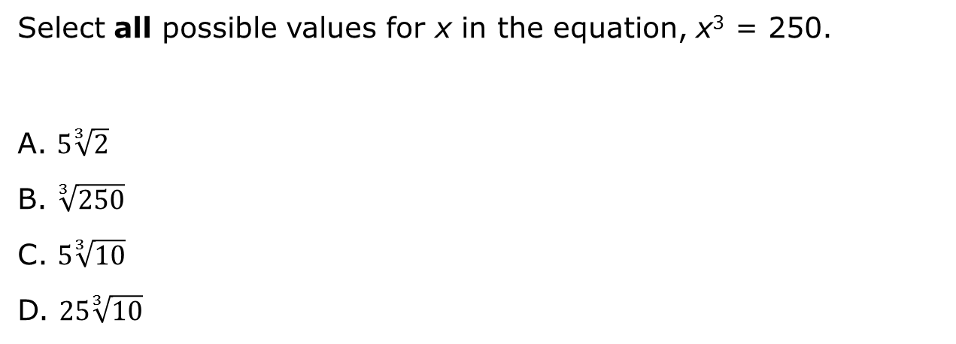
#4

Slide 9
#4 Answer
Rubric:
(1 point) Student selects all the correct expressions.
Answer: B and C

Slide 10
#5
How many times larger than 2 x 10³ is 6 x 10⁶?
3 x 10²
3 x 10³
6 x 10⁶
12 x 10⁹
Notes:
‹#›

Slide 11
#5 Answer
Rubric:
(1 point each) Student selects the correct expression.
Answer:
Example 1: B
Notes:
‹#›

Slide 12
#6
Approximately 7.5 x 10⁵ gallons of water flow over a waterfall each second. There are 8.6 x 10⁴ seconds in 1 day. Enter the approximate number of gallons of water that flow over the waterfall in 1 day.
6.45 x 10²¹
6.45 x 10²⁰
6.45 x 10¹⁰
6.45 x 10⁹

Slide 13
#6 Answer
Rubric:
(1 point each) Student gives the correct value.
Answer: C

Slide 14
#7
Which value is closest to (6 x 10⁶) + (2 x 10⁴)?
8.0 x 10¹⁰
8.0 x 10⁶
6.0 x 10¹⁰
6.0 x 10⁶

Slide 15
#7 Answer
Rubric:
(1 point each) Student gives the correct value.
Answer: D

