Slide 1

Claim 1
Smarter Balanced Sample Items
Grade 8 - Target A
Know that there are numbers that are not rational, and approximate them by rational numbers.
Questions courtesy of the Smarter Balanced Assessment Consortium Item Specifications – Version 3.0
Slideshow organized by SMc Curriculum – www.ccssmathactivities.com
Notes:
‹#›

Slide 2

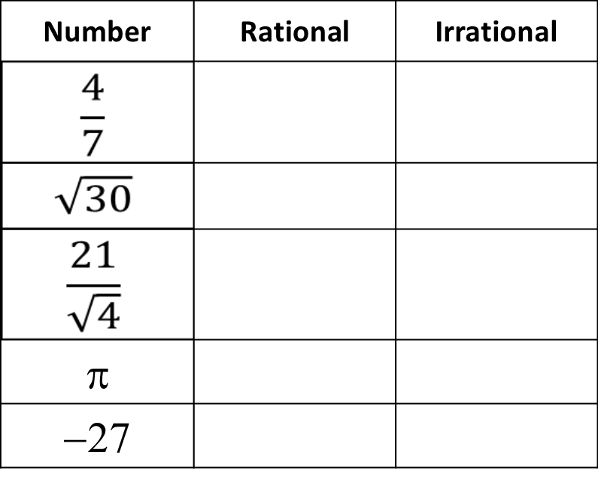
#1
Determine for each number whether it is a rational or irrational number.
Notes:
‹#›

Slide 3
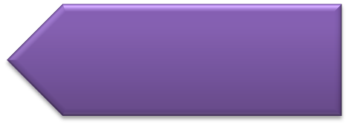
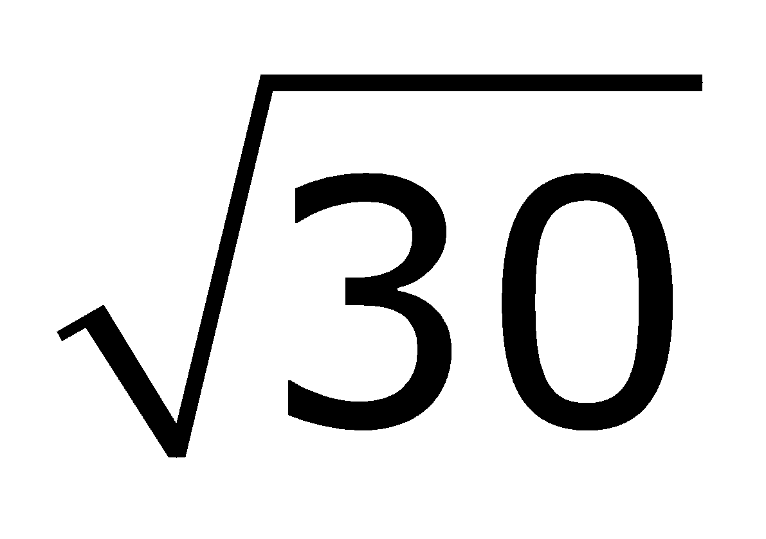
#1 Answer
Rubric:
(1 point) The student correctly classifies each number.
Answer: irrational numbers are and π, all others are rational
Notes:
‹#›

Slide 4
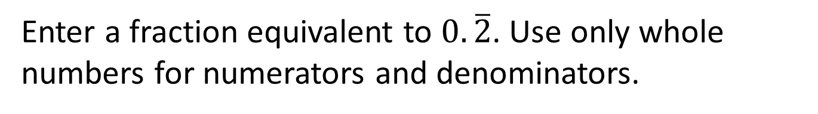
#2
Notes:
‹#›

Slide 5
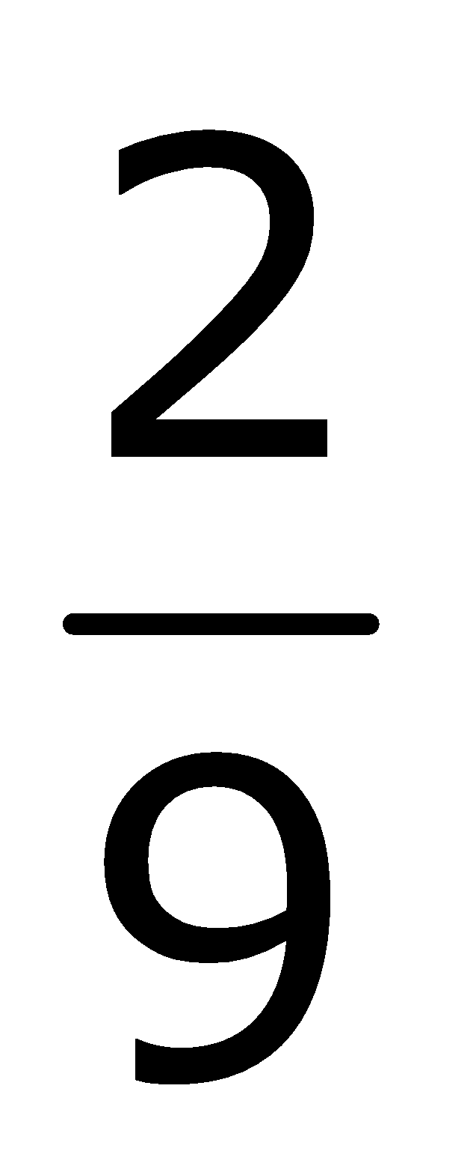
#2 Answer
Rubric:
(1 point) The student enters an equivalent fraction to the repeating decimal.
Answer:
Notes:
‹#›

Slide 6
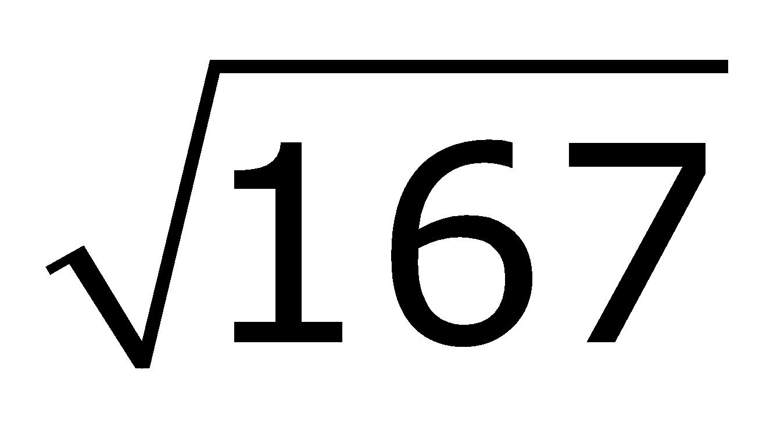
#3
Which number is the closest approximation to the value of ?
12
13
83
84
Notes:
‹#›

Slide 7
#3 Answer
Rubric:
(1 point) The student correctly identifies the closest approximation.
Answer: B
Notes:
‹#›

Slide 8
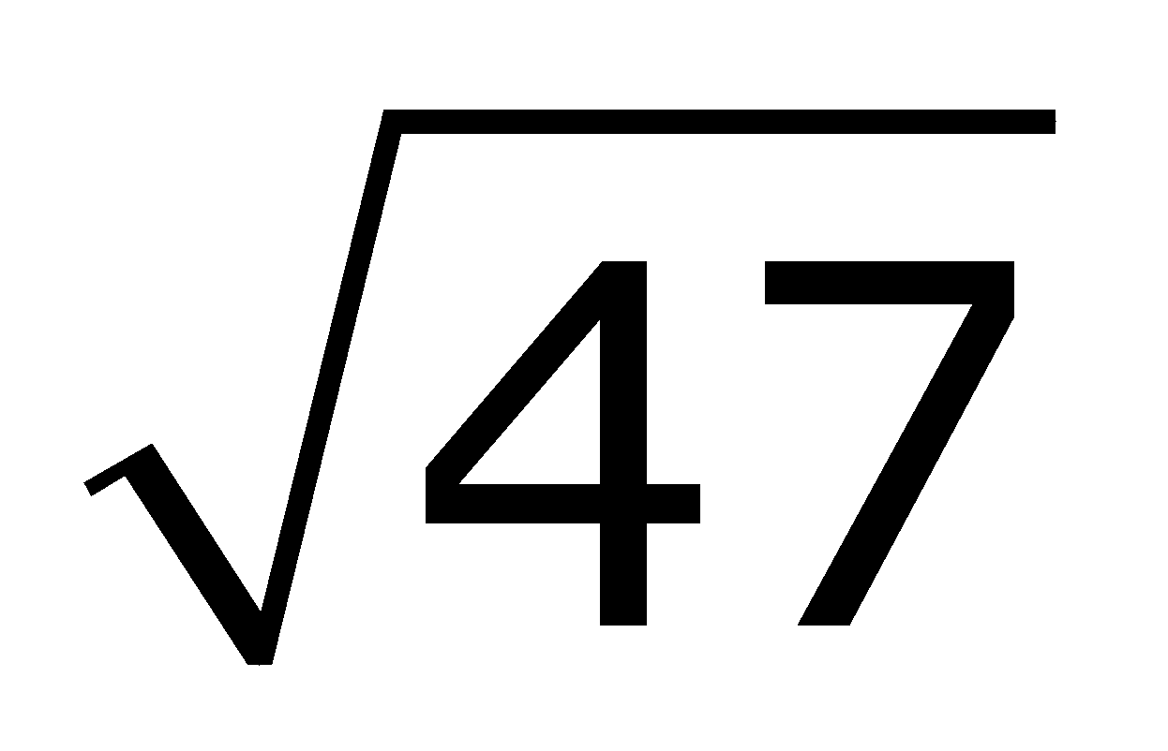
#4
Enter the approximate value of 2 to the nearest tenth.
Notes:
‹#›

Slide 9
#4 Answer
Rubric:
(1 point) Student gives the correct approximation at the specified degree of approximation.
Answer: 13.6 or 13.7
Notes:
‹#›

Slide 10

#5
Which range contains the value of ?
between 6.6 and 6.8
between 7.5 and 7.7
between 16.8 and 17.0
between 22.4 and 22.6

Slide 11
#5 Answer
Rubric:
(1 point) Student selects all the correct range.
Answer: A

Slide 12
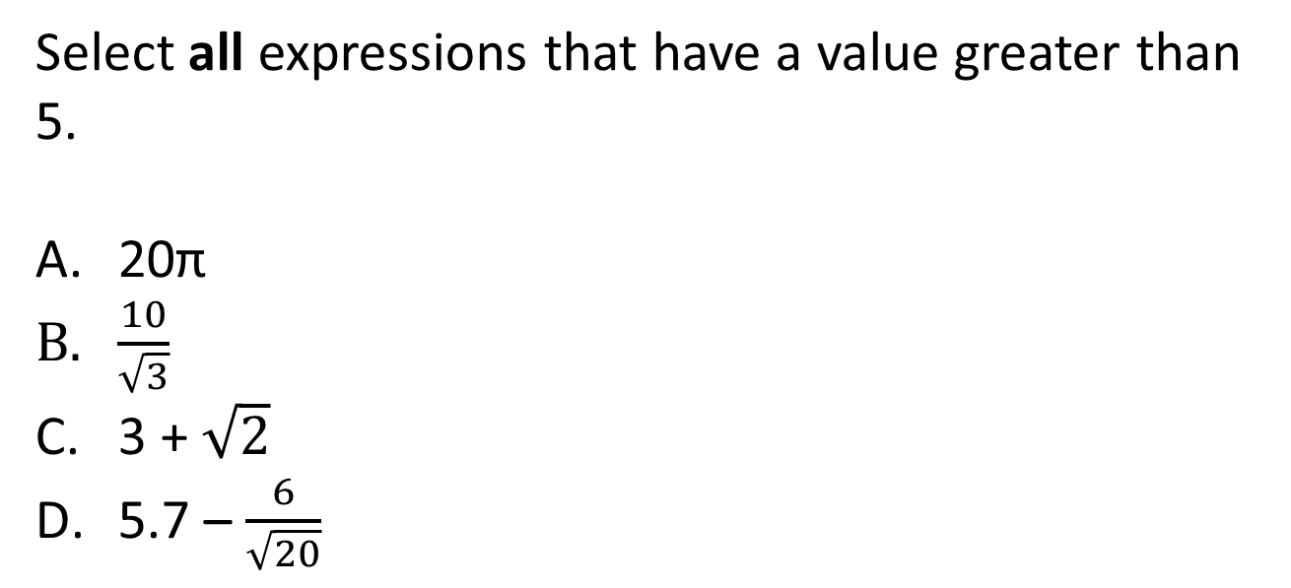
#6

Slide 13
#6 Answer
Rubric:
(1 point) Student selects all the appropriate expressions.
Answers: A and B

Slide 14
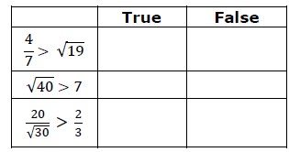
#7
Select True or False to indicate whether each comparison is true.
Notes:
‹#›

Slide 15
#7 Answer
Rubric:
(1 point) Student selects True or False correctly. In each inequality, one of the sides must contain an irrational number.
Answer: F, F, T
Notes:
‹#›

Slide 16
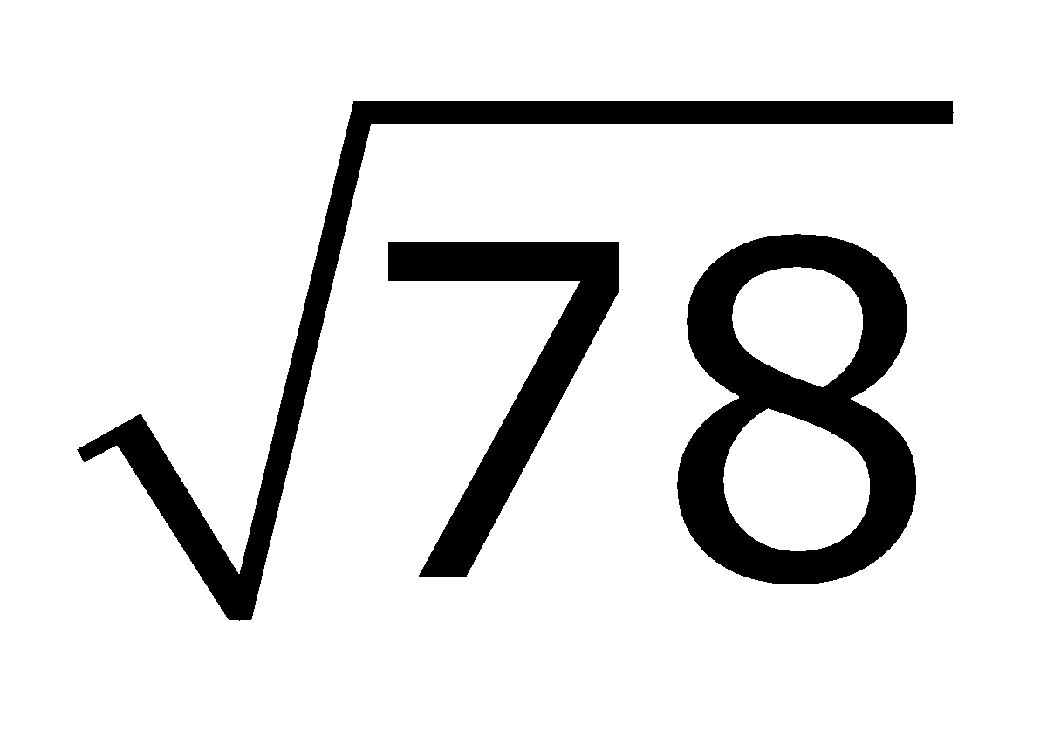
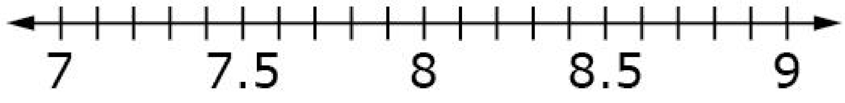
#8
Use the Add Point tool to approximate the value
of to the nearest tenth on the number line.

Slide 17
#8 Answer
Rubric:
(1 point) Student plots a point at the correct approximation.
Answer: 8.8

Slide 18
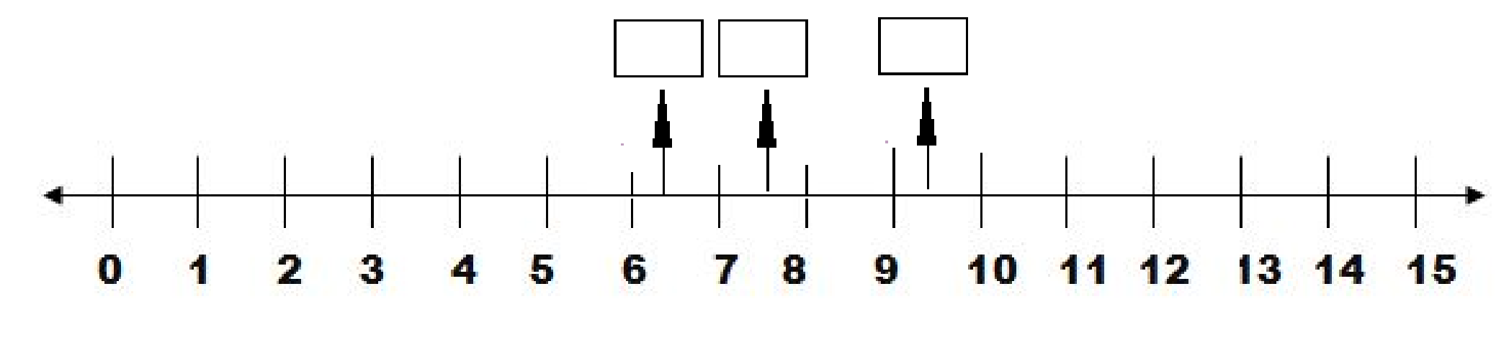
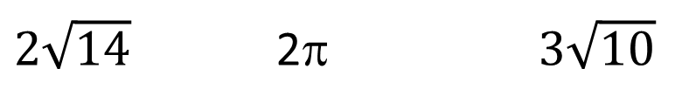
#9
Drag each expression to the number line to show the approximate value.
Notes:
‹#›

Slide 19
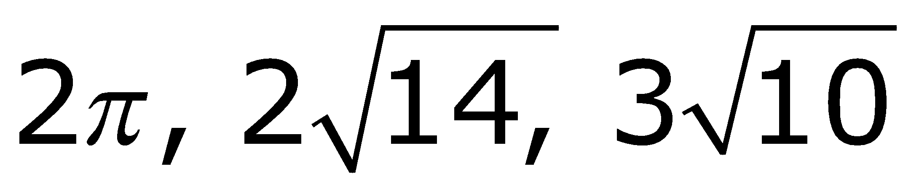
#9 Answer
Rubric:
(2 points) Student places all three expressions in the correct location.
(1 point) Student places two expressions in the correct location.
Answer:
Notes:
‹#›

