Slide 1

Claim 3
Smarter Balanced Sample Items
Grade 7
Communicating Reasoning
Questions courtesy of the Smarter Balanced Assessment Consortium Item Specifications – Version 3.0
Slideshow organized by SMc Curriculum – www.ccssmathactivities.com

Slide 2
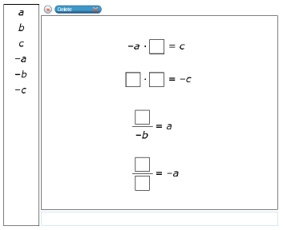
Question 1
In the following equation, a, b, and c are nonzero rational numbers.
a ⋅ -b = c
Given this equation, drag one value into each box to complete four true equations.

Slide 3
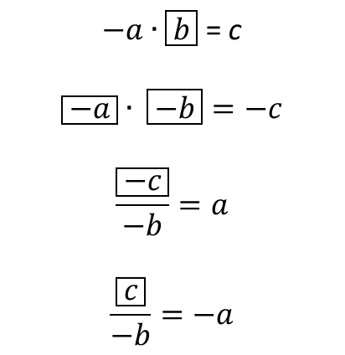
#1 Answer
Rubric:
(2 points) The student is able to complete all four equations correctly.
(1 point) The student is able to complete 3 out of 4 equations correctly.
Answer:

Slide 4
Question 2
Select the two statements that are true in all cases.
Statement 1: The greatest common factor of two distinct prime numbers is 1.
Statement 2: The greatest common factor of two distinct composite numbers is 1.
Statement 3: The product of two integers is a rational number.
Statement 4: The quotient of two integers is a rational number.

Slide 5
#2 Answer
Rubric:
(2 points) The student identifies all the correct conditions that make the argument true.
(1 point) The student identifies the correct conditions that make the argument true, but fails to consider the case of division by zero (4).
Answer: Statements 1, 3

Slide 6
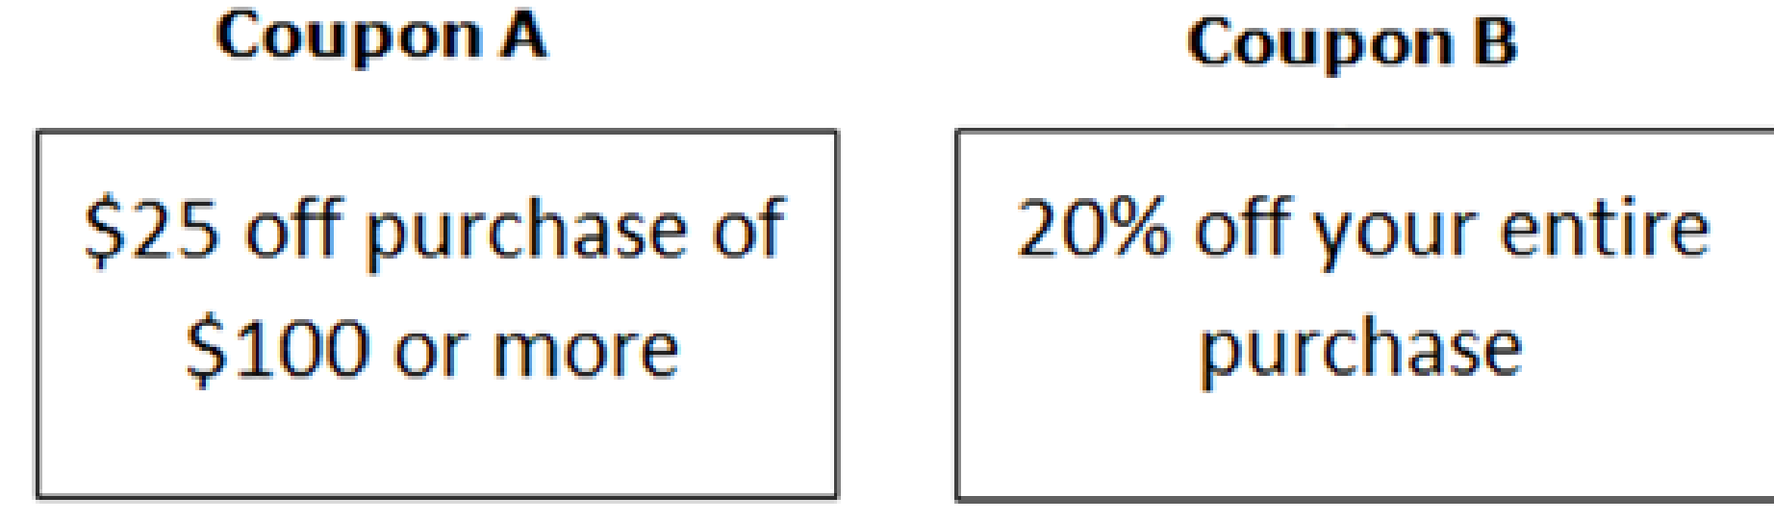
Question 3
Jane wants to buy the following items at a store.
Jeans, $32.99
Earrings, $29.99
T-shirt, $9.99
Shoes, $23.99
Jane will either use coupon A or coupon B to reduce the cost of her purchase. She sees some socks that cost $4.99. Jane thinks that adding socks to her purchase will cost her less than making the purchase without socks. Which option should Jane choose to spend the least amount of money?
A. Jane should add the socks to her purchase and then use Coupon A.
B. Jane should add the socks to her purchase and then use Coupon B.
C. Jane should make the purchase without socks and use Coupon A.
D. Jane should make the purchase without socks and use Coupon B.

Slide 7
#3 Answer
Rubric:
(1 point) The student selects the statement that represents correct reasoning.
Answer: A

Slide 8
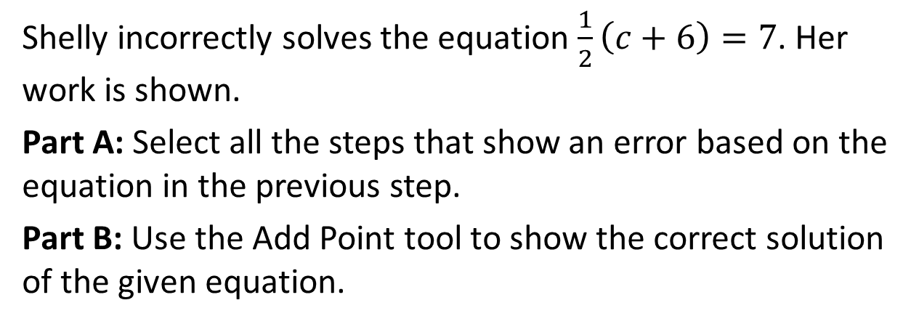
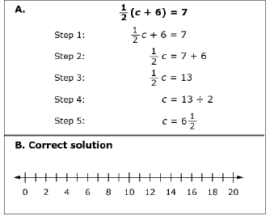
Question 4

Slide 9
#4 Answer
Rubric:
(2 points) The student selects the correct steps and plots the correct point on the number line.
(1 point) The student either selects the correct steps or plots the correct point on the number line.
Answers:
Part A: 1, 2, 4
Part B: 8

Slide 10
Question 5
Determine whether each statement is true for all cases, true for some cases, or not true for any case.
Statement | True for all | True for some | Not true for any
Two vertical angles form a linear pair.
If two angles are supplementary and congruent, they are right angles.
If the measure of an angle is 35°, then the measure of its complement is 55°.
The measure of an exterior angle of a triangle is greater than every interior angle of the triangle.

Slide 11
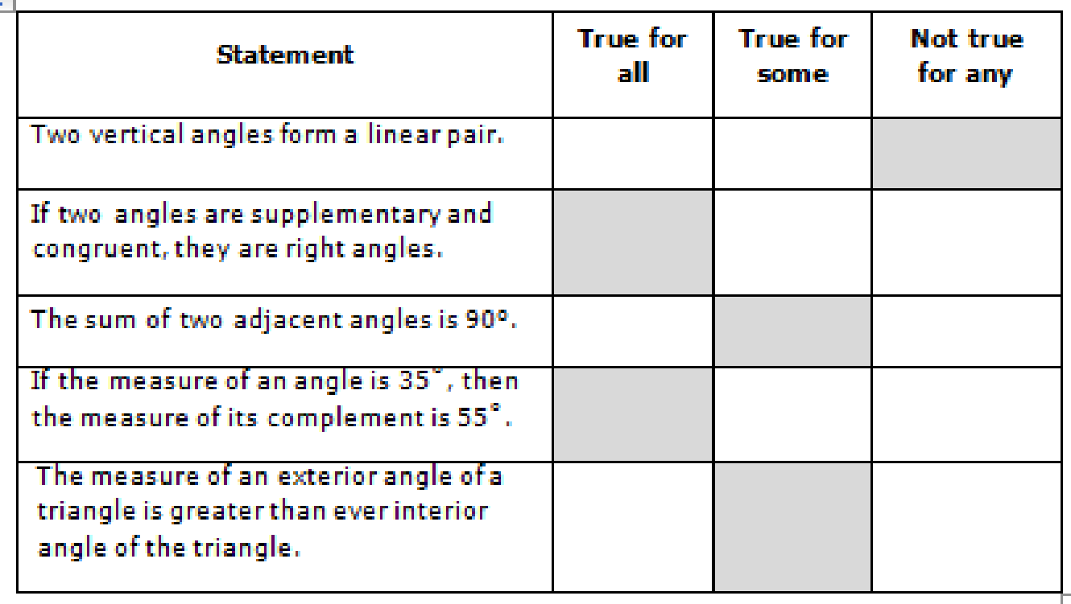
#5 Answer
Rubric:
(1 point) The student can classify each statement correctly.
Answer:

Slide 12
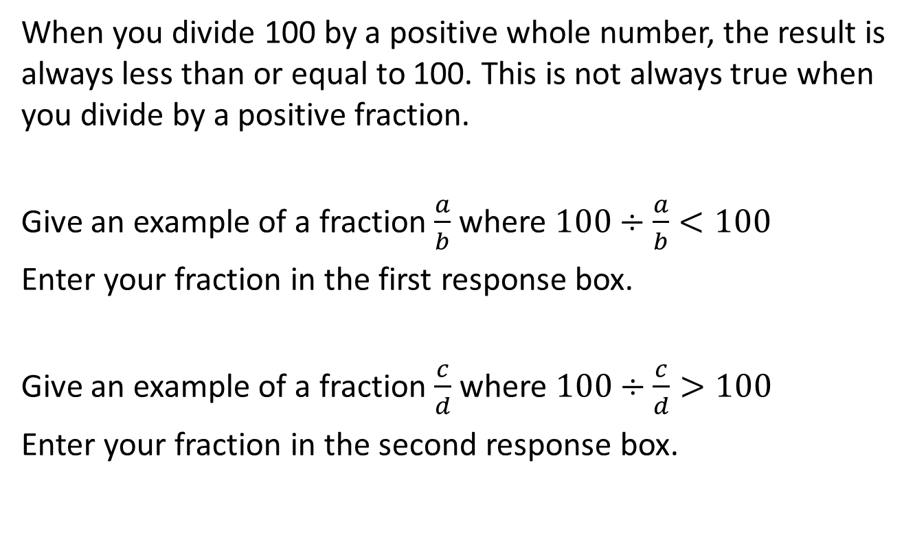
Question 6

Slide 13
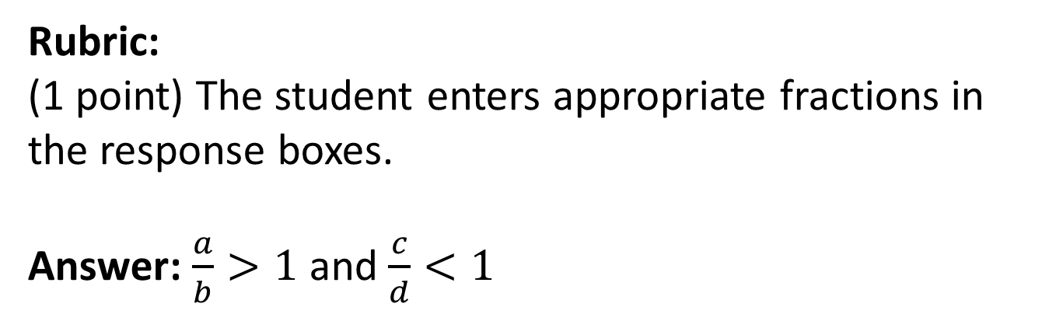
#6 Answer

Slide 14
Question 7
A robot moves at a constant speed. It travels n miles in t minutes. The robot’s pace is the number of minutes it takes to travel one mile.
Part A
What is the robot’s speed in miles per minute?
What is the robot’s pace in minutes per mile?
Part B
If the robot’s speed is greater than 1, then the pace is
Greater than 1.
Equal to 1.
Less than 1.
Cannot be determined.
Explain your reasoning.

Slide 15
#7 Answer
Rubric:
(2 points) The student enters the correct speed (n/t) in the first response box and the correct pace (t/n) in the second response box and selects the correct statement about the pace (C) and enters a correct explanation.
(1 point) The student gets Part A right or Part B right, but not both
Answer: Examples:
1. If the speed a/b is greater than 1, then the pace b/a must be less than one. The speed and the pace are reciprocals. If a number is greater than 1, then its reciprocal is less than one and vice-versa.
2. The speed is greater than 1, so a/b > 1. If we multiply both sides by b we get a > b. If we divide both sides by a, we bet 1 > b/a, which is the pace. So the pace is less than 1.

Slide 16
Question 8
In February, the price of a gallon of gasoline increased by 23% from the price in January. In March, the price decreased by 11% from the price in February. In March, gas cost $2.63 per gallon.
How much did a gallon of gasoline cost in January, in dollars? Round your answer to the nearest cent. Enter your answer in the response box.
Which equation shown can be solved to find x, the cost of gas in January?
(0.11)(0.23)x = 2.63
(1.11)(1.23)x = 2.63
(0.89)(1.23)x = 2.63
(1.11)(0.77)x = 2.63

Slide 17
#8 Answer
Rubric:
(2 points) The student enters the correct cost of a gallon of gas and selects the correct equation.
(1 point) The student does one of these parts correctly.
Answer: 2.40; C

Slide 18

Question 9
Glenn saw the figure below and said, “If I find the length (l), width (w), and radius (r), then the area (A) of the shaded region is A = l • w – πr².”
Which assumptions must Glenn be making in order for his equation to give the correct area of the shaded region? Select all that apply.
A. The quadrilateral is a rhombus.
The quadrilateral is a rectangle.
The curved figure in the center is a circle.
The curved figure in the center is a sphere.

Slide 19
#9 Answer
Rubric:
(1 point) The student selects the correct assumptions.
Answer: B and C

Slide 20
Question 10
A perfect square is a number s that is the product of an integer, n, and itself, so that s = n².
Examples of perfect squares include 25 because it is equal to 5² and 81 because it is equal to 9².
Can a perfect square be negative?
Yes; an example is -25.
No; a square of any integer is always positive.
Sometimes Yes, sometimes No; it depends on the value of n.
There is not enough information to tell.

Slide 21
#10 Answer
Rubric:
(1 point) The student selects the correct statement.
Answer: B

Slide 22
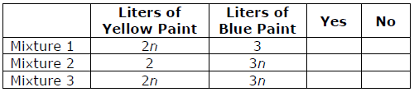
Question 11
Green paint can be made by mixing yellow paint with blue paint. Two mixtures make the same shade of green if the ratio of yellow to blue is the same. Assume n is a positive number.
Identify one or more of the mixtures below that will make the same shade of paint as a mixture of 10 liters of yellow paint and 15 liters of blue paint. Answer “Yes” if it will make the same shade of paint, answer “No” if it will not.

Slide 23
#11 Answer
Rubric:
(1 point) The student identifies the correct mixture.
Answer: N, N, Y

Slide 24
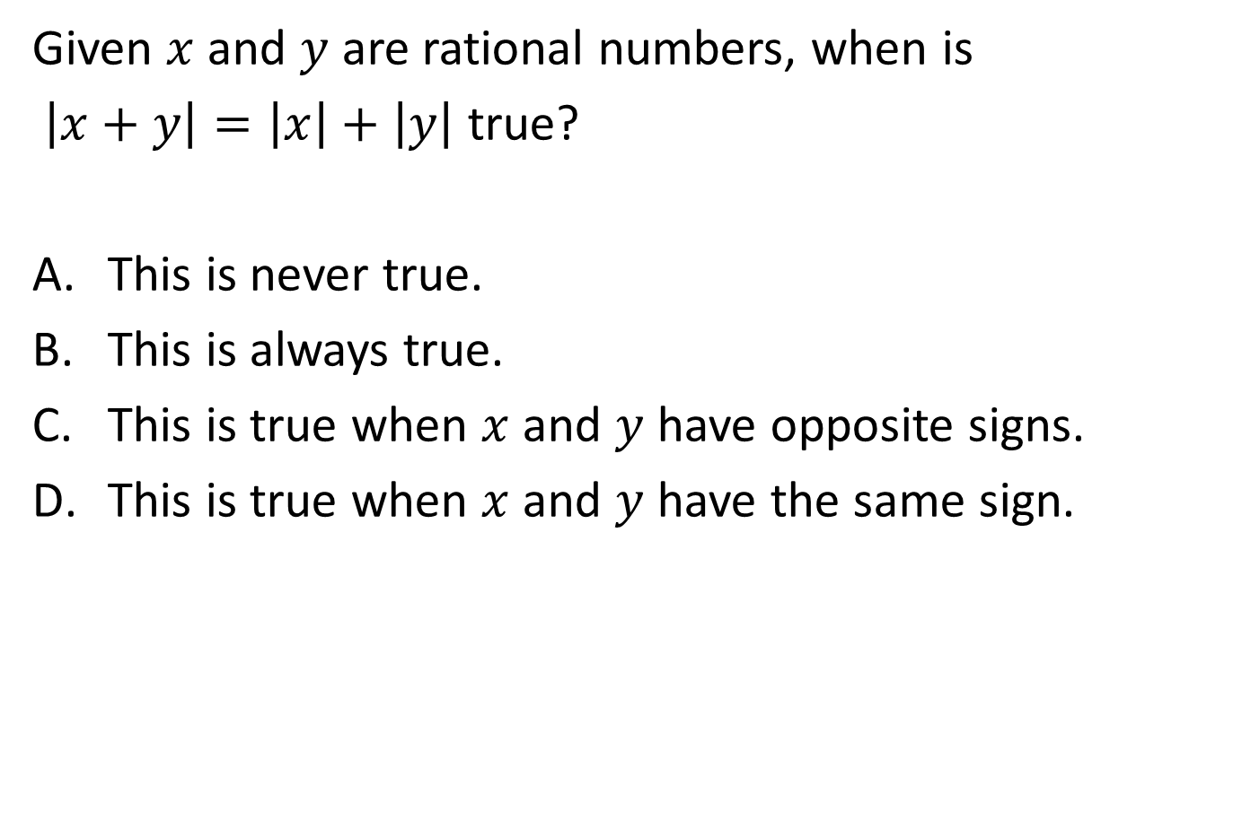
Question 12

Slide 25
#12 Answer
Rubric:
(1 point) The student selects the correct statement.
Answer: D

Slide 26
Question 13
Dena is trying to solve this problem:
A store has a sale where every item has a sale price that is 20% less than the original price. Write an expression that represents the sale price of an item if the regular price is p dollars.
Dena said, “To find 20% of a number, I should multiply by 0.20. So the sale price of an item will be 0.20p.”
Which statement best describe Dena’s reasoning?
Dena is correct.
Dena needs to subtract 0.20p from the regular price, p.
Dena should calculate the sale price as 20p and then divided by 100.
Dena is trying to solve an impossible problem because it doesn’t say what the regular price is.

Slide 27
#13 Answer
Rubric:
(1 point) The student selects the statement that represents correct reasoning.
Answer: B

Slide 28
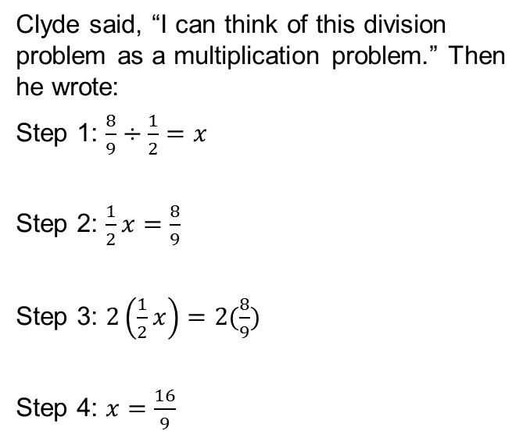
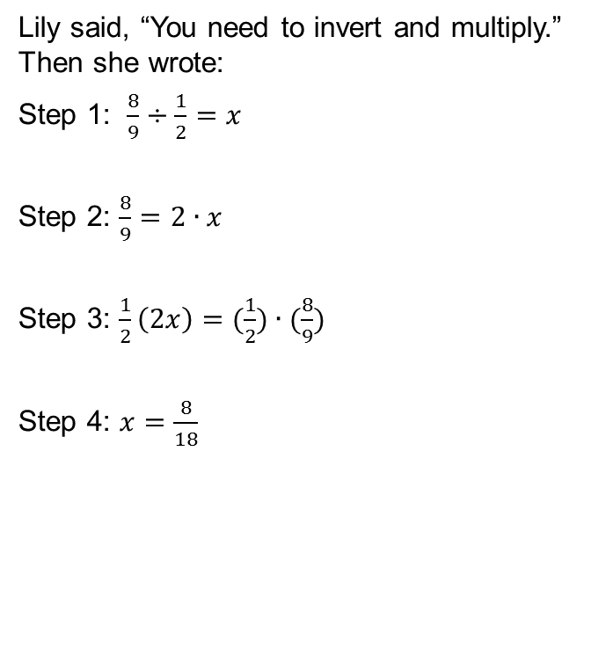
Question 14
Who solved the problem correctly?
Only Clyde solved the equation correctly.
Only Lily solved the equation correctly.
They both solved the equation correctly.
Neither one solved the equation correctly.

Slide 29
#14 Answer
Rubric:
(1 point) The student selects the correct characterization of these two approaches.
Answer: A

Slide 30
Question 15
P and T are numbers and P + T = 0.
Select all of the statements about P and T that could be true.
P= 0 and T = 0.
P = 0 or T = 0, but not both.
P can be any positive number and T can be any negative number.
P and T are on opposite sides of zero and equally distant from zero on the number line.

Slide 31
#15 Answer
Rubric:
(1 point) The student selects the correct statements.
Answer: A and D

Slide 32
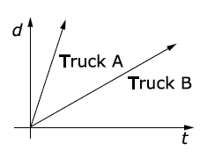
Question 16
Two trucks are traveling on a highway at a constant speed. The graphs of their distances, d, over time, t, as shown.
Which truck is traveling faster, and how do you know?
Truck (A, B) is traveling faster because the graph is (steeper, less steep, longer, shorter).

Slide 33
#16 Answer
Rubric:
(1 point) The student chooses the correct truck and the correct reason.
Answer: Truck A; steeper

