Slide 1

Claim 2
Smarter Balanced Sample Items
Grade 7
Problem Solving
Questions courtesy of the Smarter Balanced Assessment Consortium Item Specifications – Version 3.0
Slideshow organized by SMc Curriculum – www.ccssmathactivities.com

Slide 2
#1
This table shows the total change in Sara's account balance for each month listed. For example, the account change of
+$38 means that Sara's balance increased by $38 during the
month of January. Determine whether each statement about Sara’s bank account balance is true based on the table. Select True or False for each statement.
Month | Account Change
January | + $38
February | − $30
March | − $19
April | + $49
Statement | True | False
Sara has less money in her account at the end of February than at the end of any other month.
Sara’s account balance is the same at the end of April as it is at the end of January.
Sara has more money in her account at the end of April than she had at the beginning of January.

Slide 3
#1 Answer
Rubric:
(1 point) The student identifies all three statements correctly as true or false.
Answer: F, T, T

Slide 4
#2
Justin’s car can travel 77.5 miles using 3.1 gallons of gas.
At this rate, how far, in miles, can Justin travel using 8.2 gallons of gas?
Enter the distance in the response box.

Slide 5
#2 Answer
Rubric:
(1 point) The student enters the correct distances in the response boxes.
Answer: 205

Slide 6
#3
The marching band has 85 members. There are 15 more girls than boys in the band. How many boys are members of the marching band?

Slide 7
#3 Answer
Rubric:
(1 point) The student is able to correctly determine the number of boys.
Answer: 35

Slide 8
#4
Luke buys a television that is on sale for 25% off the original price. The original price is $120 more than the sale price. What is the original price of the television?

Slide 9
#4 Answer
Rubric:
(1 point) The student enters the correct full price.
Answer: 480

Slide 10
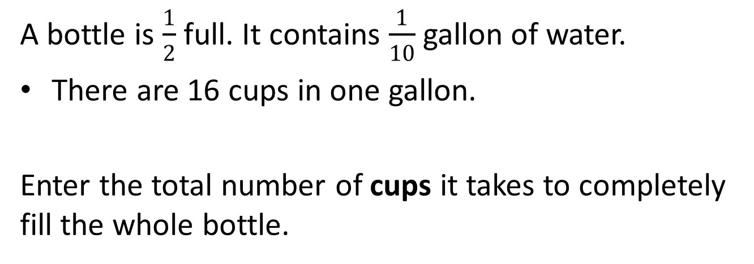
#5

Slide 11
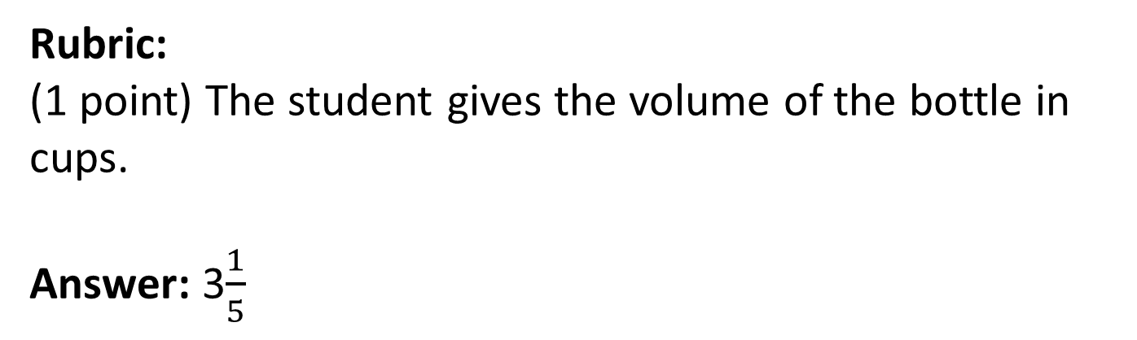
#5 Answer

Slide 12
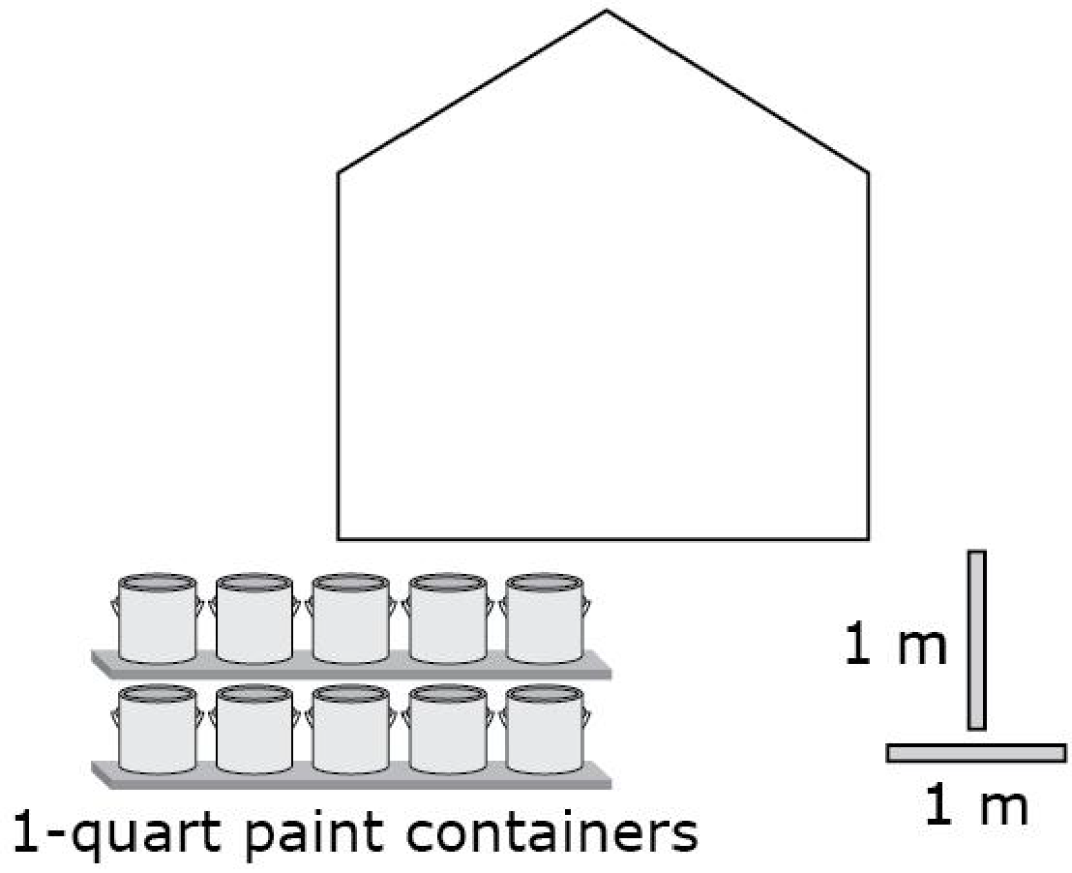
#6
John needs to paint one wall in his house. The wall is shaped like a rectangle with a triangular top, as shown. He knows that each 1-quart container of paint covers an area of 24 square feet. John uses a meter stick to measure the dimensions of the wall. [1 meter is approximately 39 inches]
Select the fewest number of
1-quart containers of paint John can use to paint the wall. You may use the meter sticks to measure the dimensions of the wall.

Slide 13
#6 Answer
Rubric:
(1 point) The student selects 4 paint cans.

Slide 14
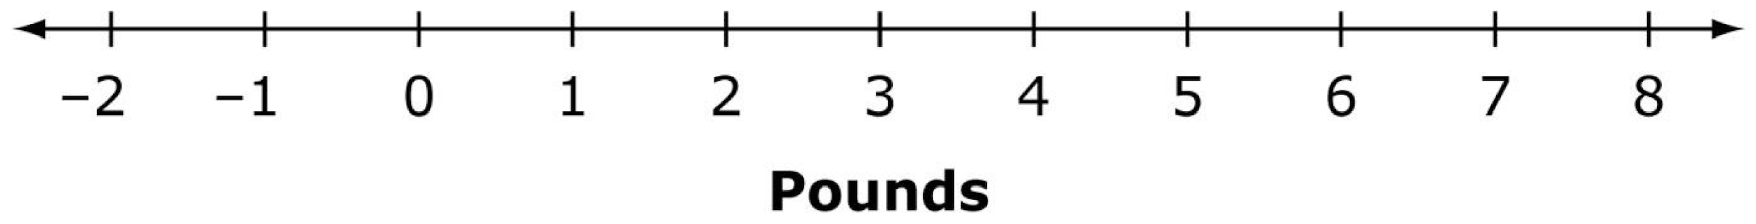
#7
David wants to buy 2 pineapples and some bananas and spend no more than $10.00.
The price of 1 pineapple is $2.99.
The price of bananas is $0.67 per pound.
Use the Connect Line or Add Arrow tool to draw a graph that represents all possible values for the number of pounds of bananas, b, David can buy.

Slide 15
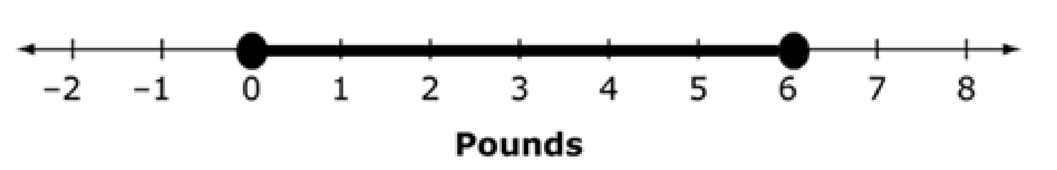
#7 Answer
Rubric:
(1 point) The student is able to correctly graph the inequality defined by the problem.
Answer:

Slide 16
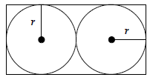
#8
Two circles touch a rectangle and each other as shown in this diagram.
The area of the rectangle is 50 square inches. Enter the radius (r), in inches, of each circle.

Slide 17
#8 Answer
Rubric:
(1 point) The student is able to determine the radius.
Answer: 2.5

Slide 18
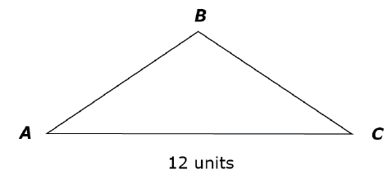
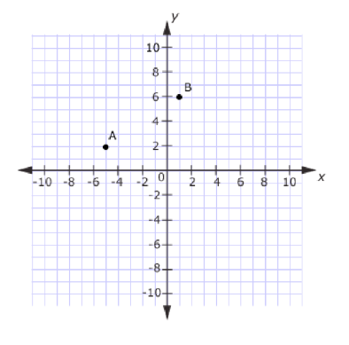
#9
Complete the sketch of triangle ABC in the coordinate plane.
Point A is plotted at (-5, 2)
Point B is plotted at (1, 6)
Side AC is parallel to the x-axis and is 12 units long.
Use the Add Point and Connect Line Tool to plot C in the coordinate plane and connect the three points.

Slide 19
#9 Answer
Rubric:
(1 point) The student plots point C in the coordinate plane and draws the three line segments.
Answer: C is plotted at (7, 2) and segments AB, AC, and BC are created.

Slide 20
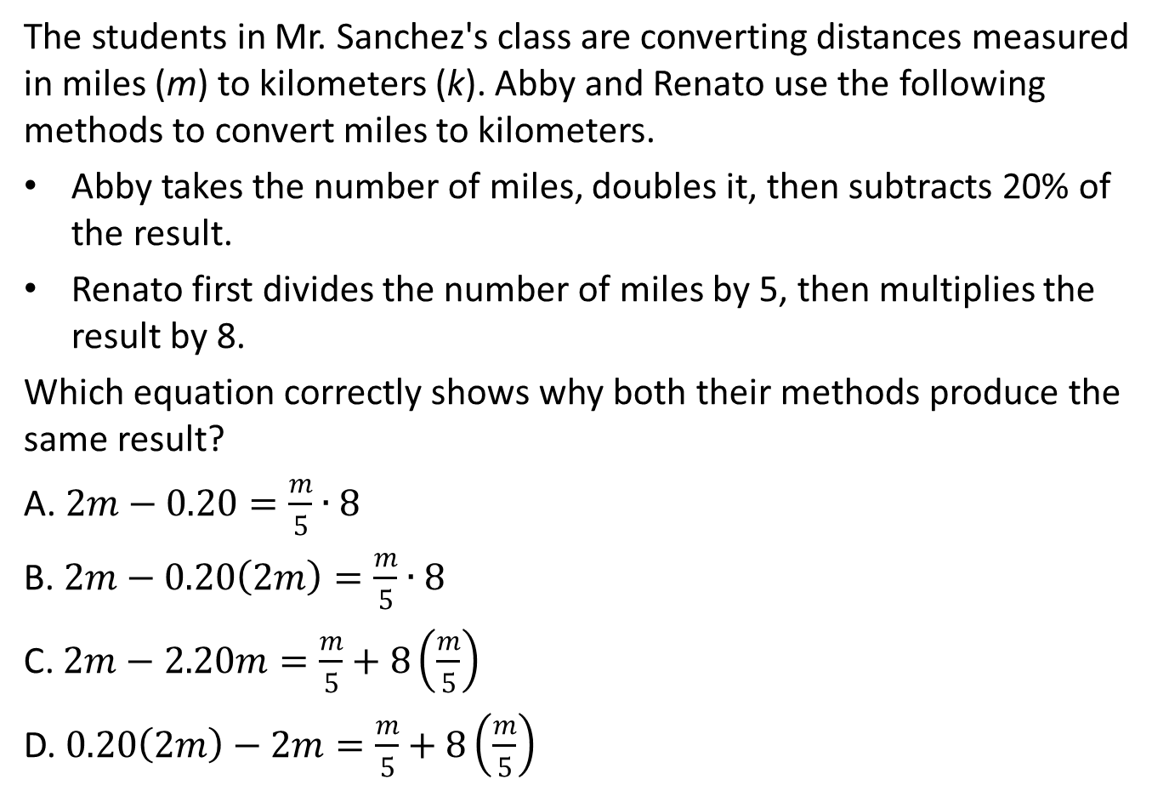
#10

Slide 21
#10 Answer
Rubric:
(1 point) The student selects the correct equation.
Answer: B

Slide 22
#11
The weather report predicted that the low temperatures would be -8 degrees Fahrenheit. The radio announcer said, “The low temperature was 5 degrees colder than predicted!”
What was the low temperature, in degrees Fahrenheit?
Enter your answer in the response box.

Slide 23
#11 Answer
Rubric:
(1 point) The student enters the correct temperature in the response box.
Answer: -13

Slide 24
#12
The school bus driver follows the same route to pick students up in the morning and to drop them off in the afternoon. Because of traffic, the afternoon drive takes 1.5 times as long as the morning drive.
Enter an equation that represents the relationship between the number of minutes x, of the morning drive, to the total number of minutes, y, that the bus driver spends picking up and dropping off students each day.

Slide 25
#12 Answer
Rubric:
(1 point) The student enters a correct equation in the response box.
Answer: E.g. y = 2.5x

Slide 26
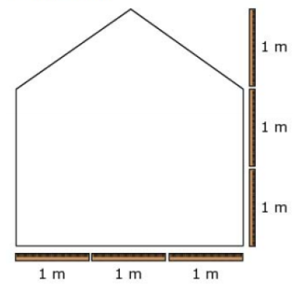
#13
John needs to paint one wall in his school. He knows that one can of paint covers an area of 24 square feet. John uses a meter stick to measure the dimensions of the wall, as shown.
1 meter is approximately 39 inches.
What is the fewest number of cans of paint John can use to paint the wall?

Slide 27
#13 Answer
Rubric:
(1 point) The student enters the correct number of cans of paint in the response box.
Answer: 4

Slide 28
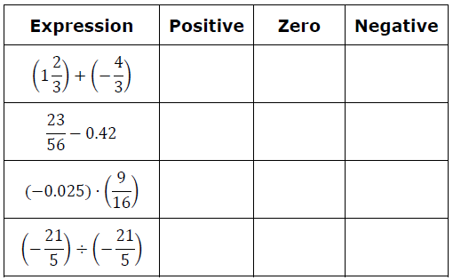
#14
Determine whether each expression has a value that is positive, negative, or zero. Select the correct comparison for each expression.

Slide 29
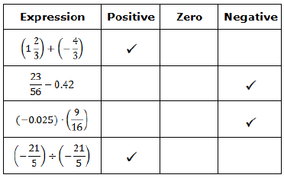
#14 Answer
Rubric:
(1 point) The student selects the correct sign for each expression, as shown below.
Answer:

Slide 30
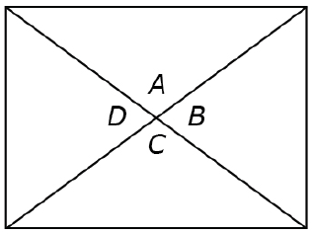
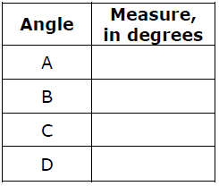
#15
The figure shows a scale drawing of a window. Find the measures of angles, A, B, C, and D to the nearest degree. Enter the measures in the table shown below.

Slide 31
#15 Answer
Rubric:
(1 point) The student enters correct angle measures in the response box within a tolerance of +/- 3 degrees.
Answer: 72, 108, 72, 108

Slide 32
#16
A mail-order company sells jars of spices.
An empty jar has a mass of 200 grams.
A full jar contains 110 grams of a spice.
The company sells n jars filled with spices.
Select the best interpretation of the expression
(200 + 110)n
The cost to ship 1 full jar
The cost to ship n full jars
The mass of 1 full jar
The mass of n full jars

Slide 33
#16 Answer
Rubric:
(1 point) The student selects the correct interpretation.
Answer: D

Slide 34
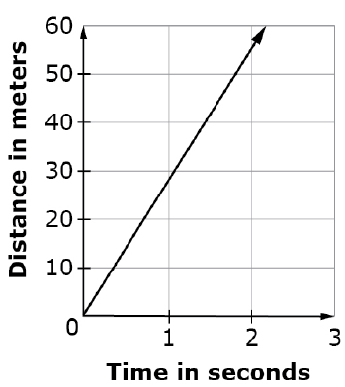
#17
A car is traveling on the highway. The distance, in meters, it has traveled over a two-second interval is shown in the graph. A crow can fly up to 32 meters per second. Would it be possible for a crow to pass the car?
Yes, it is possible for a crow to pass the car.
No, it is not possible for a crow to pass the car.
The speed of the car and the maximum speed of the crow are too close to tell.
There is not enough information to answer the question.

Slide 35
#17 Answer
Rubric:
(1 point) The student selects the correct answer choice.
Answer: A

