Slide 1

Claim 1
Smarter Balanced Sample Items
Grade 7 - Target H
Draw informal comparative inferences about two populations.
Questions courtesy of the Smarter Balanced Assessment Consortium Item Specifications – Version 3.0
Slideshow organized by SMc Curriculum – www.ccssmathactivities.com
Notes:
‹#›

Slide 2


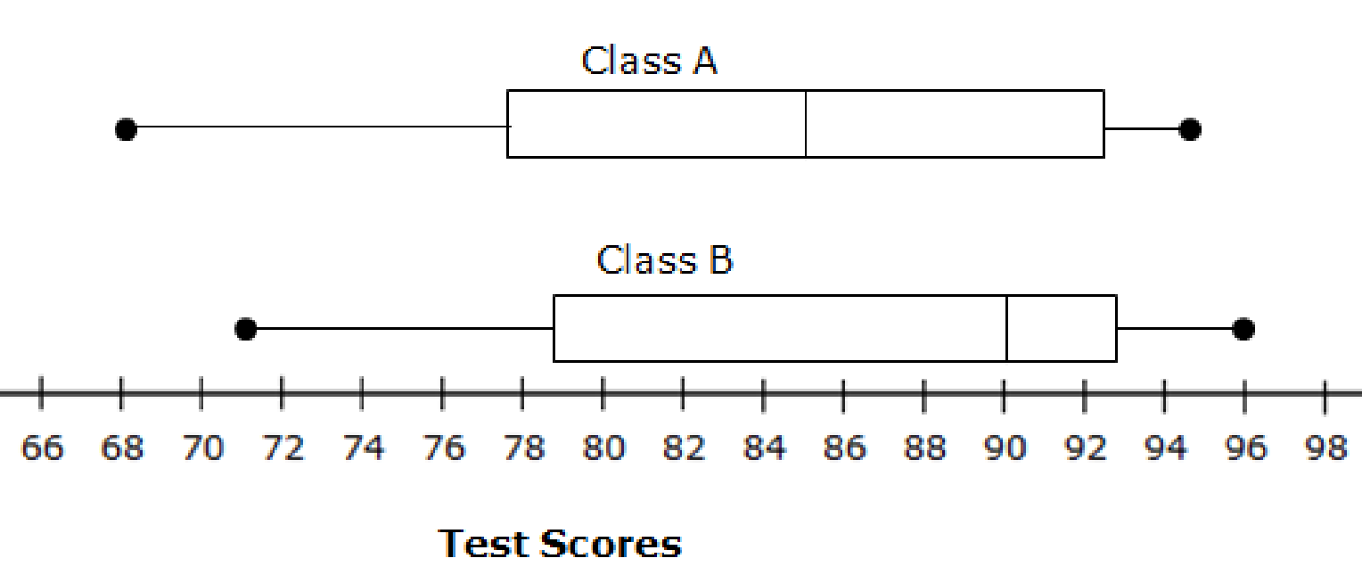
#1
The box plot shows a summary of test scores for Class A and Class B on the same exam. Both classes have the same number of students. Determine whether each statement is true based on these box plots. Select True or False for each statement.
Statement | True | False
In each class, at least 25% of students scored below 80 on the test.
The median test score of Class B is 5 points less than the median test score of Class A.
In each class, more than 25% of students have test scores greater than 90.
Notes:
‹#›

Slide 3

#1 Answer
Rubric:
(1 point) Student correctly identifies each statement as true or false. False statements could include incorrect interpretations of the measures of variability.
Answer: T, F, T
Notes:
‹#›

