Slide 1

Claim 1
Smarter Balanced Sample Items
Grade 7 - Target F
Solve real-life and mathematical problems involving angle measure, area, surface area, and volume.
Questions courtesy of the Smarter Balanced Assessment Consortium Item Specifications – Version 3.0
Slideshow organized by SMc Curriculum – www.ccssmathactivities.com
Notes:
‹#›

Slide 2


#1
The radius of a circle is 7.5 centimeters. Enter the area of the circle, in square centimeters. Round your answer to the nearest hundredth.
Notes:
‹#›

Slide 3

#1 Answer
Rubric:
(1 point) The student enters the correct area in a range of correct values.
Answer: 176.63 – 176.79
Notes:
‹#›

Slide 4
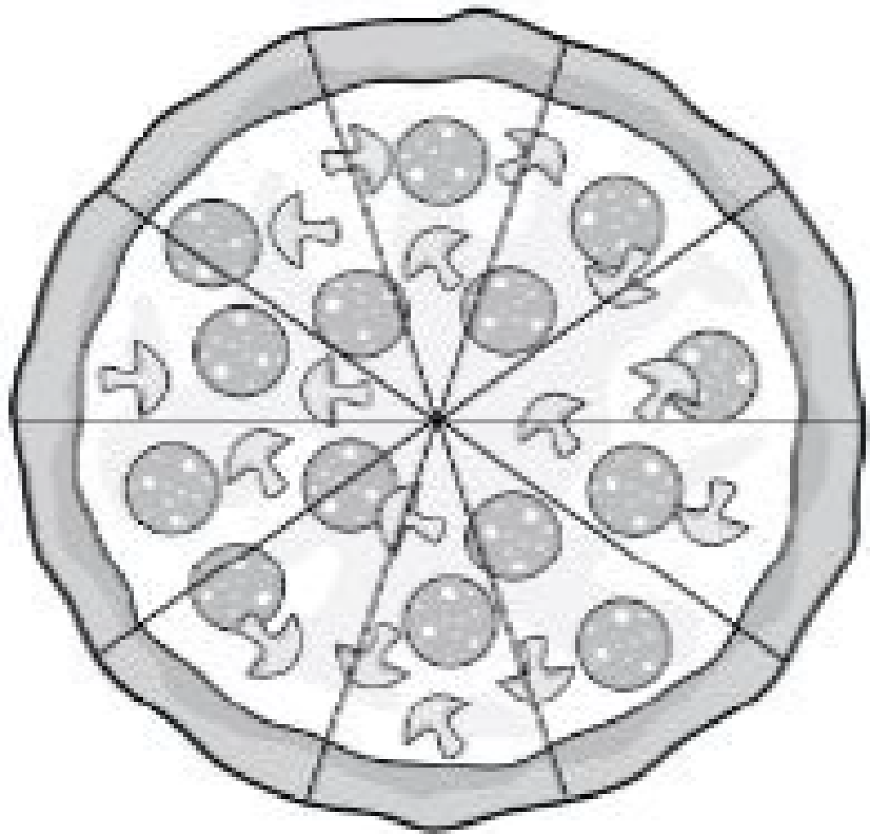
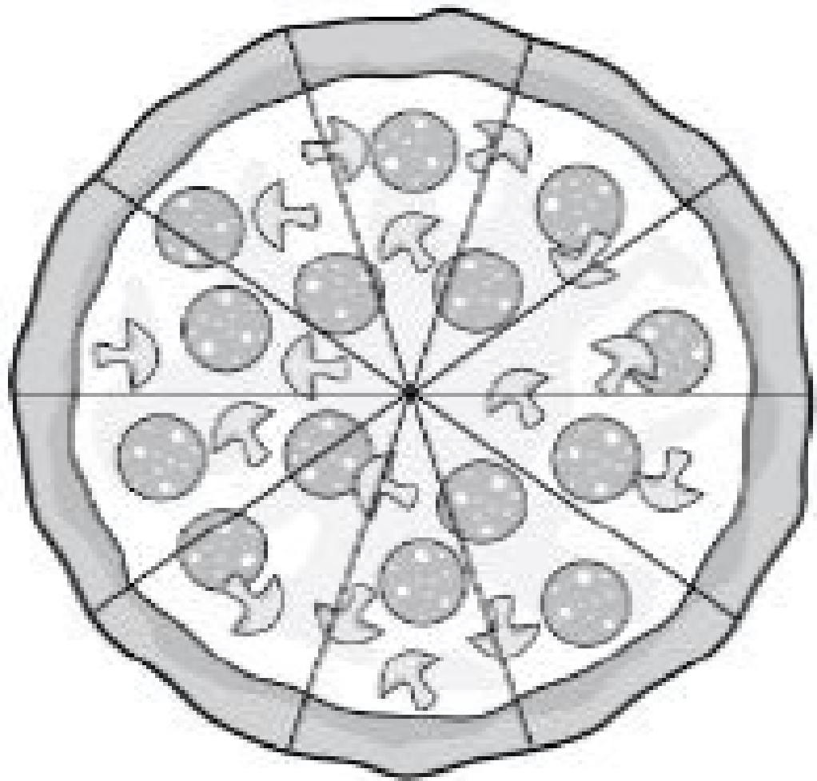
#2
Example 1: A circular table top has a radius of 3 feet. Enter the area, in square feet, of the table top. Round your answer to the nearest hundredth.
Example 2: Jill buys two circular pizzas. How much greater, in square inches, is the area of the medium pizza than the small pizza? Round your answer to the nearest hundredth.
The small pizza has an
8-inch diameter.
The medium pizza has an
12-inch diameter.
Notes:
‹#›

Slide 5
#2 Answer
Rubric:
(1 point each) The student enters the correct area in a range of correct values.
Answers:
Example 1: 28.26 – 28.305
Example 2: 62.80 – 62.90
Notes:
‹#›

Slide 6
#3
The radius of a circle is 7 centimeters. Enter the circumference of the circle, in centimeters. Round your answer to the nearest hundredth.
Notes:
‹#›

Slide 7
#3 Answer
Rubric:
(1 point) The student enters the correct circumference in a range of correct values.
Answer: 43.96 – 44.03
Notes:
‹#›

Slide 8
#4
The circumference of a circle is 31.4 inches. Enter the radius of the circle, in inches. Round your answer to the nearest whole number.
Notes:
‹#›

Slide 9
#4 Answer
Rubric:
(1 point) The student enters the correct radius.
Answer: 5
Notes:
‹#›

Slide 10
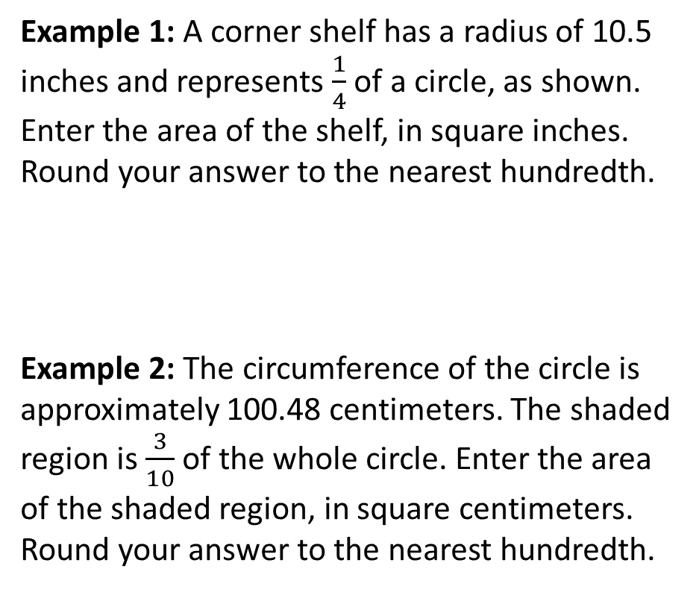
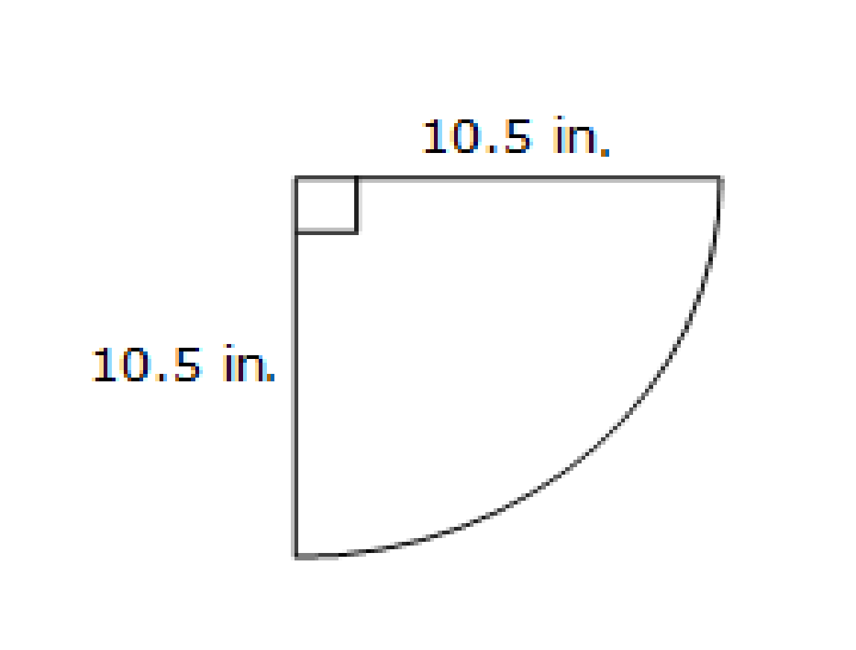
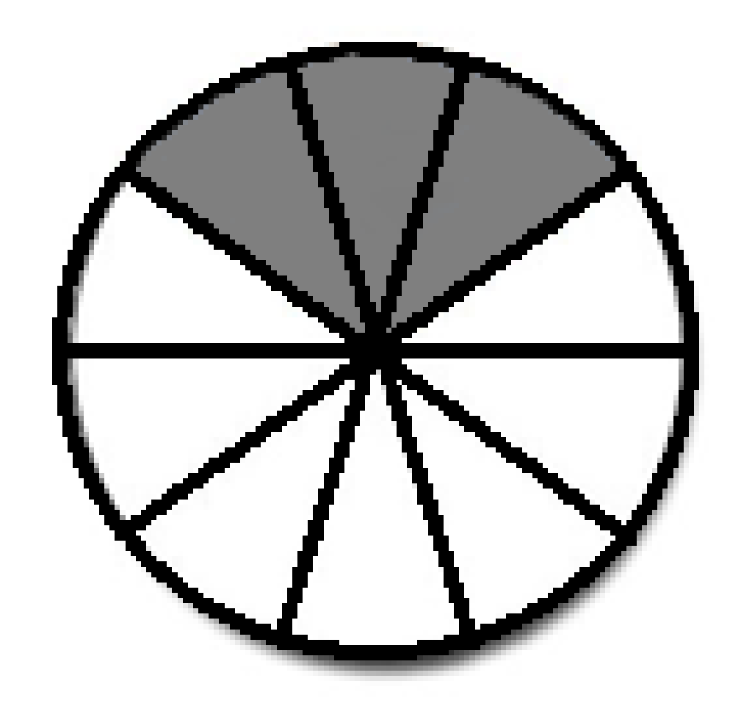
#5
Notes:
‹#›

Slide 11
#5 Answer
Rubric: (1 point each) The student enters the correct area in a range of correct values.
Answers:
Example 1: 86.55 – 86.68
Example 2: 240.77 – 241.15
Notes:
‹#›

Slide 12
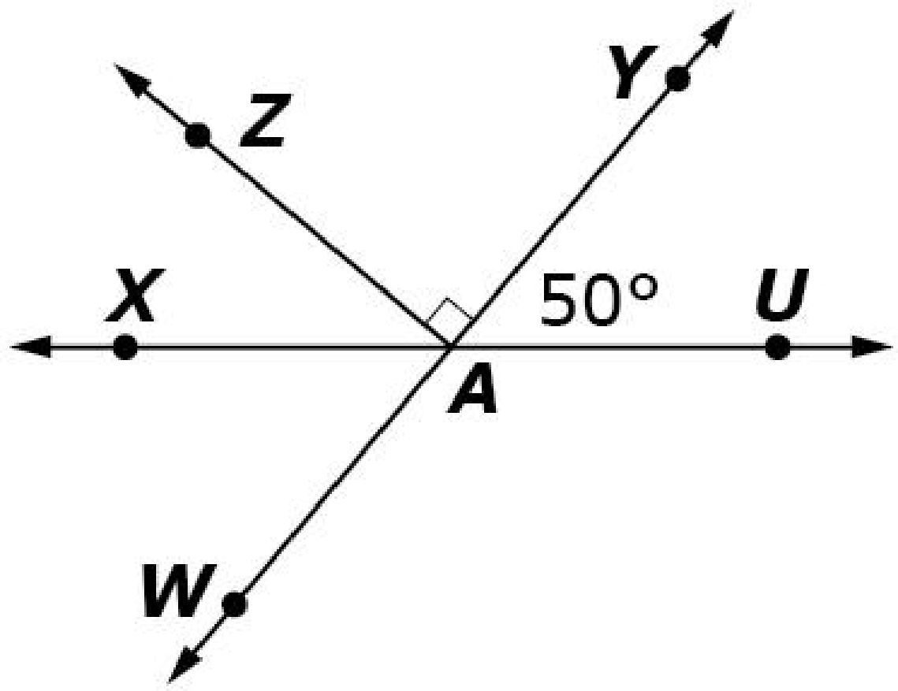
#6
Lines XU and WY intersect at point A. Based on the diagram, determine whether each statement is true. Select True or False for each statement.
Statement | True | False
An angle supplementary to ∠WAU measures 50°.
An angle complementary to ∠WAX measures 40°.
An angle vertical to ∠YAU measures 50°.

Slide 13
#6 Answer
Rubric:
(1 point) Student correctly identifies each statement as being either true or false. True choices will be correct angle measures such as False choices will be incorrect angle measure about the computation and comparative statements of the angles.
Answer: T, T, T

Slide 14
#7
Lines XU and WY intersect at point A. Based on the diagram, determine whether each statement is true. Select True or False for each statement.
Statement | True | False
m∠XAZ = 180° − m∠ZAY − m∠YAU
m∠WAZ = m∠WAY − m∠ZAY
m∠WAU = m∠XAZ − m∠ZAY

Slide 15
#7 Answer
Rubric:
(1 point) Student correctly identifies each statement as being either true or false.
Answer: T, T, F

Slide 16
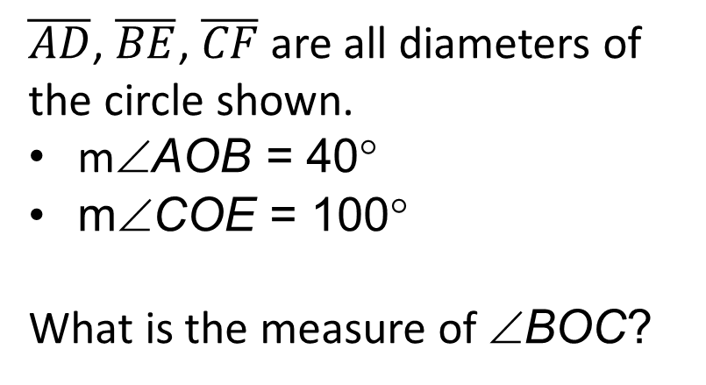
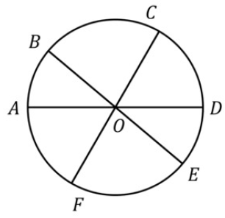
#8

Slide 17
#8 Answer
Rubric:
(1 point) Student correctly determines the measure of the angle.
Answer: 80

Slide 18
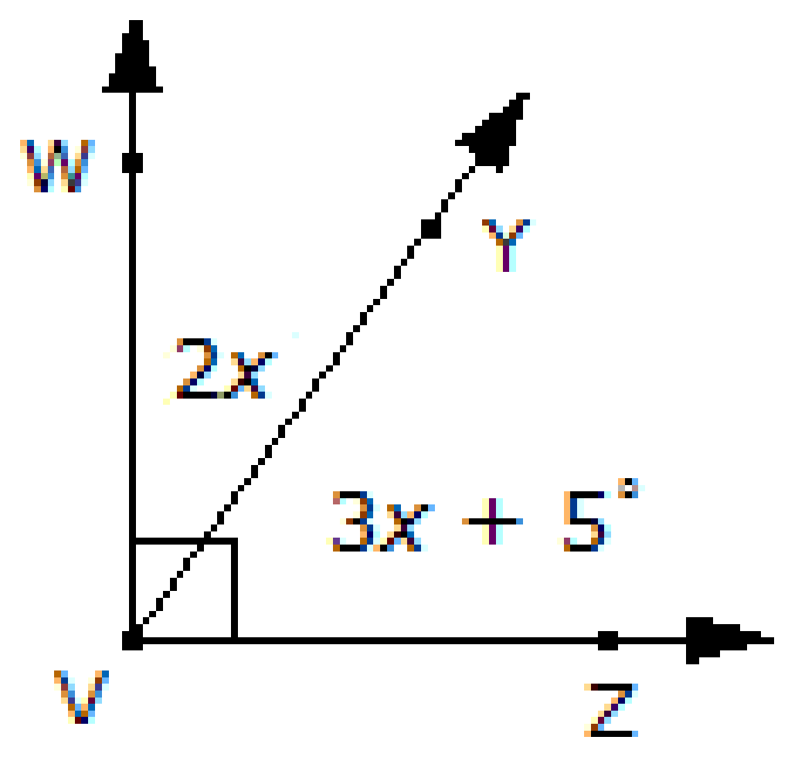
#9
Consider this figure. Enter the measure of ∠YVZ, in degrees.

Slide 19
#9 Answer
Rubric:
(1 point) The student enters the correct value.
Answer: 56

Slide 20

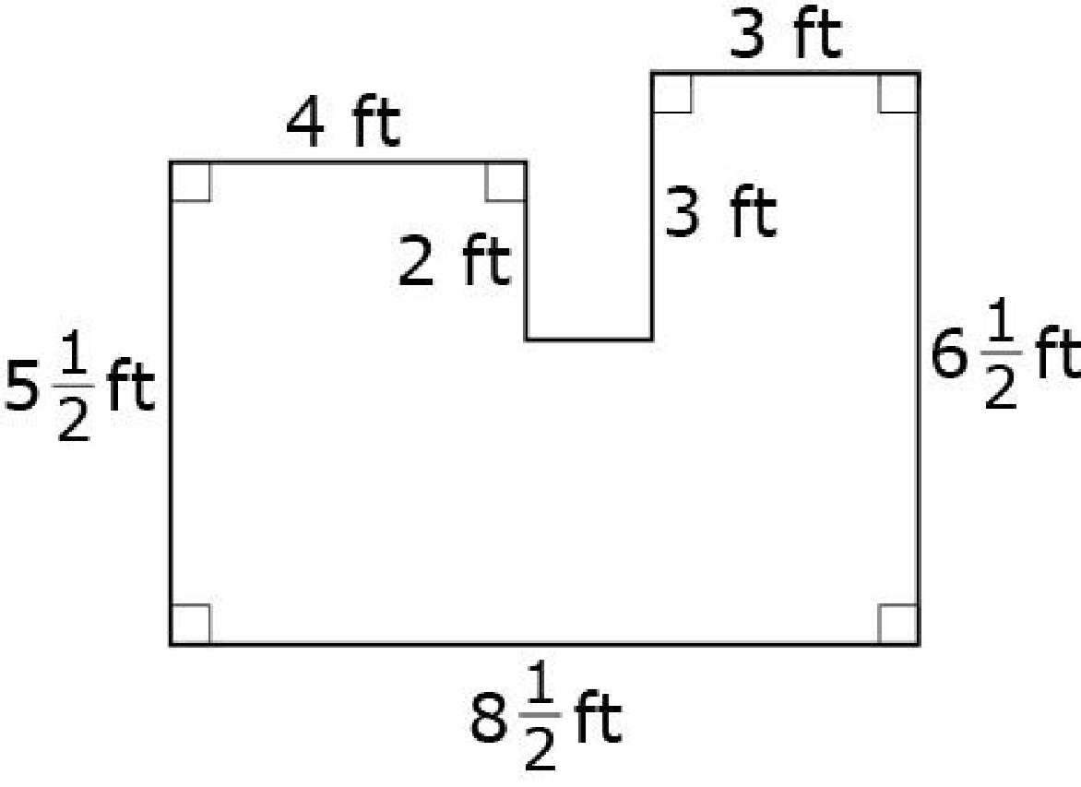
#10
This is the floor plan of Julie’s bedroom. Enter the amount of carpet, in square feet, needed to completely cover Julie’s bedroom floor.

Slide 21


#10 Answer
Rubric:
(1 point) The student enters the correct area.
Answer: 46

Slide 22
#11
The figure shown is created by joining three rectangles.
Enter the area of the figure, in square centimeters. Round to the nearest hundredth.

Slide 23
#11 Answer
Rubric:
(1 point) The student enters the correct area.
Answer: 46.75

Slide 24

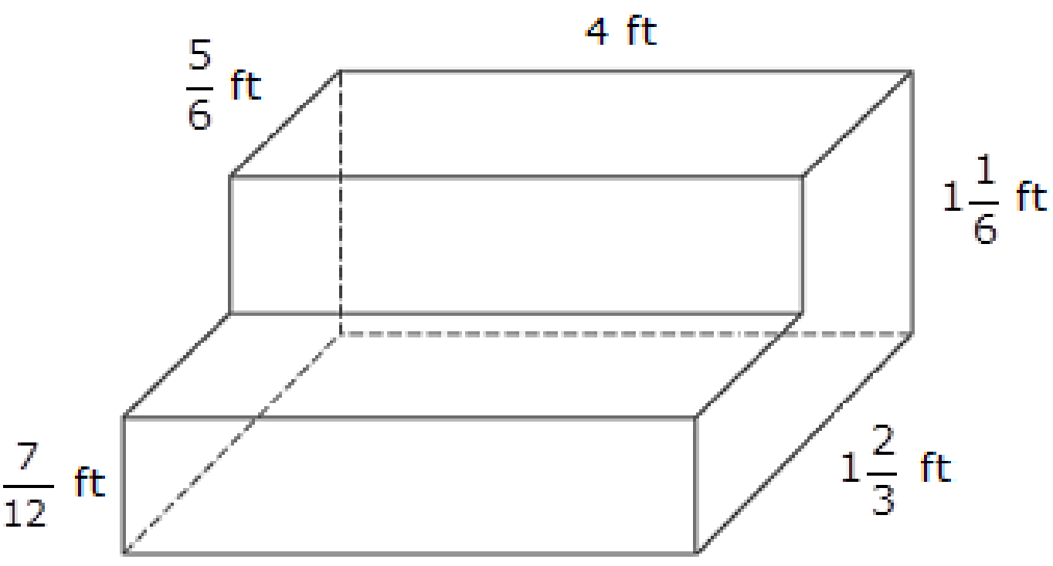
#12
The figure shows a set of concrete stairs to be built. Enter the amount of concrete, in cubic feet, needed to build the stairs. Round your answer to the nearest hundredth.

Slide 25
#12 Answer
Rubric:
(1 point) Student provides a correct surface area or volume.
Answer: 5.82

Slide 26
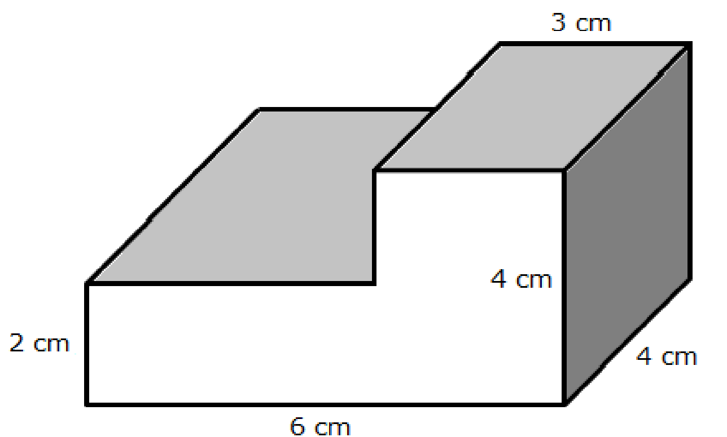
#12
The figure shown is created by joining two right rectangular prisms. Enter the volume of the figure, in cubic centimeters.

Slide 27
#12 Answer
Rubric:
(1 point) Student provides a correct surface area or volume.
Answer: 72

Slide 28

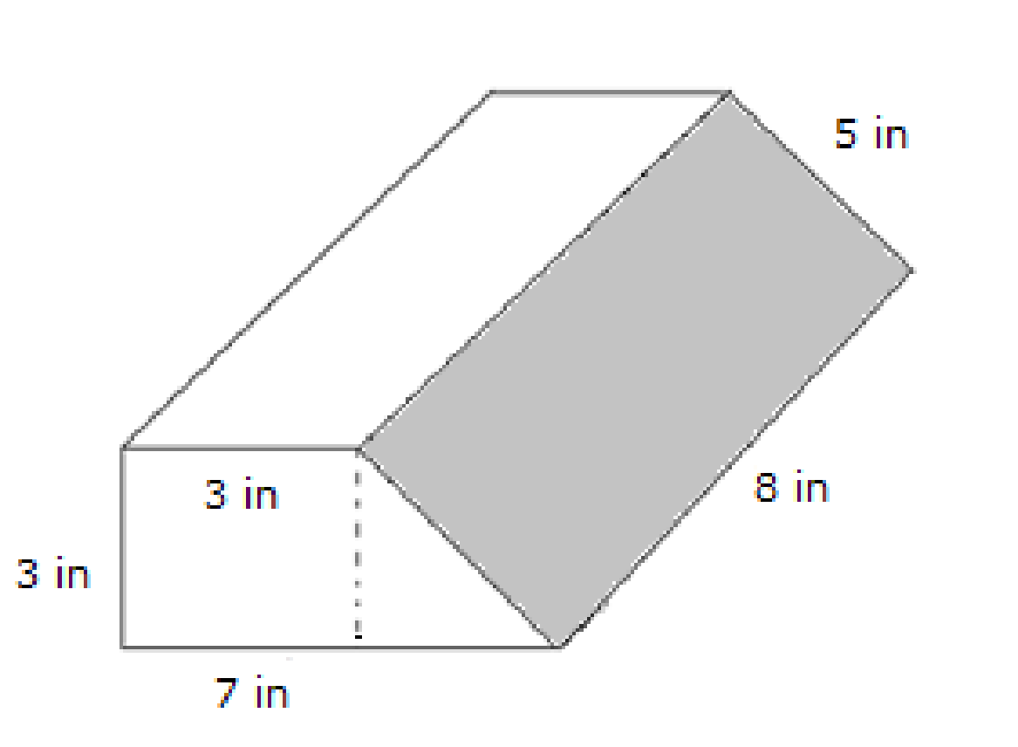
#13
The figure shows the dimensions for a package to be shipped. Enter the minimum amount of wrapping paper, in square inches, needed to cover the package. Round your answer to the nearest whole inch.

Slide 29
#13 Answer
Rubric:
(1 point) Student provides a correct surface area or volume.
Answer: 174

